Slide 1
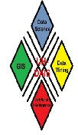
Data Science and Storytelling
Christoph F. Eick
University of Houston, USA
Atchafalaya Swamp, Louisiana
Data Analysis and Intelligent Systems Lab

Slide 2
Talk Outline
Importance of Data Science
Data Science Curriculum
Data Science is More than Using Tools
Data Storytelling
Examples of Data Storytelling
Conclusion
Data Analysis and Intelligent Systems Lab

Slide 3
Importance of Data Science
“It is a capital mistake to theorize before one has data.”- Arthur Conan Doyle, Author of Sherlock Holmes
If you’re a scientist, and you have to have an answer, even in the absence of data, you’re not going to be a good scientist.” – Neil deGrasse Tyson, Astrophysicist
“Without big data analytics, companies are blind and deaf, wandering out onto the Web like deer on a freeway.” – Geoffrey Moore, Partner at MDV
Data Analysis and Intelligent Systems Lab
Notes:
r

Slide 4
Resposibilities of Data Scientists
1. We have to have some committment to tell the truth
„Torture the data long enough and it will confess to anything." Nobel Prize winning economist Ronald Coase
“To find signals in data, we must learn to reduce the noise - not just the noise that resides in the data, but also the noise that resides in us. It is nearly impossible for noisy minds to perceive anything but noise in data.” ― Stephen Few, Signal: Understanding What Matters in a World of Noise
2. We have to know what we are doing
Data Analysis and Intelligent Systems Lab
Notes:
r

Slide 5
Example: Not knowing what we are doing—Spurious Correlations
Consumption of Ice Cream and Drowning in Swiming Pools are highly correlated.
Data Analysis and Intelligent Systems Lab
Notes:
r

Slide 6
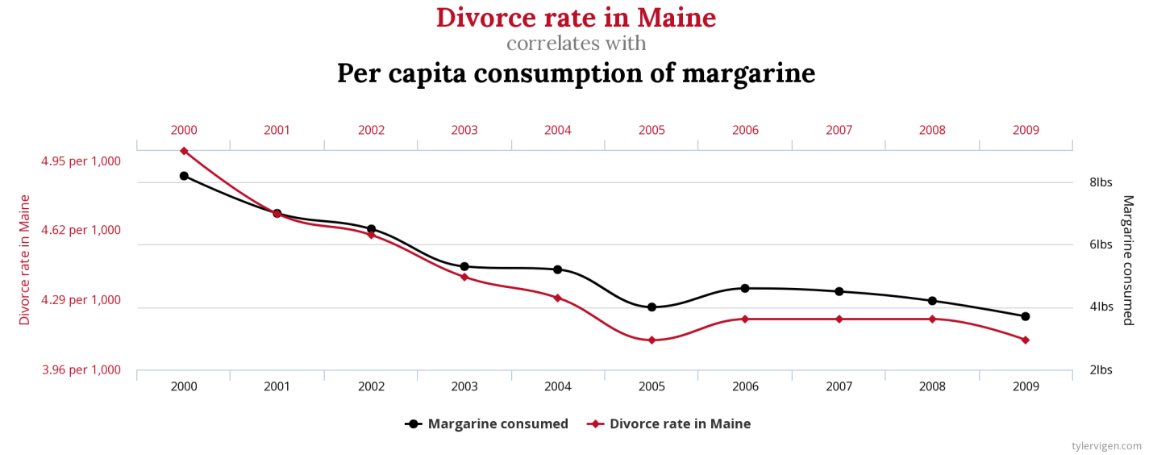
Spurious Correlations 2
Correlation 99.26%
Correlation: 95.45%
Data Analysis and Intelligent Systems Lab
Notes:
r

Slide 7
Spurious Correlations 3
Correlation 95.24%
Data Analysis and Intelligent Systems Lab
Notes:
r

Slide 8
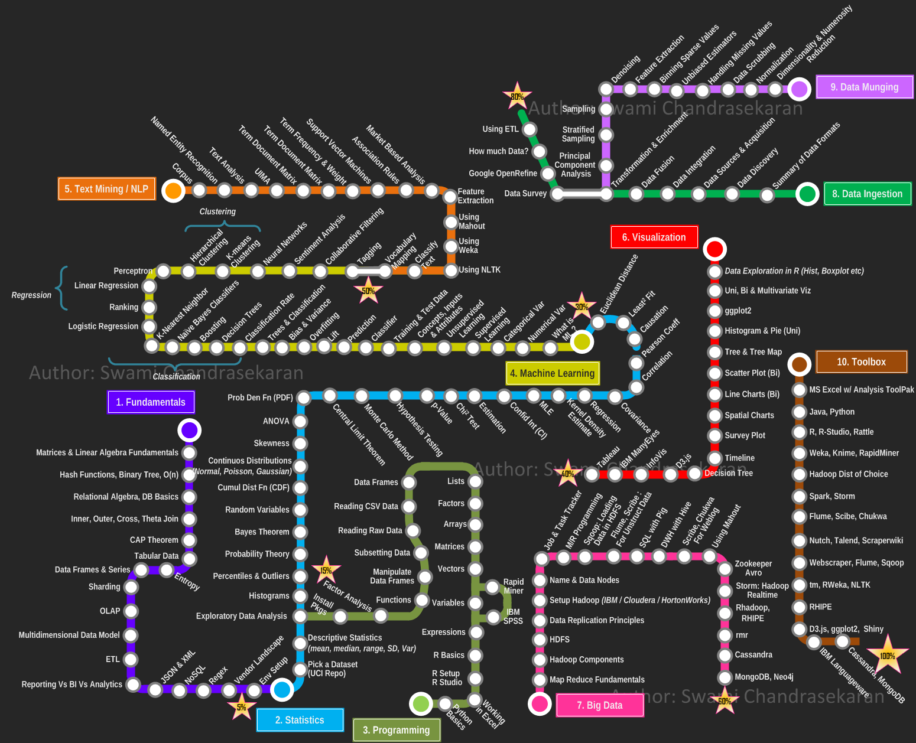
Talk Outline
Data Science According to Swami Chandrasekaran
Importance of Data Science
Data Science is More than Using Tools
Data Storytelling
Examples of Data Storytelling
Conclusion
Data Analysis and Intelligent Systems Lab

Slide 9
2. COSC Data Science Curriculum
Comment: Work in Progress
COSC 3335 - Data Science I (starting in 2019)
Credit Hours: 3.0 Lecture Contact Hours: 3 Lab Contact Hours: 0
Prerequisite: ‘Data Structures’
Data science process, data preprocessing, exploratory data analysis, data visualization, basic statistics, basic machine learning concepts, classification and prediction, similarity assessment, clustering, post-processing and interpreting data analysis results, use of data analysis tools and programming languages and data analysis case studies.
Data Analysis and Intelligent Systems Lab
Notes:
r

Slide 10
COSC 4335 - Data Science II
Comment: preliminary, work in progress;
Prerequisite: COSC 3335 (Data Science I)
Mandatory List:
Comprehensive, Semester-long Data Analysis Project
More coverage of neural networks and deep learning
More in depth coverage of ensemble learning approaches.
More coverage of prediction techniques e.g. linear regression, non-linear regression, SVM regression, regression trees,…
More coverage on overfitting, model evaluation and using statistical testing for model comparison
Maybe List:
Kernels
Density Estimation (Parametric and Non-parametric)
More on data visualization
More on time series analysis
Anomaly detection
Belief networks and hidden Markov models
Dimensionality Reduction
Data Analysis and Intelligent Systems Lab
Notes:
r

Slide 11
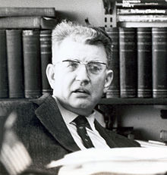
3. Data Science is More than Using Tools
The problem with data is that it says a lot, but it also says nothing. ‘Big data’ is terrific, but it’s usually thin. To understand why something is happening, we have to engage in both forensics and guess work.”- Sendhil Mullainathan, Professor of economics, Harvard
“But a theory is not like an airline or bus timetable. We are not interested simply in the accuracy of its predictions. A theory also serves as a base for thinking. It helps us to understand what is going on by enabling us to organize our thoughts. Faced with a choice between a theory which predicts well but gives us little insight into how the system works and one which gives us this insight but predicts badly, I would choose the latter, and I am inclined to think that most economists would do the same.” ― Ronald H. Coase, Essays on Economics and Economists
Data Analysis and Intelligent Systems Lab
Notes:
r

Slide 12
Theories/Models that Predict Well: Deep Neural Networks
Data Analysis and Intelligent Systems Lab
Notes:
r

Slide 13
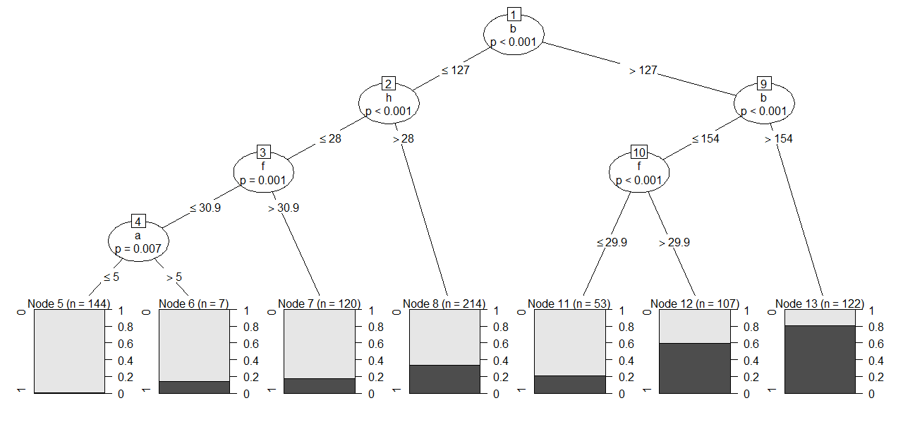
Models that Tell Us What is Going On
Example: Decision Tree Learnt from a Pima Indian Diabetes Dataset
Variables: b=blood sugar level, f=BMI,h=age,a=#pregnancies
Example Rule: If 127<b<157 and f<29.9 then Not Diabetes
Data Analysis and Intelligent Systems Lab
Notes:
r

Slide 14
4. Data Science and Storytelling
“Data scientists are involved with gathering data, massaging it into a tractable form, making it tell its story, and presenting that story to others.” – Mike Loukides, VP, O’Reilly Media
“Our challenge as data scientists is to translate this haystack of information into guidance for staff so they can make smart decisions…We “humanize” the data by turning raw numbers into a story about our performance. Data scientists want to believe that data has all the answers. But the most important part of our job is qualitative: asking questions, creating directives from our data, and telling its story. ” Jeff Bladtand and Bob Filbin
Data Analysis and Intelligent Systems Lab
Notes:
r

Slide 15
Data Science and Storytelling 2
Google’s Chief Economist Dr. Hal R.Varian stated, "The ability to take data—to be able to understand it, to process it, to extract value from it, to visualize it, to communicate it—that’s going to be a hugely important skill in the next decades."
“When hiring data scientists, people tend to focus primarily on technical qualifications. It’s hard to find candidates who have the right mix of computational and statistical skills. But what’s even harder is finding people who have those skills and are good at communicating the story behind the data.” Michael Li
Data Analysis and Intelligent Systems Lab
Notes:
r

Slide 16
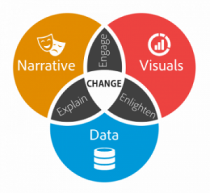
Ingredients of Good Data Science Story Telling
Data visualization expert Stephen Few said, “Data storytelling is a structured approach for communicating data insights, and it involves a combination of three key elements: data, visuals, and narrative”.
Data Analysis and Intelligent Systems Lab
Notes:
r

Slide 17
Ingredients of Good Data Science Story Telling 2
It’s important to understand how these different elements combine and work together in data storytelling.
When narrative is coupled with data, it helps to explain to your audience what’s happening in the data and why a particular insight is important. Ample context and commentary is often needed to fully appreciate an insight.
When visuals are applied to data, they can enlighten the audience to insights that they wouldn’t see without charts or graphs. Many interesting patterns and outliers in the data would remain hidden in the rows and columns of data tables without the help of data visualizations.
Finally, when narrative and visuals are merged together, they can engage or even entertain an audience. When you combine the right visuals and narrative with the right data, you have a data story that can influence and drive change.
Data Analysis and Intelligent Systems Lab
Notes:
r

Slide 18
6 Ways to Enhance your Data Storytelling Skills (proposed by Tyler Byers, Comverge, Inc.)
Read as much as possible. . Human connection is critical to effective storytelling.
Write as much as possible. Writing provides clarity to your thoughts. You will ask better questions.
Find your voice. Don’t be afraid of saying “I” in your blog posts.
Visualizations First: The words you write or say should be meant to add context to your visualizations.
Listen to stand-up comedy.
Know your audience
Know your Audience:
Data Analysis and Intelligent Systems Lab
Notes:
r

Slide 19
Other Skills for Data Science Storytelling (see also article by Michael Li)
skip
Ability to articulate the business/scientific value of their work.
The right level of technical detail.
Getting visualizations right.
Data Analysis and Intelligent Systems Lab
Notes:
r

Slide 20
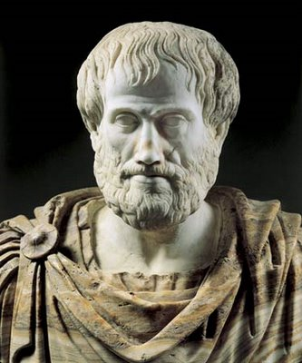
Aristotle’s Contribution
skip
Aristotle’s classic five-point plan to create a persuasive argument:
1. Deliver a story or statement that arouses the audience’s interest.
2. Pose a problem or question that has to be solved or answered.
3. Offer a solution to the problem you raised.
4. Describe specific benefits for adopting the course of action set forth in your solution.
5. State a call to action.
Data Analysis and Intelligent Systems Lab
Notes:
r

Slide 21
Steps to Create a Data Story by Shantanu Kumar
skip
Begin with a Pen-Paper Approach following Aristotle’s plan
Dig deeper to identify the sole purpose of your story
Use powerful headings
Design a road-map
Conclude with brevity
Source: https://dzone.com/articles/the-art-of-story-telling-in-data-science-and-how-t
Data Analysis and Intelligent Systems Lab
Notes:
r

Slide 22
Storyboarding (Source UC Berkeley GSJ)
Source: https://multimedia.journalism.berkeley.edu/tutorials/starttofinish-storyboarding/
A storyboard is a sketch of how to organize a story and a list of its contents. A storyboard helps you:
Define the parameters of a story within available resources and time
Organize and focus a story
Figure out what medium to use for each part of the story
The first step to creating a data story is storyboarding it.
Data Analysis and Intelligent Systems Lab
Notes:
r

Slide 23
Storytelling and TED Talks (observed by Carmine Gallow)
Modern-day storytelling is often associated with the popular TED conference series and its slogan of “Ideas Worth Spreading.” Sandberg had realized that the best way to connect with people on an emotional level is through the power of story. In my analysis of 500 of the most popular TED talks (more than 150 hours), I discovered a remarkable fact: stories make up at least 65% of the content of the most successful TED presentations. In some cases, like Sheryl Sandberg’s talk, stories make up more than 70 percent of the content.
A popular TED speaker, Brené Brown, has noted, “Stories are just data with a soul.”
Most leaders who make pitches and presentations take the opposite approach, filling their content with mind-numbing and unemotional statistics and data.
Data Analysis and Intelligent Systems Lab
Notes:
r

Slide 24
5. Data Storytelling Examples: Science Magazine Contest
The 2017 Data Stories Contest saw submissions from around the world that tackled everything from wound healing to radioactive exposure to changing landscapes. Below are our winners in the student, professional, and corporate entity categories, as well as your pick for the People’s Choice award! In 2017 there was
A student winner
A professional winner
A cooperate winner
A people’s choice
Results: http://www.sciencemag.org/projects/data-stories/winners/2017
Data Analysis and Intelligent Systems Lab
Notes:
r

Slide 25
2017 Student Winner Video by Kate Bredbenner:
Title "Wait... How Many People Died?"
This video demonstrates how stop animation and simple graphics can be very effective tools to communicate statistical information in a fun and fresh way. The fact that the video has an agile script and a solid data foundation liberates the author from needing sophisticated graphics in order to communicate clearly.
Video URL: https://youtu.be/YCATvQiLj68
Data Analysis and Intelligent Systems Lab
Notes:
r

Slide 26
2017 Professional Winner by Gregory Shirah
"Seasonal Changes in Carbon Dioxide"
What makes this visualization stand out in a plethora of similar graphics is the departure from the typical flat representation of the data by adding a third dimension to explain the flow of carbon dioxide in different altitudes. The author brilliantly uses this extra layer of information by integrating it into the narrative of the video and playing with different angles to convey a fascinating story.
Video URL: https://youtu.be/X2TOrKdJsqs
Data Analysis and Intelligent Systems Lab
Notes:
r

Slide 27
Story Telling Examples2: Hans Rosling and Gap Minder
Hans Rosling (27 July 1948 – 7 February 2017) was a Swedish physician, academic, statistician, and public speaker. He was the Professor of International Health at Karolinska Institute. He held presentations around the world, in which he promoted the use of data to explore development issues.
In Hans Rosling’s hands, data sings. Global trends in health and economics come to vivid life. And the big picture of global development—with some surprisingly good news—snaps into sharp focus. https://www.ted.com/speakers/hans_rosling
Hans Rosling and his collaborator’s created Gapminder; an organization that centers on producing sophisticated graphics and visualization tool for data story telling. Gapminder is also committed to educate the public about the social problems in the world. (www: https://www.gapminder.org/ )
Data Analysis and Intelligent Systems Lab
Notes:
r

Slide 28
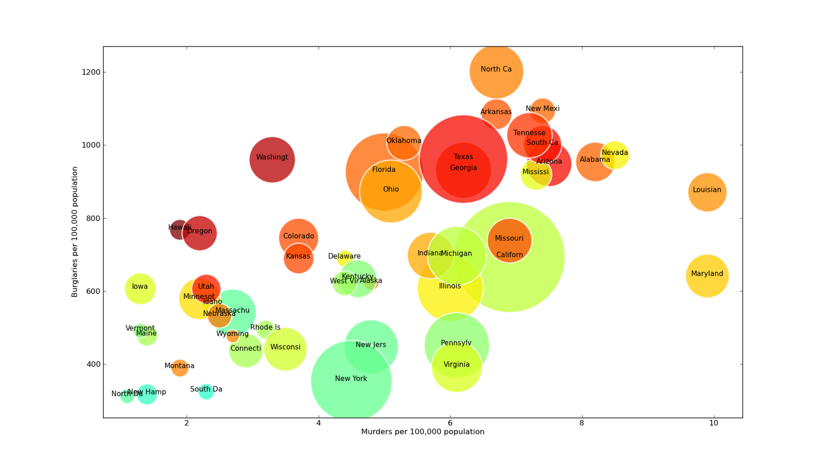
Bubble Charts and Adding a Story to It
Gap Minder: https://www.gapminder.org/tools/#_data_/_lastModified:1521732308820;&chart-type=bubbles
Video: https://www.ted.com/talks/hans_rosling_asia_s_rise_how_and_when (start at 6:37 (year 1930) until 10:30a of video steam)
Bubble Chart
Data Analysis and Intelligent Systems Lab
Notes:
r

Slide 29
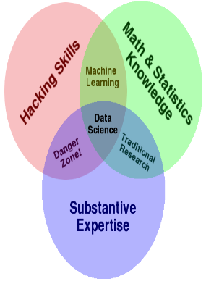
6. Conclusion
I hope I convinced that data science is not only about using fancy deep learning and other tools, but
Knowing what we are actually doing or using and understanding the limitations and assumptions of the employed approaches and tools
Selecting “the best” visualization and knowing how to use visualization tools properly
Transforming data analysis results into actionable knowledge
Capabilities to integrate our findings/research into the bigger picture
and last, but not least: data storytelling
are equally important skills.
Data Analysis and Intelligent Systems Lab
Notes:
r

