Slide 1
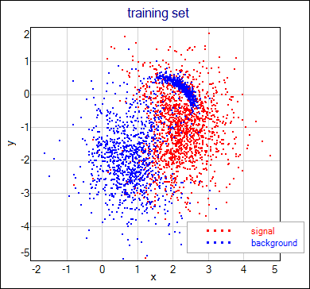
Interpreting Supervised Scatter Plots
Group B Task: Interpret the supervised scatter plot below; assess the difficulty of separating signals and background using attributes x and y based on the scatter plot!

