Slide 1
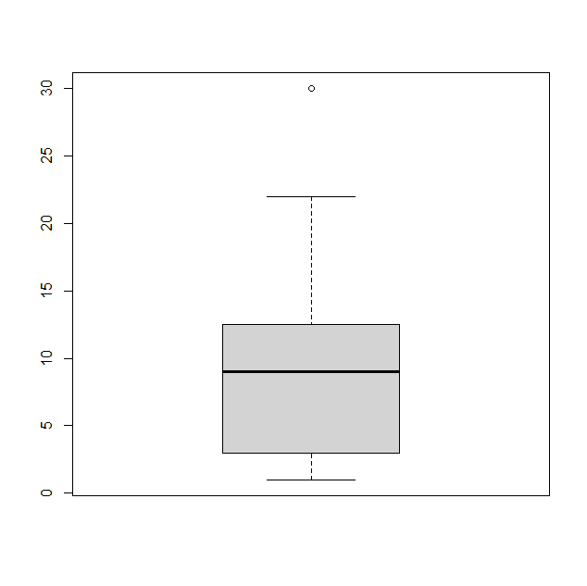
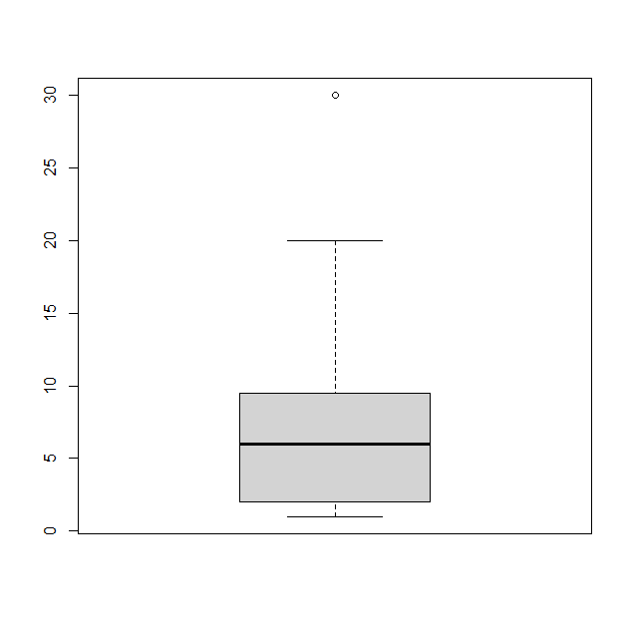
x<-c(1,2,2,2,4,4,8,9,9,10,20,30) y<-c(1,2,2,2,4,4,8,9,9,10,11,12, 13,18,22,30) y x
Group C Task: Compare the boxplots x and y which have been created using the R-commands: boxplot(x) and boxplot(y). Summarize your findings in a slide/set of slides!

