Slide 1


A Short Dive Into Neural Networks
Raunak Sarbajna
COSC 3337
24th September, 2024
Remark: Slides of this lecture were designed by
Christoph F. Eick and Raunak Sarbajna (University of Houston);
please mention this fact if you use any of those slides in your lectures!

Slide 2

Exploring Neurons Using 50,000 Portraits
Notes:
You can generate this by feeding all 50,000 portraits to an algorithm that learns the similarities and differences of the images and how to get from one to another seamlessly. Imagine all images placed on a map, where similar photos are close to each other. Using this special kind of map, you can place your finger on any point and look at the photo at that position. You can even point somewhere in between two photos and the algorithm will give you an image, that looks like a fused version of both photos.
​
The video above most likely shows a random path through this map. On this path, many real photos are passed (the ones that look normal) and everything in between is imagined by the algorithm.
The particular algorithm used to generate these is called "Progressive GAN" and the code (directly from the researchers, good luck) is here: https://github.com/tkarras/progressive_growing_of_gans
It was up on Twitter a few days ago but the creator has since deleted his tweet due to restrictions on the input dataset.

Slide 3

Neural Dreaming
Neural networks can be used to create surreal and psychedelic images!
Google's DeepDream project, released in 2015, gained widespread attention for its hallucinatory images generated by convolving neural networks with themselves, resulting in mesmerizing and bizarre compositions.
While initially a curiosity, deep dreaming has found applications in art, entertainment, and neuroscience research, offering insights into the inner workings of neural networks and the human mind's perception of visual stimuli.
In the rain, Shibuya, Tokyo Leonid Afremov Style
Notes:
Neural networks have exhibited a phenomenon akin to dreaming when trained on images or data. This process, called "hallucination" or "deep dreaming," involves the network amplifying patterns it detects in input data to create surreal and sometimes psychedelic visuals.
In the rain, Shibuya, Tokyo Leonid Afremov Style

Slide 4
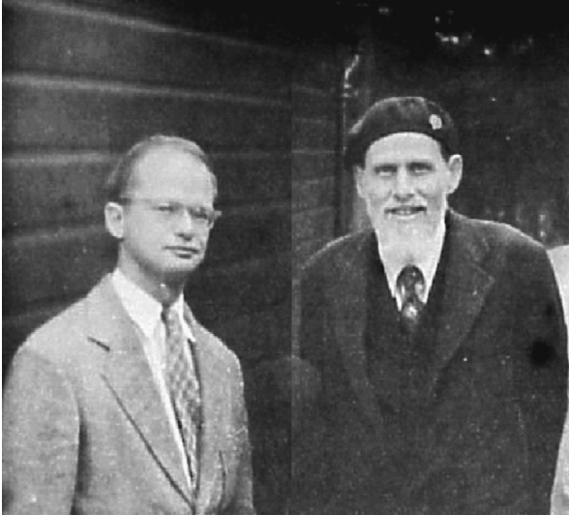
Brief History
In the 1940s, scientists Warren McCulloch and Walter Pitts were fascinated by the human brain.
They wondered if it would be possible to create a machine that mimicked the way neurons connect and transmit information.
Their work in 1943 led to the development of the first artificial neural network model, a simple design that laid the foundation for future advancements.
McCulloch (right) and Pitts (left) in 1949
Notes:
In 1943 American neurophysiologist and cybernetician of the University of Illinois at Chicago Warren McCulloch and self-taught logician and cognitive psychologist Walter Pitts published “A Logical Calculus of the ideas Imminent in Nervous Activity,” describing the “McCulloch - Pitts neuron, ”the first mathematical model of a neural network.
Building on ideas in Alan Turing’s “On Computable Numbers”, McCulloch and Pitts's paper provided a way to describe brain functions in abstract terms, and showed that simple elements connected in a neural network can have immense computational power. The paper received little attention until its ideas were applied by John von Neumann, Norbert Wiener, and others.

Slide 5
Rise and Fall (And Rise)
Initial surge of excitement in the 1950s with the Perceptron model
Limitations of early models led to a period of decline in the 1960s and 1970s
Breakthroughs in algorithms and computing power revived interest in the 1980s
Notes:
The perceptron, developed by Frank Rosenblatt in 1957, marked a significant milestone in neural network history. It was capable of learning simple binary classifications and became the foundation for future developments.
In the 1980s, renewed interest in neural networks emerged with the development of backpropagation, a powerful algorithm for training multi-layer perceptrons, by Geoffrey Hinton, David Rumelhart, and Ronald Williams.
Throughout the 1990s and early 2000s, neural networks experienced a resurgence in popularity fueled by advancements in computing power, data availability, and algorithmic improvements.Initial optimism surrounding neural networks waned in the 1960s due to limitations in computational power and a lack of understanding of learning algorithms, leading to the first "AI winter."

Slide 6

Separability
Data is not linearly separable in one dimension
Not separable if you insist on using a specific class of functions
$$x$$

Slide 7



Blown Up Feature Space
Data are separable in $<x, x^{2}>$space
$$x2$$
$$x$$

Slide 8
News Sept. 18
Task1 is due Monday end of the day!
There will be a Task2 lab on Tu., Sept. 23; please read the Task2 specification!
Today’s Topic’s:
  Review DT Induction Algorithm / Recall Precision
  Neural Networks
  Undergraduate Research Oppoturnities
Notes:
The Universal Approximation Theorem has profound implications for the practical application of neural networks in fields such as image and speech recognition, natural language processing, and predictive modeling.
It suggests that, given enough data and computational resources, neural networks are capable of approximating any function, making them versatile and adaptable tools for solving real-world problems.
However, while neural networks can theoretically represent any function, the challenge lies in training them effectively, avoiding overfitting, and generalizing well to unseen data, highlighting the importance of robust training procedures and model evaluation techniques in practice.

Slide 9
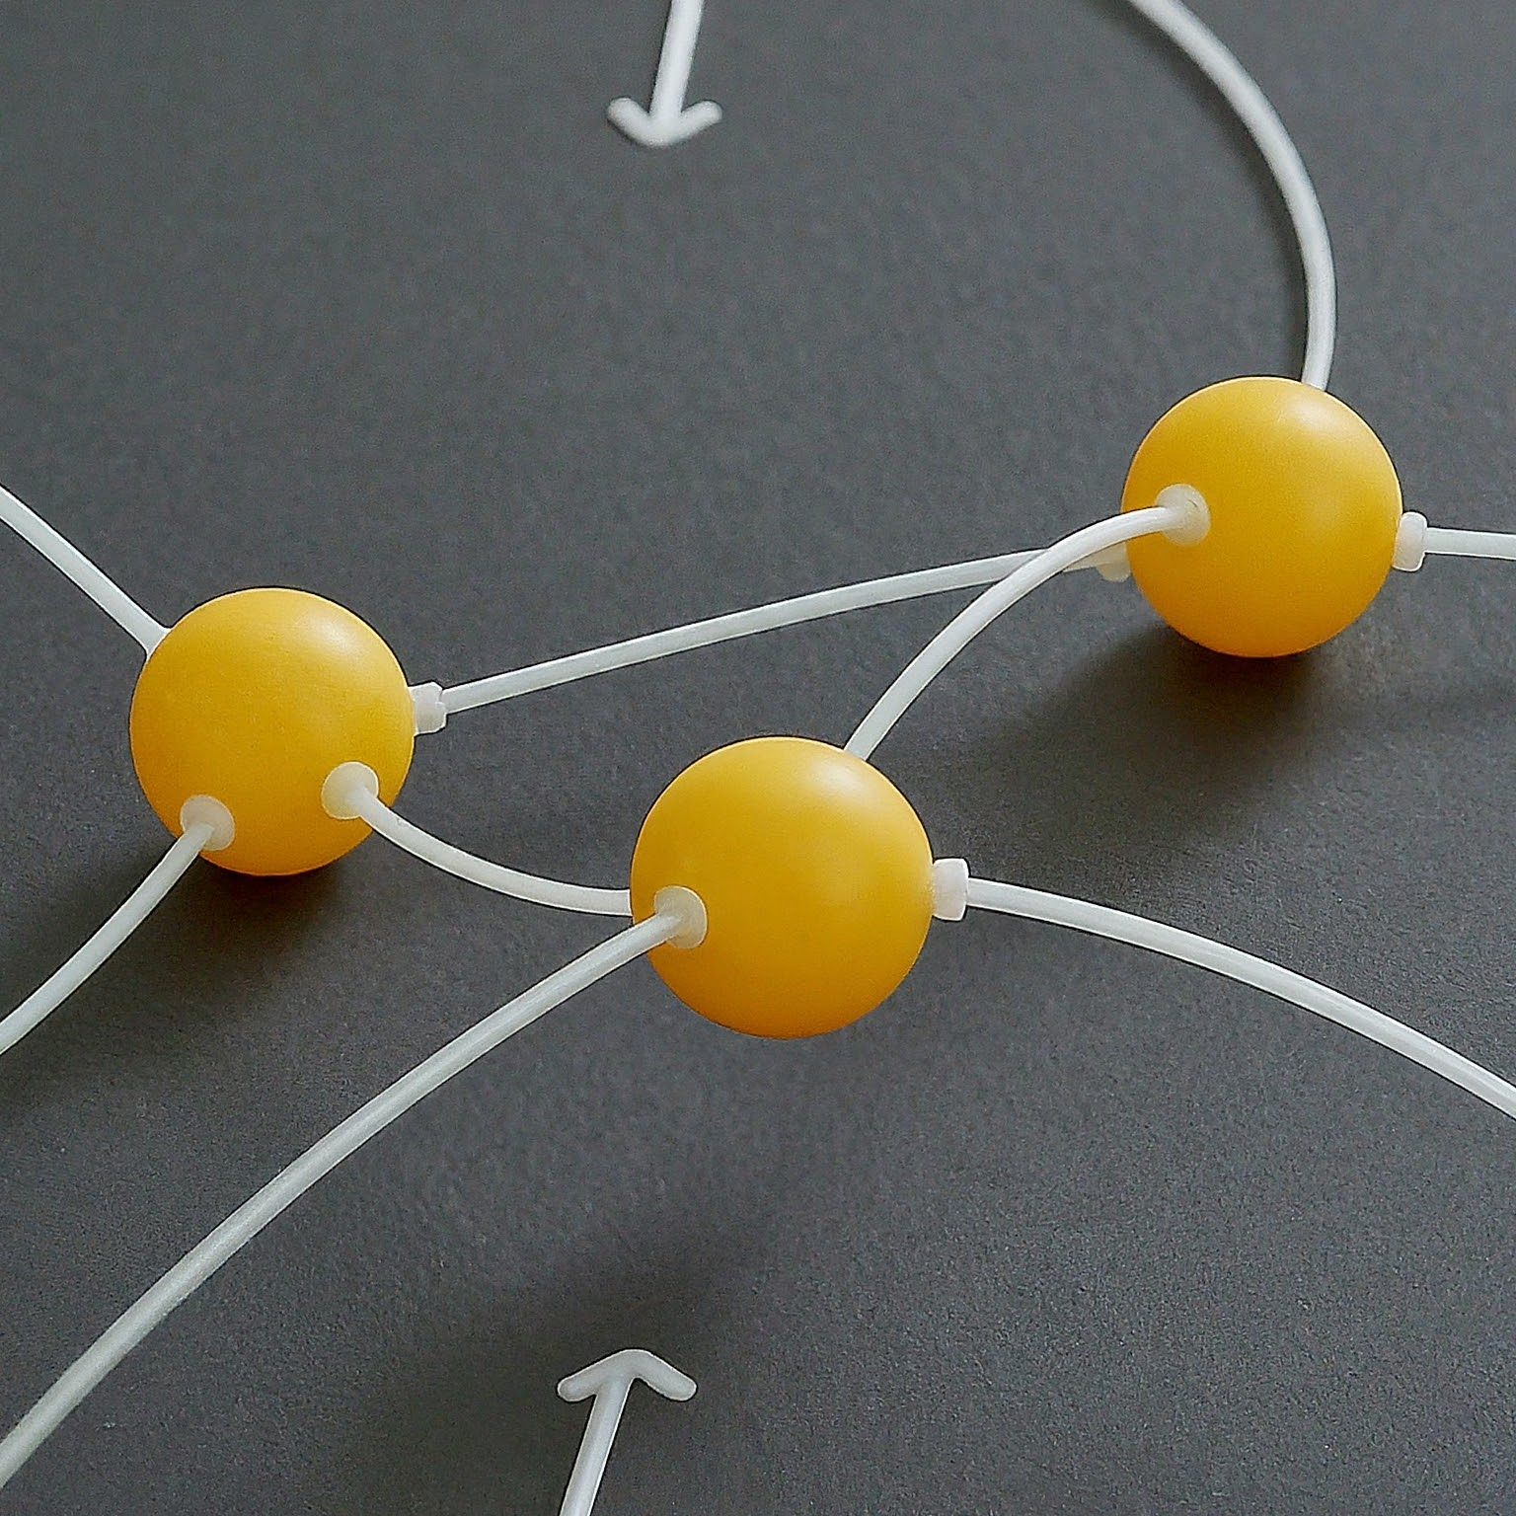
Universal Approximation
What is a Universal Approximator?
  A system capable of approximating any continuous function to an arbitrary degree of accuracy.
  In simpler terms, it can learn to represent any complex relationship between inputs and outputs, given enough data and the right architecture.
Notes:
Neural networks possess a remarkable ability – they can be considered universal approximators. This means they can, in theory, approximate any continuous function to an arbitrary degree of accuracy. Imagine a function that maps any input to an output, like predicting house prices based on size and location. A universal approximator, like a neural network, can learn this complex relationship between inputs and outputs with enough data and the right internal structure. This property makes neural networks incredibly versatile and powerful tools for various tasks, from image recognition to natural language processing.

Slide 10
Universal Approximation Theorem
The UAT, first proven by George Cybenko in 1989 and later refined by Kurt Hornik in 1991, states that a feedforward neural network with a single hidden layer containing a finite number of neurons can approximate any continuous function to arbitrary accuracy.
This theorem provides a mathematical foundation for the remarkable ability of neural networks to learn complex mappings between input and output data, making them powerful tools for function approximation and pattern recognition tasks.
By adjusting the weights and biases of the neurons within the network during the training process, neural networks can effectively model highly nonlinear relationships, enabling them to solve a wide range of problems across various domains.
Notes:
The Universal Approximation Theorem has profound implications for the practical application of neural networks in fields such as image and speech recognition, natural language processing, and predictive modeling.
It suggests that, given enough data and computational resources, neural networks are capable of approximating any function, making them versatile and adaptable tools for solving real-world problems.
However, while neural networks can theoretically represent any function, the challenge lies in training them effectively, avoiding overfitting, and generalizing well to unseen data, highlighting the importance of robust training procedures and model evaluation techniques in practice.

Slide 11
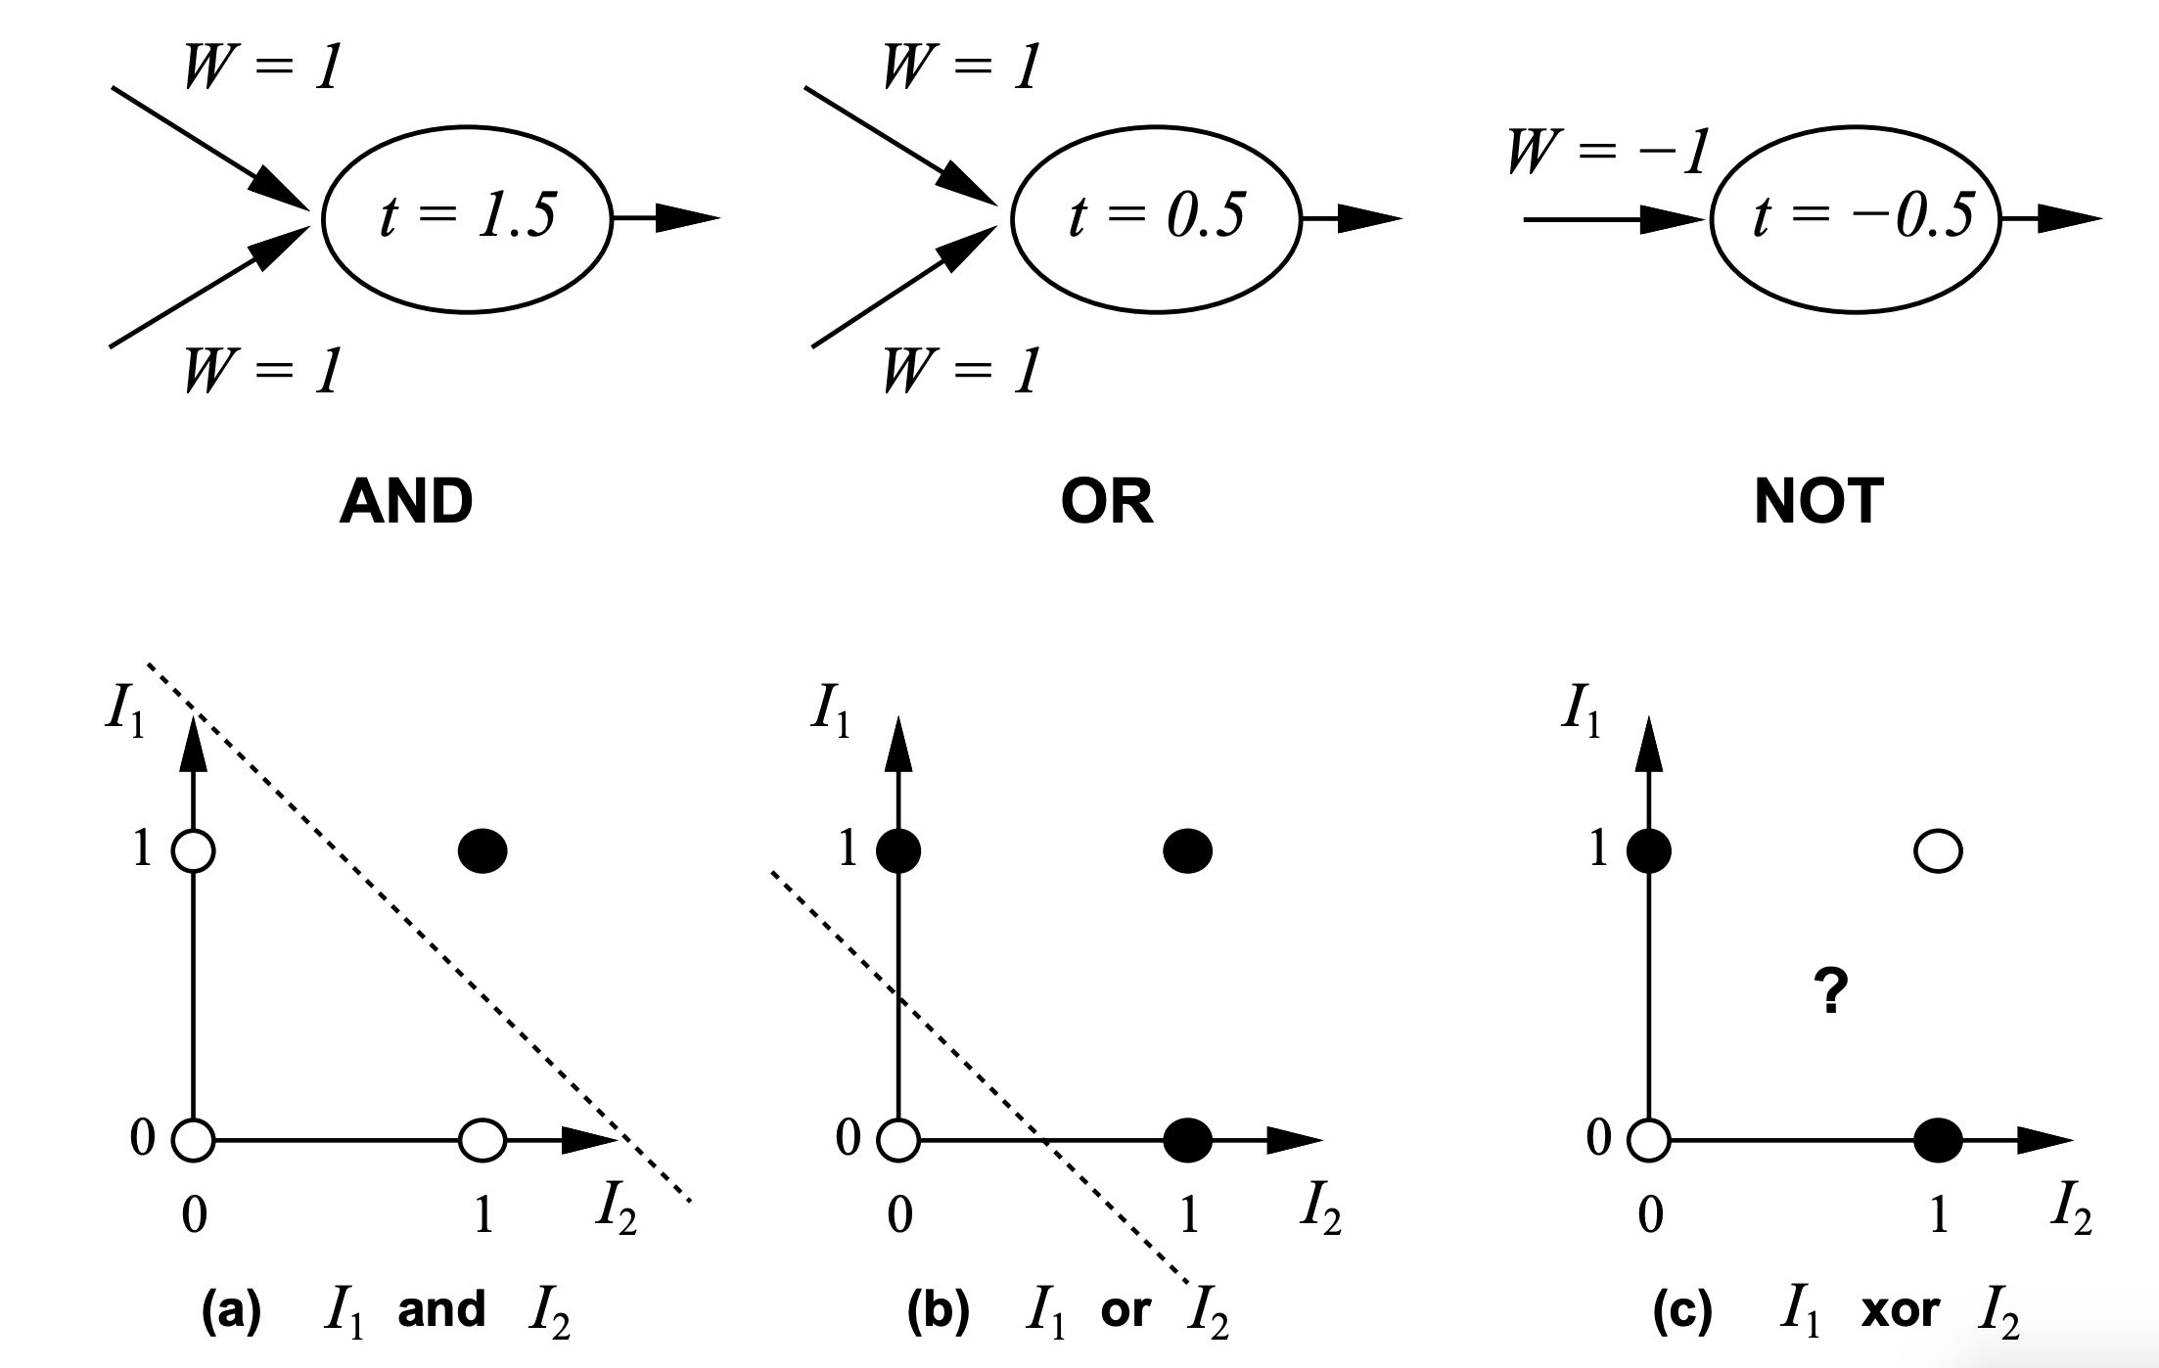

Neural Computation
McCulloch and Pitts (1943) showed how linear threshold units can be used to compute logical functions
$$y=sign(∑w_{i}I_{i} − T)$$

Slide 12
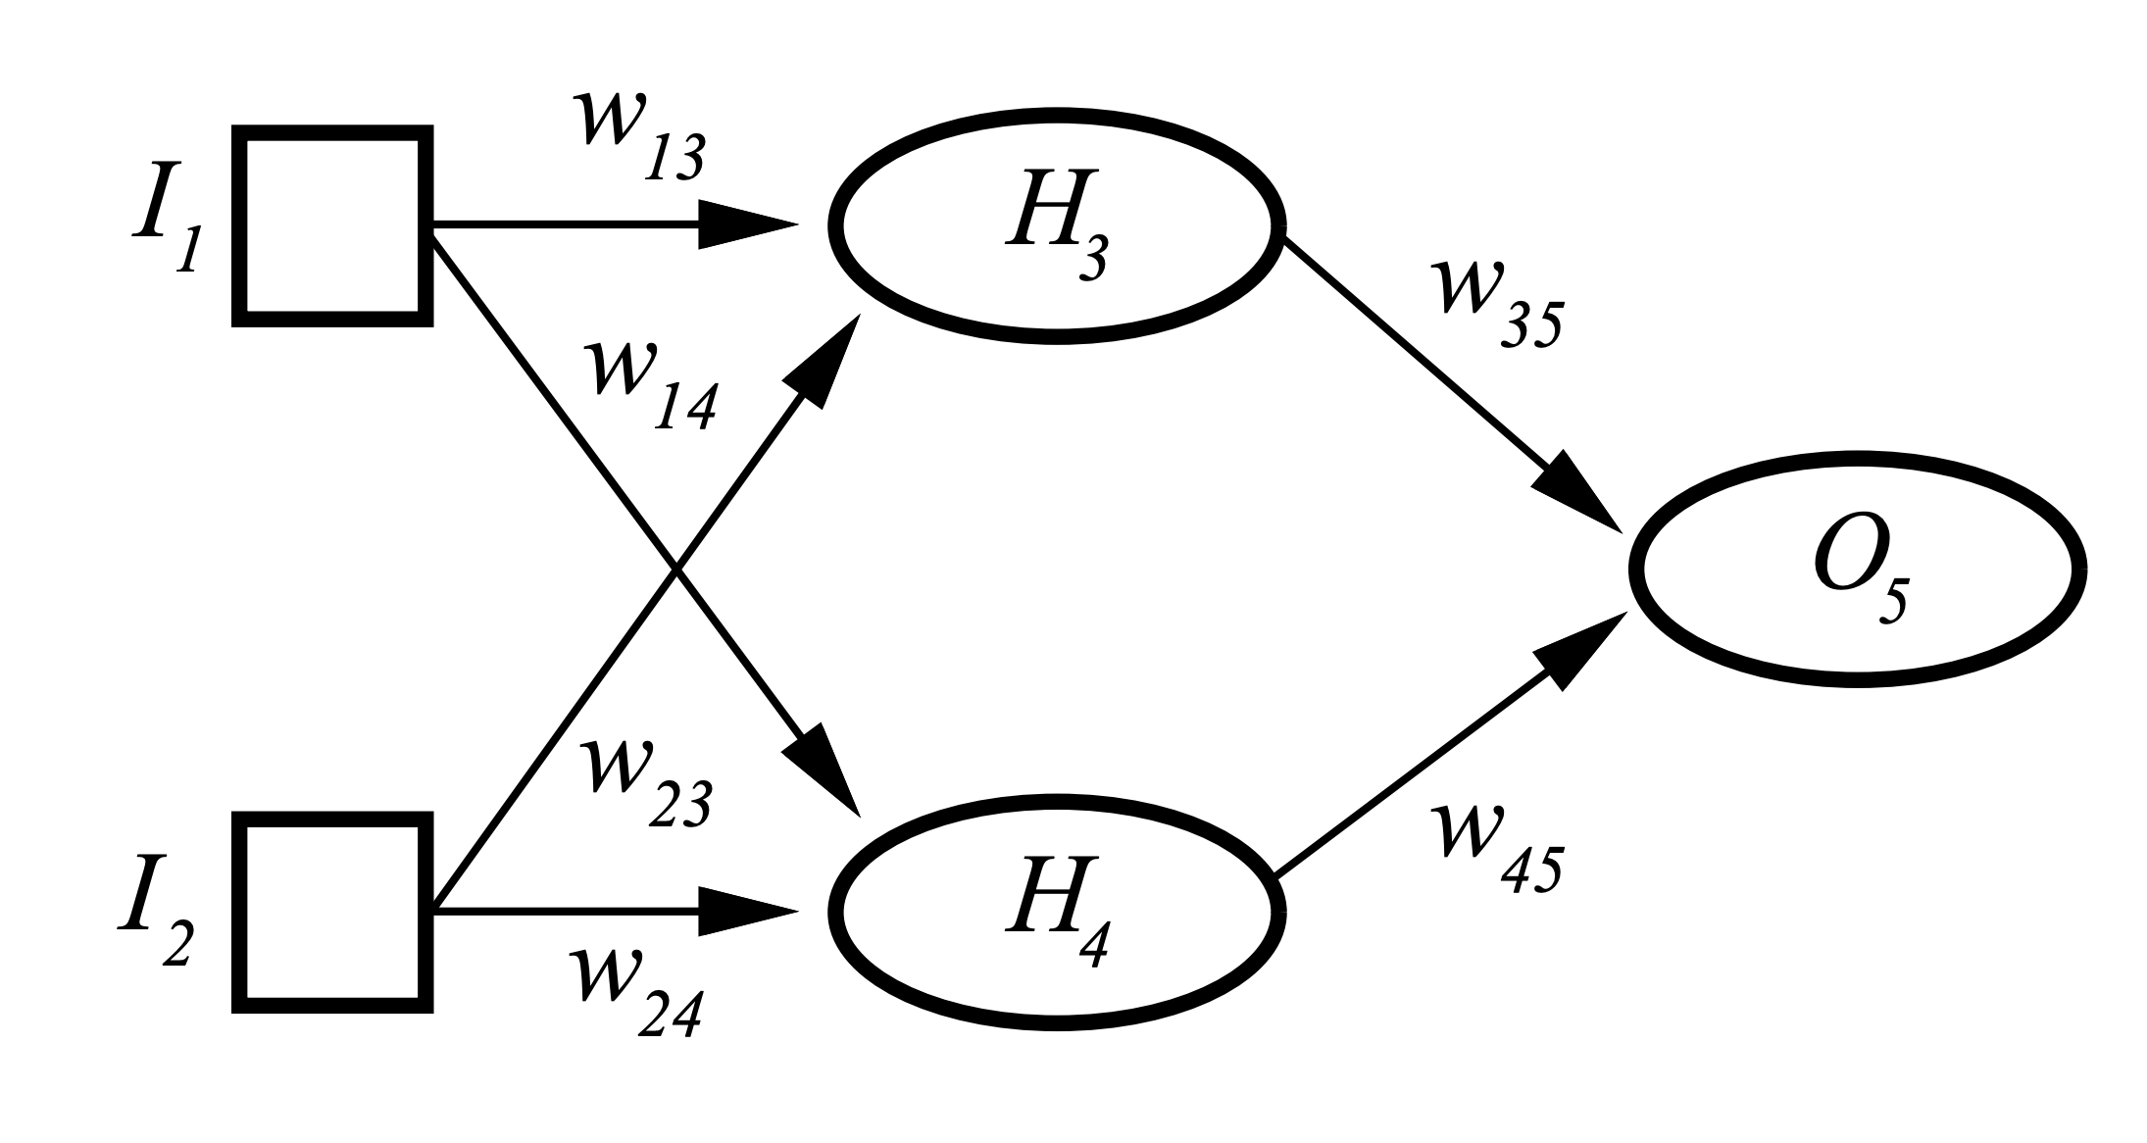
Neural Computation (contd)
But XOR?
Two Layered Two Unit Network

Slide 13
Artificial Neural Networks (ANN)
Output Y is 1 if at least two of the three inputs are equal to 1.

Slide 14
Artificial Neural Networks (ANN)

Slide 15
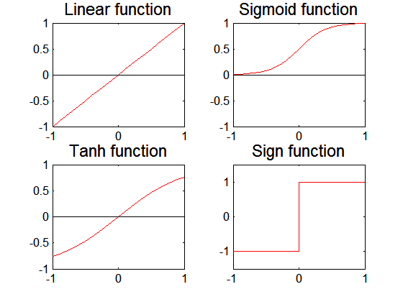
Artificial Neural Networks (ANN)
Various types of neural network topology
  single-layered network (perceptron) versus
  multi-layered network
  Feed-forward versus recurrent network
Various types of
activation functions (f)

Slide 16
Multilayer Neural Network
Hidden layers
  intermediary layers between input & output layers
More general activation functions (sigmoid, linear, etc)

Slide 17
General Structure of ANN
Training ANN means learning the weights of the neurons

Slide 18
Neural Network Terminology
A neural network is composed of a number of units (nodes) that are connected by links. Each link has a weight associated with it. Each unit has an activation level and a means to compute the activation level at the next step in time.
Most neural networks are decomposed of a linear component called input function, and a non-linear component call activation function. Popular activation functions include: relu, tanh, and sigmoid function.
The architecture of a neural network determines how units are connected and what activation function are used for the network computations. Architectures are subdivided into feed-forward and recurrent networks. Moreover, single layer and multi-layer neural networks (that contain hidden units) are distinguished.
Learning in the context of neural networks centers on finding “good” weights for a given architecture so that the error in performing a particular task is minimized. Most approaches center on learning a function from a set of training examples, and use hill-climbing and steepest decent hill-climbing approaches to find the best values for the weights that lead to the “lowest error”.
Loss functions are mechanisms that compute a NN’s error for a training set; NN training looks for finding weights which minimize this function.

Slide 19
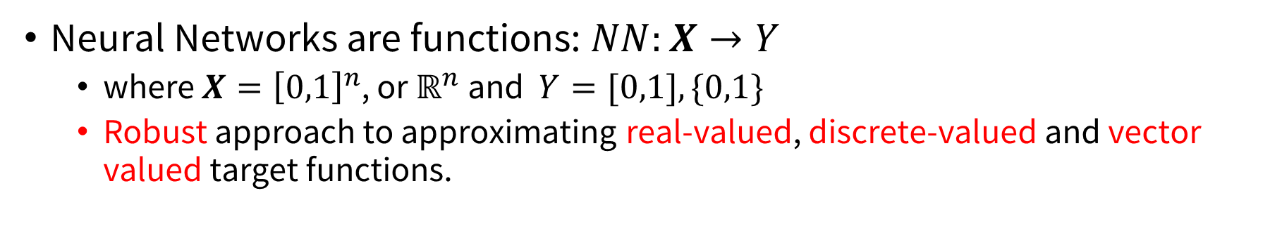
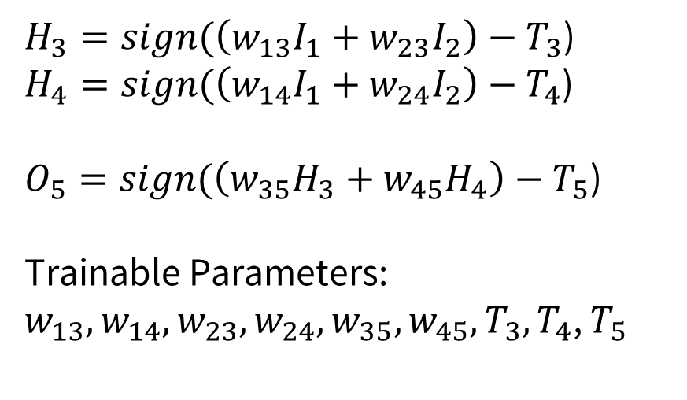
NN Architecture
Neural Networks are functions: $NN:X→Y$
  where $X={\left[0,1\right]}^{n}$, or $ℝ^{n}$ and $Y=[0,1], \{0,1\}$
  Robust approach to approximating real-valued, discrete-valued and vector valued target functions.
$H_{3}=sign(\left(w_{13}I_{1}+w_{23}I_{2}\right)−T_{3}$)
$H_{4}=sign(\left(w_{14}I_{1}+w_{24}I_{2}\right)−T_{4}$)
$O_{5}=sign(\left(w_{35}H_{3}+w_{45}H_{4}\right)−T_{5}$)
Trainable Parameters:
$w_{13},w_{14}, w_{23}, w_{24}, w_{35}, w_{45}, T_{3},T_{4}$, $T_{5}$

Slide 20
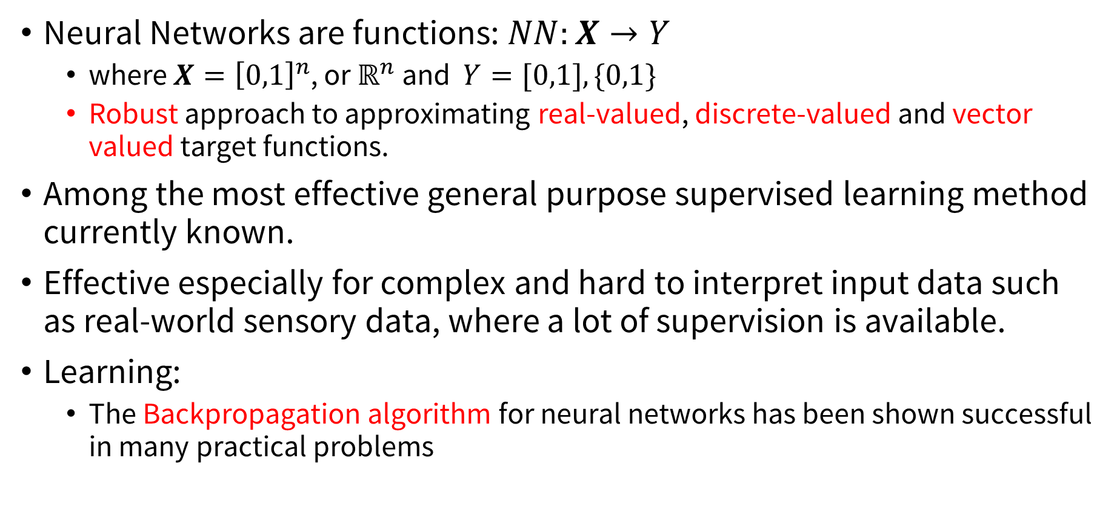
NN Architecture (Contd.)
Neural Networks are functions: $NN:X→Y$
  where $X={\left[0,1\right]}^{n}$, or $ℝ^{n}$ and $Y=[0,1], \{0,1\}$
  Robust approach to approximating real-valued, discrete-valued and vector valued target functions.
Among the most effective general purpose supervised learning method currently known.
Effective especially for complex and hard to interpret input data such as real-world sensory data, where a lot of supervision is available.
Learning:
  The Backpropagation algorithm for neural networks has been shown successful in many practical problems

Slide 21
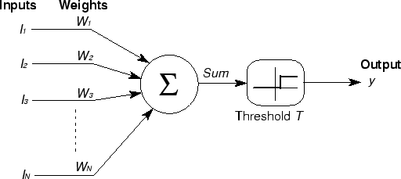
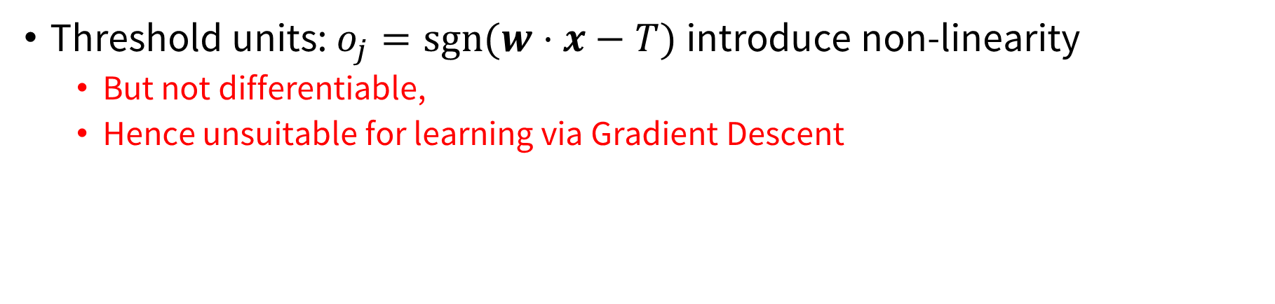
Basic Unit in Multi-Layer Neural Network
Threshold units: $o_{j}=sgn⁡(w⋅x−T)$introduce non-linearity
  But not differentiable,
  Hence unsuitable for learning via Gradient Descent
activation
Output
Hidden
Input

Slide 22
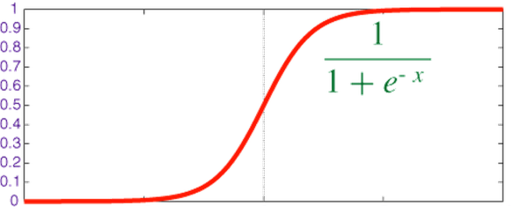


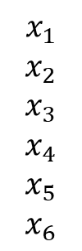
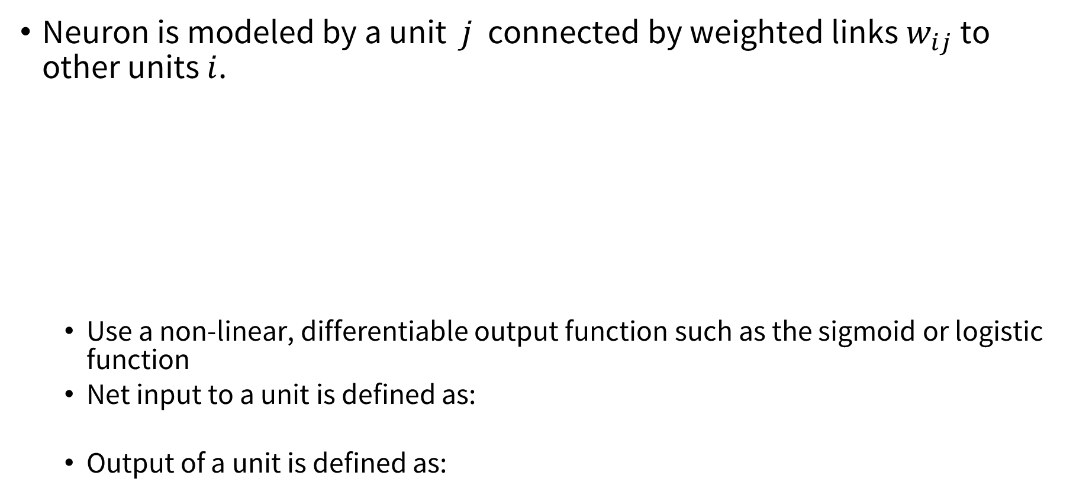


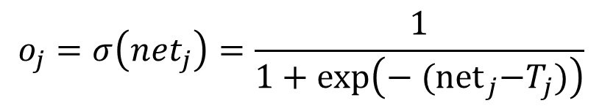

Logistic Neuron / Sigmoid Activation
Neuron is modeled by a unit $j$ connected by weighted links $w_{ij}$ to other units $i$.
  Use a non-linear, differentiable output function such as the sigmoid or logistic function
  Net input to a unit is defined as:
  Output of a unit is defined as:
$$x_{1}$$
$$x_{2}$$
$$x_{3}$$
$$x_{4}$$
$$x_{5}$$
$$x_{6}$$
$$w_{1j}$$
$$x_{j}$$
$$o_{j}$$
$$w_{6j}$$
$${net}_{j}=∑w_{ij}⋅x_{i}$$
$$o_{j}=σ\left(net_{j}\right)=\frac{1}{1+exp\left(− {(net}_{j}−T_{j})\right)}$$

Slide 23
Representational Power
Any function can be approximated to arbitrary accuracy by a three layer network.

Slide 24
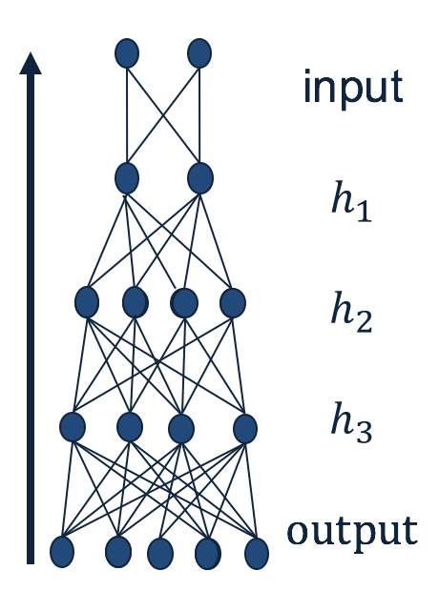
Small Quiz
Given an arbitrary neural network, how do we make predictions?
  Given input, calculate the output of each layer (starting from the first layer), until you get to the output.
What do you need to fully specify a neural network?
  The weights.
Why do you think NN predictions are quick?
  Because many of the computations could be parallelized.
What makes a neural networks expressive?
  The non-linear units.

Slide 25

Training a NN
$H_{3}=σ(\left(w_{13}I_{1}+w_{23}I_{2}\right)−T_{3}$)
$H_{4}=σ(\left(w_{14}I_{1}+w_{24}I_{2}\right)−T_{4}$)
$O_{5}=σ(\left(w_{35}H_{3}+w_{45}H_{4}\right)−T_{5}$)
Trainable Parameters:
$w_{13},w_{14}, w_{23}, w_{24}, w_{35}, w_{45}, T_{3},T_{4}$, $T_{5}$

Slide 26
NN Comp.
w13
Example:
all weights are 0.1 except w45=1; γ=0.2
Training Example: (I1=1,I2=1;a5=1)
g is the sigmoid activation function
I1
a3
w35
w23
a5
a_{i}:= activation of node i
z_{i} := linear input of node i:
a_{i} =g(z_{i})
w14
w45
I2
a4
w24
a4=g(z4)=
g(x1*w14+x2*w24)=g(0.2)=0.550
a3=g(z3)=
g(x1*w13+x2*w23)=g(0.2)=0.550
a5=g(z5)=
g(a3*w35+a4*w45)=g(0.605)=0.647
error(a5)=
1-0.647=0.353
g(x)= 1/(1+e^{−x} )
g’(x)= g(x)*(1-g(x))
γ is the learning rate

Slide 27

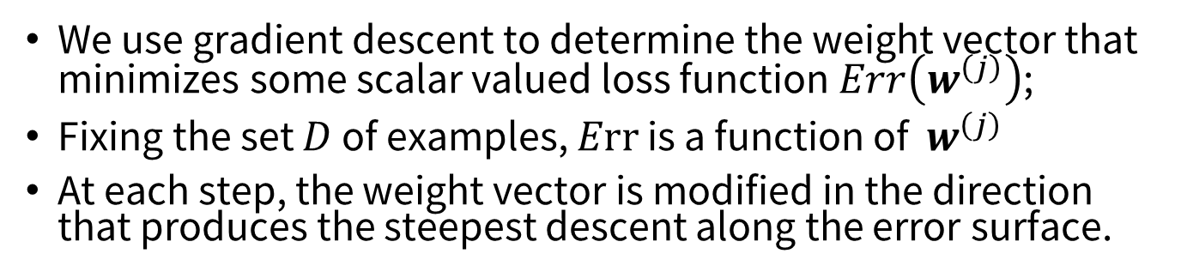


Gradient Descent
We use gradient descent to determine the weight vector that minimizes some scalar valued loss function $Err\left(w^{\left(j\right)}\right)$;
Fixing the set $D$ of examples, $Err$ is a function of $w^{\left(j\right)}$
At each step, the weight vector is modified in the direction that produces the steepest descent along the error surface.
$Err(w)$
$w_{3}$ $w_{2}$ $w_{1}$ $w_{0}$
$$w$$

Slide 28
Gradient Descent for Multilayer NN
Weight update:
Error function:
Activation function f must be differentiable
For sigmoid function:

Slide 29
Neural Network Learning ---Mostly Steepest Descent Hill Climbing on a Differentiable Error Function
Current Weight Vector
Important! How far you jump depends on:
the learning rate α.
On the error |T-O|
The input activation of the node
Gradient of the Error Function
Remarks on α:
too low → slow convergence
too high → might overshoot goal
New Weight Vector

Slide 30
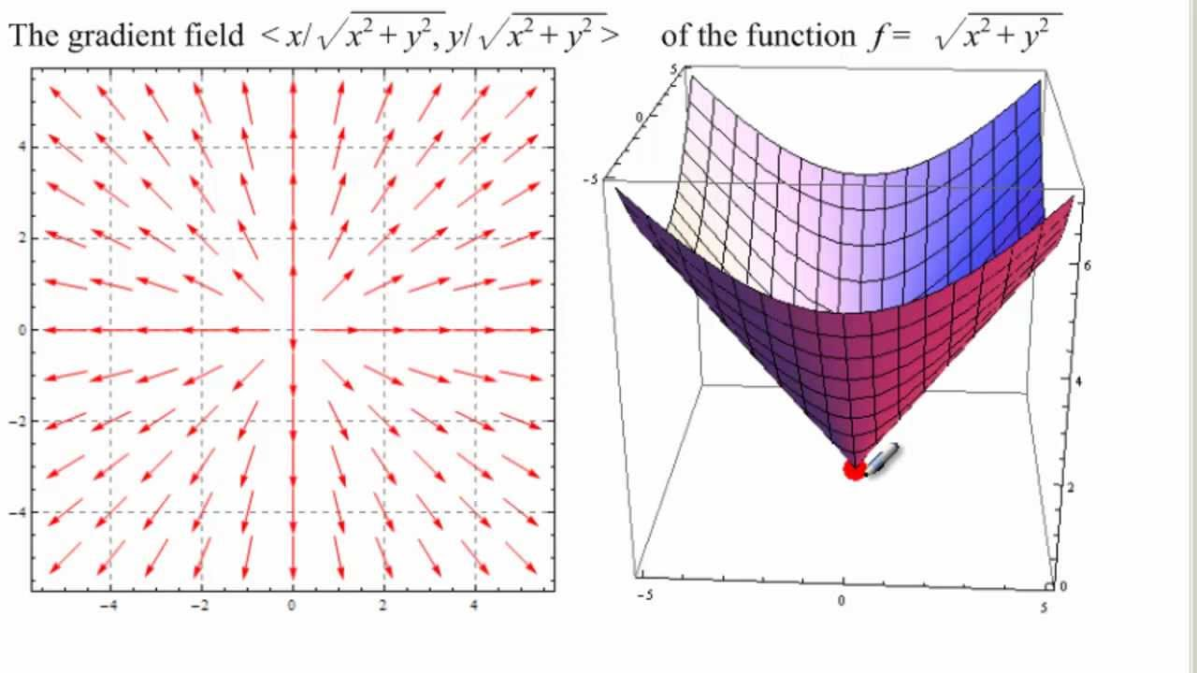
Error Function Gradient based on 2 Weights
Video on this topic at starting at 2:50: https://www.youtube.com/watch?v=IHZwWFHWa-w&index=3&list=PLZHQObOWTQDNU6R1_67000Dx_ZCJB-3pi&t=0s
Remark: To minimize the error/loss function we will walk in the inverse direction of the arrows!
If the steepest gradient is for example (1,2) then the second weight contributes more to the error;
Consequently, it is increased twice as much in comparison to the increase of the first weight.

Slide 31
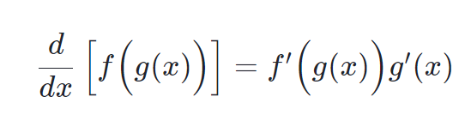

Quiz!
What is the chain rule for differentiating a composite function?
$\frac{d}{dx}$ $\left(\left[f\left(g\left(x\right)\right)\right]\right)$
$\frac{df}{dx}$= $\frac{df}{dg}$ $\frac{dg}{dx}$

Slide 32
News Sept. 23, 2025
Please fill out the Task1 Team Member Contribution Assessment Form by Thursday end of the Day in MS Teams
Special Events
  Today, 12p-12:50p: Task2 Lab taught bye Pei-Chi
  Sept. 25: 11:55p: Mock Exam with Lock Down Browsers 12:10p: Panel Discussion “ChatGPT and DS1”
  Sept. 30: 11:30a Review for Exam1 12:05 & 3 Task1 Results Group Presentations (12 minute presentation, 1-2 minute discussion)
  Oct. 2, 11:30a: Exam1 in our Classroom
Today: Continue the Discussion of NN followed by Task2 Lab.

Slide 33
Learning with a Multi-Layer Perceptron
The problem is what to do with the other set of weights – we do not get feedback in the intermediate layer(s).
Solution: If all the activation functions are differentiable, then the output of the network is also a differentiable function of the input and weights in the network.
Define an error function (e.g., sum of squares) that is a differentiable function of the output, i.e. this error function is also a differentiable function of the weights.
We can then evaluate the derivatives of the error with respect to the weights, and use these derivatives to find weight values that minimize this error function, using gradient descent (or other optimization methods).
This results in an algorithm called back-propagation.
activation
Output
w²_{ij}
Hidden
w¹_{ij}
Input

Slide 34
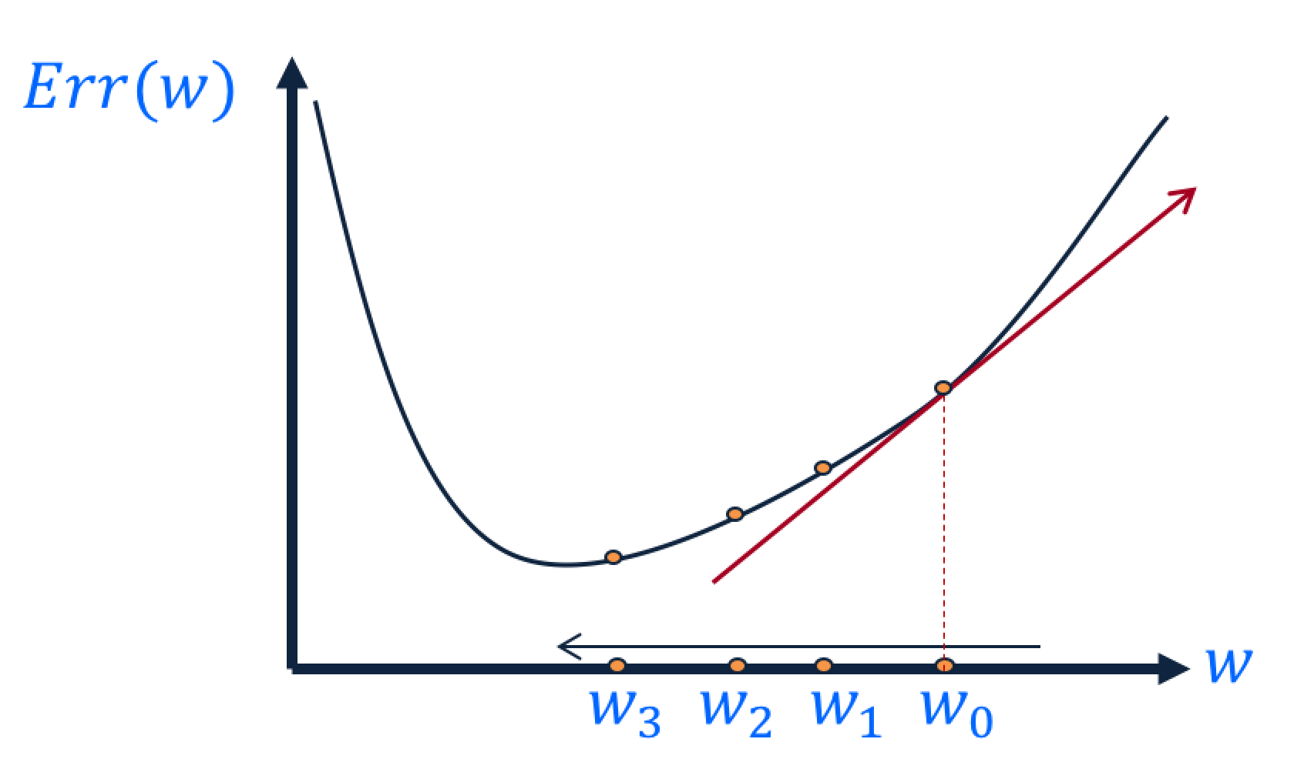

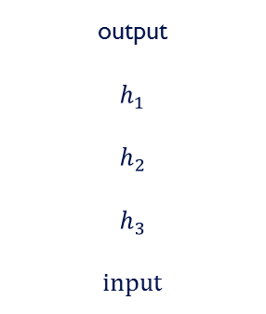
Backpropagation Intuition
Gradient Descent
  Change the weights in the direction of gradient to minimize the error function.
Chain Rule
  Use the chain rule to calculate the weights of the intermediate weights
Dynamic Programming (Memoization)
  Memoize the weight updates to make the updates faster.
output
$$h_{1}$$
$$h_{2}$$
$$h_{3}$$
input
$$\frac{∂E}{∂w_{ij}}$$

Slide 35

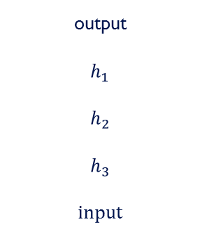
Backpropagation Steps
Loop over instances:
  The forward step
    Given the input, make predictions layer-by-layer, starting from the first layer)
  The backward step
    Calculate the error in the output
    Backpropagate the Error Layer by Layer
    Update the weights layer-by-layer, starting from the final layer
output
$$h_{1}$$
$$h_{2}$$
$$h_{3}$$
input
$$\frac{∂E}{∂w_{ij}}$$

Slide 36

Backpropagation Algorithm
Create a fully connected three layer network. Initialize weights.
Until all examples produce the correct output within $ε$ (or other criteria)
For each example in the training set do:
  Compute the network output for this example
  Compute the error between the output and target value
  $$δ_{k}=\left(t_{k}−o_{k}\right)o_{k}\left(1−o_{k}\right)$$
  For each output unit k, compute error term
  $${δ_{j}= o}_{j}\left(1−o_{j}\right).\sum_{k∈downstream\left(j\right)}{−δ_{k} w_{jk} }$$
  For each hidden unit, compute error term: $Δw_{ij}=Rδ_{j}x_{i}$
  Update network weights with $Δw_{ij}$
End epoch

Slide 37
3337 News Sept. 23
Today: 11:55p: Mock Exam 12:10-12:50p: Panel Discussion Group Bar
Task1 presentations 12:05p on Tuesday (3 Groups):
  Upload your slides to Dr. Eick’s Laptop at 11:25a!
  Prepare a 12 minute presentation followed by 1-2 minutes of questions (14 minutes per group)
  Presentations are evaluated by Pei-Chi and Athina based on: Content(35%), Form(35%), Interestingness(20%), and Time Management (10%)
  Groups will present from the front of our classroom
Exam1 takes place Th., Oct. 2, 11:30a in our class room; a review list will be posted by the end of the day of Sa., Sept 27 on the course website.
Next Lecture Topics:
  Backpropagation
  k-NN Classifiers
  Support Vector Machines (likely on Oct. 7)
Notes:
The Universal Approximation Theorem has profound implications for the practical application of neural networks in fields such as image and speech recognition, natural language processing, and predictive modeling.
It suggests that, given enough data and computational resources, neural networks are capable of approximating any function, making them versatile and adaptable tools for solving real-world problems.
However, while neural networks can theoretically represent any function, the challenge lies in training them effectively, avoiding overfitting, and generalizing well to unseen data, highlighting the importance of robust training procedures and model evaluation techniques in practice.

Slide 38
Updating Weights in Neural Networks
w_{ij}:= Old_w_{ij} + a*input_activation_{i}*associated_error_{j}
Multi-layer Network: Associated_Error (Δi)):=
  Output Node i: g’(z_{i})*(T-O)
  Intermediate Node k connected to i: g’(z_{i})*w _{ki} *error_at_node_i
w13
Δ3
a1
a3
Δ5
I1
Δ3
w35
w23
a5
Δ4
Δ5
w14
Δ4
w45
a2
a4
w24
I2
Multi-layer Network

Slide 39
Back Propagation Formula Example
g(x)= 1/(1+e^{−x} )
g’(x)= g(x)*(1-g(x))
γ is the learning rate
w13
I1
a3
w35
w23
a5
a_{i}:= activation of node i
z_{i} := linear input of node i:
a_{i} =g(z_{i})
w14
w45
I2
a4
w35= w35 + γ*a3*Δ5
w45= w45 + γ*a4*Δ5
w13= w13 + γ*x1*Δ3
w23= w23 + γ*x2*Δ3
w14= w14 + γ*x1*Δ4
w24= w24 + γ*x2*Δ4
w24
a4=g(z4)=g(x1*w14+x2*w24)
a3=g(z3)=g(x1*w13+x2*w23)
a5=g(z5)=g(a3*w35+a4*w45)
Δ5=error*g’(z5)=error*a5*(1-a5)
Δ4= Δ5*w45*g’(z4)=Δ5*w45*a4*(1-a4)
Δ3=Δ5*w35*a3*(1-a3)

Slide 40
Example BP
We assume all weights are 0.1 except w45=1; γ=1 and
That the batch contains single example: (x1=1,x2=1;a5=1)
g is the sigmoid function
w13
a5 is 0.6594 with the adjusted
weights!
I1
a3
w35
w23
a5
w14
w45
w35= w35 + γ*a3*Δ5=
0.1+1*0.55*0.08=0.145
w45= w45 + γ*a4*Δ5=1.045
w13= w13 + γ*x1*Δ3=0.102
w23= w23 + γ*x2*Δ3=0.102
w14= w14 + γ*x1*Δ4=0.12
w24= w24 + γ*x2*Δ4=0.12
a4’=g(0.24)=0.557
a3’=g(0.204)=0.554
a5’=g(0.66045)=0.66
I2
a4
w24
a4=g(z4)=g(x1*w14+x2*w24)=g(0.2)=0.550
a3=g(z3)=g(x1*w13+x2*w23)=g(0.2)=0.550
a5=g(z5)=g(a3*w35+a4*w45)=g(0.605)=0.647
Δ5=error*g’(z5)=error*a5*(1-a5)=
*0.353*0.647*0.353=0.08
Δ4=Δ5*w45*a4*(1-a4)=0.02
Δ3=Δ5*w35*a3*(1-a3)=0.002

Slide 41
Example BP
Example: all weights are 0.1 except w45=1; γ=0.2
Training Example: (x1=1,x2=1;a5=1)
g is the sigmoid function
g(x)= 1/(1+e^{−x} )
g’(x)= g(x)*(1-g(x))
γ is the learning rate
w13
I1
a3
w35
w23
a5
a5 is 0.6483 with the adjusted
weights!
w14
w45
w35= w35 + γ*a3*Δ5=
0.1+0.2*0.55*0.08=0.109
w45= w45 + γ*a4*Δ5=1.009
w13= w13 + γ*x1*Δ3=0.1004
w23= w23 + γ*x2*Δ3=0.1004
w14= w14 + γ*x1*Δ4=0.104
w24= w24 + γ*x2*Δ4=0.104
a4’=g(0.208)=0.551
a3’=g(0.2008)=0.551
a5’=g(0.611554)=0.6483
I2
a4
w24
a4=g(z4)=g(x1*w14+x2*w24)=g(0.2)=0.550
a3=g(z3)=g(x1*w13+x2*w23)=g(0.2)=0.550
a5=g(z5)=g(a3*w35+a4*w45)=g(0.605)=0.647
Δ5=error*g’(a5)=error*a5*(1-a5)=
0.353*0.353*0.647=0.08
Δ4=Δ5*w45*a4*(1-a4)=0.02
Δ3=Δ5*w35*a3*(1-a3)=0.002

Slide 42
Comments on NN Weight Learning
No guarantee of convergence; neural networks form non-convex functions with multiple local minima
In practice, many large networks can be trained on large amounts of data for realistic problems.
Many epochs (tens of thousands) may be needed for adequate training. Large data sets may require many hours of CPU
Termination criteria: Number of epochs; Threshold on training set error; No decrease in error; Increased error on a validation set.
To avoid local minima: several trials with different random initial weights with majority or voting techniques

Slide 43
Over-training Prevention
Running too many epochs and/or a NN with many hidden layers may lead to an overfit network
Keep an held-out validation set and test accuracy after every epoch
Early stopping: maintain weights for best performing network on the validation set and return it when performance decreases significantly beyond that.
To avoid losing training data to validation:
  Use 10-fold cross-validation to determine the average number of epochs that optimizes validation performance
  Train on the full data set using this many epochs to produce the final results

Slide 44
Over-fitting prevention
Too few hidden units prevent the system from adequately fitting the data and learning the concept.
Using too many hidden units leads to over-fitting.
Similar cross-validation method can be used to determine an appropriate number of hidden units. (general)
Another approach to prevent over-fitting is weight-decay: all weights are multiplied by some fraction in (0,1) after every epoch.
  Encourages smaller weights and less complex hypothesis
  Equivalently: change Error function to include a term for the sum of the squares of the weights in the network. (general)

Slide 45
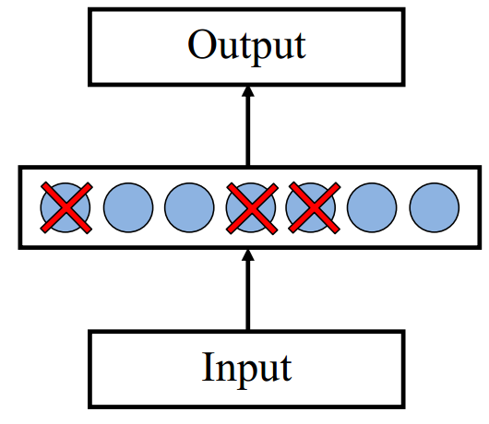

Dropout training
Proposed by (Hinton et al, 2012)
Each time decide whether to delete one hidden unit with some probability $p$

Slide 46
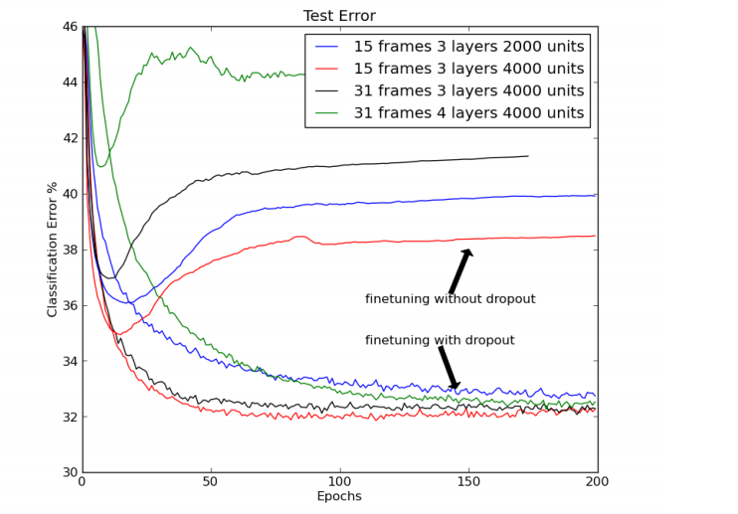

Dropout training
Dropout of $50\%$ of the hidden units and $20\%$ of the input units (Hinton et al, 2012)

Slide 47
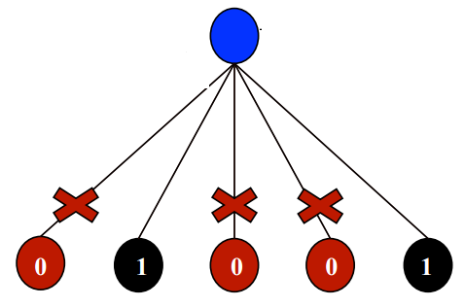
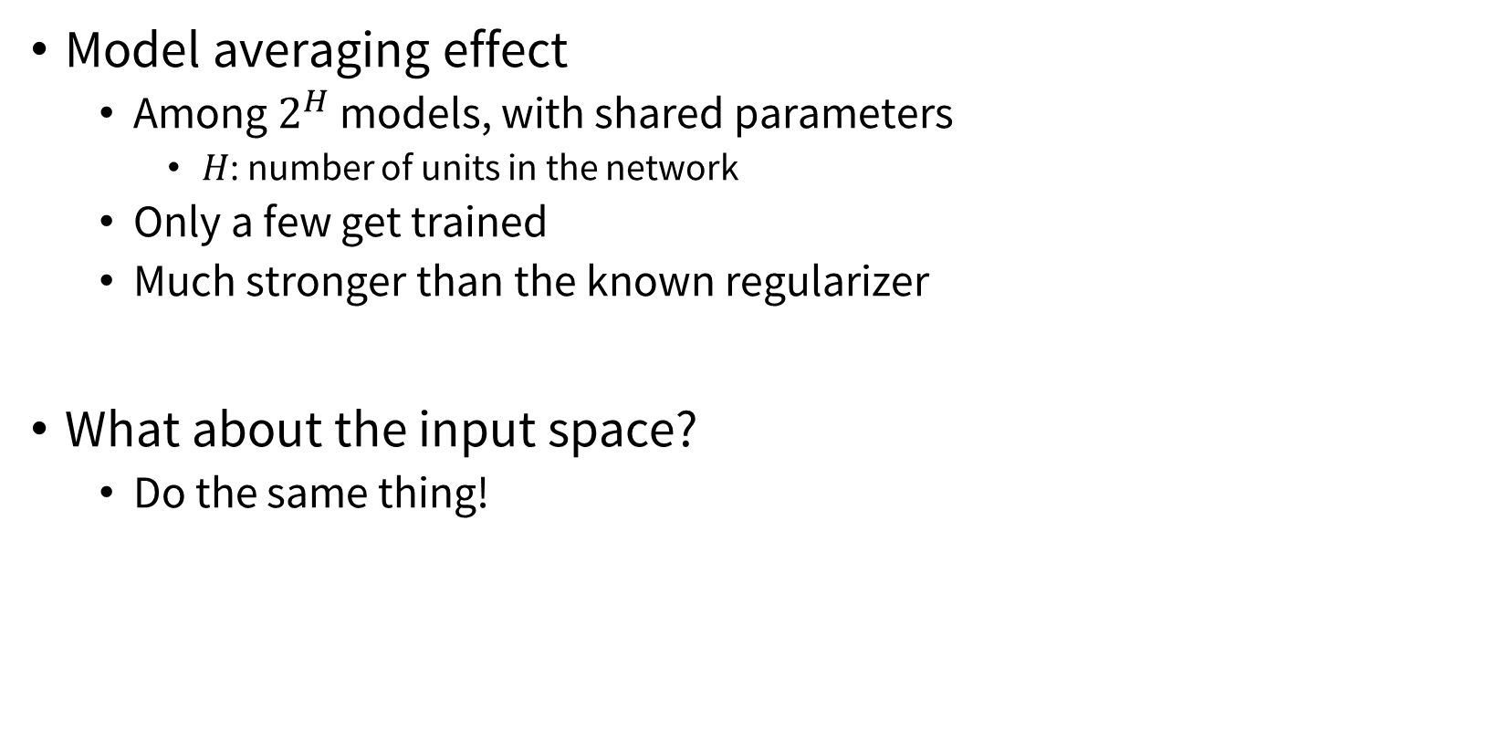
Dropout training
Model averaging effect
  Among $2^{H}$ models, with shared parameters
    $H$: number of units in the network
  Only a few get trained
  Much stronger than the known regularizer
What about the input space?
  Do the same thing!

Slide 48
Demo + Lab
Link:
  https://playground.tensorflow.org/
Lab:
  https://nnfs.io

Slide 49
Convolution Neural Network
a type of deep learning algorithm that specializes in analyzing grid-like data, such as images, by automatically learning and extracting meaningful features

Slide 50

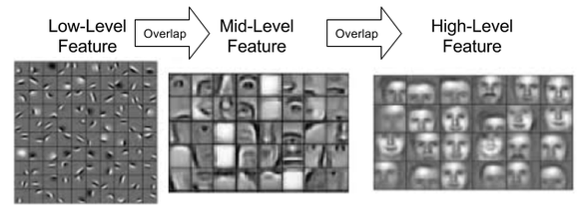
Why CNN?
Task: Images recognition, video processing (grid-like data)
Learn hierarchical feature map

Slide 51
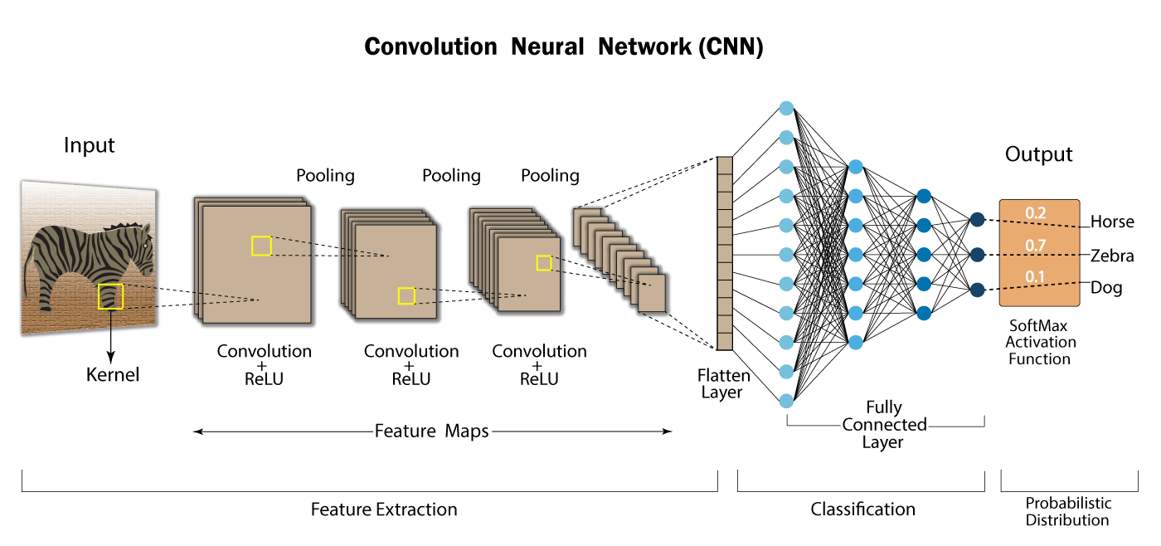
High-level features
Low-level features
Mid-level features

Slide 52

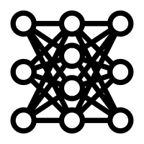
Convolution Operation – Extract Features
Kernel for snout
0 | 1 | 1 | 0
1 | 0 | 0 | 1
1 | 0 | 0 | 1
0 | 1 | 1 | 0
A snout
Kernel for cap
CNN
A cap
0 | 0 | 0 | 1
0 | 0 | 1 | 0
0 | 1 | 0 | 0
1 | 0 | 0 | 0
It’s buc-ee’s!

Slide 53
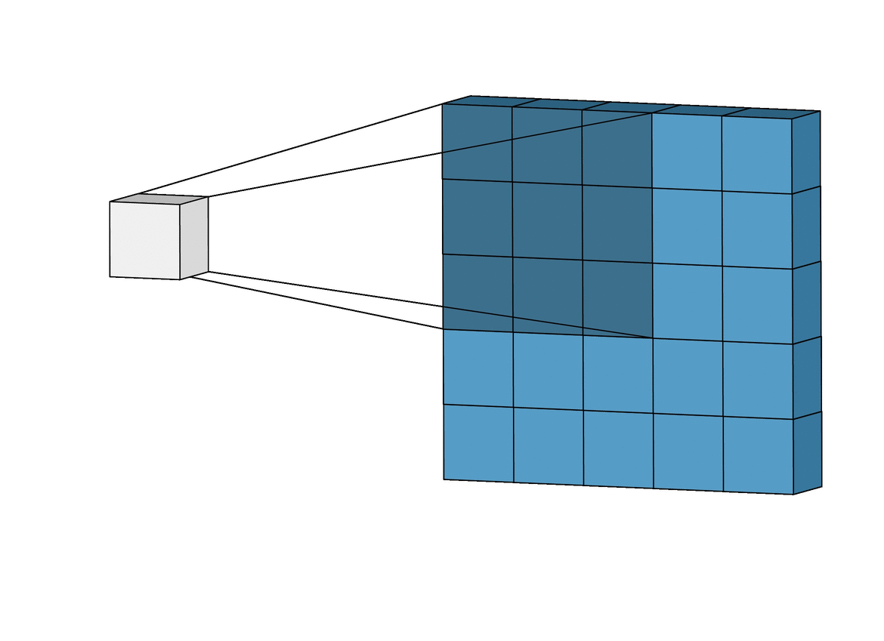
Convolution Operation – Kernel
Kernel (filter) slides or convolves across the input image to learn features
We need to decide:
The size of kernels (big kernel learn big features)
The number of kernels (more kernels the model learn more diversified features)
How many pixels the kernel moves → stride
Input Image
Feature Map

Slide 54
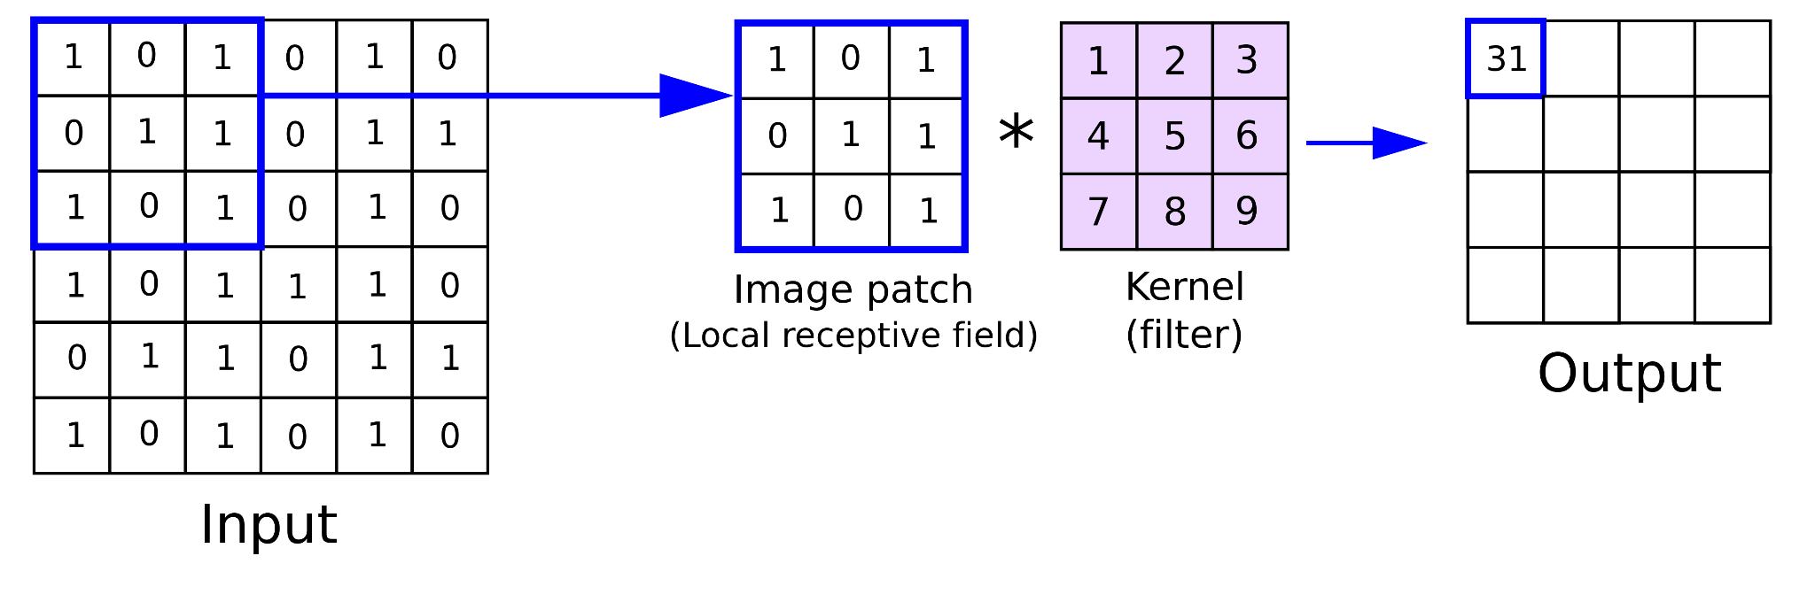
Convolution Operation
How much weight the region has this feature
1x1 + 0x4 + 1x7 + 0x2 + 1x5 + 0x8 + 1x3 + 1x6 + 1x9 =31

Slide 55
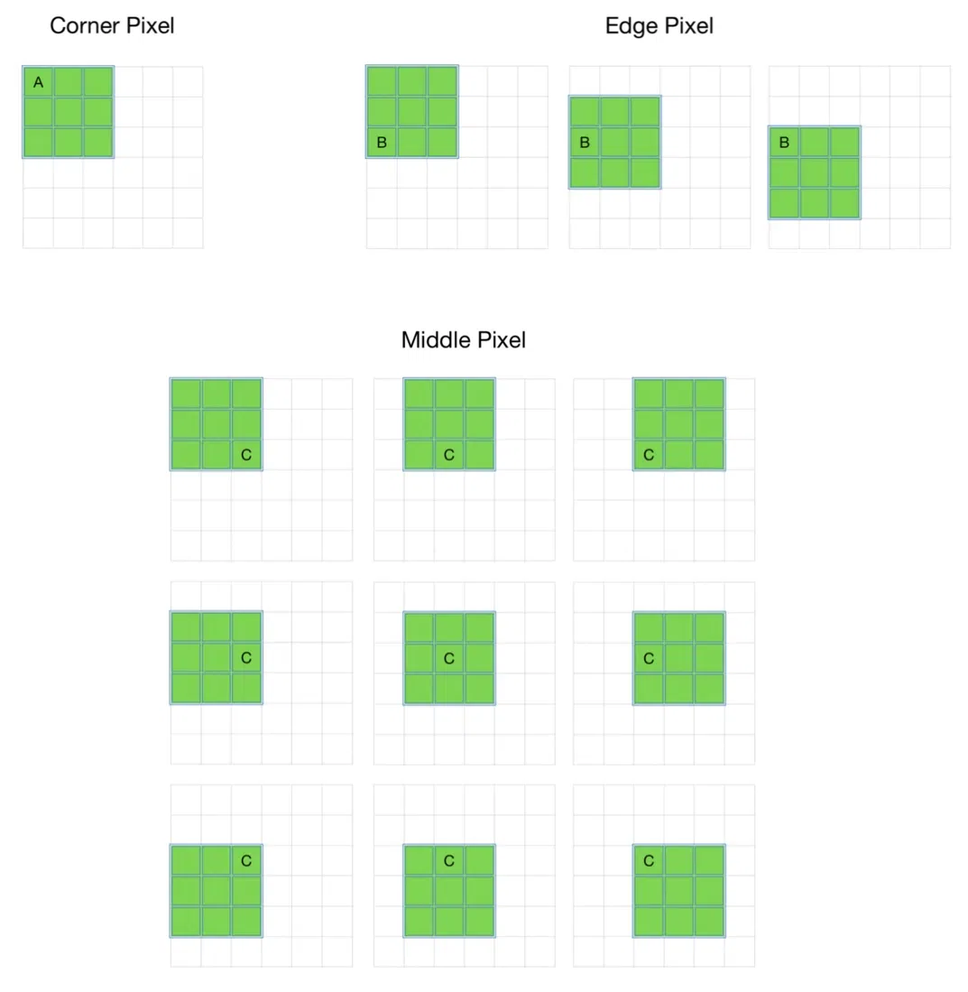
☹️Problem
Output feature map became smaller → loss of information?
The pixels at the borders of the input are included in fewer convolutional → what if important features are at the edges?

Slide 56
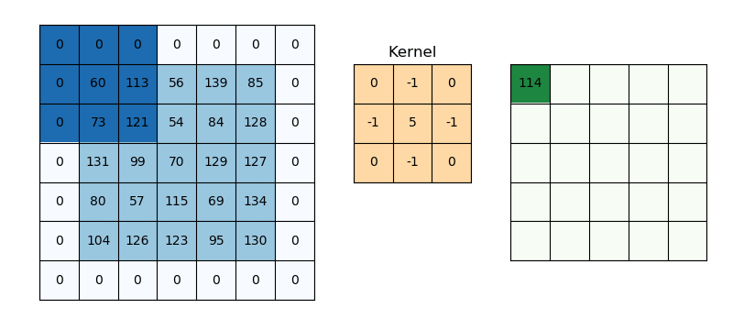
Convolution Operation – Padding
Valid Padding: no padding, only convolution
Output size: 1+(n − f)/s , where n is the input size, f kernel size
Same Padding: preserve the same size
Padding = 1
Output size: 1+(n + 2p - f )/s
Output size
(5 + 2 x 1 - 3)/1+1 = 5

Slide 57
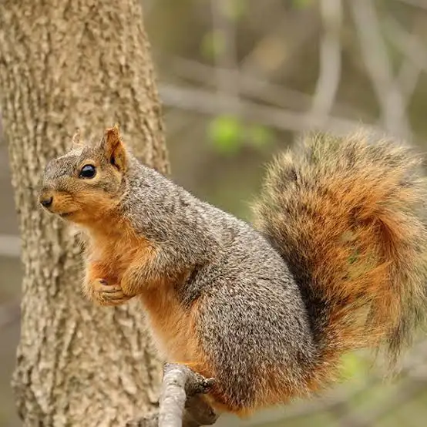
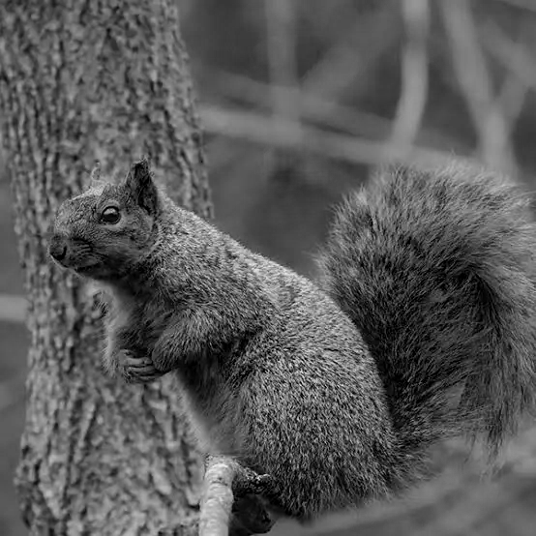
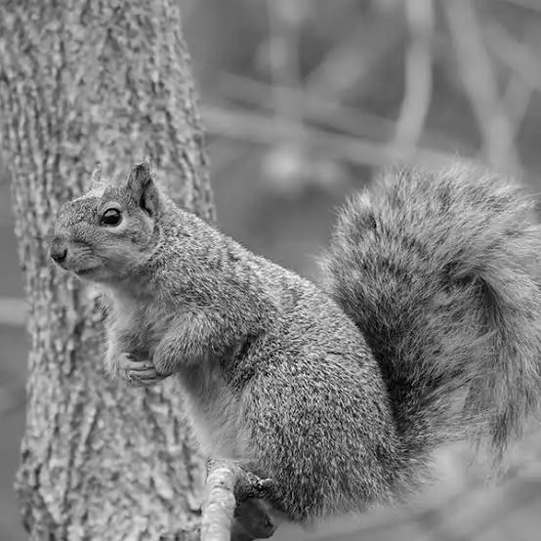
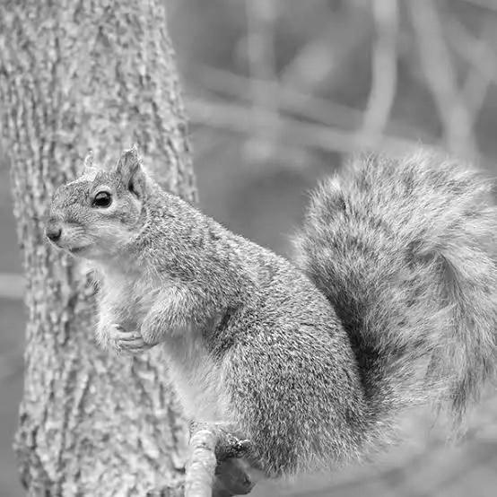
Pooling Operation (downsampling or subsampling)
👍Purpose: to reduce the spatial dimensions of feature maps
Control the size of filter and sliding stride over each channel (depth) of the whole image.
Pooling operates channel by channel, while convolution mixes across channels.
Channel 1
Channel 2
Channel 3

Slide 58
Types of Pooling
Max Pooling
Pooling filter 2x2
2 | 3
1 | 3
0 | 2 | 1 | 3
2 | 0 | 3 | 1
1 | 0 | 3 | 2
0 | 0 | 0 | 1
Stride 2x2
Average Pooling
1 | 2
1/4 | 6/4
Output size
(4 - 2)/2 + 1 = 2
Feature Map
Output size = [(n - f) / stride] + 1

Slide 59
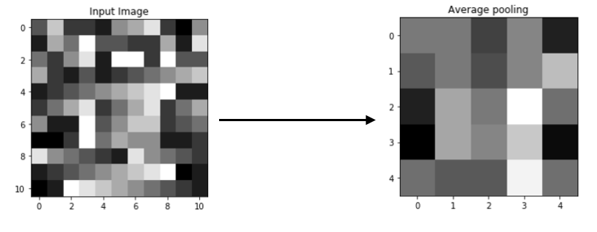
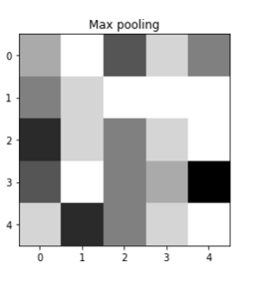
Effects of Pooling

Slide 60
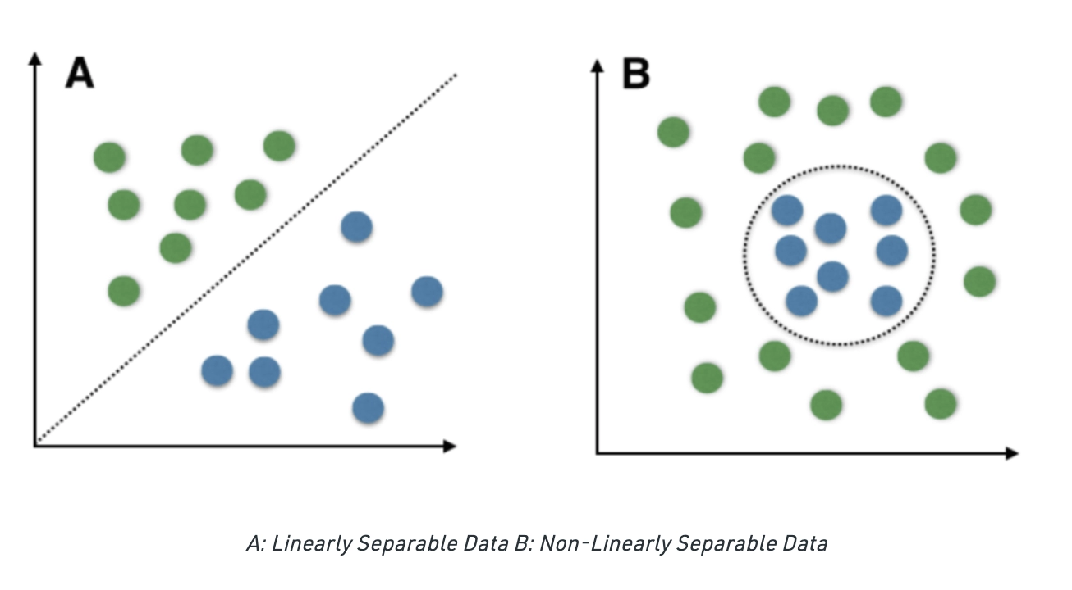
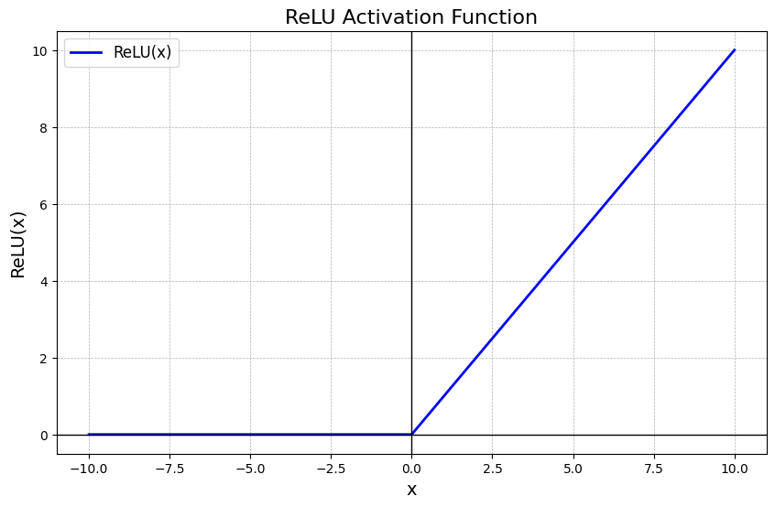
Non-linearity in Classification Tasks
ReLU helps models learn nonlinearity because it breaks linearity by introducing a threshold at 0.
ReLU(x) = max(x, 0)

Slide 61
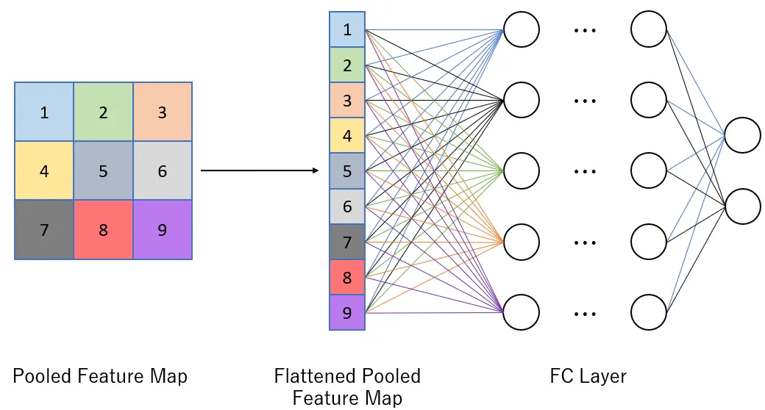
Fully Connected (Dense) Layers
Purpose: capturing global patterns and relationships
Add dropout (deactivate some neuron) to prevent overfitting
→ usually 20-50%
Softmax to turn into probability for classification

Slide 62
Practice: Q1
Which type of data are CNNs best at handling?
Text messages from strangers on Hinge → text
A meme gif that your friend always posted
My singing recording of a cover of Ocean Eyes → audio
Nvidia stock prices from 2020-2025 → time series data

Slide 63
Practice: Q2
Which one is correct?
CNNs use filter to filter out noise in convolution operation
The hierarchical feature map is at the fully connected layer to do classification
CNNs use kernels to construct feature map to learn local patterns
In face recognition, CNNs will extract the face shape at stage 1, and then extract eye shape in stage 2 → should learn edges and lines, then partial objects such as eyes, and finally face.

Slide 64
Practice: Q3
CNN convolution operation is to
Extract features by learning different kernels
Reduce the computation time by reducing image dimensions
→ This is pooling
C. Help the model to achieve non-linear classification
→ ReLU activation can do this

Slide 65
Practice Q4
You are a ML engineer at a startup, in what case you need pooling in CNNs?
The clients are complaining about your model accuracy
Company computers don’t have enough computational power
Your co-worker from marketing department feels that the image data is super dark
There is not enough labeled data for your new classification project → data augementation

Slide 66
4 things U must know about CNN!!!
CNN can handle IMAGE or VIDEO data.
CNN extract local features with kernels to construct hierarchical feature map.
Convolution operation is to extract features and learn which features are important.
Pooling operation is to reduce spatial dimension to reduce computational cost & redundant information.

