Slide 1
Christoph F. Eick Randomized Hill Climbing
Nov. 21, 2021

Slide 2
Dec. 2 News
Makeup class on Dec. 7, 11:30a in our regular class room; topics: Data Storytelling and Review for the final exam.
The final exam has been scheduled for Tu., Dec. 14 in F 160 (same place as Midterm exam) 11a. The exam will take 110 minutes. A review list for the exam will be posted at the course website by Dec. 8 the latest.
Today’s topics:
Randomized Hill Climbing
Group L Group Homework Presentation
Group M Group Homework Presentation
Anomaly and Outlier Detection

Slide 3
A Lot of DS, DM and AI Tasks Require:

Slide 4
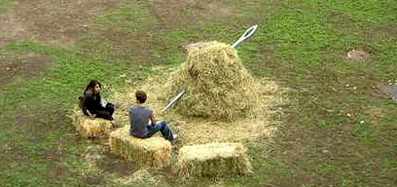
A not so Realistic Scenario:

Slide 5
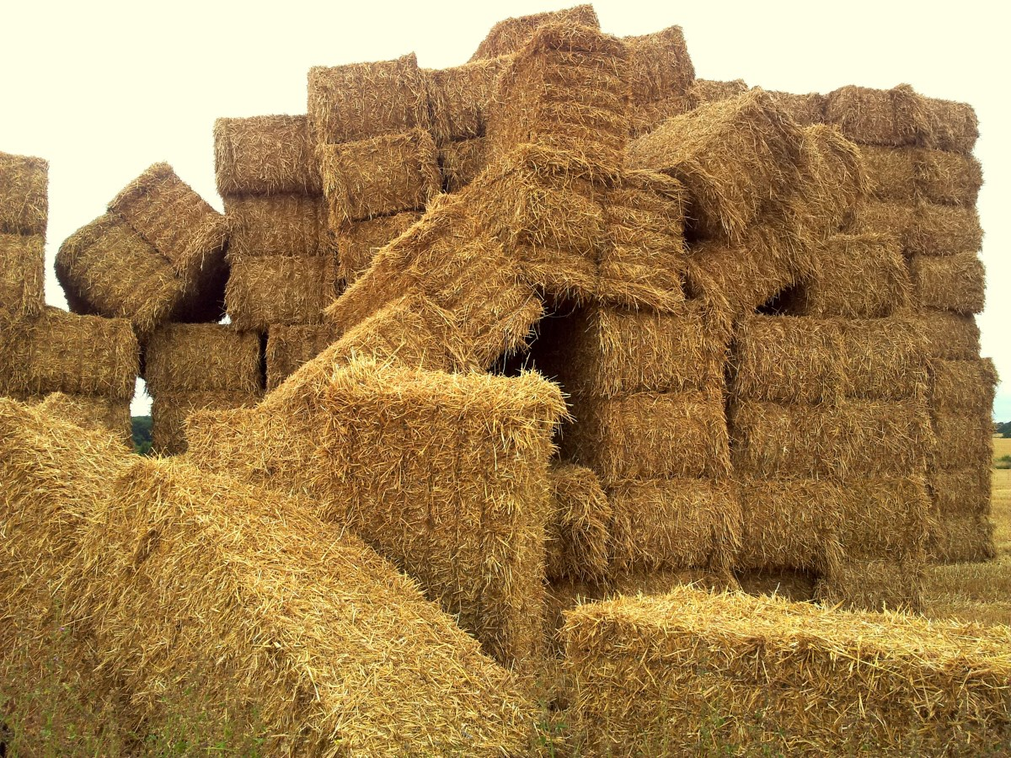
A More Realistic Scenario:

Slide 6
Randomized Hill Climbing is one of the “few” Approaches to “Solve” Challenging “Finding a Needle in Haystack” Problems

Slide 7
Randomized Hill Climbing
Neighborhood
Hill Climbing: Sample p points randomly in the neighborhood of the currently best
solution; determine the best solution of the n sampled points. If it is better than the
current solution, make it the new current solution and continue the search; otherwise,
terminate returning the current solution.
Advantages: easy to apply, does not need many resources, usually fast.
Problems: How do I define my neighborhood; what parameter p should I choose?
Notes:
The last technology I like to introduce in today’s presentation are shared ontologies. Shared ontologies are important to standardize communication, and for gathering information from different information sources. Ontologies play an important role for agent-based systems.
Ontologies basically describe...

Slide 8
Example Randomized Hill Climbing
Maximize f(x,y,z)=|x-y-0.2|*|x*z-0.8|*|0.3-z*z*y|
with x,y,z in [0,1]
Neighborhood Design: Create solutions 50 solutions s, such that:
s= (min(1, max(0,x+r1)), min(1, max(0,y+r2)), min(1, max(0, z+r3))
with r1, r2, r3 being random numbers in [-0.05,+0.05].

Slide 9
Problems Hill Climbing
Terminates at a local optimum (moreover, the deviation between local and global optimum is usually unknown)
Has problems with plateau (terminates), especially if the size of the plateau is larger than the neighborhood size.
Has problems with ridges (usually falls of the “golden” path)
The obtained solution strongly depends on the starting position.
Too large neighborhood sizes →random search, might shoot over hills.
Too small neighborhood sizes →slow convergence, might get stuck on small hills.
Too large parameter p →slow search;
too small parameter p →terminates without getting really close to the mountain top

Slide 10
Pikes Peak (14,110) Ascent Footrace

Slide 11
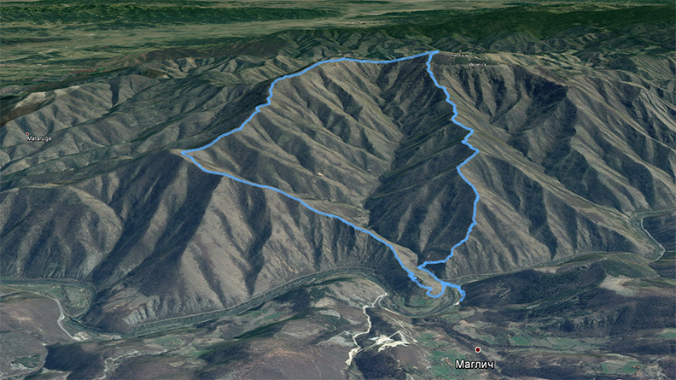
Example: Falling off Ridges

Slide 12
Example: Neighborhood for Searching “Good” DBSCAN Parameters
Current Solution is: (Minpoint, ε)
Create p “new” Solutions (Minpoint’, ε’) by setting:
Minpoint’= Minpoint or Minpoint+1 or Minpoint−1 with equal probability
ε’= r∗ε with r being a random number in [0.95, 1.05]
Remark: Search starts from a random position. Therefore, running RHC multiple times using different starting positions makes sense!

Slide 13
Randomized Hill Climbing Variations
Execute algorithm for a number of initial configurations (randomized hill climbing with restart)
Use information of the previous runs to improve the choice of initial configurations.
Dynamically adjust the size of the neighborhood size and the number of points sampled. For example, start with large size neighborhoods and decrease the size of the neighborhood as the search evolves.
Allow downward moves: Simulated Annealing
Resample before terminating (e.g. sample p points; if there is no improvement sample another 2p points; if there is still no improvement sample another 4p points; if there is no improvement after that finally terminate).
Use domain specific knowledge to determine neighborhood sizes and number of points sampled.

Slide 14
Hill Climbing for State Space Search
Define a neighborhood as the set of states that can be reached by n operator applications from the current state (where n is a constant to be chosen based on the characteristics of a particular search problem)
The state space version creates all states in the neighborhood of the current state (alternatively, it could just create some states which would be a randomized version), and picks the one with the best evaluation as the new current state, or it terminates unsuccessfully if there is no state that is better than the current state.
A variable path has to be added to the hill climbing code that memorizes the path from the initial state to the current state. The path variable is initialized with an empty list. Every time a new current state is obtained the operator or operator sequence that was used to reach this state is appended to the path variable.
A goal test has to be added to the hill climbing code (if it returns true the algorithm terminates returning the contents of its path variable as its solution).
I
Not covered in 2021!

