Slide 1
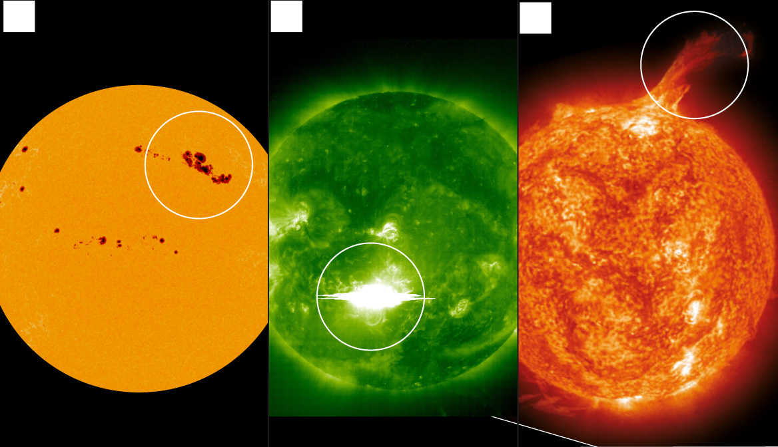
Solar Flares
Solar storm: Why the next disaster to strike will come from the sun (telegraph.co.uk)
Sunspots Solar Flares Coronal Mass Ejection

Slide 2
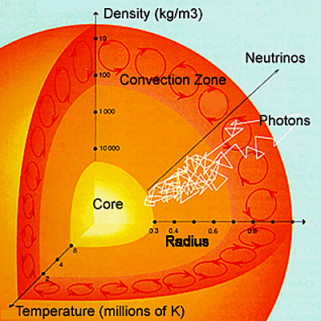
What are Solar Flares?
Solar flares are intense explosions of electromagnetic radiation from the Sun.
They are the solar system's largest explosive events and can release more energy than a billion hydrogen bombs.
Flares occur in active regions on the Sun, which are areas of intense magnetic activity.
In 2001, the strongest ever recorded flare occurred! [1]
Solar flares are thought to be caused by the sudden release of magnetic energy stored in the Sun's corona.
This energy release can occur when twisted magnetic fields become unstable and snap.
The energy released by a solar flare can heat the surrounding plasma to millions of degrees Celsius, and accelerate charged particles to nearly the speed of light
[1] Biggest solar flare on record, https://earthobservatory.nasa.gov/images/1331/biggest-solar-flare-on-record
UH-DAIS

Slide 3
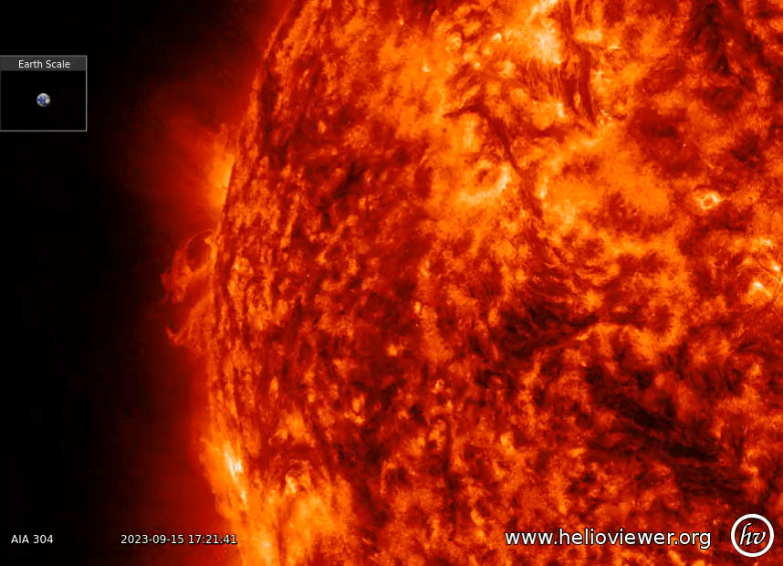
Solar Flares
Video Credit:
Keith Strong
@drkstrong
Solar physicist
A prominence erupting away from the E limb of the Sun at about 18:30 UT on 15 September.
Note how much of the plasma that was thrown off the Sun fell back onto the disk as it did not attain escape velocity (615 km/s).
UH-DAIS

Slide 4
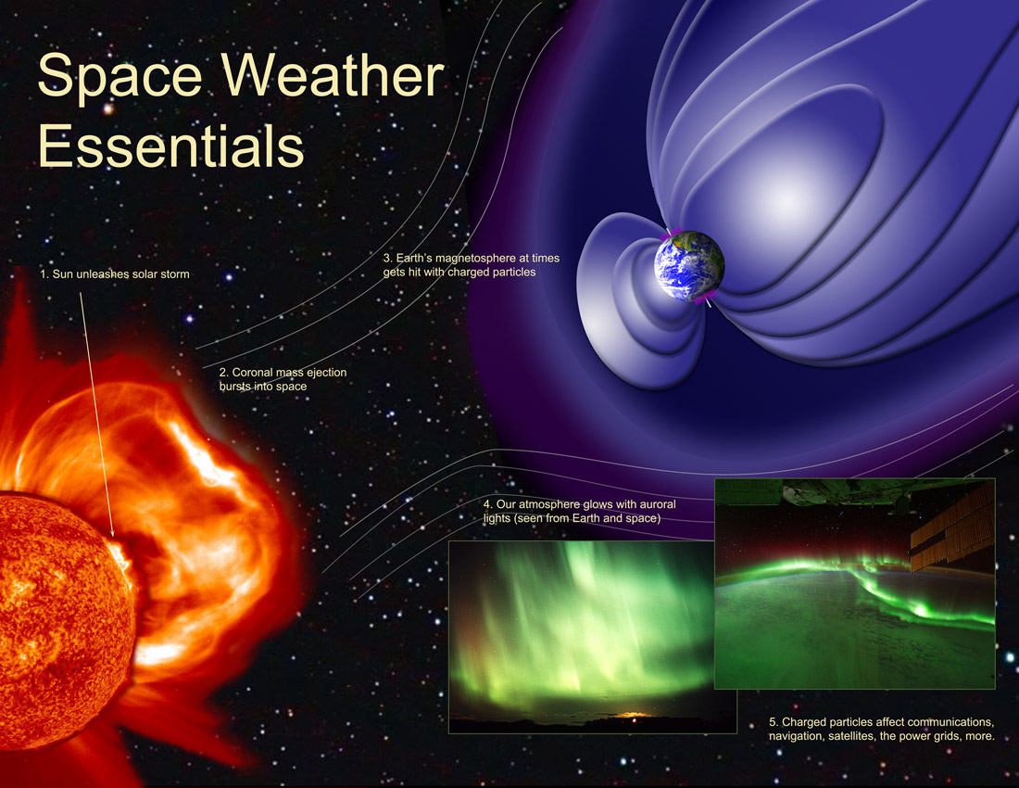
Solar Flares and Earth
Solar flares can have a variety of effects on Earth.
  The most immediate effect is the release of electromagnetic radiation, which can disrupt radio communications and damage electrical grids.
  Solar flares can also accelerate charged particles, which can create radiation storms in Earth's atmosphere.
  These radiation storms can pose a hazard to astronauts and airline passengers and can damage satellites and other electronic equipment.
In addition, solar flares can sometimes produce coronal mass ejections (CMEs), which are large clouds of plasma that can travel through space and impact Earth. CMEs can cause geomagnetic storms, which can disrupt power grids, damage satellites, and cause auroras. NASA spacecraft flies right through sun explosion, captures footage | Mashable
UH-DAIS

Slide 5
Additional Notes
Solar flares are classified according to their brightness in the X-ray wavelengths, as measured by the NOAA/GOES X-ray sensor [1], into:
  A-class flares (weakest, often undetectable)
  B-class (still weak)
  C-class flares are weak, common solar flares. They typically have little or no effect on Earth
  M-class flares are medium-strength solar flares. They can cause brief radio blackouts and minor radiation storms on Earth
  X-class flares are the most powerful solar flares. They can cause widespread radio blackouts and long-lasting radiation storms on Earth
Solar flares occur more frequently during the peak of the solar cycle, which is an 11-year cycle of solar activity.
Scientists are still working to understand the exact relationship between solar flares and CMEs. However, there are indications that the two phenomena are closely linked.
For current Solar Weather, see: https://www.swpc.noaa.gov/
[1] Solar flares, https://www.swpc.noaa.gov/phenomena/solar-flares-radio-blackouts
UH-DAIS

Slide 6
Group Task 3
The 2025 Task 3 focuses on six activities:
Familiarizing with the solar flare dataset, summarizing solar flares
Building an interpretable solar flare classifier
Exploring images generated by the RHESSI*
Change analysis
Intensity assessment, mapping, and spatial analysis
Story writing
* Reuven Ramaty High Energy Solar Spectroscopic Imager
UH-DAIS

Slide 7
About RHESSI
RHESSI was designed to observe solar flares across a wide range of X-ray and gamma-ray energies. The flare list includes counts or fluxes in bands like:
  3–6 keV
  6–12 keV
  12–25 keV
  25–50 keV
  50–100 keV
  100–300 keV
  300–800 keV
  800-7000 keV
These bands reflect different physical processes:
  Lower energies (3–12 keV): Dominated by thermal emissions from hot plasma
  Higher energies (25+ keV): Indicate non-thermal processes like particle acceleration
UH-DAIS

Slide 8
Activities 1 & 2
Activity 1: Familiarize yourself with the solar flare dataset. We will work with Solar Cycle 24, the most recently completed solar cycle
(December 2008 – December 2019)
Data are available till March 2018
Activity 2: Build an interpretable solar flare classifier
Use a decision tree
Questions?!
UH-DAIS

Slide 9
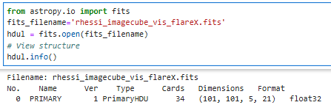
Activity 3
RHESSI image cube exploration
When analyzing RHESSI data, researchers often generate image cubes or stacks across energy and time to study spectral behavior or flare evolution
Install the available Python or R library to read FITS files
Learn about the structure
Zero index
(X, Y, energy, time)
Questions?!
UH-DAIS

Slide 10
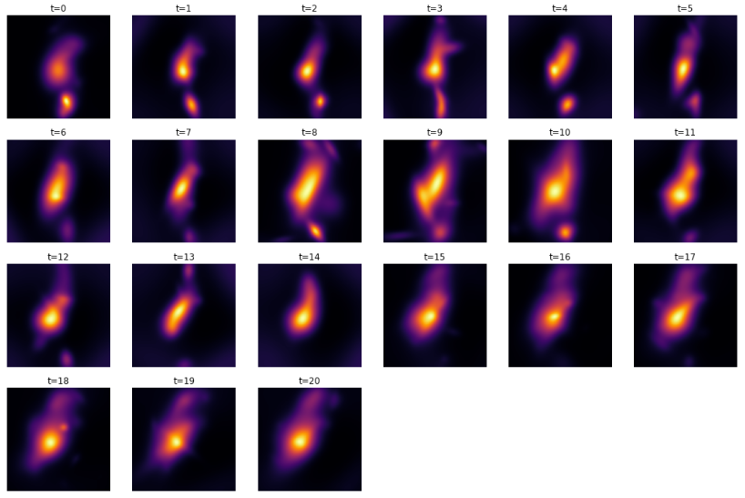
Activity 3 (continued)
An example output on 2011-09-22, 10:53 am
Evolution of an X-class flare in the 6-12 keV energy band
Questions?!
UH-DAIS

Slide 11
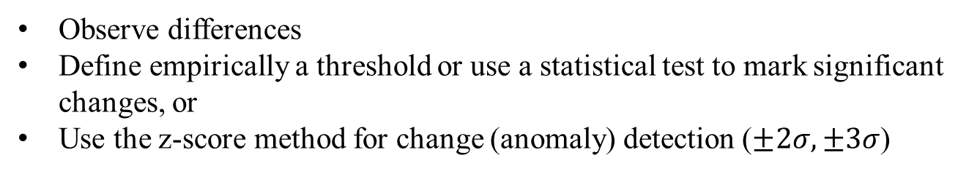
Activity 4
Temporal analysis
Detecting changes in a time series—often called change point detection or concept drift. It is crucial for identifying shifts in behavior, trends, or anomalies
Develop a method to capture shifts
We need to select a time interval, for example, every day, or 12h
μ=750
μ=80
μ=600
Day 1
Day 2
Day 3
Observe differences
Define empirically a threshold or use a statistical test to mark significant changes, or
Use the z-score method for change (anomaly) detection ($±2σ,±3σ$)
IDEAS
UH-DAIS

Slide 12
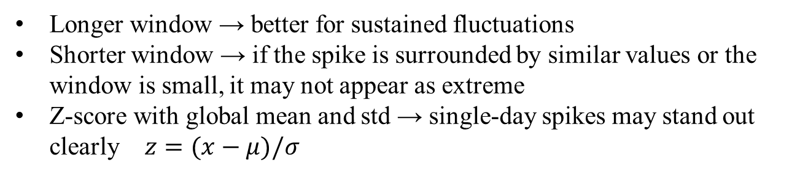


Activity 4 (continued)
Longer window → better for sustained fluctuations
Shorter window → if the spike is surrounded by similar values or the window is small, it may not appear as extreme
Z-score with global mean and std → single-day spikes may stand out clearly $z=(x−μ)/σ$
Questions?!
A=[750, 80, 600, 570, 600, 2500, 310, 205], μ=716, σ=821
z_{s}=-0.77
$\left|zs\right|$=2.17 > 2
A=[750, 80, 600, 570, 600, 2500, 310, 205]
μ_{3D}=1223, σ_{3D}=1105
N/A
$\left|zs\right|$=1.15 < 2
3-day moving average
maybe the window is small 😕
UH-DAIS

Slide 13
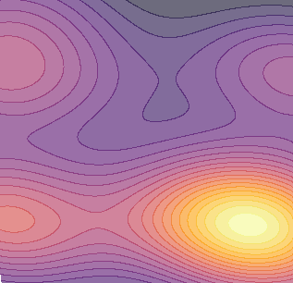

Activity 5
Intensity assessment, mapping, and spatial analysis
Select between naïve, parametric, and non-parametric density estimation
Maybe we will keep positions in solar coordinates (arcseconds)
Create a grid in solar coordinates (x,y) with a step of 200 for example
Define a distance function (Euclidean?)
Get (probability) density estimations for all grid positions
Visualize results
$$\left(x,y\right)∈\left[x_{min},x_{max}\right]×\left[y_{min},y_{max}\right]$$
You can restrict the grid coordinates to be inside
the solar radius
y
$$x^{2}+y^{2}≤{960}^{2}$$
Dense area
x
Questions?!
UH-DAIS

Slide 14
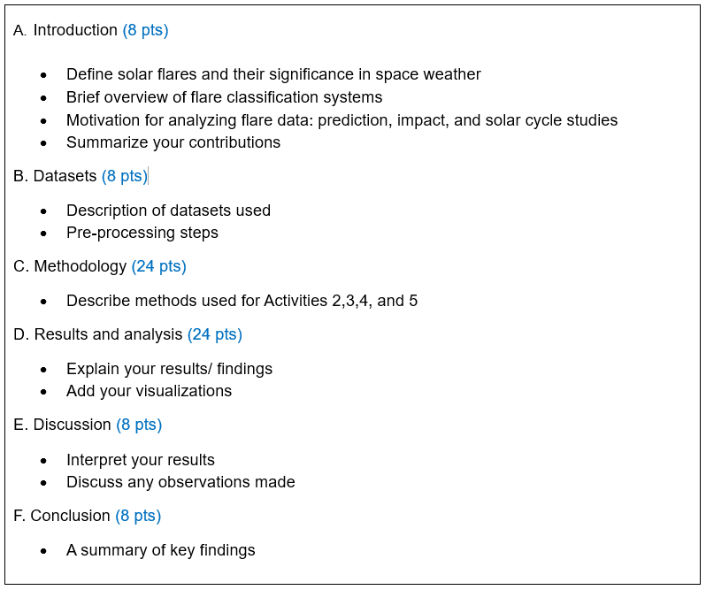
Activity 6
Story writing following the provided structure
Questions?!
UH-DAIS

Slide 15
Useful Libraries
Python
  pandas dataframe (data pre-processing)
  numpy (numerical computing)
  scikit-learn (data modeling)
  matplotlib (data visualizations)
  seaborn (data visualizations)
  astropy (read FITS)
  sunpy (solar data analysis)
R
  dplyr, data.table, tidyverse (data pre-processing)
  matrix, array (numerical computing)
  caret, mlr3, tidymodels (data modeling)
  ggplot2 (data visualizations)
  ggpubr (data visualizations)
  FITSio, astro (read FITS)
UH-DAIS

Slide 16
Helpful Links
Detailed Explanation of the Solar Cycle:
http://solarcellcentral.com/sun_page.html
NASA’s Parker Solar Probe spacecraft flies right through sun explosion, captures footage:
https://mashable.com/article/sun-solar-ejection-nasa-footage
Reuven Ramaty High Energy Solar Spectroscopic Imager was a NASA solar flare observatory. After more than 16 years of successful operations since its launch in 2002, RHESSI was decommissioned on 16 August, 2018.
https://en.wikipedia.org/wiki/Reuven_Ramaty_High_Energy_Solar_Spectroscopic_Imager
Heliosviewer, https://gs671-suske.ndc.nasa.gov/
UH-DAIS

