Slide 1
News Sept. 2, 2025
Tong and Farzana will be TAs for this Section of COSC 4368. They will introduce themselves either today or on Sept. 4!
GHC Groups will be set up and shared during the lecture on Sept. 4!
GHC Tasks of Groups A-F have already been posted on the course website. Group A will present on Th., Sept. 11!
Video on Collaborating Agents: start at 15: http://arstechnica.com/science/2012/03/robots-swarm-the-stage-at-ted/
Today’s Class:
  Search
  Brief Discussion of Task1 (will be continued on Sept. 4)
A

Slide 2
Teaching Plan Search
Search1: Classification of Search Problems, Terminology, and Overview (only partially covered in the textbook)
Search2: Problem Solving Agents
Search3: Heuristic Search, Exploration and Local Search
Search4: Randomized Hill Climbing and Backtracking (not covered in the textbook!)
Search5: Games (will cover this topic quite quickly in 2025, skipping several subjects)
Search6: Constraint Satisfaction Problems
Search7: Likely more on Greedy Search and A*.
Search8: Information and Discussion of Problem Set1
EC1: Introduction to Evolutionary Computing (EC) / Genetic Algorithms (GA)
EC2: Using EC to Solve Travelling Salesman Problems
2025 Teaching Order: Search1-Local Search(Second Half of Search3)-RHC(part of Search 4)-Search2-…
A

Slide 3
Classification of Search Problems
State Space Search
Constraint Satisfaction
Problems
Optimization
Problems
Search
Uninformed Search
Heuristic Search
Notes:
The last technology I like to introduce in today’s presentation are shared ontologies. Shared ontologies are important to standardize communication, and for gathering information from different information sources. Ontologies play an important role for agent-based systems.
Ontologies basically describe...

Slide 4
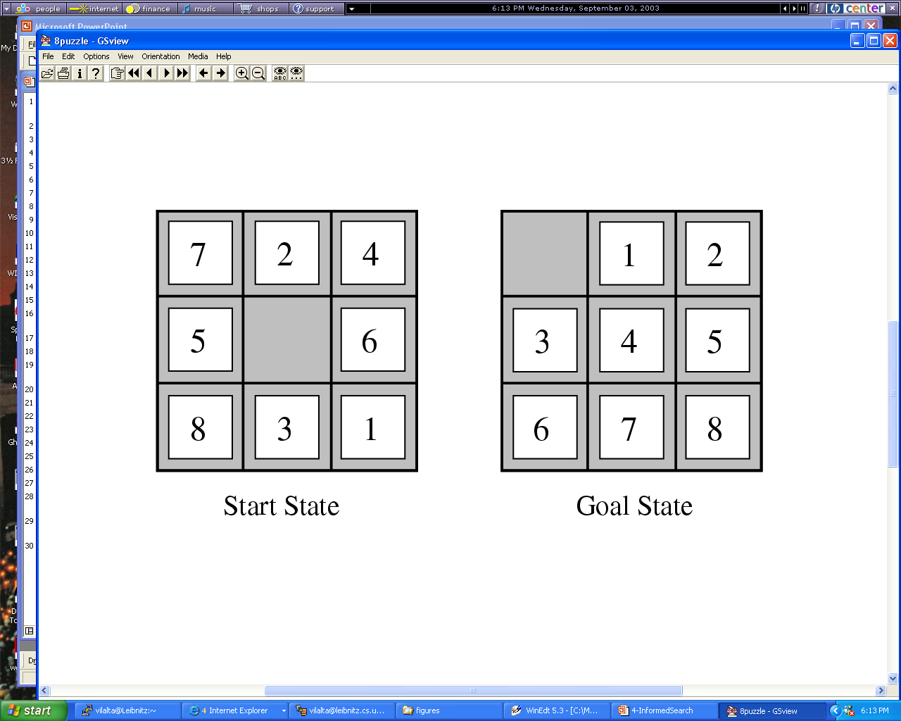
Figure
Example: State Space Search
Goal: find an operator sequence that leads from the start state to the goal state
State Space: a 3x3 matrix containing the numbers 1,…,8 and *(empty)
Operators: North, South, East, West

Slide 5
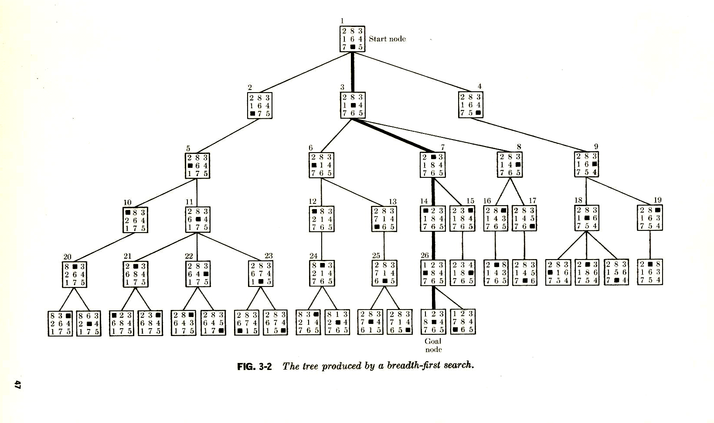
A Search Tree for the 8-Puzzle
Space Complexity: O(n)=O(b**(d+1)

Slide 6
Optimization Problems
Maximize f(x,y,z)=|x-y-0.2|*|x*z-0.8|*|0.3-z*z*y|
with x,y,z in [0,1]
Characteristics:
No explicit operators
the path that leads to the solution is not important
Frequently involves real numbers → number of solutions is not finite
Problems might be complicated by additionally requiring that the solution satisfies a set of contraints.
Life is easier if the function is continuous and differentiable → e.g. classical numerical optimization techniques can directly be applied
AI and evolutionary computing are more attractive for “nasty” optimization problems.

Slide 7
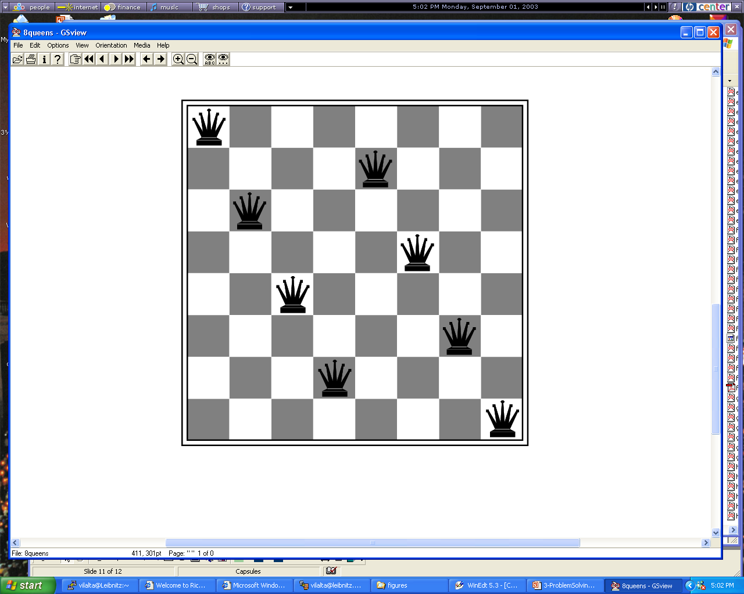
Constraint Satisfaction Problems
http://www.cis.temple.edu/~ingargio/cis587/readings/constraints.html
Find q1=(x1,y1),…,q8=(x8,y8) such that constraint_satisfied.

Slide 8
Heuristic Search
augment
General Search
Algorithms
Domain-specific
Knowledge
Notes:
The last technology I like to introduce in today’s presentation are shared ontologies. Shared ontologies are important to standardize communication, and for gathering information from different information sources. Ontologies play an important role for agent-based systems.
Ontologies basically describe...

Slide 9
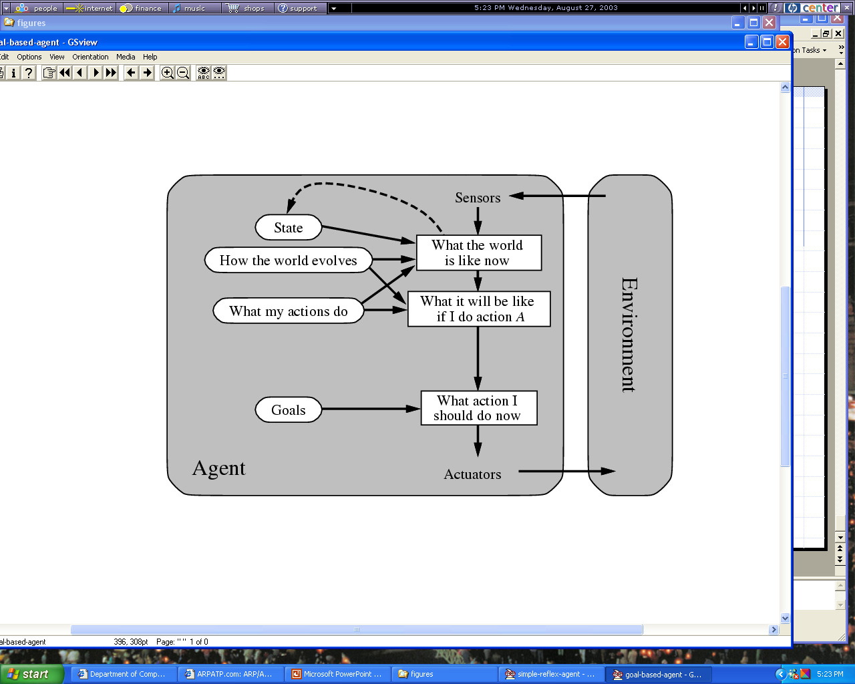
Figure 2.13

Slide 10
Classification of Search Algorithms
State Space Search
Backtracking
Expansion Search
Hill Climbing
Breadth First
Depth
First
Best First Search
Uniform Cost
A*
Greedy Search
Remark: Many other search algorithms exist that do not appear above
Notes:
The last technology I like to introduce in today’s presentation are shared ontologies. Shared ontologies are important to standardize communication, and for gathering information from different information sources. Ontologies play an important role for agent-based systems.
Ontologies basically describe...

Slide 11
A Search Tree for the 8-Puzzle
Space Complexity: O(n)=O(b**(d+1)

Slide 12
Characterization of
State Space Search Algorithms
A search strategy consists of the following:
A state space S, set of operators O: S→S, an initial state, and a (set of) goal state(s).
A control strategy that determines how the search space will be searched; it consists of an operator selection and state selection function:
  Operator selection function: selects which operator(s) is (are) applied to a given state
  State selection function: selects the state to which an operator (selected by the operator selection function) is applied next.
Remarks: Operator selection functions only return operators that have not been applied yet, and state selection functions return only states that have not been completely expanded yet (some applicable operators have not been applied to this state yet); moreover, we assume that ties are broken randomly.
Notes:
The last technology I like to introduce in today’s presentation are shared ontologies. Shared ontologies are important to standardize communication, and for gathering information from different information sources. Ontologies play an important role for agent-based systems.
Ontologies basically describe...

Slide 13
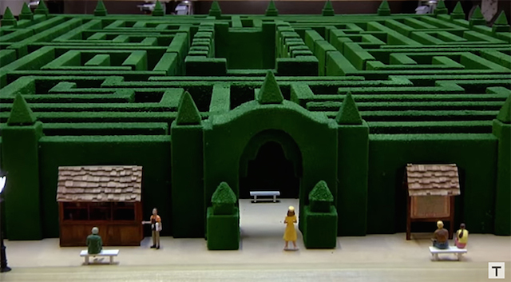
Example: Search Strategies for the 8 Puzzle
Strategy 1 (Breadth First):
Operator Selection Function: select all operators
State Selection Function: Select a state s giving preference to states that are closer to the initial state i(closeness is evaluated by the number of operator applications it took to reach s from i)
Strategy 2 (Backtracking with depth bound set to 7):
Operator Selection Function : Select (applicable) operator by priorities: N>S>E>W
State Selection Function : If the most recently created state is less than 7 operator applications away from the initial state (forward search) and there are applicable operators left, use this state; otherwise, use the predecessor of the recently created state (backtracking).
Background: https://en.wikipedia.org/wiki/Ariadne
https://en.wikipedia.org/wiki/Ariadne%27s_thread_%28logic%29
https://en.wikipedia.org/wiki/Labyrinth

Slide 14
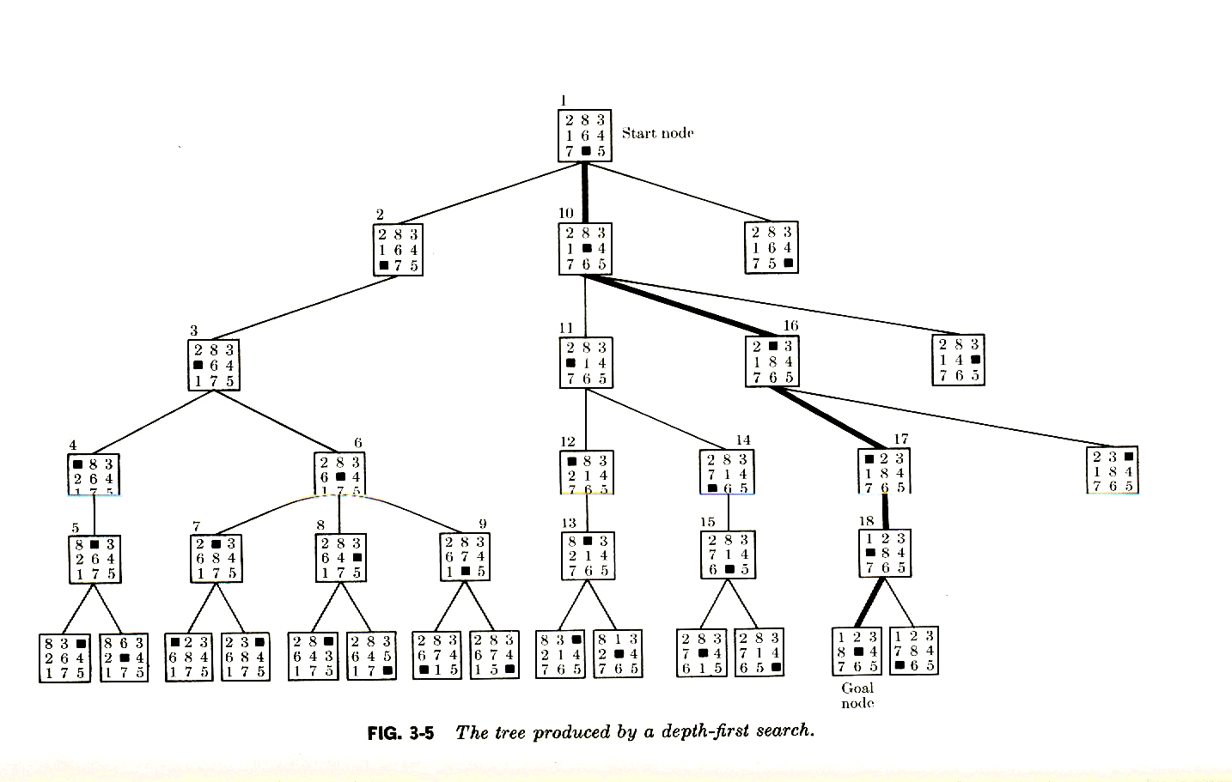
Tree Produced by Depth First Search
Space Complexity Backtracking: O(d)
Space Complexity Expansion Depth-first Search: O(b*d)
Search Graph or Tree??

Slide 15


What happens To People That
Do Not Know Search Strategies
The Shining
The Shining - Bing video
Kubrick shining labyrinthe 1980 - Bing video

Slide 16
Textbook Search Reading List
Students suggested Textbook reading groups…Please read the 4th edition (which appeared in Dec. 2020, I believe) of the textbook and not older editions!
Reading List:
Chapter 3: mandatory: 63-92, 96-102, 104-106; optional: 92-96, 102-104
Chapter 4: mandatory: 110-115, 141 optional: 116-119 (EC will be covered separately later), 119-122
Chapter 5: mandatory: 146-158, 174-175 optional: 159-161, 164-168
Chapter 6: mandatory: 180-193(skip 6.1.2) optional: 194-199
There are some additional slides, discussing categories of search algorithms, backtracking, randomized hill climbing which are not covered in the textbook!
Remark: all page numbers refer to the 4th Edition from 2021…

Slide 17
2025 Labyrinth Task GHC Group A (on Sept. 11)
Assume a labyrinth of interconnected rooms is given and two players---who start in different room---try to find each other. There will be many intersections of walkways that connect rooms all of which look completely the same; that is, players do not know if they are in the same room or and you do not know if you entered a particular crossing or use a particular path before; however, you will be given a piece of chalk that allow you to put signs of your own choosing on a wall. Devise a search strategy for each player (could be the same or different) that enables the players to find each other (being in the same room)
Task and its challenges will be further discussed in Sept. 9 Lecture

