Slide 1
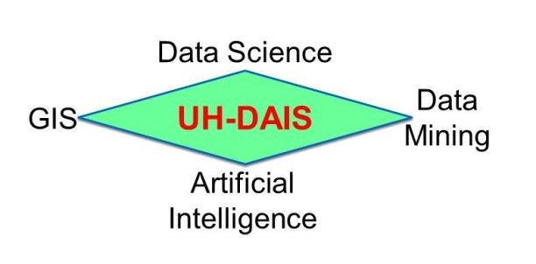
Christoph F. Eick

Slide 2
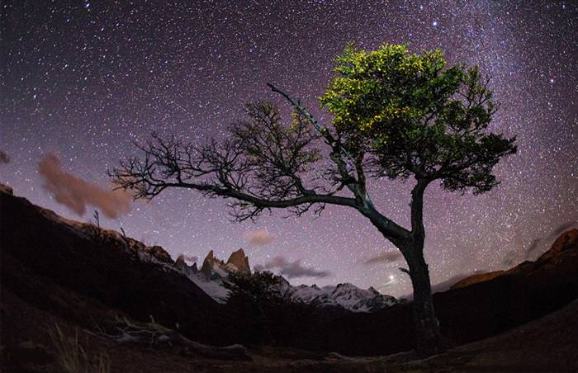
UH-DAIS Research Projects 9/25-8/26
Spatial and Spatio-temporal Data Analysis Frameworks
Association Analysis Frameworks
Using Generative AI to Create Elevation Realistic Horizon Images (Moon; maybe seafloor)
Density-based and Supervised Clustering
Anomaly Detection (Anomaly Drift, AD in Videos)
Automated Frameworks to Monitor Marine Reserves
???
Christoph F. Eick

Slide 3

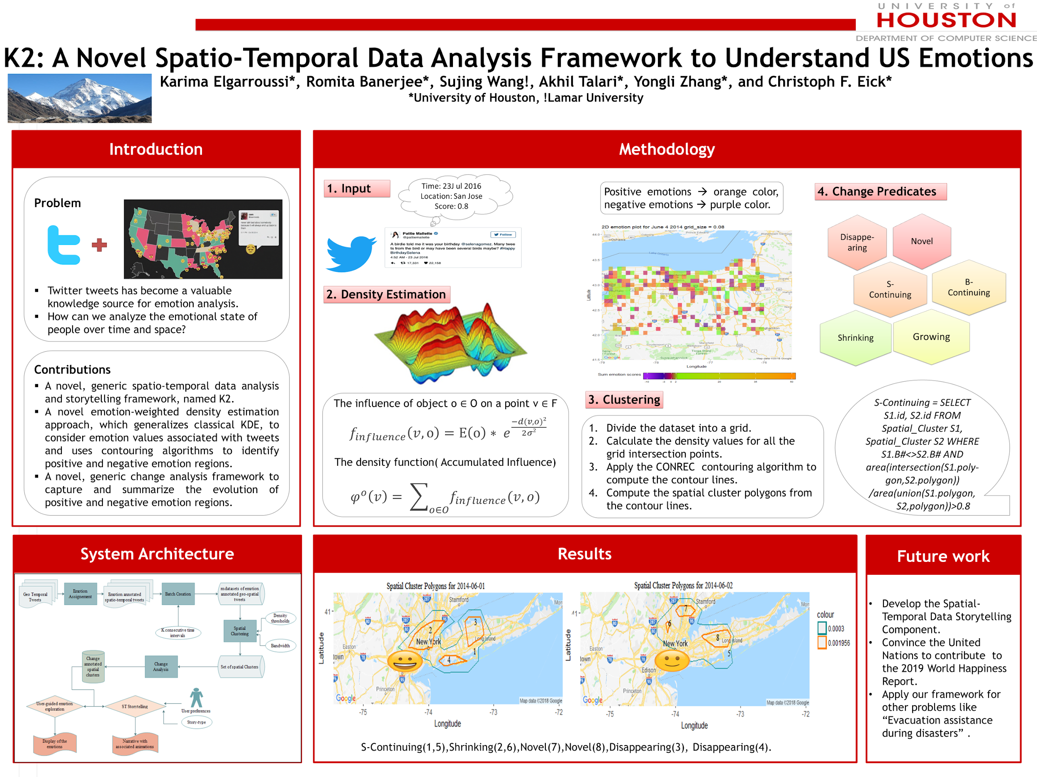
K2 Project Goals
Given a set of tweets (or questionnaires soliciting preferences and opinions) with the location (longitude and latitude), time they were posted and their emotional assessment in [-1,+1] (+1:=very positive emotions, 0:=no or even mix of emotions, -1: very negative emotions)
Research Steps and Goals:
Subdivide the dataset into batches, corresponding to different time intervals
Identify spatial clusters of highly positive emotions (e.g. average emotional assessment >0.4) and regions of highly negative emotions (e.g. average emotion assessment < −0.4) for each batch.
Capture patterns of change and evolution of the regions identified in 2.
Based on a selected story type and user preferences, convert results found in steps 2 and 3 into a narrative and animations that tells the story of spatio-temporal evolution of emotions in an region (e.g. Texas, US,…) over a period of time (e.g. 5 years, 1 year, 1 month), similar to: https://www.ted.com/talks/hans_rosling_asia_s_rise_how_and_when

Slide 4


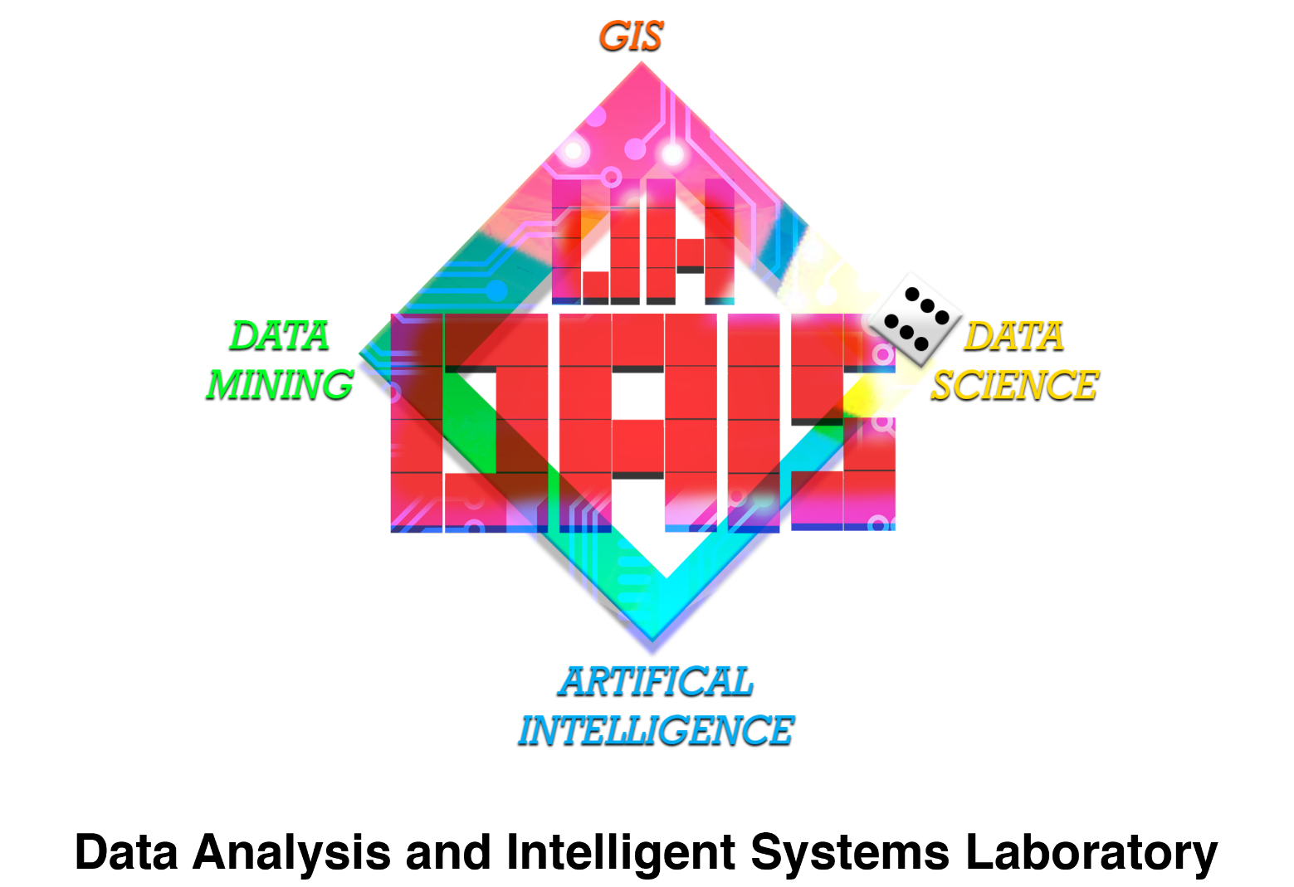


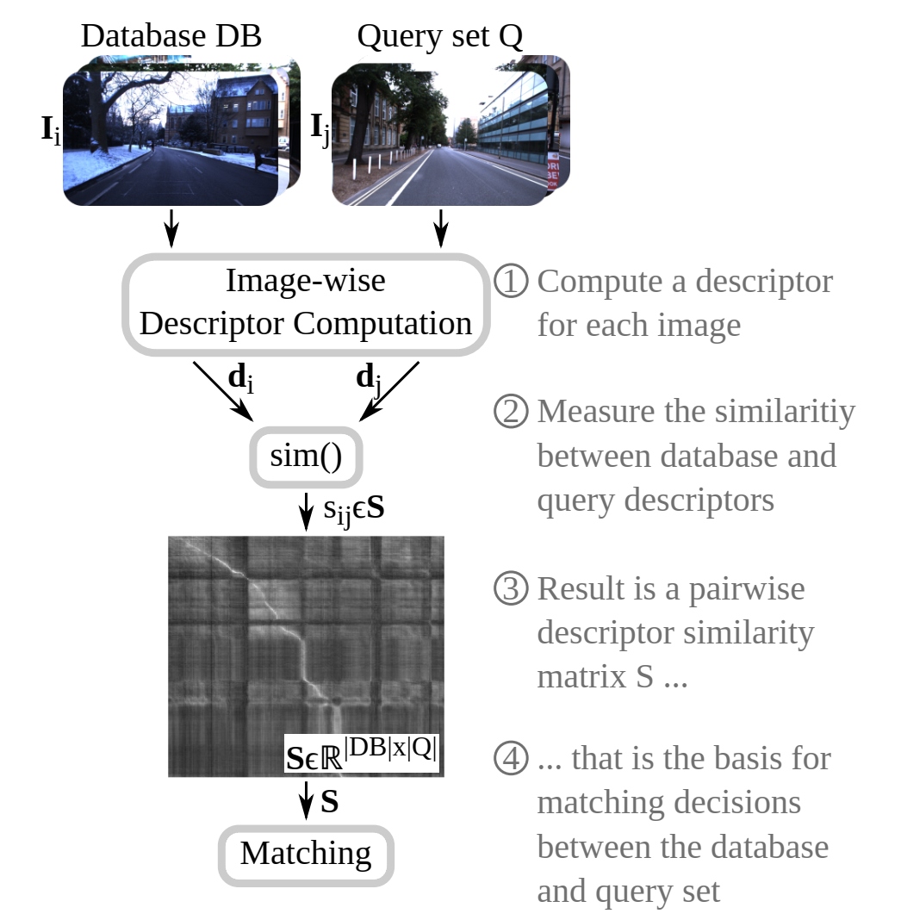

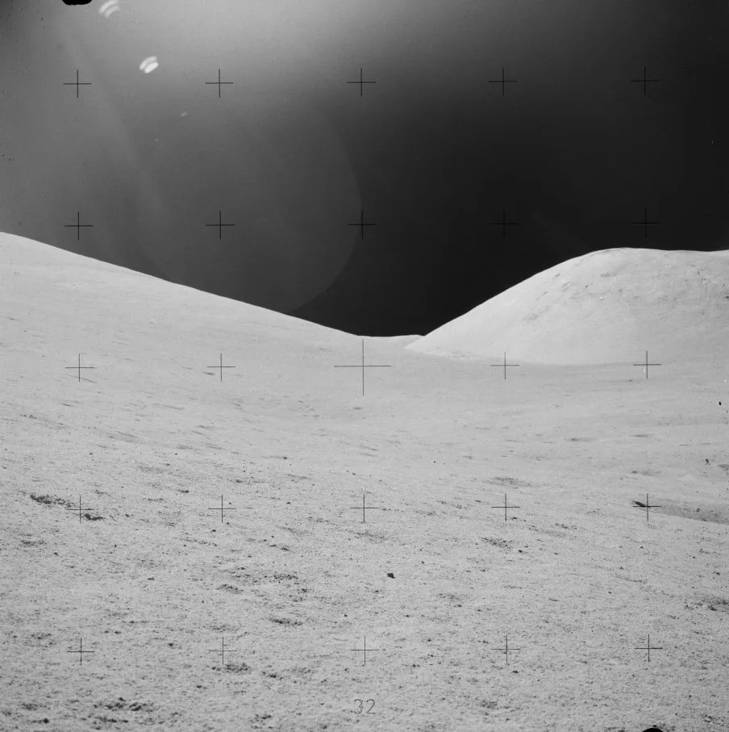
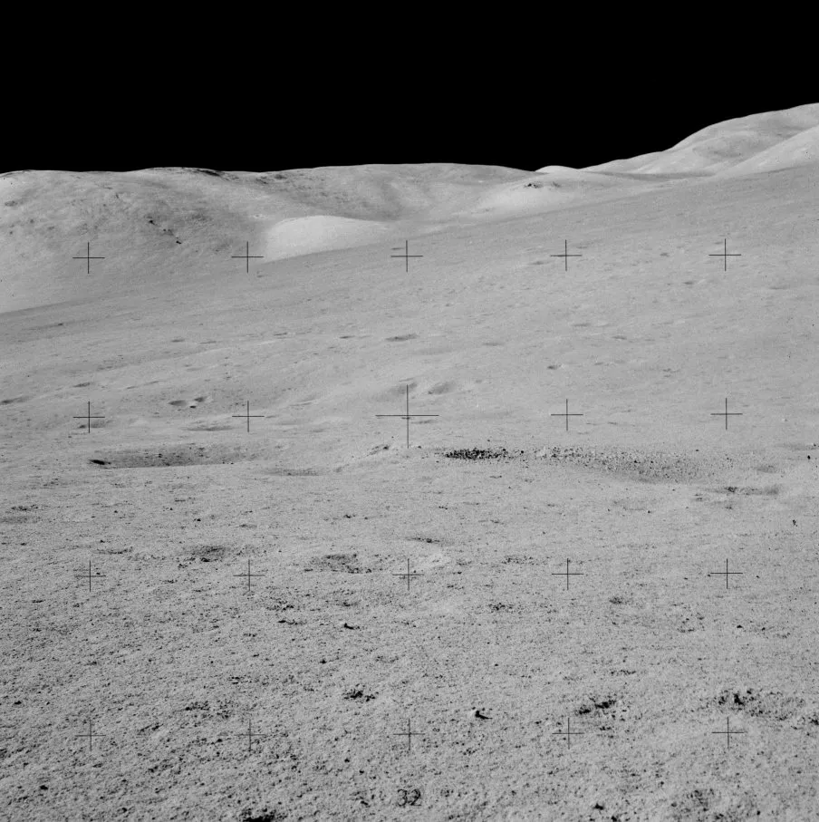
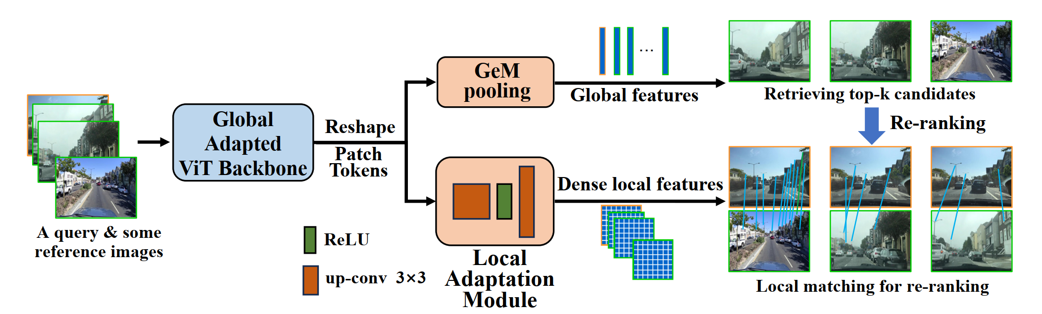
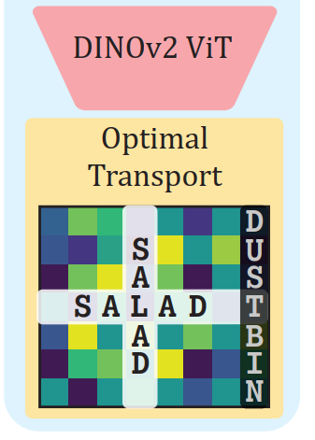
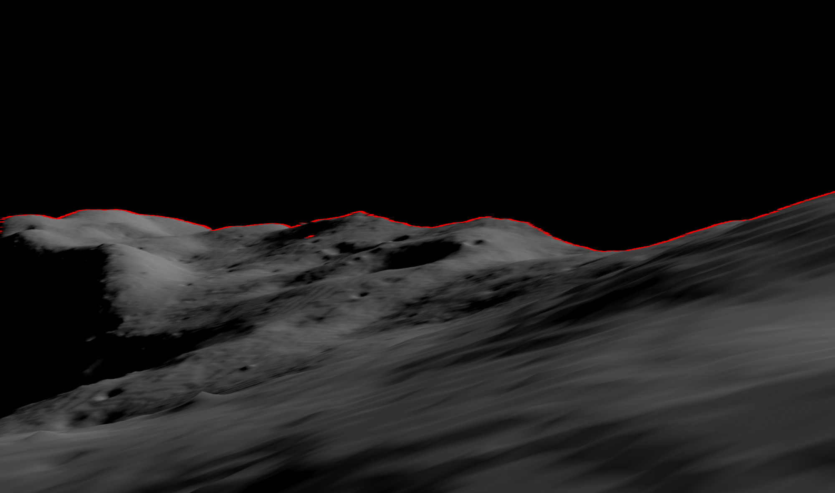

Accurate Geolocation and Navigation Through Landscape Recognition Using Visual Place Recognition
Raunak Sarbajna and Christoph F. Eick
Dept. of Computer Science, University of Houston
@RaunakDune
rsarbajna@uh.edu
I. Motivation
II. Visual Place Recognition
Is accurate geolocation possible without relying on GPS/satellite triangulation data?
Is landscape recognition tech robust enough to achieve high accuracy?
Can modern visual place recognition/urban landmark recognition techniques be generalized to work on arbitrary non-urban terrain?
Are existing Lunar/Martian Digital Elevation Models (DEMs) good enough to create a 3D surface model with enough resolution to train a landscape recognition ML model?
Given a reference set composed of database images $I_{i}∈DB$ of known places, and one or multiple query images $I_{j}∈Q,$ the goal is to find matches between these two sets, i.e., those instances where image $j$ from the query set shows the same place as image $i$ from the database.
To find these matches, it is essential to compute one or multiple descriptors $d$ for each image – these descriptors should be similar for images showing the same place and dissimilar for different places.
A descriptor is typically represented as a numerical vector (e.g., $128−D$ or $4,096−D$).
III. Novel Two Stage VPR Pipeline
IV. Result: Lunar Horizon (Apollo 17)
Typical VPR baseline has a ResNet backbone followed by NetVLAD aggregation.
ResNet is replaced here with a partially fine-tuned DINOv2 backbone and incorporates an optimal transport aggregation using the Sinkhorn Algorithm.
Research and prelim results compare favourably with state-of-the-art results on common VPR benchmarks.
Input Images
EVA-1 at the LM. 4 o'clock pan. North Massif, large boulder track.
Illustration of the local adaptation and our two-stage VPR pipeline.
Matches
Detected Location*:
Confidence: 94%
LATITUDE | LONGITUDE
-22.73 | 345.77
(*Selenographic coordinate system)
Output
Unique Horizon Generated From Digital Elevation Model
used as unique signature for identifying location

Slide 5

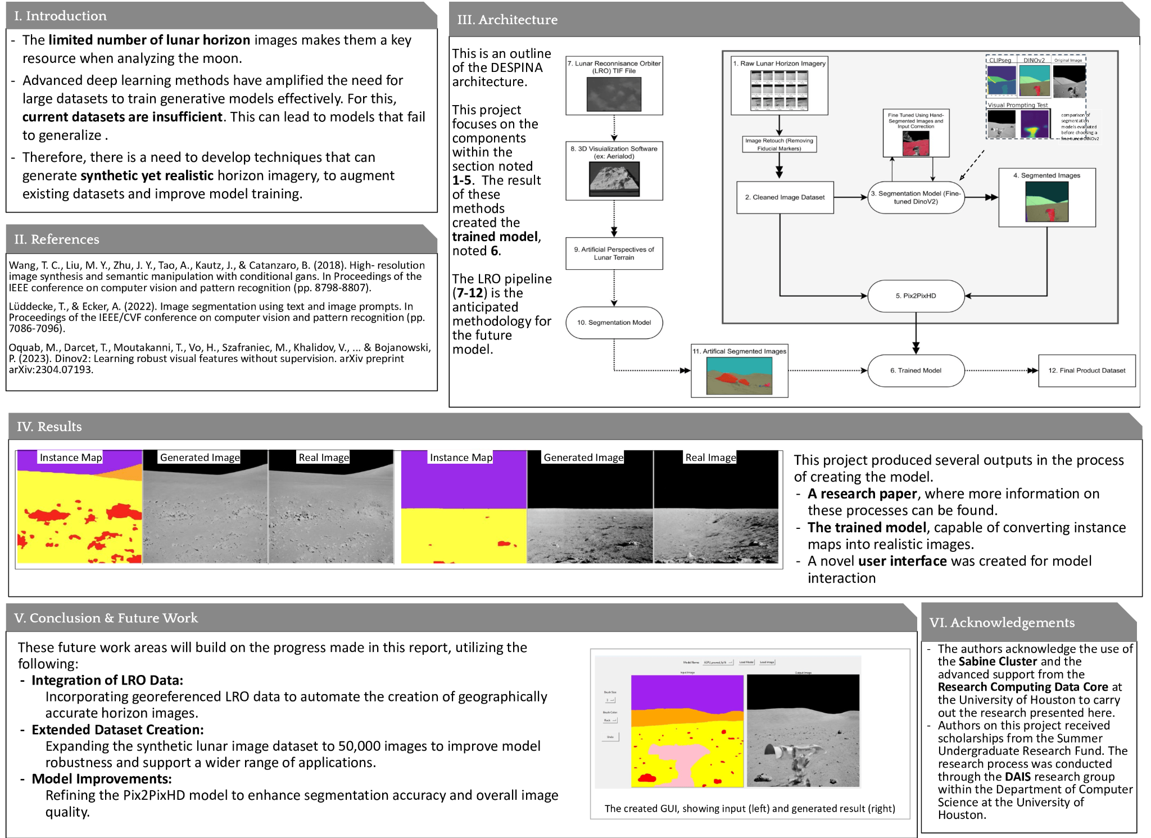

Slide 6
Related Spatial Dataset Mining
Task:
Given a set of spatial datasets over the same observation area; e.g. PM2.5 concentrations, burglary densities, and COVID-19 infection rates over Texas (point-wise functions over longitude and latitude)
Research Questions:
Explore different notions or relatedness: correlation, agreement in hotspots,…
Identify the degree of relatedness of pairs/groups of spatial datasets.
Analyze the role of thresholds in ‘relatedness’
Analyze delays and other temporal relationships with respect to ‘relatedness’
Develop methods to identify regional relatedness
Goal: Find interesting Hypotheses!
Possible Topic for UG Research: To conduct this research we need polygonal hotspot discovery/clustering algorithms which identify regions in a spatial dataset in which the point-wise function is about a particular threshold θ.
UH-DAIS

Slide 7
Collocation Mining Frameworks
Definition:
Spatial colocation patterns represent subsets of spatial events whose instances are often located in close geographic proximity. For example, car break-ins might often occur in close proximity to shopping malls.
Research Themes:
Density-based Collocation Mining Approaches
Algorithms to Discover Regional Collocation Patterns
Collocation Mining Involving Continuous Variables
Spatio-temporal Collocation Mining
UH-DAIS

Slide 8
Density-Related Research
Density Estimation
Evaluation of
Density-based
Clustering Results
Density-Based
Clustering Algorithms
Foundations
For Density-Based Algorithms

Slide 9
Density-Based Frameworks
Scope:
This research centers on the development of algorithms and frameworks which operate on density information or full-fledged density functions that has been created relying on naïve, parametric and non-parametric density estimation techniques. Application of such algorithms include clustering, outlier detection and association analysis. Developing novel density estimation techniques is part of this research as well.
Past Work:
In the last 20 years UH-DAIS developed 4 novel density-based clustering algorithms and a Density-Based Association Analysis Framework For Continuous Variable Collocation Mining. We also developed novel non-parametric density estimation techniques.
UH-DAIS

Slide 10
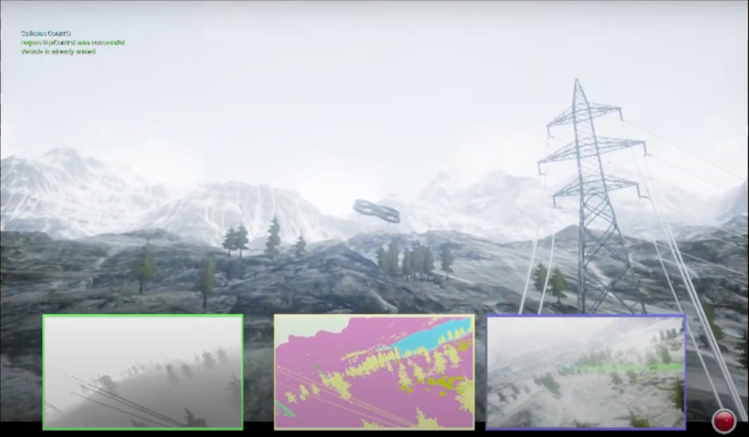
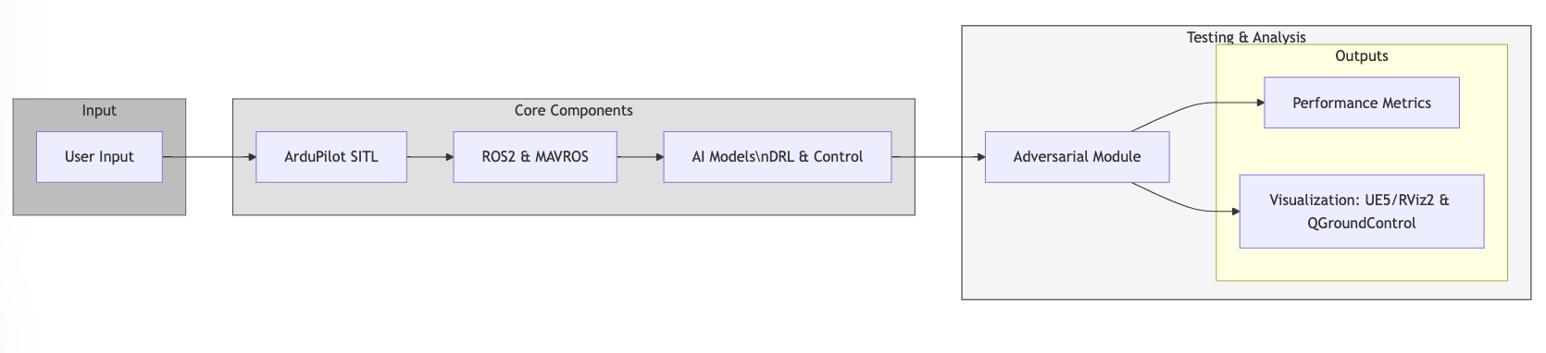
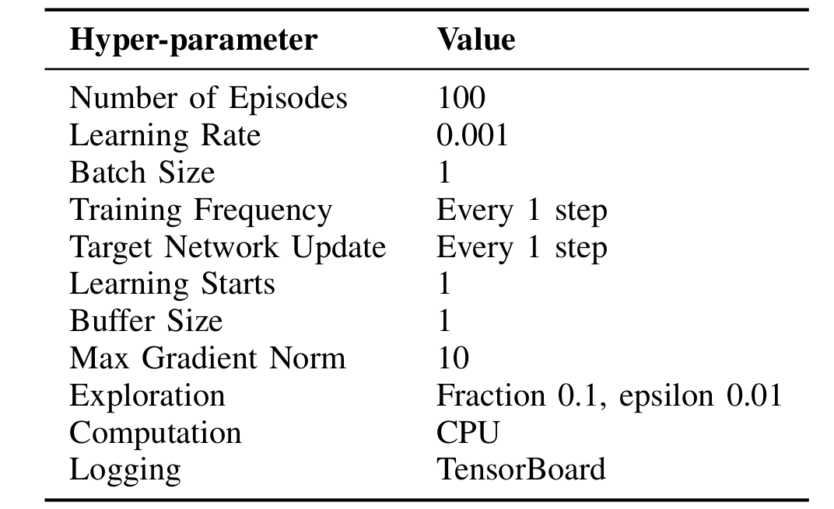
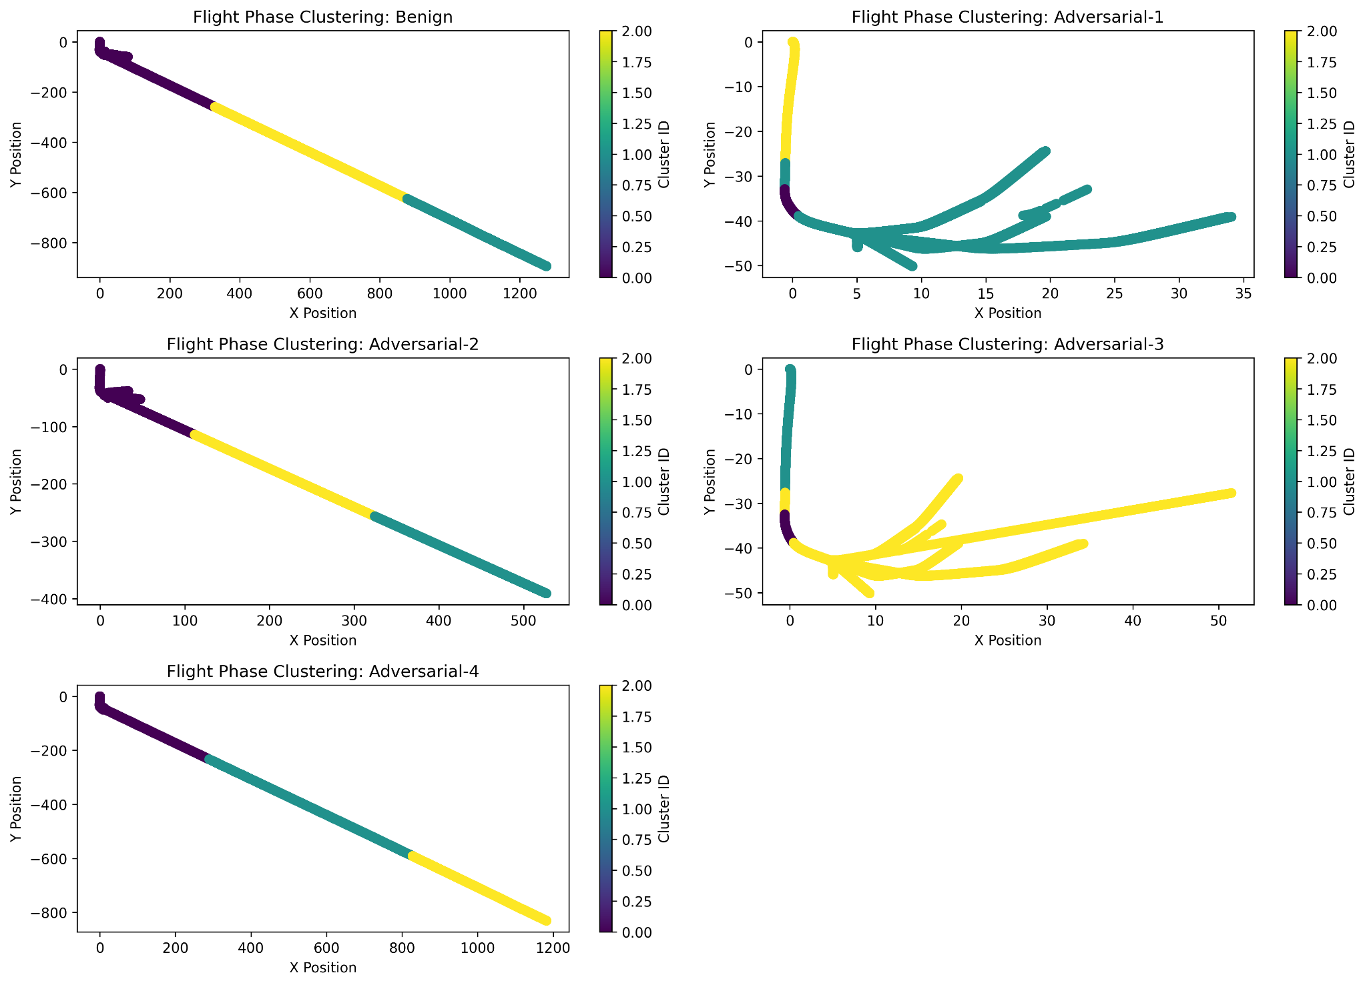
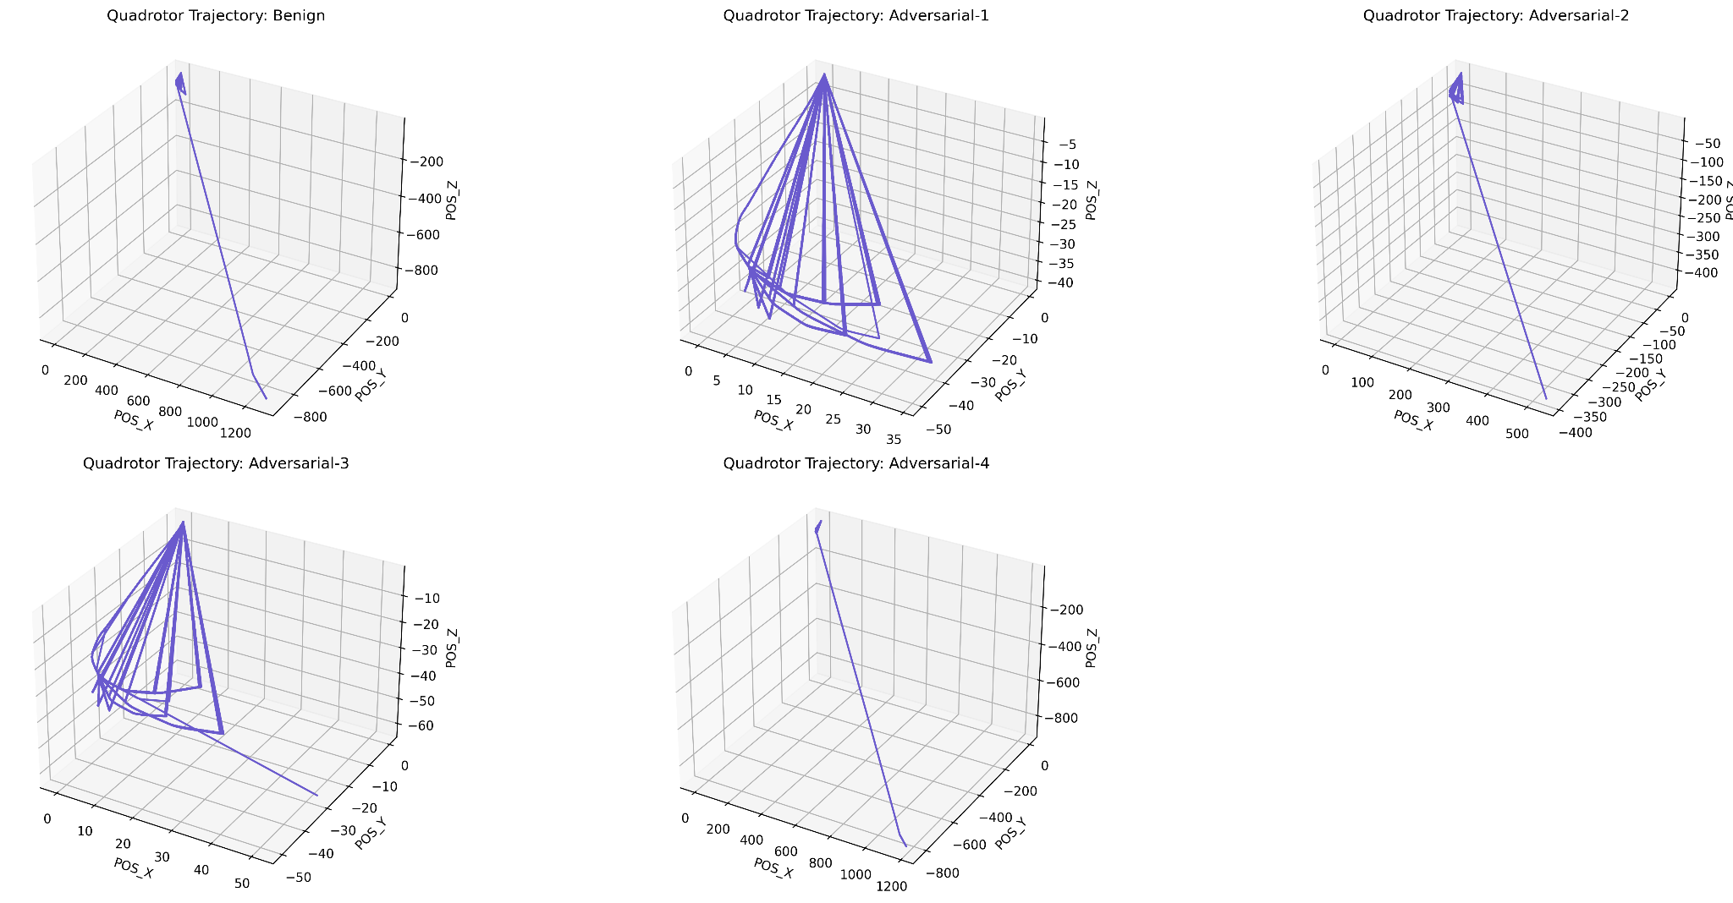
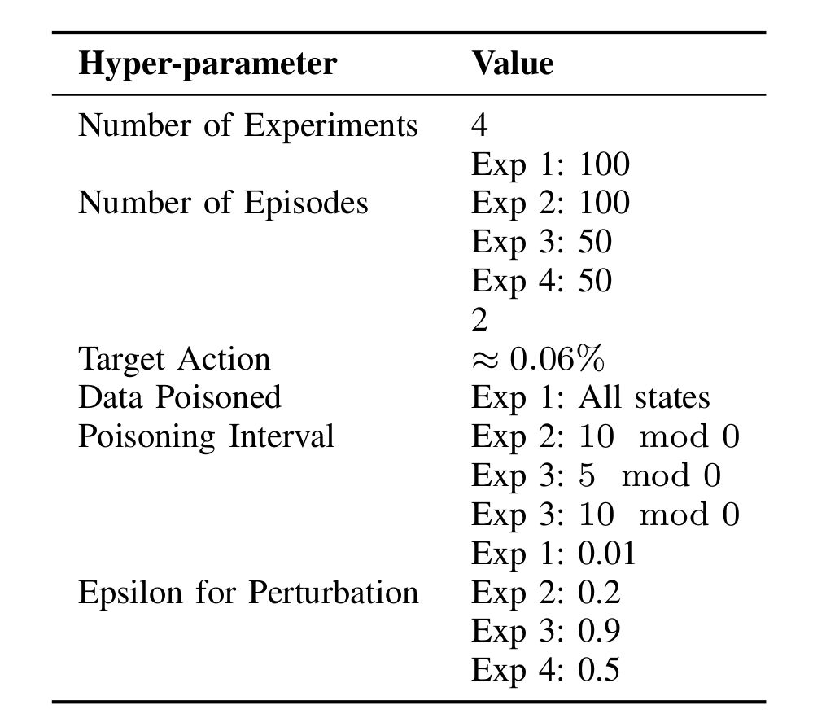
Autonomous and Distributed AI Testbed for
Drone Coordination and Collaboration
Jennifer Csicsery-Ronay and Dr. Christoph F. Eick
Department of Computer Science,
University of Houston
I. Motivation
II. System Architecture
Drones are increasingly deployed in disaster response scenarios such as search-and-rescue operations and post-disaster assessment. However, their autonomous AI models face significant challenges in real-world conditions such as adversarial threats and unpredictable environments.
Problem: Existing drone simulators focus on performance but lack adversarial testing capabilities.
Expected Contributions
A novel drone simulator for adversarial AI testing in single and swarm scenarios
Performance benchmarks under benign and adversarial perturbations
Open-source toolkit for AI researchers and industry professionals
ArduPilot SITL: Provides realistic flight dynamics and autopilot functionality.
ROS2 & MAVROS: Middleware enabling multi-drone communication and control.
AI Models Under Test: Deep reinforcement learning (DRL) and traditional control algorithms.
Adversarial Module: Injects perturbations such as gradient-aligned noise, sensor spoofing, communication latency.
Performance Metrics: Tracks drone resilience and response time.
Visualization Tools: UE5/RViz2 for 3D monitoring, QGroundControl for telemetry.
III. Methodology
Simulation Setup
Configure ArduPilot SITL for drone dynamics.
Integrate ROS2 & MAVROS for communication and control.
Develop simulation scenarios with varying environmental factors (wind, obstacles, network disruptions).
Control Development
Implement single-drone autonomous navigation and obstacle avoidance.
Develop swarm coordination strategies, including leader-follower and consensus-based decision-making models.
Train AI models using reinforcement learning for adaptability.
Adversarial Testing
Inject perturbations in:
Action Space: Manipulating control commands.
Observation Space: Sensor spoofing (GPS drift, IMU noise).
Communication Space: Introducing latency and packet loss.
Evaluate model resilience under adversarial conditions.
Performance Evaluation
Assess mission success, response time, and recovery effectiveness.
Compare AI models based on robustness and computational efficiency.
Generate insights to enhance AI reliability.
IV. Current Results: Single Autonomous Drone
K-means clustering based on position and orientation: POS_X, POS_Y, POS_Z, roll, pitch, and yaw.
Trajectory comparison across experiments. The trajectory is a path that defines where and when a UAV is expected to be along its flight

Slide 11
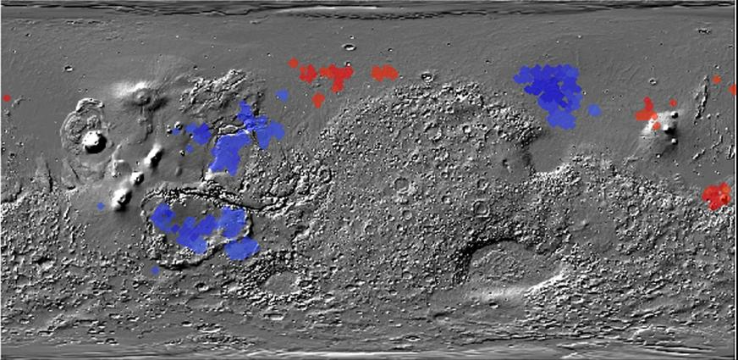
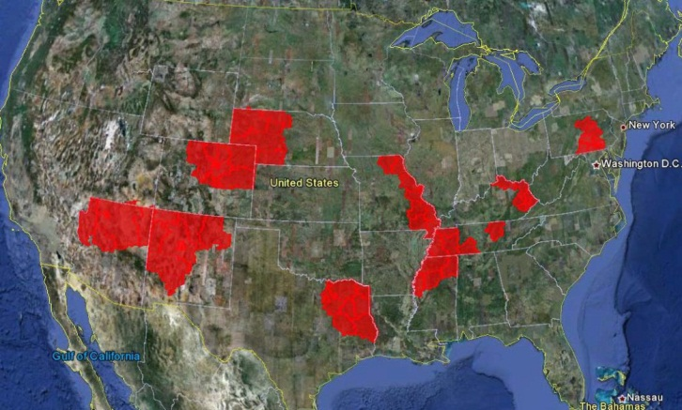
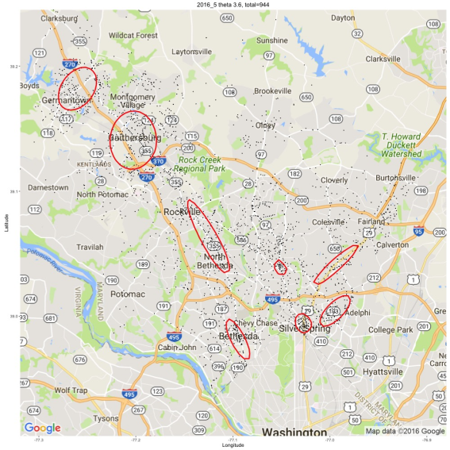
Helping Scientists to Make Sense Out of their Data
Figure 1: Co-location regions involving deep and
shallow ice on Mars
Figure 2: Interestingness hotspots where both income and CTR are high.
Figure 3: Maryland Crime Hotspots
UH-DAIS

Slide 12



Some UH-DAIS Graduates 1
Dr. Wei Ding, Associate Professor, Department of Computer Science, University of Massachusetts, Boston
Christopher T. Ryu, Professor,
Department of Computer Science, California State University, Fullerton
Sharon M. Tuttle, Professor,
Department of Computer Science,
Humboldt State University, Arcata, California
Sujing Wang, Associate Professor,
Department of Computer Science,
Lamar University, Beaumont, Texas
I graduated 19 PhD students and supervised 90+ MS Theses in my career!
Christoph F. Eick

Slide 13
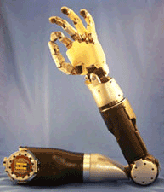

Some UH-DAIS Graduates 2
Yongli Zhang PhD Airbnb
Chun-sheng Chen PhD eBay
Puja Anchlia MS eBay
Chong Wang MS Apple
Justin Thomas MS John Hopkins University Applied Physics Laboratory
Mei-kang Wu MS Microsoft, Bellevue, Washington
Jing Wang MS AOL, California
Rachsuda Jiamthapthaksin PhD Faculty, Assumption University, Bangkok, Thailand
Christoph F. Eick

