Slide 1
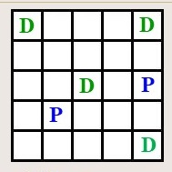
COSC 4368
Group Project Spring 2021
Learning Paths from Feedback Using Reinforcement Learning for a Transportation World

Slide 2




PD-World
Terminal State: Drop off cells contain 4 blocks each
Initial State: Agent is in cell (5,1) and pickup cells contain 8 blocks
(1,1)
(1,2)
(1,3)
(1,4)
(1,5)
Goal:
Transport
from pickup
cells to
dropoff cells!
(2,1)
(2,2)
(2,3)
(2,4)
(2,5)
(3,1)
(3,2)
(3,3)
(3,4)
(3,5)
(4,1)
(4,2)
(4,3)
(4,4)
(4,5)
(5,1)
(5,2)
(5,3)
(5,4)
(5,5)
Pickup: Cells: (3,5), (4,2) (contain 8 blocks initially)
Dropoff Cells: (1,1), (1,5), (3,3), (5,5) (capacity 4 blocks)

Slide 3
PD-World
Spring 2021
D
D
D
P
P
D
Operators‒there are six of them:
North, South, East, West are applicable in each state, and move
the agent to the cell in that direction except leaving the grid is not allowed.
Pickup is only applicable if the agent is in an pickup cell that
contain at least one block and if the agent does not already carry a block.
Dropoff is only applicable if the agent is in a dropoff cell that contains
less that 4 blocks and the agent carries a block.
Initial state of the PD-World: Each pickup cell contains 8 blocks and
dropoff cells contain 0 blocks; the agent always starts in position (5,1).

Slide 4
Rewards in the PD-World
Rewards:
Picking up a block from a pickup state: +13
Dropping off a block in a dropoff state: +13
Applying north, south, east, west: -1.

Slide 5
2021 Policies
PRandom: If pickup and dropoff is applicable,
choose this operator; otherwise, choose an operator
randomly.
PExploit: If pickup and dropoff is applicable, choose this
operator; otherwise, apply the applicable operator with the
highest q-value (break ties by rolling a dice for operators
with the same utility) with probability 0.80 and choose a
different applicable operator randomly with probability
0.20.
PGreedy: If pickup and dropoff is applicable, choose this
operator; otherwise, apply the applicable operator with the
highest q-value (break ties by rolling a dice for operators
with the same utility).

Slide 6
Performance Measures
Bank account of the agent
Number of operators applied to reach a terminal state from the initial state—this can happen multiple times in a single experiment!

Slide 7
State Space PD-World
The actual state space of the PD World is as follows:
(i, j, x, a, b, c, d, e, f) with
(i,j) is the position of the agent
x is 1 if the agent carries a block and 0 if not
(a,b,c,d,e,f) are the number of blocks in cells
(1,1), (1,5), (3,3), (3,5), (4,2), (5,5)
Initial State: (5,1,0,0,0,0,8,8,0)
Terminal State: (*,*,0,4,4,4,0,0,4) there a 4 of those
Remark: The actual reinforcement learning approach likely
will use a simplified state space that aggregates multiple states
of the actual state space into a single state in the reinforcement
learning state space.

Slide 8
Mapping State Spaces to RL State Space
Most worlds have enormously large state spaces or even non-finite state spaces.
Moreover, how quickly Q/TD learning learns is inversely proportional to the size of the state space.
Consequently, smaller state spaces are used as RL-state spaces, and the original state space are rarely used as RL-state space.
World State Space
Reduction
RL-State Space

Slide 9
“Simple” Reinforcement Learning State Space1
In this approach reinforcement learning states have the form (i,j,x) where:
(i,j) is the position of the agent
x is 1 if the agent carries a block; otherwise, 0.
That is the state space has only 50 states.
Discussion:
The algorithm initially learns paths between pickup states and dropoff states—different paths for x=1 or for x=0
Minor complication: The q-values of those paths will decrease is soon as the particular pickup state runs out of blocks or the particular dropoff state cannot store any further blocks, as it is no longer attractive to visit these locations.

Slide 10
Alternative More Complicated
Reinforcement Learning State Space2
Reinforcement learning states have the form (i,j,x,s,t,u,v) where
(i,j) is the position of the agent
x is 1 if the agent carries a block; otherwise, 0.
g, h, i are boolean variables whose meaning depend on, if the agent carries a block or not.
  Case 1: x=0 (agent does not carry a block)
    s is 1, if cell (3,5) contains at least one block
    t is 1, if cell (4,2) contains at least one block
    u is 0, irrelevant
    v is 0, irrelevant
  Case 2: x=1 (agent does carry a block)
    s is 1, if cell (1,1) contains less than 4 blocks
    t is 1, if cell (1,5) contains less than 4 blocks
    u is 1, if cell (3,3) contains less than 4 blocks
    v is 1, if cell (5,5) contains less than 4 blocks
There are100+400=500 states total in reinforcement learning state space2

Slide 11
Analysis of Attractive Paths
See also: http://horstmann.com/gridworld/gridworld-manual.html http://cs.stanford.edu/people/karpathy/reinforcejs/gridworld_td.html

Slide 12
TD-Q-Learning for the PD-World
Remark: This is the QL approach you must use!!!
Goal: Measure the utility of using action a in state s, denoted by Q(a,s); the following update formula is used every time an agent reaches state s’ from s using actions a:
Q(a,s) ← (1-α)∗Q(a,s) +
α∗[R(s’,a,s)+ γ*max_{a’}Q(a’,s’)]
α is the learning rate; γ is the discount factor
a’ has to be an applicable operator in s’; e.g. pickup and drop-off are not applicable in a pickup/dropoff states if empty/full! The q-values of non-applicable operators are therefore not considered!
R(s’,a ,s) is the reward of reaching s’ from s
by applying a; e.g. -1 if moving, +13 if picking
up or dropping blocks for the PD-World.

Slide 13
SARSA
S’
a
s
Approach: SARSA selects, using the policy π, the action a’ to be applied to s’ and then updates Q-values as follows:
Q(a,s) ← Q(a,s) +
α [ R(s) + γ*Q(a’,s’) − Q(a,s) ]
SARSA vs. Q-Learning
SARSA uses the actually taken action for the update and is therefore more realistic as it uses the employed policy; however, it has problems with convergence.
Q-Learning is an off-policy learning algorithm and geared towards the optimal behavior although this might not be realistic to accomplish in practice, as in most applications policies are needed that allow for some exploration.

Slide 14
4368 Group Project in a Nutshell
Policy
RL-System
RL-
Space
Learning
Rate α
Discount
Rate γ
Utility
Update
Q-Learning/SARSA
???
What design
leads to the
best performance?
RL-System
Performance

Slide 15
Suggested Implementation Steps
Write a function aplop: (i,j,x,a,b,c,d,e,f)→2^{{n,s,e,w,p,d}} that
returns the set of applicable operators in (i,j,x,a,b,c,d,e,f)
Write a function apply: (i,j,x,a,b,c,d,e,f)×{n,s,e,w,p,d}→
(i’,j’,x’,a’,b’,c’,d’,e’,f’)
Implement the q-table data structure
Implement the SARSA/Q-Learning q-table update
Implement the 3 policies
Write functions that enable an agent to act according to a policy
for n steps which also computes the performance variables
Develop visualization functions for Q-Tables
Develop a visualization functions for the evolution of the PD-World
Develop visualization functions for attractive paths
Develop functions to run experiments 1-4.

Slide 16
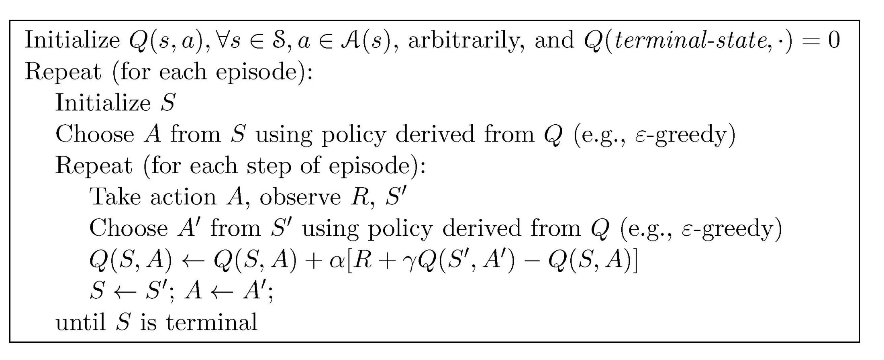
SARSA Pseudo-Code
S’
A
S

