Slide 1
COSC 6368 and “What is AI?”
Introduction to AI (today, and TH)
  What is AI?
  Sub-fields of AI
  Problems investigated by AI research
Course Information

Slide 2
Part1a: Definitions of AI
“AI centers on the simulation of intelligence using computers”
“AI develops programming paradigms, languages, tools, and environments for application areas for which conventional programming fails”
  Symbolic programming (LISP)
  Functional programming
  Heuristic Programming
  Logical Programming (PROLOG)
  Rule-based Programming (Expert system shells)
  Soft Computing (Belief network tools, fuzzy logic tool boxes,…)
  Object-oriented programming (Smalltalk)

Slide 3
More Definitions of AI
Rich/Knight: ”AI is the study of how to make computers do things which, at the moment, people do better”
Winston: “AI is the study of computations that make it possible to perceive, reason, and act.
Turing Test: If an artificial intelligent system is not distinguishable from a human being, it is definitely intelligent.
https://en.wikipedia.org/wiki/Turing_test
Eugene Goostman Winner 2014 Touring Test: https://en.wikipedia.org/wiki/Eugene_Goostman
Please read: http://www.zdnet.com/article/beyond-cortana-what-artificial-intelligence-means-for-the-future-of-microsoft/

Slide 4
Physical Symbol System Hypothesis
“What the brain does can be thought of at some level as a kind of computation”
Physical Symbol System Hypothesis (PSSH): A physical symbol system has the sufficient and necessary means for general, intelligent actions.
Remarks PSSH:
Subjected to empirical validation
If false → AI is quite limited
Important for psychology and philosophy

Slide 5
Questions/Thoughts about AI
What are the limitations of AI? Can computers only do what they are told? Can computers be creative? Can computers think? What problems cannot be solved by computers today?
Computers show promise to control the current waste of energy and other natural resources.
Computer can work in environment that are unsuitable for human beings.
If computers control everything --- who controls the computers?
If computers are intelligent what civil rights should be given to computers?
If computers can perform most of our work; what should the human beings do?
Only those things that can be represented in computers are important.
It is fun to play with computers.

Slide 6
Topics Covered in COSC 6368
More general topics:
  Expose to many search algorithm
  Probabilistic Reasoning
  Making sense out of data
AI-specific Topics:
  reasoning in uncertain environments and belief networks
  Heuristic search, Constraint Satisfaction Problems, and Games
  Learning from examples and reinforcement learning
  brief coverage of planning, evolutionary computing, and maybe Robotics
  Exposure to AI tools (belief networks, decision trees, ANN)

Slide 7
2016 Organization COSC 6368
August 23+25: 1. Introduction to AI (covers chapter 1 and chapter 2 in part) 1.5 lectures
August 25+30 September 1+8+13+15+20+22: 2. Problem Solving (covering chapter 3, 4 in part, 5, and 6 in part, centering on uninformed and informed search , adversarial search and games, A*, alpha-beta search, evolutionary computing, game theory (chapter 17 and other material), and solving constraint satisfaction problems, discussion course Project 1) 7.5 lectures
September 27+29: 3. Planning and Acting (covering chapters 10 and 11 in part) 1.5 lectures
September 29 October 4+6+11+20+25+27 Nov. 1: 4. Machine Learning (covering learning from examples (chapter 18), deep learning (extra material) and reinforcement Learning (chapter 21, chapter17 in part; Discussion Project2) 7.5 lectures
October 20: Discussion of Homework1 and Review for Midterm Exam
October 25: Midterm Exam
November 1+3+8+10+15+17: 5. Reasoning and Learning in Uncertain Environments (covers chapters 13, 14, 15 in part, and 20 in part, centering on “basics” in probabilistic reasoning, naïve Bayesian approaches, belief networks and hidden markov models (HMM)) 5.5 lectures
November 29: 6. Robotics (Chapter 25) 1 lecture
December 1: 7. Course Summary, Discussion of Homework and Review for the Final Exam
December 8, 2p: Final Exam

Slide 8
Positive Forces for AI
Knowledge Discovery in Data and Data Mining (KDD)
Intelligent Agents for WWW; multi-agent systems
Robotics (Robot Soccer, Robot Waiters, industrial robots, rovers, toy robots…)
Creating of Knowledge Bases and Sharing of Knowledge (especially for Science and Engineering)
Computer Chess and Computer Games in General --- AI for Entertainment
Automating human skills; e.g. driving; helping handicapped persons
Speech Recognition, Image Annotation
Internet of Things
Deep Learning
Intelligent “this and that”

Slide 9
6368 Homepage
http://www2.cs.uh.edu/~ceick/AI16.html
Algorithms Covered in COSC 6368
See Teaching Plan Word-file
Textbook Code Repository
https://github.com/aimacode
IJCAI 2016 Homepage
http://ijcai-16.org/index.php/welcome/view/home

Slide 10
Course Elements
∼23 Lectures
2 Exams (midterm and final exam)
2 Homeworks (review questions, exam style paper and pencil problems, and other small tasks that involve using AI-tools)
Medium-size Course Projects: Project 1: Search/Games and Project2: Reinforcement Learning require programming; can use language of your liking.
Discussion of homeworks
2 45 minute Reviews before the two exams
Each student gives a short 3-5 minute presentation about something
Will try to use demos and animations --- we have to see if this turns out to be useful; your input is appreciated!

Slide 11


AI
Knowledge Representation
Knowledge-based
and Expert Systems
Planning
Coping with Vague,
Incomplete and
Uncertain Knowledge
Searching
Intelligently
Logical Reasoning
& Theorem Proving
Communicating,
Perceiving and
Acting
Intelligent Agents
& Distributed AI
AI Programming
Learning & Knowledge Discovery

Slide 12
Part1b: Examples of Problems
Investigated by Different Subfields of AI

Slide 13
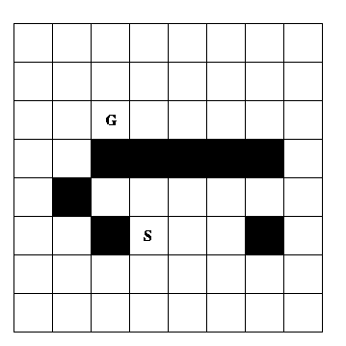
Knowledge Representation
Problem: Can the above chess board be cover by 31 domino pieces
that cover 2 fields?
AI’s contribution: object-oriented and frame-based systems, ontology
languages, logical knowledge representation frameworks, belief networks,
semantic web

Slide 14
Natural Language Understanding
I saw the Golden Gate Bridge flying to San Francisco.
I ate dinner with a friend. I ate dinner with a fork.
John went to a restaurant. He ordered a steak. After an hour John left happily.
I went to three dentists this morning.

Slide 15
Planning
Objective: Construct a sequence of actions that will achieve a goal.
Example: John want to buy a house
Characteristics of Planning:
Goals and Subgoals
Operators that potentially make goal predicate true
Parallelism
Dependency between goals / subgoals
Plan and sub-plans might fail, requiring plan modification

Slide 16
Heuristic Search
Heuristo (greek): I find
Copes with problems for which it is not feasible to look at all solutions
Heuristics: rules a thumb (help you to explore the more promising solutions first), based on experience, frequently fuzzy
Main ideas of heuristics: search space reduction, ordering solutions intelligently, simplifications of computations
Example problems: puzzles, traveling salesman problem, chess,…

Slide 17
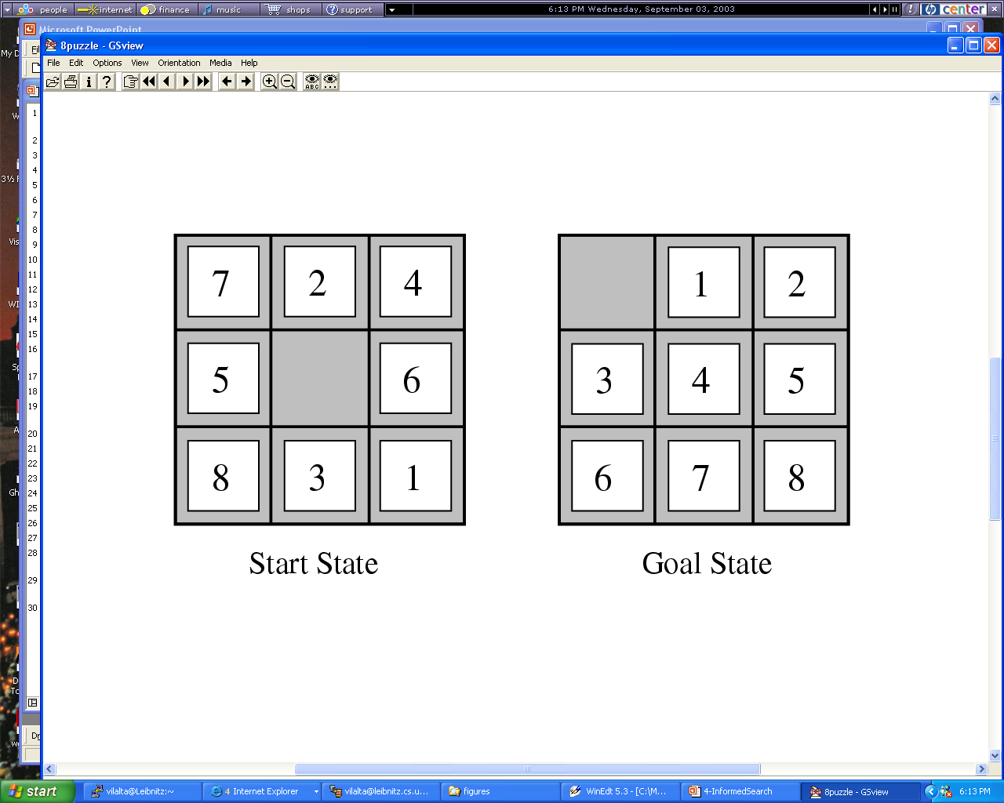
Figure

Slide 18
Evolutionary Computing
http://www2.cs.uh.edu/~ceick/6367/6367.html
Evolutionary algorithms are global search techniques.
They are built on Darwin’s theory of evolution by natural selection.
Numerous potential solutions are encoded in structures, called chromosomes.
During each iteration, the EA evaluates solutions adn generates offspring based on the fitness of each solution in the task.
Substructures, or genes, of the solutions are then modified through genetic operators such as mutation or recombination.
The idea: structures that led to good solutions in previous evaluations can be mutated or combined to form even better solutions.

Slide 19
Soft Computing
Conventional Programming:
Relies on two-valued logic
Mostly uses a symbolic (non-numerical knowledge representation framework)
Soft Computing (e.g. Fuzzy Logic, Belief Networks, Hidden Markov Models):
Tolerance for uncertainty and imprecision
Uses weights, probabilities, possibilities
Strongly relies on numeric approximation and interpolation
Remark: There seem to be two worlds in computer science; one views the world as consisting of numbers; the other views the world as consisting of symbols.

Slide 20
Different Forms of Learning
Learning agent receives feedback with respect to its actions (e.g. using a teacher)
  Supervised Learning/Learning from Examples/Inductive Learning: feedback is received with respect to all possible actions of the agent
  Reinforcement Learning: feedback is only received with respect to the taken action of the agent
Unsupervised Learning: Learning without feedback
Notes:
The last technology I like to introduce in today’s presentation are shared ontologies. Shared ontologies are important to standardize communication, and for gathering information from different information sources. Ontologies play an important role for agent-based systems.
Ontologies basically describe...

Slide 21
Machine Learning Classification-
Model Construction (1)
Classification
Algorithms
Training
Data
Classifier
(Model)
IF rank = ‘professor’
OR years > 6
THEN tenured = ‘yes’

Slide 22
Classification Process (2): Use the Model in Prediction
Classifier
Testing
Data
Unseen Data
(Jeff, Professor, 4)
Tenured?

Slide 23

Knowledge Discovery in Data [and Data Mining] (KDD)
Let us find something interesting!
Definition := “KDD is the non-trivial process of identifying valid, novel, potentially useful, and ultimately understandable patterns in data” (Fayyad)
Notes:
The first technology I like to …
The above picture is, in my opinion, a good description of the task of knowledge discovery in that it illustrates a huge search space that contains very very few interesting things, and if applied in practice, KDD is frequently like finding a needle in a hay stack, except that you are not sure what you are looking for...

Slide 24
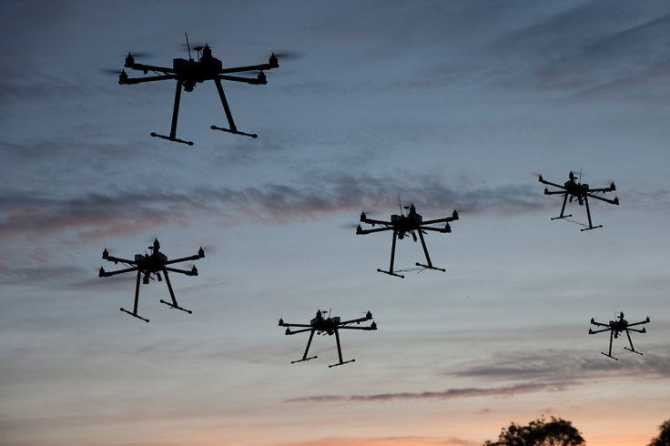
Flying SWARM Robots
http://arstechnica.com/science/2012/03/robots-swarm-the-stage-at-ted/
Watch First 2 minutes. 4:30, 10:15. 15:30
Requires:
  Planning
  Multi-Agent System and Distributed AI
  Search
  Reasoning in uncertain Environments
  Machine Leaning
  Computer Vision
  ……
Notes:
The first technology I like to …
The above picture is, in my opinion, a good description of the task of knowledge discovery in that it illustrates a huge search space that contains very very few interesting things, and if applied in practice, KDD is frequently like finding a needle in a hay stack, except that you are not sure what you are looking for...

Slide 25
2. General Course Information
Course Id: COSC 6368 Machine Learning
Time: TU/TH 2:30-4p
Instructor: Christoph F. Eick
Homepage: http://www2.cs.uh.edu/~ceick
Office Hours TU 4-4:45p TH 12:45-2p
TA Nguyen Pham
Office Hours TU TH
Classroom: CAM 101
E-mail: ceick@uh.edu
/

Slide 26
Prerequisites COSC 6368
Background
In general, the course is self-contained
Programming
  Some experience in writing programs with 200+ lines in some programming language (C, C++, Java,…)
  Basic knowledge of data structures (particularly trees and graphs); what is taught in an introductory undergraduate data structure course; e.g. COSC 2320
  basic data structures, complexity…
No knowledge of LISP, PROLOG and other AI languages is required
Ability to deal with “abstract mathematical concepts”
Basic knowledge of probability theory is helpful, but I will give a very basic review early November…
COSC 4345 prerequisite will not be enforced

Slide 27
Textbook
http://aima.cs.berkeley.edu/

Slide 28
Grading
2 Exams 54%
2 Homeworks 12%
2 Projects 30-32%
Attendance and Extra Credit 2-4%
Remark: Weights are subject to change
NOTE: PLAGIARISM IS NOT TOLERATED.

Slide 29
Exams
Will be open notes/textbook
Will get a review list before the exam
Exams will center (80% or more) on material that was covered in the lecture
Exam scores will be immediately converted into number grades
A few sample exams are available

Slide 30
COSC 6368: Important Dates for 2016
• October 15: Deadline Homework1
• October 6: Deadline Course Project1
• October 20: Review for Midterm Exam
• October 15: Midterm Exam
• November 18: Deadline Course Project2
• November 28: Deadline Homework2
• December 1: Review for Final Exam
• Th., December 8, 2p: Final Exam

Slide 31
Questionnaires
There will be a few questionnaires during the course of the semester, inquiring
Your programming experience and what languages you use…
Background knowledge from other courses
About your expectations
What things you like/ do not like when taking a course (e.g. making presentations, group project )
What do you think about the graduate program you are part of? What do you expect from the graduate program you are part of? What is important for you as a graduate student → COSC Graduate Committee

Slide 32
Other Things
There will be some group activities
Project1 should be available on Sept.4, and Homework1 should be available on Sept. 22, the latest
I am contemplating giving students small tasks that contribute to the course, and students will receive 2-3% credit for those tasks.

