Slide 1
Neural Network and Variational Autoencoders
Md Mahin

Slide 2
Neural Networks

Slide 3
Decisions and Knowledge
Decisions
Knowledge
Say you want to decide whether you are going to attend a festival this upcoming weekend. There are three variables that go into your decision
X1= Is the weather good? [0=bad,1=good]
X2= Does your friend want to go with you? [0=no,1=yes]
X3= Is it near public transportation? [0=no,1=yes]
Your Decisions Might be like this:
x1 | x2 | x3 | Y
0 | 0 | 0 | No
0 | 0 | 1 | No
0 | 1 | 0 | No
0 | 1 | 1 | No
1 | 0 | 0 | Yes
1 | 0 | 1 | Yes
1 | 1 | 0 | Yes
1 | 1 | 1 | Yes
Reference: Introduction to Neural Networks, Taylor B. Arnold, Yale Statistics

Slide 4
Visual Represntation
1
x1
Decision Boundary/ Hyperplane
0
1
x3
x2
1

Slide 5
How to Simplify It
Using Equations:
Y= 0, (x1*w1+ x2*w2+ x3*w3)+b< threshold
Y= 1, (x1*w1+ x2*w2+ x3*w3)+b>= threshold
If we replace individual variables using vectors, s.t.
X=[x1,x2,x3], W=[w1,w2,w3], B=[b1,b2,b3][B is bias, that shift the plane towards origin]
Y= 0, XW+B< 0
Y= 1, XW+B>= 0
The same hyperplane is applied to logistic regression

Slide 6
What is a Neuron
Perceptron
How it works

Slide 7
How the Activation Function Works (An Example with Sigmoid Function)
Normal activation function will just through 0 or 1. If value does not cross a threshold it will through 0 else 1.
When we use Sigmoid function. For a particularly positive or negative value of x . w + b, the result will be nearly the same as with the perceptron (i.e., near 0 or 1). For values close to the boundary of the separating hyperplane, values near 0.5 will be emitted.
Many more activation functions available, that you can use based on your need.
hyperbolic tan, rectified linear unit, leaky rectified linear unit, maxout

Slide 8
Neural Network
Problem with single perceptron is, if you have very high dimensional data, it will not work.
For example you have 784 variables (pixels) from image. Your hyperplane need to be very complex
In such cases you have to use networks of perceptron's or neurons

Slide 9
A network of perceptrons
What is Happening
Neural Network
If you see individual neural level:
They become active or deactivate based on inputs
When we see at layer level:
A layer is allowing a group of features
In this particular example our hidden layers are actually separating features. As a result, 2nd layer sees less feature than input layer, and 3rd layer sees less feature than 2nd layer, and output layer only get features that will help it to make a very simple decision

Slide 10
How they learn
Cost Function/ Loss Function
Basically we train a network
During the training process, we give it a input x and let it generate an output y~.
We know the real output y. Using that we calculate the error or loss, and back-propagate it to every neuron, use gradient descent to adjust there weights so we make less error next time
A search algorithm

Slide 11
Functions
Cost Functions
Gradient Descent

Slide 12
Question
Can you relate how the search algorithms you learnt so far work here?

Slide 13
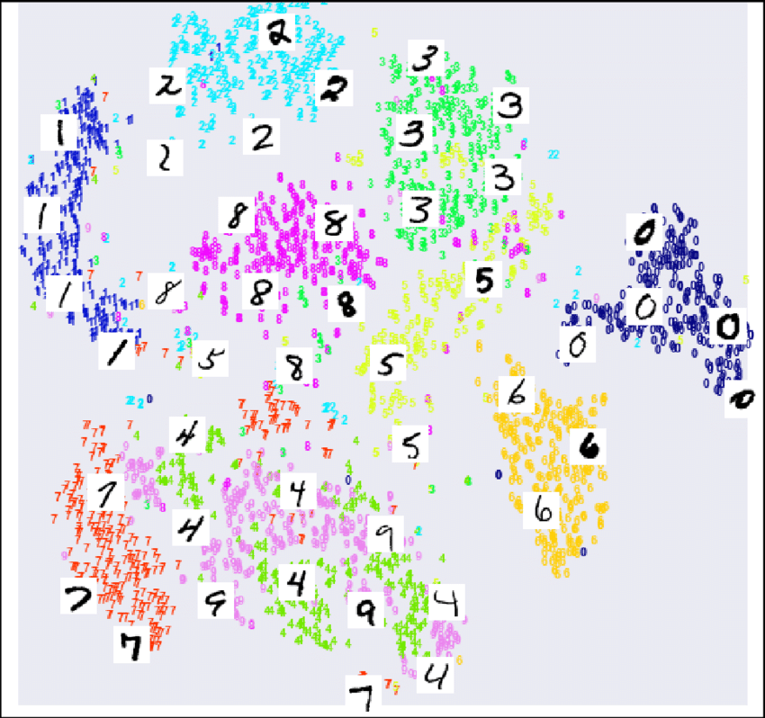
Why Neural Networks
Consider the MNIST digit dataset, you need a very complex model to learn different characters hyperplane.
Due to complex nature, automatic feature selection capability from loss, Neural Network is very good at this
Other classifiers can also do these, but you may need to do a lot of feature engineering [In NN hidden layers doing that automatically]
Simplified Representation in 2D

Slide 14
Autoencoders

Slide 15
Autoencoders
An autoencoder is a feed-forward neural net whose job it is to take an input x and reconstruct x.
To make this non-trivial, we need to add a bottleneck layer whose dimension is much smaller than the input.
Basically, what is happening here, we are reducing 784 dimension input to only 20 dimension.
We are compressing features, only trying to keep important ones
Next we are trying to reproduce that using only those important ones

Slide 16
Real Life Similarity
You take a picture (3D-> 2D)
Create a 3D print from the 2D plot

Slide 17
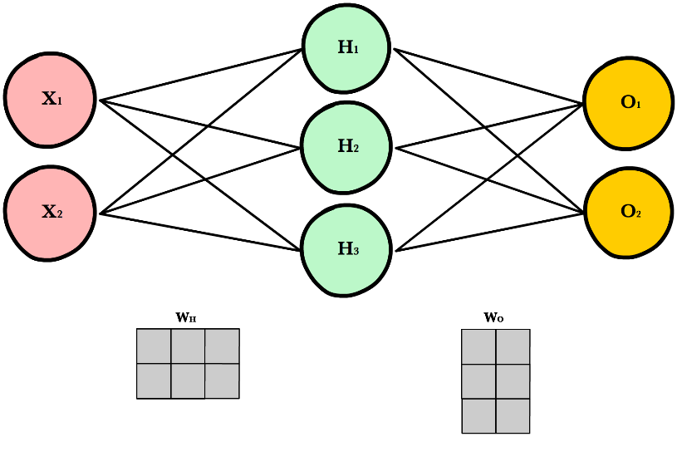
How Autoencoders Works
x: Input vector or array
$\hat{x}:$ Output vector or array
V: A matrix of weights. For example if D has 3 neurons, K has 2 neuron, for every connection there will be a weight and it is a 3 * 2 weight matrix
U: Another matrix of weights. For example if D has 3 neurons, K has 2 neuron, for every connection there will be a weight and it is a 2 * 3 weight matrix

Slide 18
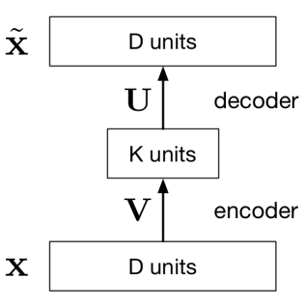
How it works
Vx: A matrix multiplication project D dimensional x to k dimensional plane. Shown for 3 to 2. Dimensionality Reduction
Ux : Project k dimensional hidden unit to D dimensional $\hat{x}$
Overall Output is: $\hat{x}=UVx$ [A linear function]
How it learn:
Learn the U, V matrix or all weights so that we get minimum loss
L(x, $\hat{x})={|\left|x−\hat{x}\right||}^{2}$
We minimize L to learn U,V

Slide 19
Why Autoencoders?
Map high-dimensional data to two dimensions for visualization
Compression
Learn abstract features in an unsupervised way so you can apply them to a supervised task
Unlabled data can be much more plentiful than labeled data
Learn a semantically meaningful representation where you can, e.g., interpolate between different images.

Slide 20
Some limitations of autoencoders
They’re not generative models, so they don’t define a distribution
How to choose the latent dimension?

Slide 21
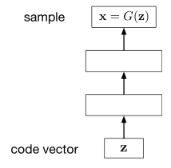
Generative Models
One of the goals of unsupervised learning is to learn representations of images, sentences, etc.
A generative model is a function of representation z.
X= G(z) [G is the generator function]
Example: VAE, GAN

Slide 22
How Learning Distribution Help
Normal AE
VAE

Slide 23
Example
You reduced 784 pixel character images to 20 dimension using a normal autoencoder and a VAE
Normal encoder part is giving you a 20 dimensional mean value (or just the cluster center). So when decoder will reproduce, it will be some sample near that mean
But, in VAE it is giving you a variance also. So, basically now you can generate some sample you did not even see (due to variance), but will also be similar to an image cluster
Example from 2D cluster at page 12

Slide 24
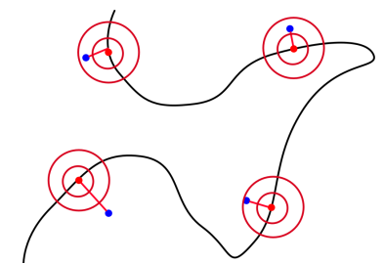
How VAE Learn Distribution
VAE based on variational inference
Decoder does is calculate p(z|x)= p(x,z)/p(x)
What generator part does is:
$p(x)=\int{p\left(z\right)p\left(x | z\right)dz}$
A noisy observation model is learnt
$p(x|z)=N(x;G_{θ}\left(z\right),ηI)$
$θ$ is μ and α learnt by the decoder

Slide 25
How VAE Learn Distribution(Not Covered)
Direct computation of p(x) is costly
It introduce a further function to approximate the posterior distribution as
$q_{ϕ}(z|x)≈p_{θ}(z|x)$
Approximate q(z) which is known to p(z|x)
the idea is to jointly optimize the generative model parameters $θ$ to reduce the reconstruction error between the input and the output and $ϕ$ to make $q_{ϕ}(z|x)$ as close as $p_{θ}\left(z | x\right)$
Min $D_{KL}(q_{ϕ}(.|x)||p_{θ}(.|x))$
It uses KL divergence to make the parameters similar and define new loss function using ELBO method that does both task at the same time
$L_{θ,ϕ}\left(x\right)=\log{p_{θ}\left(x\right)−D_{KL}(q_{ϕ}(.|x)||p_{θ}(.|x))}$

Slide 26
Reparameterization Trick(Not Covered)
Back propagation won’t work on random node z (if we think it as just distribution)
So z is made into two deterministic node for mean and std and random part separated as Gaussian error

Slide 27
Class Conditional VAE(Not Covered)
A class-conditional VAE provides the labels to both the encoder and the decoder.
Since the latent code z no longer has to model the image category, it can focus on modeling the stylistic features

Slide 28
References
Variational Autoencoder Lacture by Roger Grosse and Jimmy Ba [CSC421/2516 Lecture 17: Variational Autoencoders ]
Variational Autoencoder Wikipedia: CSC421/2516 Lecture 17: Variational Autoencoders
Ali Ghodsi, Lec : Deep Learning, Variational Autoencoder [https://www.youtube.com/watch?v=uaaqyVS9-rM]

