Slide 1
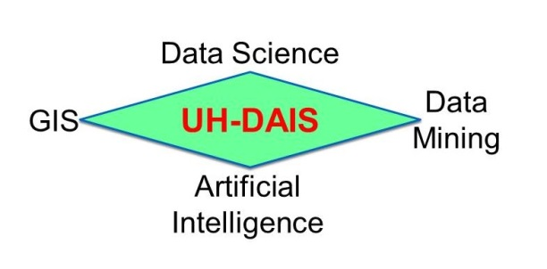
Christoph F. Eick

Slide 2
UH-DAIS Research Projects 1/22-12/22
Spatial and Spatio-temporal Data Analysis Frameworks
Mining Related Datasets and Association Analysis
Happiness Analysis Based on Tweets and Other Text Documents
AI for Better MRI-Scanning and Analysis (with Dr. Tsekos)
Educational Data Mining (lead by Dr. Rizk)
Crowdsourcing after Disasters with Blockchain (with Dr. Laszka)
Pre- and Post-Disaster Planning for the Houston Foodbank (with Dr. Laszka and Kakadiaris)
Analyzing the Causes and Effects of COVID-19
Social Media, Anxiety and COVID-19
Models for Infectious Disease Spread
Christoph F. Eick

