Slide 1




Norma: A Framework for Finding Threshold
Associations Between Continuous Variables Using
Point-wise Function
Md Mahin
Ph.D. (Completed requirements)
Department of Computer Science, University of Houston
mdmahin3@gmail.com
Dr. Christoph F. Eick
Associate Professor
Director, UH Data Analysis and Intelligent Systems Lab (UH-DAIS)
CEick@central.uh.edu
Department of Computer Science, University of Houston

Slide 2
Table of Content
1
Scope of the Research
2
Introduction to Point-wise Functions
3
Research Domain, Gaps , Questions and Contributions
4
Framework Components: CVT patterns, and Interestingness Measures
5
Case Study
6
Novel Grid-based Hotspot Discovery Algorithm
7
Conclusion and Broader Impact
12/17/2024

Slide 3
Scope of the Research
How strongly are values above different thresholds from spatial continuous variables related?
What is the association score for the following patterns?
  Pattern 1: {(COVID-19 Infection Rate 0.15) (PM2.5 8)}
  Pattern 2: {(COVID−19 Infection Rate 0.4), (Median Income 70000), (Poverty Rate 25)}
How can we calculate associations across all possible thresholds?
Note: Infinite thresholds are possible for any continuous variable.
A Novel Framework that define and utilizes point-wise functions.
Calculates the association strength between two point-wise functions above two thresholds.
  Pattern: {($Ψ_{\text{COVID}\text{−19 }\text{Infection} \text{Rate}}$ 0.15) ($Ψ_{\text{PM}\text{2.5}}$ 8)}
12/17/2024

Slide 4

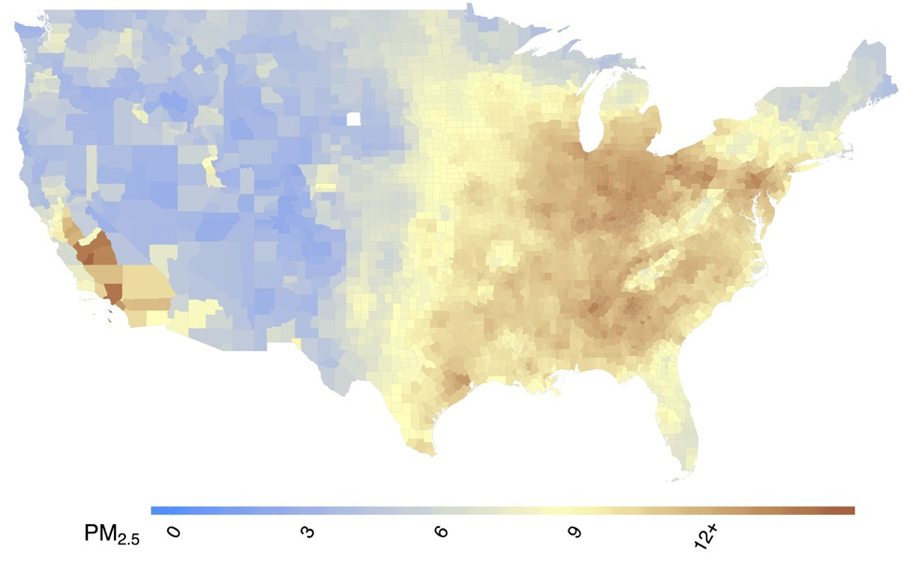
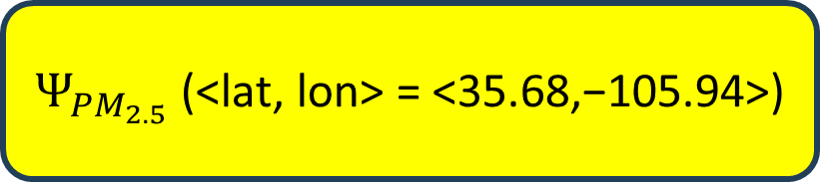
Workflow of Point-wise Functions ($Ψ_{\text{v}}$)
Maps a geographic location (l) to its corresponding value for a spatial variable (v)
$Ψ_{{PM}_{2.5}}$ (<lat, lon> = <35.68,−105.94>)
Density functions (Continuous/Discrete Point Events)
Interpolation functions (Continuous Point Events)
Polygonal functions (Continuous Point Events within
Polygons)
3
Captures heterogeneity in spatial data

Slide 5
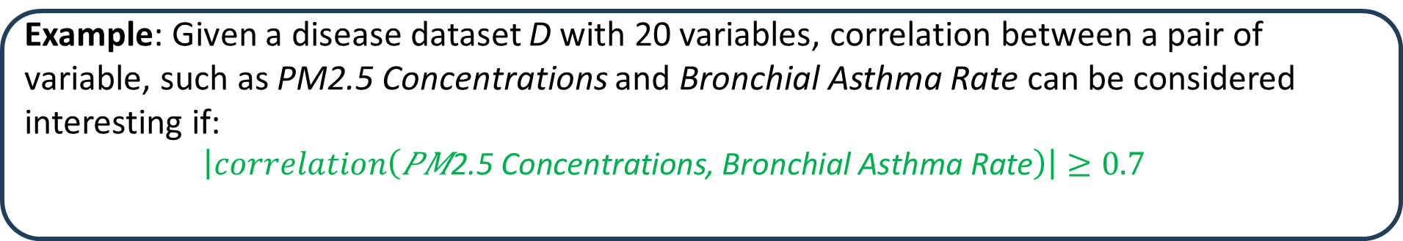
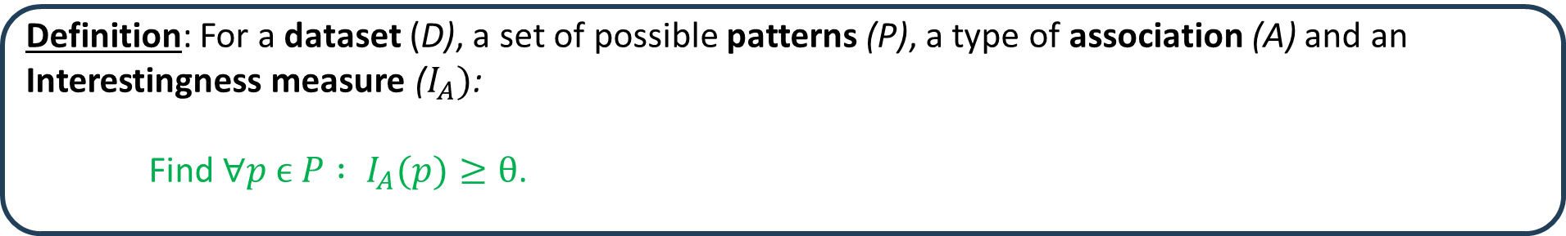
Research Domain: Association Analysis
Definition: For a dataset (D), a set of possible patterns (P), a type of association (A) and an Interestingness measure ($I_{A})$:
    Find ∀$p ϵ P : I_{A}(p)≥θ$.
  Example: Given a disease dataset D with 20 variables, correlation between a pair of variable, such as PM2.5 Concentrations and Bronchial Asthma Rate can be considered interesting if:
    $$\left|correlation\left(\text{PM}\text{2.5 }\text{Concentrations}\text{, }\text{Bronchial} \text{Asthma} \text{Rate}\right)\right|≥0.7$$

Slide 6
Research Gap
No method exists to assess associations among multiple continuous variables in spatial data.
  Measures from spatial statistics are primarily univariate.
  Extended measures, like bi-variate Moran I, need to categorize values to measure associations.
    As agreement among continuous values are not measured, impossible to find how different subset of values are related.
    Extended measures are limited to two variable association.

Slide 7
Research Questions
Problem 1: Scarcity of association measures for continuous variables in the literature
  Existing measures, like Correlation and Bivariate Moran’s I, have limited capabilities.
  Question: Can their capabilities be extended?
Problem 2: Measures like Correlation and Moran I cannot identify associations among subsets of values from two continuous variables
  Question: How can we uncover interesting associations among subsets of values using threshold-based frameworks?

Slide 8
Contributions
Proposed Continuous Variable Threshold (CVT) patterns.
Developed a novel interestingness measures to identify spatial associations among values above thresholds.
Introduced threshold-independent relatedness measures using CVT patterns.
Conducted a case study to demonstrate the characteristics and effectiveness of the proposed measures.

Slide 9
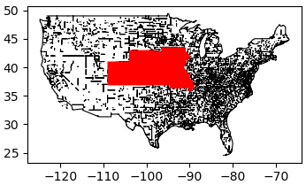
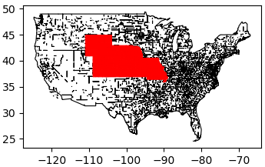
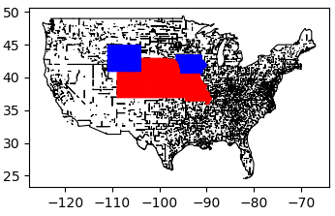
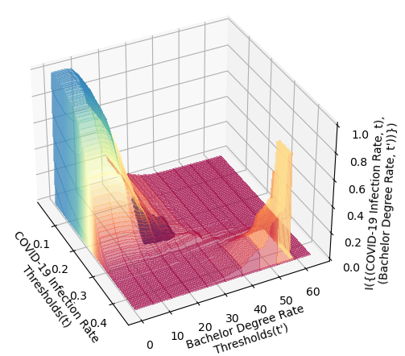



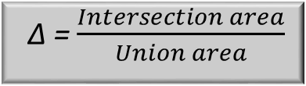
Continuous Variable Threshold (CVT) Pattern Mining
Intuition : Hotspots from point-wise functions will align spatially.
Objective : Identify agreement among hotspots/regions with values exceeding respective thresholds from point-wise functions.
Interestingness Measure I
  I({(v t), (v′ t′)}) = ∆(H($Ψ_{\text{v}}$, t), H($Ψ_{\text{v}\text{′}}$, t′))
H($Ψ_{\text{v}}$, t)
H($Ψ_{\text{v}\text{′}}$, t’)
Union & Intersection
Agreement ∆
  I = 0.30
  ∆ = $\frac{Intersection area}{Union area}$
  30% agreement
Association for all Thresholds

Slide 10
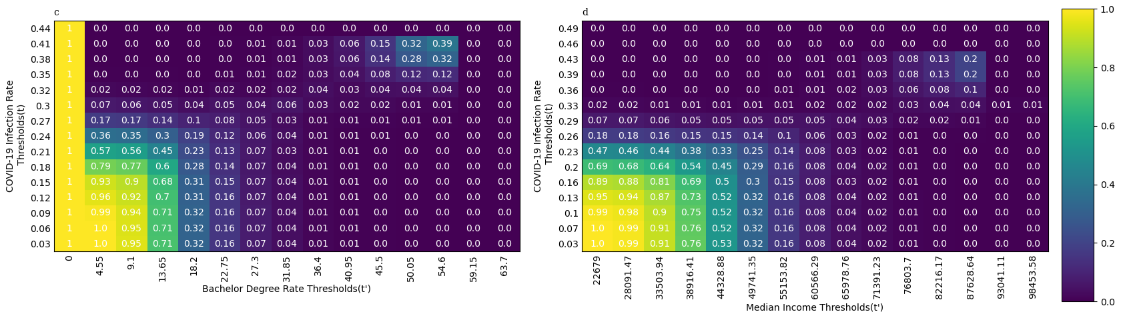
Key Characteristics of the Interestingness Measure
Local Maxima
Low Support Patterns
Global Maxima
Trivial Patterns
Trivial Patterns: Hotspots that cover nearly 100% of the area are not meaningful.
  Hotspot coverage should be limited to <= α.
Low Support Patterns: Hotspots covering near 0% of the area lack significance.
  Hotspot coverage should be at least ≥ β.

Slide 11
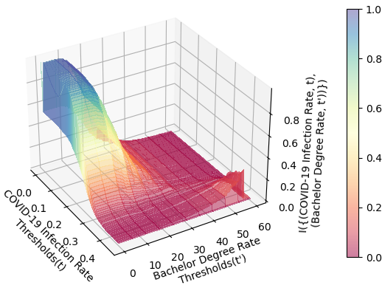
Computationally Efficient Interestingness Measure
Replace hotspot generation with the counting of points exceeding threshold t.
Approximate Interestingness I’(p) = $\frac{Intersection of total thresholds above t,t′}{Union of total thresholds above t,t′}$ =$\frac{count((Ψ_{\text{v}}≥t) \bigwedge{(Ψ_{\text{v}\text{′}}}≥t′))}{count({(Ψ}_{\text{v}}≥t)⋁(Ψ_{\text{v}\text{′}}≥t′)) }$
Without Approximation
With Approximation
Difference

Slide 12
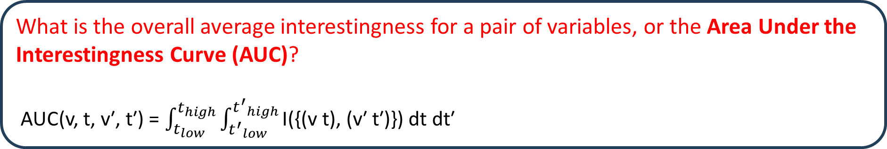
Threshold Independent Variable Relatedness
What is the overall average interestingness for a pair of variables, or the Area Under the Interestingness Curve (AUC)?
AUC(v, t, v′, t′) = $\int_{t_{low}}^{t_{high}}{\int_{{t^{′}}_{low}}^{{t^{′}}_{high}}{\text{I}\text{(\{(}\text{v} \text{t}\text{), (}\text{v}\text{′ }\text{t}\text{′)\}) }\text{dt} \text{dt}\text{′} }}$

Slide 13
Case Study
Data Source: John Hopkins Covid-19 data repository and New York Times Covid-19 data repository
Data Scope: Twenty County level variables from whole contiguous USA
Total Patterns Analyzed: 234,964 (from 190 possible pairs)
Compared against: Pearson Correlation, Bi-variate Moran I
Variable: Bachelor Degree Rate, Average Precipitation, Average Temperature, Population Density, Household Density, Unemployment Rate, Agriculture Employee Percentage, Mining Employee Percentage, Construction Employee Percentage, Manufacturing Employee Percentage, Trade Employee Percentage, Transportation Employee Percentage, Technology Employee Percentage, Fire Services Employee Percentage, Service Providing Employee Percentage, Government Employee Percentage, Median Income, Poverty Rate, COVID19 Infection Rate, COVID-19 Death Rate

Slide 14
What Area Under the Curve (AUC) Tells Us?
Pattern No | Pattern | Pearson Correlation | Bi-variate Moran I | AUC
Pattern 1 | {(Population Density t),(Household Density t′)} | 0.99 | 0.6 | 0.38
Pattern 2 | {(Trade Employee Rate t),(Household Density t′)} | -0.04 | -0.02 | 0.1
Pattern 3 | {(Population Density t),(Average Precipitation t′)} | 0.04 | 0 | 0.14
Similarity with Traditional Measures : Pattern 1 shows the highest agreement with the AUC measure among 190 pairs, similar to the pair's correlation and Moran's I values.
CVT Reveals Hidden Associations
  Pearson Correlation and Bi-Variate Moran I show no association for Pattern 2 and Pattern 3, yet our CVT measure uncovers a 10% and 14% average hotspot agreement.
  Linear relationships and spatial statistics often miss small subset value level spatial associations, which are successfully captured by CVT association.
Broader Association Measurement Scope: The CVT measure analyzes associations at individual thresholds, uncovering relationships across numerous subsets of values from two continuous variables that other methods cannot detect.

Slide 15
How Different these Measures are Themselves?
Pattern | Pearson Correlation | Bi-variate Moran I | AUC
{(Population Density t),(Household Density t′)} | 190 | 190 | 190
{(Trade Employee Rate t),(Household Density t′)} | 122 | 125 | 172
From high value to low value
Measure 1, Measure 2 | Rank Correlation
Pearson Correlation, AUC | 0.74
Bi-Variate Moran I, AUC | 0.73
High positive correlation indicating similar type of ranking
Slight difference indicates new knowledge

Slide 16
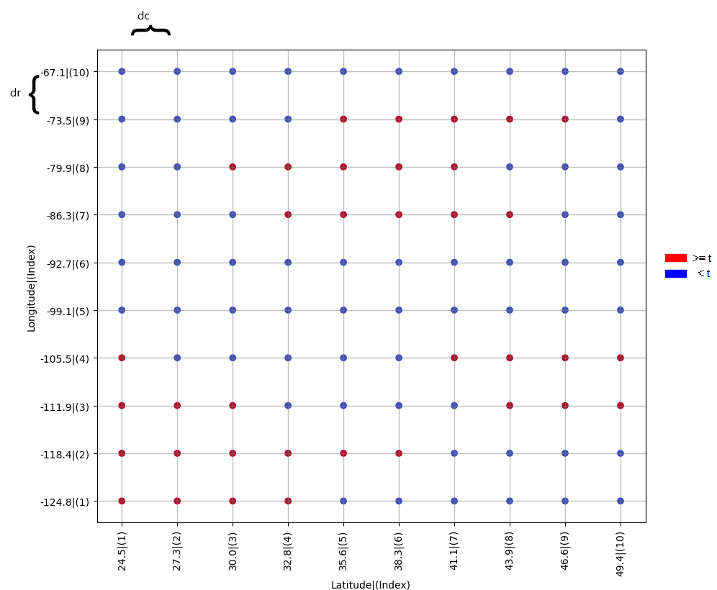
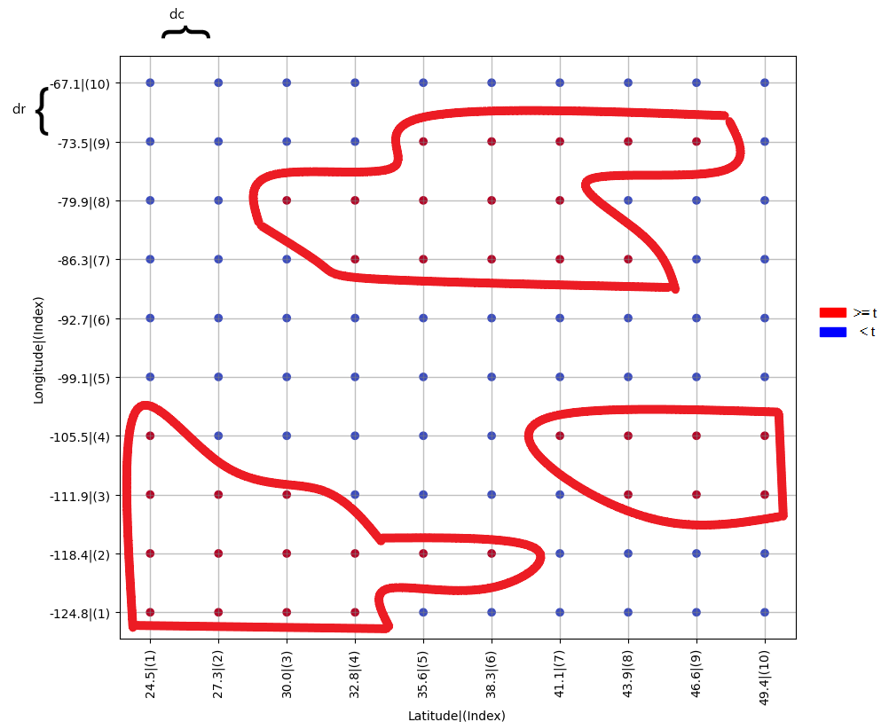
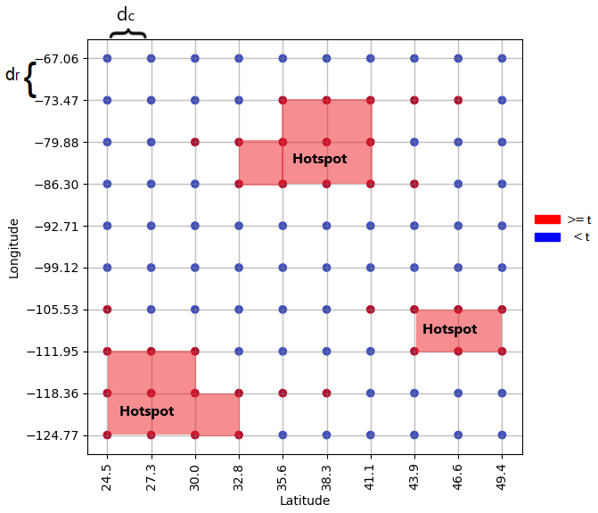
Hotspot Discovery Algorithm
Intuition : We need to cluster sample representative points, while keeping the shape of the clusters regular.
dr or dc distance between neighbors
If two neighbors are above t they are connected
Returns union of cell polygon as hotspot
Grid points with point-wise functions above or below thresholds
Finds connected set of points
Generate polygon if all points in a cell are above thresholds

Slide 17
Conclusion
Proposed a novel framework for association mining using point-wise functions, introducing a new class of continuous variable threshold patterns, new interestingness measures, and a unique hotspot discovery algorithm.
Provides insights similar to traditional measures while capturing unique associations overlooked by them.
12/17/2024

Slide 18
Broder Impact
Public Health: Detecting thresholds indicating high cancer associated strongly with high PM2.5 threshold
Environmental Science: Understanding how temperature thresholds influence humidity dynamics
Urban Planning and Policy Making: Finding associations between high crime thresholds and low security infrastructure density in different regions
12/17/2024

Slide 19
Thank You! Questions?
Contact Information:
Email: mdmahin3@gmail.com
LinkedIn: linkedin.com/in/mmahin
12/17/2024

