Slide 1
Optimization Tutorial
From: Pritam Sukumar & Daphne Tsatsoulis
CS 546: Theory of Machine Learning
1

Slide 2
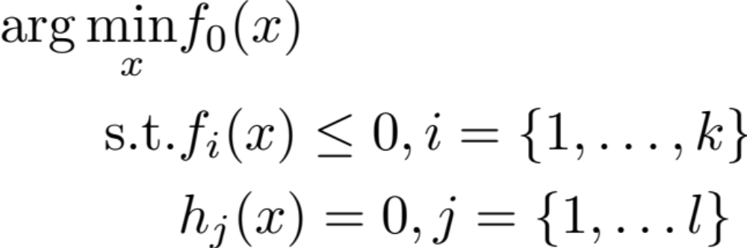
What is Optimization?
Find the minimum or maximum of an objective function given a set of constraints:
<number>

Slide 3
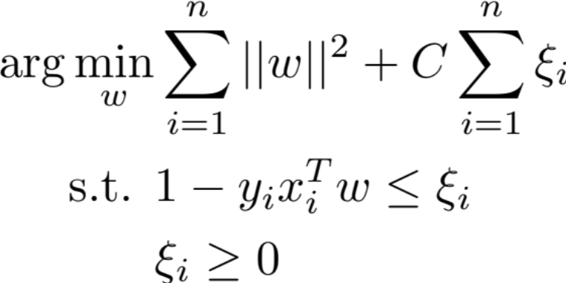
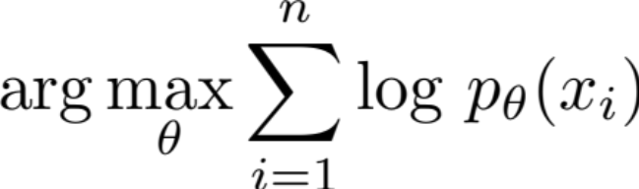
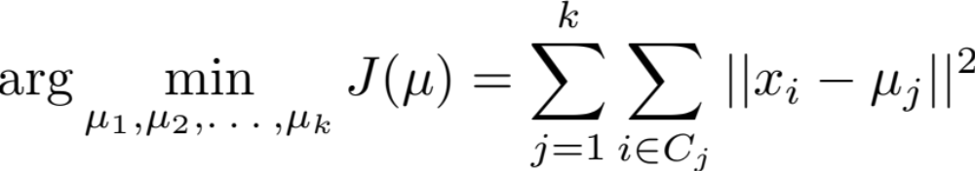
Why Do We Care?
Linear Classification Maximum Likelihood
K-Means
<number>

Slide 4
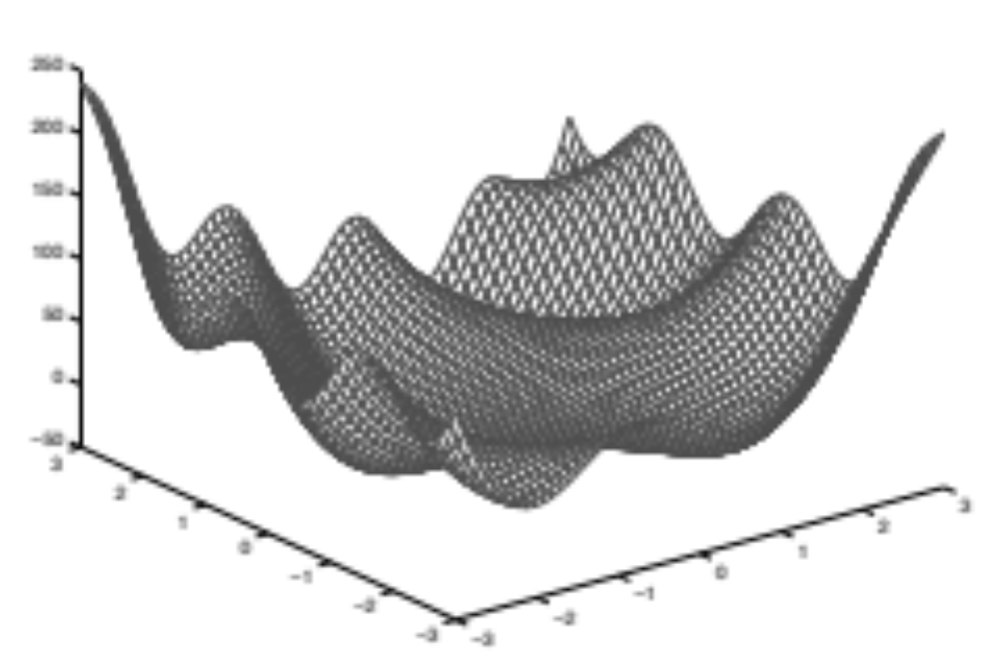
Prefer Convex Problems
Local (non global) minima and maxima:
<number>

Slide 5
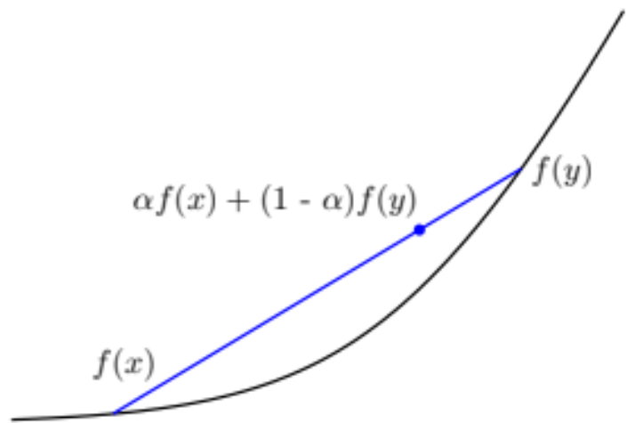
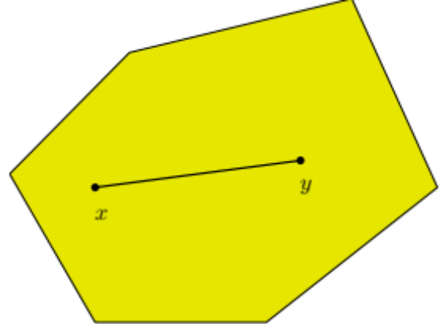

Convex Functions and Sets
<number>

Slide 6
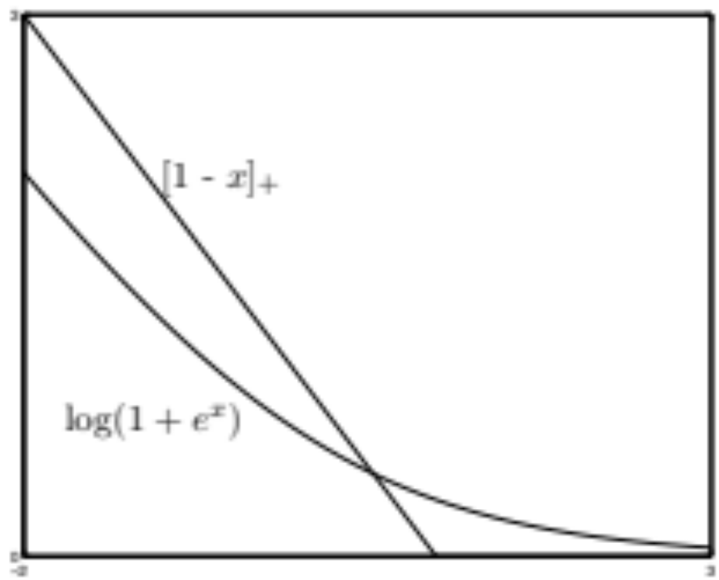
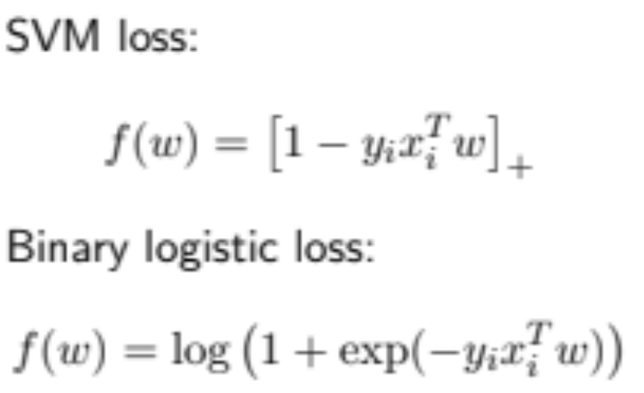
Important Convex Functions
<number>

Slide 7
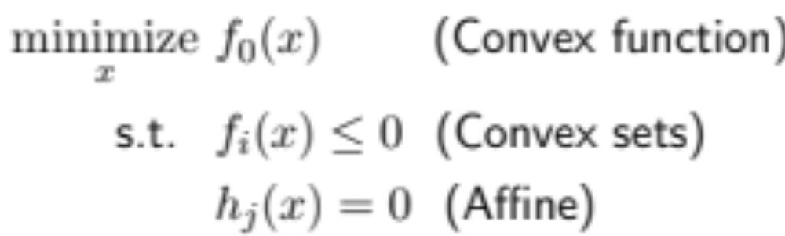
Convex Optimization Problem
<number>

Slide 8
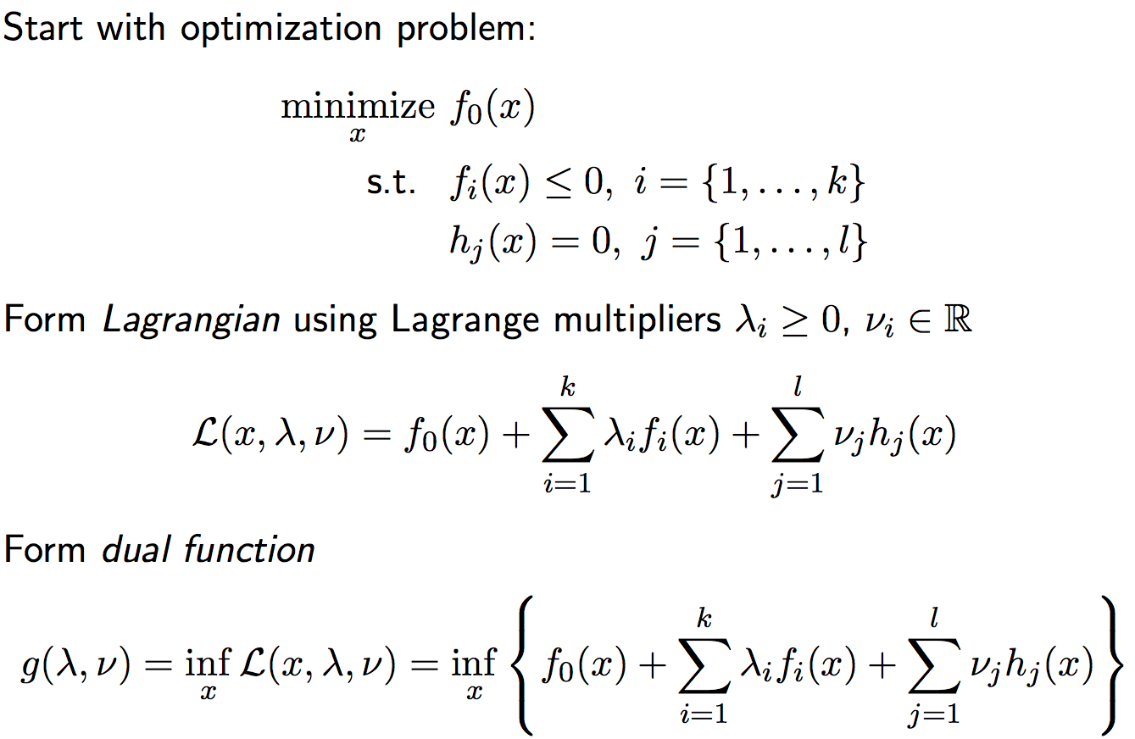
Lagrangian Dual
<number>

Slide 9
First Order Methods:
Gradient Descent
Newton’s Method
Introduction to Convex Optimization for Machine Learning, John Duchi, UC Berkeley, Tutorial, 2009
Subgradient Descent
Introduction to Convex Optimization for Machine Learning, John Duchi, UC Berkeley, Tutorial, 2009
Stochastic Gradient Descent
Stochastic Optimization for Machine Learning, Nathan Srebro and Ambuj Tewari, presented at ICML'10
Trust Regions
Trust Region Newton method for large-scale logistic regression, C.-J. Lin, R. C. Weng, and S. S. Keerthi, Journal of Machine Learning Research, 2008
Dual Coordinate Descent
Dual Coordinate Descent Methods for logistic regression and maximum entropy models, H.-F. Yu, F.-L. Huang, and C.-J. Lin, . Machine Learning Journal, 2011
Linear Classification
Recent Advances of Large-scale linear classification, G.-X. Yuan, C.-H. Ho, and C.-J. Lin. Proceedings of the IEEE, 100(2012)
9

Slide 10
First Order Methods:
Gradient Descent
Newton’s Method
Introduction to Convex Optimization for Machine Learning, John Duchi, UC Berkeley, Tutorial, 2009
Subgradient Descent
Introduction to Convex Optimization for Machine Learning, John Duchi, UC Berkeley, Tutorial, 2009
Stochastic Gradient Descent
Stochastic Optimization for Machine Learning, Nathan Srebro and Ambuj Tewari, presented at ICML'10
Trust Regions
Trust Region Newton method for large-scale logistic regression, C.-J. Lin, R. C. Weng, and S. S. Keerthi, Journal of Machine Learning Research, 2008
Dual Coordinate Descent
Dual Coordinate Descent Methods for logistic regression and maximum entropy models, H.-F. Yu, F.-L. Huang, and C.-J. Lin, . Machine Learning Journal, 2011
Linear Classification
Recent Advances of Large-scale linear classification, G.-X. Yuan, C.-H. Ho, and C.-J. Lin. Proceedings of the IEEE, 100(2012)
10

Slide 11
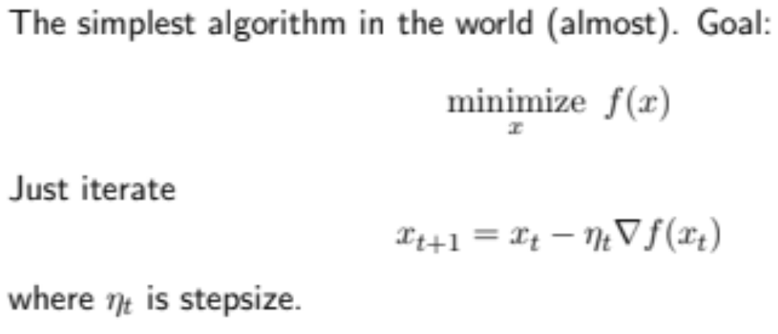
Gradient Descent
<number>

Slide 12
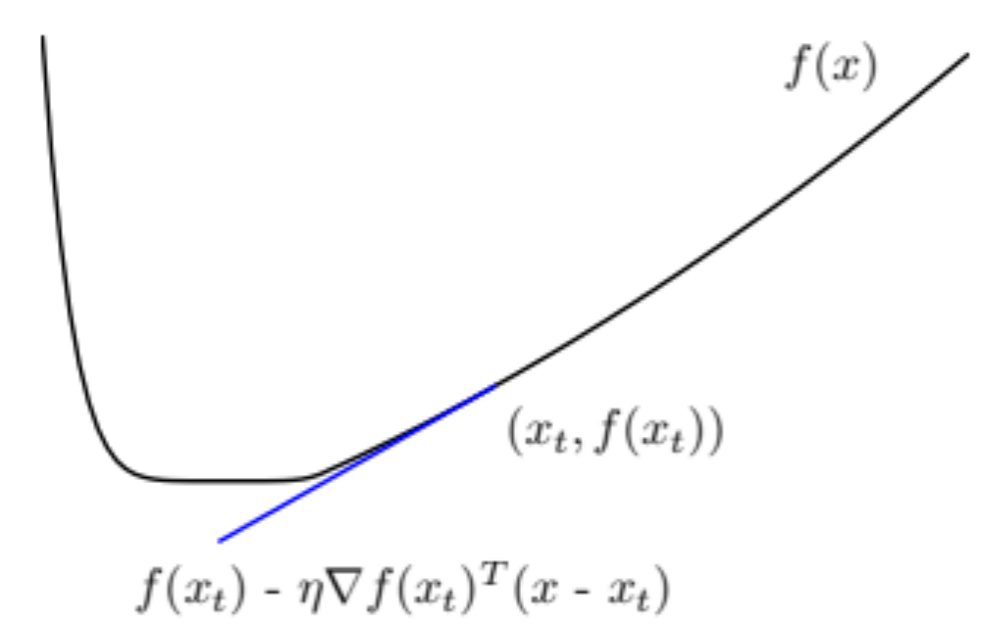
Single Step Illustration
<number>

Slide 13
Full Gradient Descent Illustration
<number>
Notes:
Elipses are level curves (function is quadratic). If we start on ---- line –gradient goes towards minimum (middle), if not, bounce back and forth
<number>

Slide 14
First Order Methods:
Gradient Descent
Newton’s Method
Introduction to Convex Optimization for Machine Learning, John Duchi, UC Berkeley, Tutorial, 2009
Subgradient Descent
Introduction to Convex Optimization for Machine Learning, John Duchi, UC Berkeley, Tutorial, 2009
Stochastic Gradient Descent
Stochastic Optimization for Machine Learning, Nathan Srebro and Ambuj Tewari, presented at ICML'10
Trust Regions
Trust Region Newton method for large-scale logistic regression, C.-J. Lin, R. C. Weng, and S. S. Keerthi, Journal of Machine Learning Research, 2008
Dual Coordinate Descent
Dual Coordinate Descent Methods for logistic regression and maximum entropy models, H.-F. Yu, F.-L. Huang, and C.-J. Lin, . Machine Learning Journal, 2011
Linear Classification
Recent Advances of Large-scale linear classification, G.-X. Yuan, C.-H. Ho, and C.-J. Lin. Proceedings of the IEEE, 100(2012)
14

Slide 15
First Order Methods:
Gradient Descent
Newton’s Method
Introduction to Convex Optimization for Machine Learning, John Duchi, UC Berkeley, Tutorial, 2009
Subgradient Descent
Introduction to Convex Optimization for Machine Learning, John Duchi, UC Berkeley, Tutorial, 2009
Stochastic Gradient Descent
Stochastic Optimization for Machine Learning, Nathan Srebro and Ambuj Tewari, presented at ICML'10
Trust Regions
Trust Region Newton method for large-scale logistic regression, C.-J. Lin, R. C. Weng, and S. S. Keerthi, Journal of Machine Learning Research, 2008
Dual Coordinate Descent
Dual Coordinate Descent Methods for logistic regression and maximum entropy models, H.-F. Yu, F.-L. Huang, and C.-J. Lin, . Machine Learning Journal, 2011
Linear Classification
Recent Advances of Large-scale linear classification, G.-X. Yuan, C.-H. Ho, and C.-J. Lin. Proceedings of the IEEE, 100(2012)
15

Slide 16
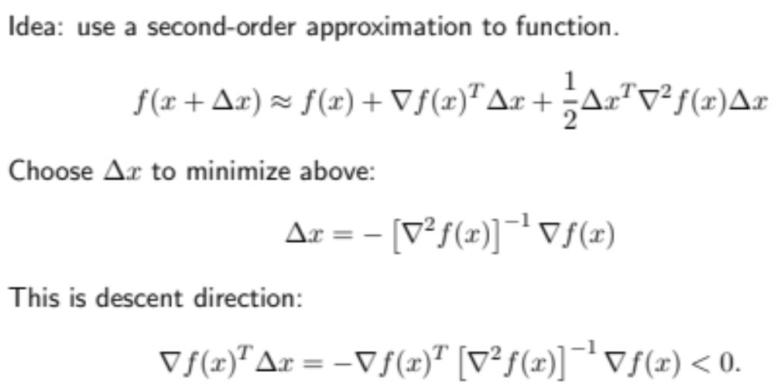
Newton’s Method
Inverse Hessian
Gradient
<number>
Notes:
Need Hessian to be invertible --- positive definite
<number>

Slide 17
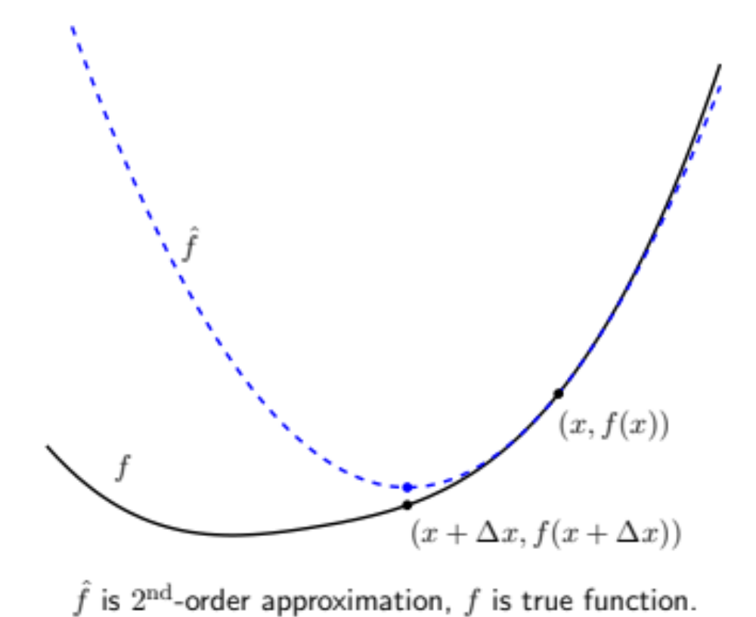
Newton’s Method Picture
<number>

Slide 18
First Order Methods:
Gradient Descent
Newton’s Method
Introduction to Convex Optimization for Machine Learning, John Duchi, UC Berkeley, Tutorial, 2009
Subgradient Descent
Introduction to Convex Optimization for Machine Learning, John Duchi, UC Berkeley, Tutorial, 2009
Stochastic Gradient Descent
Stochastic Optimization for Machine Learning, Nathan Srebro and Ambuj Tewari, presented at ICML'10
Trust Regions
Trust Region Newton method for large-scale logistic regression, C.-J. Lin, R. C. Weng, and S. S. Keerthi, Journal of Machine Learning Research, 2008
Dual Coordinate Descent
Dual Coordinate Descent Methods for logistic regression and maximum entropy models, H.-F. Yu, F.-L. Huang, and C.-J. Lin, . Machine Learning Journal, 2011
Linear Classification
Recent Advances of Large-scale linear classification, G.-X. Yuan, C.-H. Ho, and C.-J. Lin. Proceedings of the IEEE, 100(2012)
18

Slide 19
First Order Methods:
Gradient Descent
Newton’s Method
Introduction to Convex Optimization for Machine Learning, John Duchi, UC Berkeley, Tutorial, 2009
Subgradient Descent
Introduction to Convex Optimization for Machine Learning, John Duchi, UC Berkeley, Tutorial, 2009
Stochastic Gradient Descent
Stochastic Optimization for Machine Learning, Nathan Srebro and Ambuj Tewari, presented at ICML'10
Trust Regions
Trust Region Newton method for large-scale logistic regression, C.-J. Lin, R. C. Weng, and S. S. Keerthi, Journal of Machine Learning Research, 2008
Dual Coordinate Descent
Dual Coordinate Descent Methods for logistic regression and maximum entropy models, H.-F. Yu, F.-L. Huang, and C.-J. Lin, . Machine Learning Journal, 2011
Linear Classification
Recent Advances of Large-scale linear classification, G.-X. Yuan, C.-H. Ho, and C.-J. Lin. Proceedings of the IEEE, 100(2012)
19

Slide 20
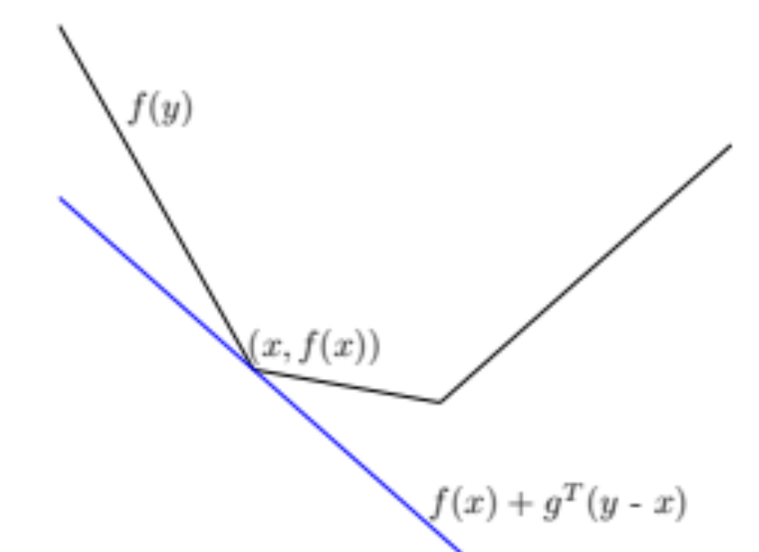
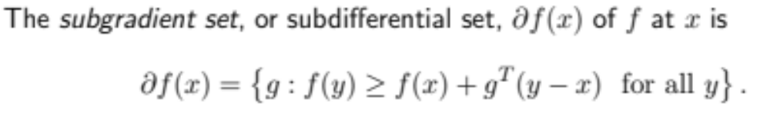
Subgradient Descent Motivation
<number>

Slide 21
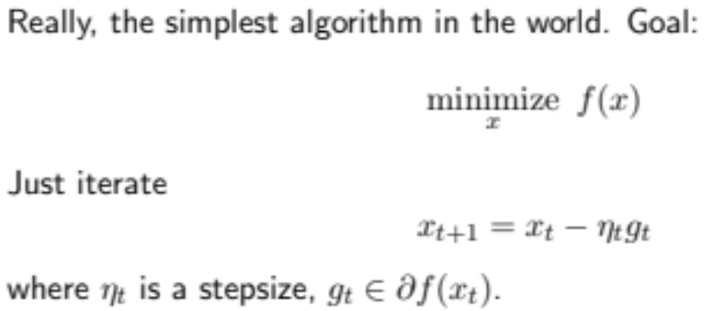
Subgradient Descent – Algorithm
<number>

Slide 22
First Order Methods:
Gradient Descent
Newton’s Method
Introduction to Convex Optimization for Machine Learning, John Duchi, UC Berkeley, Tutorial, 2009
Subgradient Descent
Introduction to Convex Optimization for Machine Learning, John Duchi, UC Berkeley, Tutorial, 2009
Stochastic Gradient Descent
Stochastic Optimization for Machine Learning, Nathan Srebro and Ambuj Tewari, presented at ICML'10
Trust Regions
Trust Region Newton method for large-scale logistic regression, C.-J. Lin, R. C. Weng, and S. S. Keerthi, Journal of Machine Learning Research, 2008
Dual Coordinate Descent
Dual Coordinate Descent Methods for logistic regression and maximum entropy models, H.-F. Yu, F.-L. Huang, and C.-J. Lin, . Machine Learning Journal, 2011
Linear Classification
Recent Advances of Large-scale linear classification, G.-X. Yuan, C.-H. Ho, and C.-J. Lin. Proceedings of the IEEE, 100(2012)
22

Slide 23
First Order Methods:
Gradient Descent
Newton’s Method
Introduction to Convex Optimization for Machine Learning, John Duchi, UC Berkeley, Tutorial, 2009
Subgradient Descent
Introduction to Convex Optimization for Machine Learning, John Duchi, UC Berkeley, Tutorial, 2009
Stochastic Gradient Descent
Stochastic Optimization for Machine Learning, Nathan Srebro and Ambuj Tewari, presented at ICML'10
Trust Regions
Trust Region Newton method for large-scale logistic regression, C.-J. Lin, R. C. Weng, and S. S. Keerthi, Journal of Machine Learning Research, 2008
Dual Coordinate Descent
Dual Coordinate Descent Methods for logistic regression and maximum entropy models, H.-F. Yu, F.-L. Huang, and C.-J. Lin, . Machine Learning Journal, 2011
Linear Classification
Recent Advances of Large-scale linear classification, G.-X. Yuan, C.-H. Ho, and C.-J. Lin. Proceedings of the IEEE, 100(2012)
23
Notes:
A brief introduction to Stochastic gradient descent
<number>

Slide 24
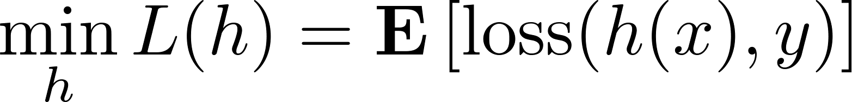
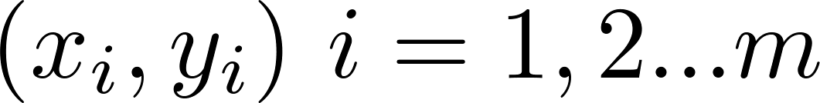
Online learning and optimization
Goal of machine learning :
  Minimize expected loss
given samples
This is Stochastic Optimization
  Assume loss function is convex
<number>

Slide 25
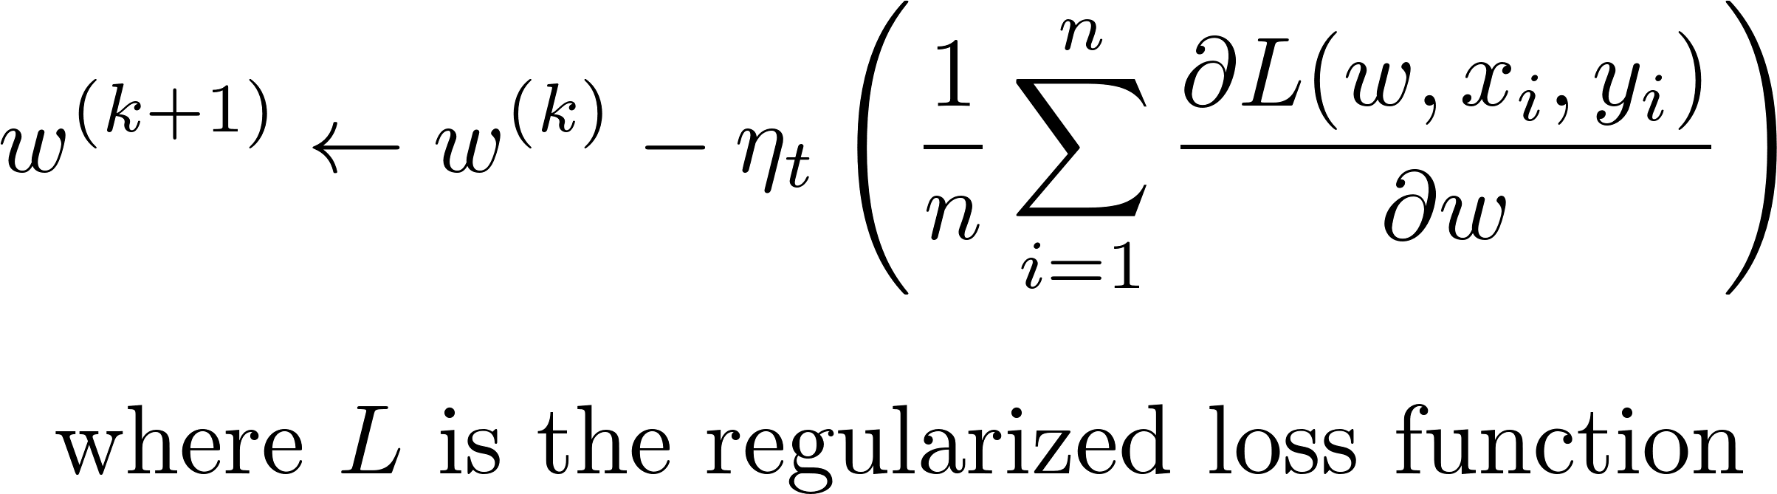
Batch (sub)gradient descent for ML
Process all examples together in each step
Entire training set examined at each step
Very slow when n is very large
<number>

Slide 26

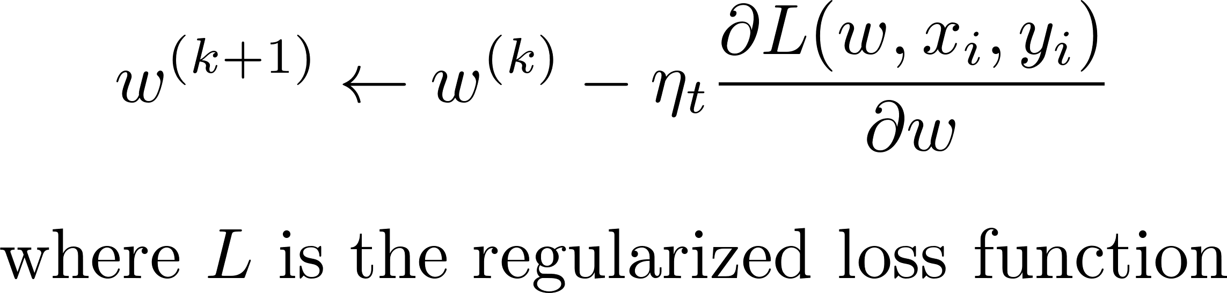
Stochastic (sub)gradient descent
“Optimize” one example at a time
Choose examples randomly (or reorder and choose in order)
  Learning representative of example distribution
<number>

Slide 27
Stochastic (sub)gradient descent
Equivalent to online learning (the weight vector w changes with every example)
Convergence guaranteed for convex functions (to local minimum)
<number>

Slide 28
Hybrid!
Stochastic – 1 example per iteration
Batch – All the examples!
Sample Average Approximation (SAA):
  Sample m examples at each step and perform SGD on them
Allows for parallelization, but choice of m based on heuristics
<number>

Slide 29

SGD - Issues
Convergence very sensitive to learning rate
( ) (oscillations near solution due to probabilistic nature of sampling)
  Might need to decrease with time to ensure the algorithm converges eventually
Basically – SGD good for machine learning with large data sets!
<number>

Slide 30
First Order Methods:
Gradient Descent
Newton’s Method
Introduction to Convex Optimization for Machine Learning, John Duchi, UC Berkeley, Tutorial, 2009
Subgradient Descent
Introduction to Convex Optimization for Machine Learning, John Duchi, UC Berkeley, Tutorial, 2009
Stochastic Gradient Descent
Stochastic Optimization for Machine Learning, Nathan Srebro and Ambuj Tewari, presented at ICML'10
Trust Regions
Trust Region Newton method for large-scale logistic regression, C.-J. Lin, R. C. Weng, and S. S. Keerthi, Journal of Machine Learning Research, 2008
Dual Coordinate Descent
Dual Coordinate Descent Methods for logistic regression and maximum entropy models, H.-F. Yu, F.-L. Huang, and C.-J. Lin, . Machine Learning Journal, 2011
Linear Classification
Recent Advances of Large-scale linear classification, G.-X. Yuan, C.-H. Ho, and C.-J. Lin. Proceedings of the IEEE, 100(2012)
30

Slide 31
First Order Methods:
Gradient Descent
Newton’s Method
Introduction to Convex Optimization for Machine Learning, John Duchi, UC Berkeley, Tutorial, 2009
Subgradient Descent
Introduction to Convex Optimization for Machine Learning, John Duchi, UC Berkeley, Tutorial, 2009
Stochastic Gradient Descent
Stochastic Optimization for Machine Learning, Nathan Srebro and Ambuj Tewari, presented at ICML'10
Trust Regions
Trust Region Newton method for large-scale logistic regression, C.-J. Lin, R. C. Weng, and S. S. Keerthi, Journal of Machine Learning Research, 2008
Dual Coordinate Descent
Dual Coordinate Descent Methods for logistic regression and maximum entropy models, H.-F. Yu, F.-L. Huang, and C.-J. Lin, . Machine Learning Journal, 2011
Linear Classification
Recent Advances of Large-scale linear classification, G.-X. Yuan, C.-H. Ho, and C.-J. Lin. Proceedings of the IEEE, 100(2012)
31

Slide 32
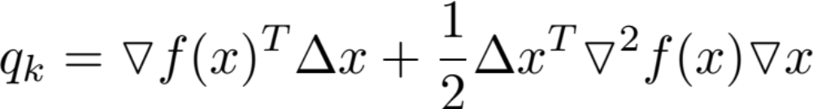
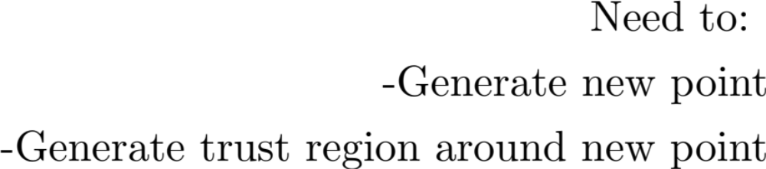
Problem Formulation
<number>

Slide 33
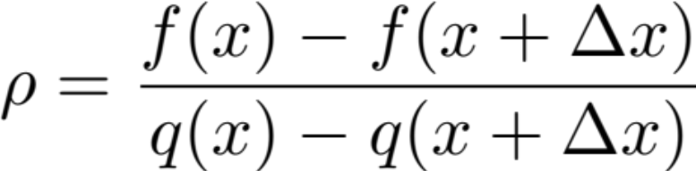
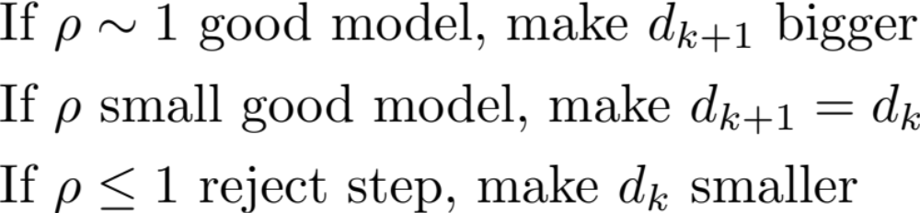
New Points
<number>

Slide 34
Limited Memory Quasi-Newton Methods
<number>

Slide 35
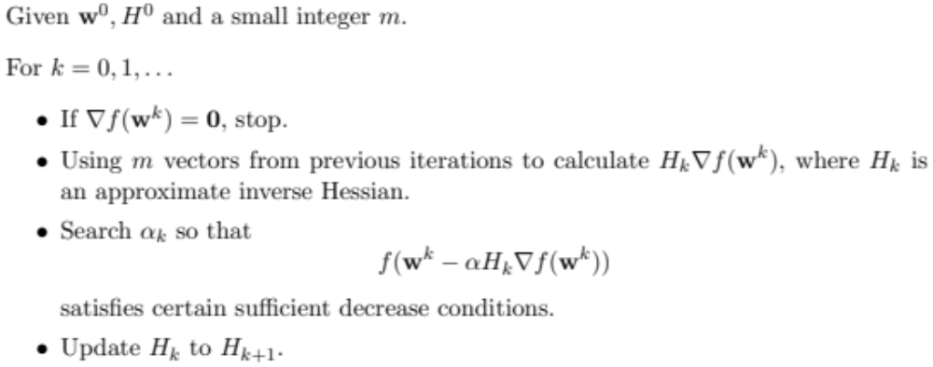
Limited Memory BFGS
<number>

Slide 36
First Order Methods:
Gradient Descent
Newton’s Method
Introduction to Convex Optimization for Machine Learning, John Duchi, UC Berkeley, Tutorial, 2009
Subgradient Descent
Introduction to Convex Optimization for Machine Learning, John Duchi, UC Berkeley, Tutorial, 2009
Stochastic Gradient Descent
Stochastic Optimization for Machine Learning, Nathan Srebro and Ambuj Tewari, presented at ICML'10
Trust Regions
Trust Region Newton method for large-scale logistic regression, C.-J. Lin, R. C. Weng, and S. S. Keerthi, Journal of Machine Learning Research, 2008
Dual Coordinate Descent
Dual Coordinate Descent Methods for logistic regression and maximum entropy models, H.-F. Yu, F.-L. Huang, and C.-J. Lin, . Machine Learning Journal, 2011
Linear Classification
Recent Advances of Large-scale linear classification, G.-X. Yuan, C.-H. Ho, and C.-J. Lin. Proceedings of the IEEE, 100(2012)
36

Slide 37
First Order Methods:
Gradient Descent
Newton’s Method
Introduction to Convex Optimization for Machine Learning, John Duchi, UC Berkeley, Tutorial, 2009
Subgradient Descent
Introduction to Convex Optimization for Machine Learning, John Duchi, UC Berkeley, Tutorial, 2009
Stochastic Gradient Descent
Stochastic Optimization for Machine Learning, Nathan Srebro and Ambuj Tewari, presented at ICML'10
Trust Regions
Trust Region Newton method for large-scale logistic regression, C.-J. Lin, R. C. Weng, and S. S. Keerthi, Journal of Machine Learning Research, 2008
Dual Coordinate Descent
Dual Coordinate Descent Methods for logistic regression and maximum entropy models, H.-F. Yu, F.-L. Huang, and C.-J. Lin, . Machine Learning Journal, 2011
Linear Classification
Recent Advances of Large-scale linear classification, G.-X. Yuan, C.-H. Ho, and C.-J. Lin. Proceedings of the IEEE, 100(2012)
37
Notes:
Paper presents the formulation of the dual coordinate descent for Logistic Regression Learning
<number>

Slide 38
Coordinate descent
Minimize along each coordinate direction in turn. Repeat till minimum is found
  One complete cycle of coordinate descent is the same as gradient descent
In some cases, analytical expressions available:
  Example: Dual form of SVM!
Otherwise, numerical methods needed for each iteration
38

Slide 39
Dual coordinate descent
Coordinate descent applied to the dual problem
Commonly used to solve the dual problem for SVMs
  Allows for application of the Kernel trick
  Coordinate descent for optimization
In this paper: Dual logistic regression and optimization using coordinate descent
38

Slide 40
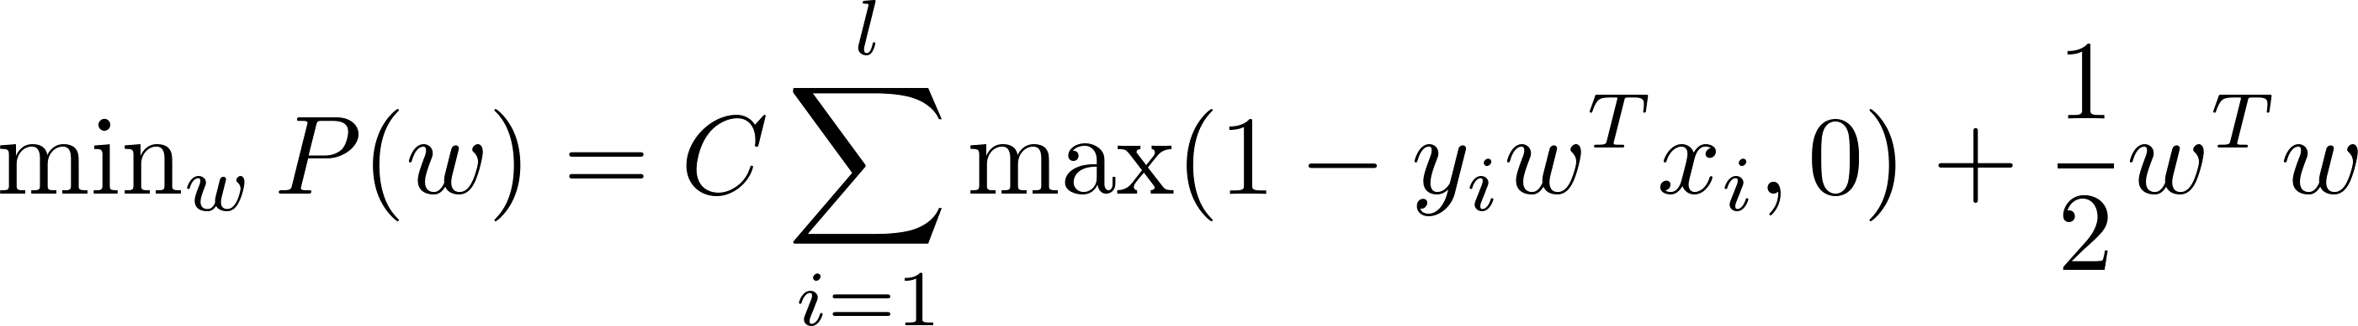
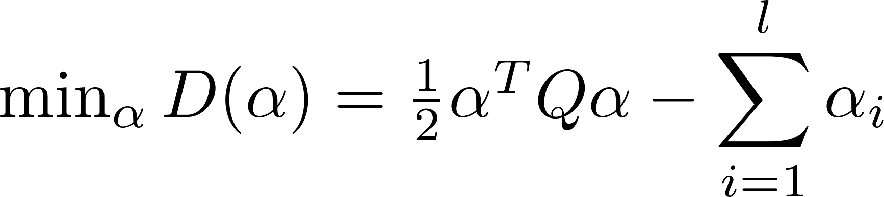
Dual form of SVM
SVM
Dual form
<number>

Slide 41
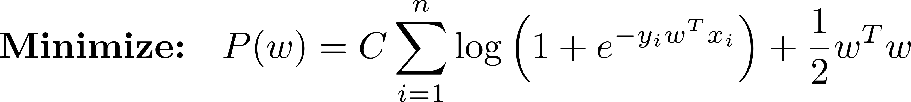
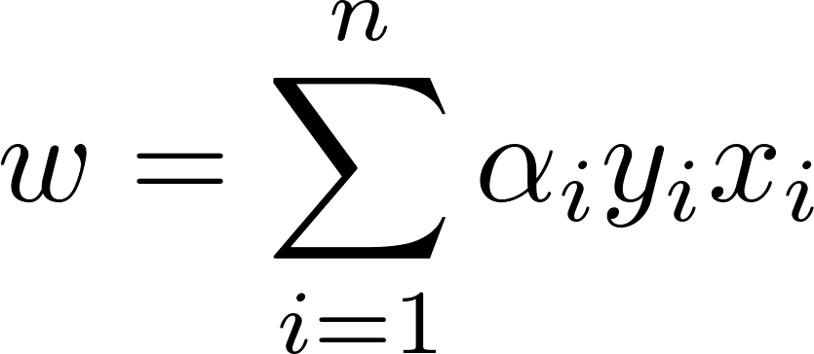
Dual form of LR
LR:
Dual form (we let )
<number>

Slide 42
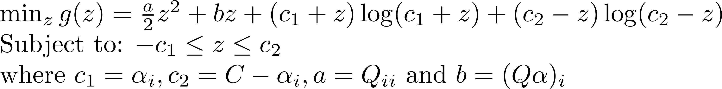
Coordinate descent for dual LR
Along each coordinate direction:
<number>

Slide 43
Coordinate descent for dual LR
No analytical expression available
  Use numerical optimization (Newton’s method/bisection method/BFGS/…)to iterate along each direction
Beware of log!
<number>
Notes:
Beware of logarithmic issues
<number>

Slide 44
Coordinate descent for dual ME
Maximum Entropy (ME) is extension of LR to multi-class problems
  In each iteartion, solve in two levels:
    Outer level – Consider block of variables at a time
      Each block has all labels and one example
    Inner level – Subproblem solved by dual coordinate descent
Can also be solved similar to online CRF (exponentiated gradient methods)
<number>

Slide 45
First Order Methods:
Gradient Descent
Newton’s Method
Introduction to Convex Optimization for Machine Learning, John Duchi, UC Berkeley, Tutorial, 2009
Subgradient Descent
Introduction to Convex Optimization for Machine Learning, John Duchi, UC Berkeley, Tutorial, 2009
Stochastic Gradient Descent
Stochastic Optimization for Machine Learning, Nathan Srebro and Ambuj Tewari, presented at ICML'10
Trust Regions
Trust Region Newton method for large-scale logistic regression, C.-J. Lin, R. C. Weng, and S. S. Keerthi, Journal of Machine Learning Research, 2008
Dual Coordinate Descent
Dual Coordinate Descent Methods for logistic regression and maximum entropy models, H.-F. Yu, F.-L. Huang, and C.-J. Lin, . Machine Learning Journal, 2011
Linear Classification
Recent Advances of Large-scale linear classification, G.-X. Yuan, C.-H. Ho, and C.-J. Lin. Proceedings of the IEEE, 100(2012)
45

Slide 46
First Order Methods:
Gradient Descent
Newton’s Method
Introduction to Convex Optimization for Machine Learning, John Duchi, UC Berkeley, Tutorial, 2009
Subgradient Descent
Introduction to Convex Optimization for Machine Learning, John Duchi, UC Berkeley, Tutorial, 2009
Stochastic Gradient Descent
Stochastic Optimization for Machine Learning, Nathan Srebro and Ambuj Tewari, presented at ICML'10
Trust Regions
Trust Region Newton method for large-scale logistic regression, C.-J. Lin, R. C. Weng, and S. S. Keerthi, Journal of Machine Learning Research, 2008
Dual Coordinate Descent
Dual Coordinate Descent Methods for logistic regression and maximum entropy models, H.-F. Yu, F.-L. Huang, and C.-J. Lin, . Machine Learning Journal, 2011
Linear Classification
Recent Advances of Large-scale linear classification, G.-X. Yuan, C.-H. Ho, and C.-J. Lin. Proceedings of the IEEE, 100(2012)
46
Notes:
Paper presents survey of recent linear methods (most of which we have covered) and compares performance to nonlinear classifiers
<number>

Slide 47
Large scale linear classification
Big data sets usually have large number of features, examples
Nonlinear classifiers (including kernel methods) more accurate, but slow
46

Slide 48
Large scale linear classification
Linear classifiers less accurate, but at least an order of magnitude faster
  Loss in accuracy lower with increase in number of examples
Speed usually dependent on more than algorithm order
  Memory/disk capacity
  Parallelizability
46

Slide 49
Large scale linear classification
Choice of optimization method depends on:
  Data property
    Number of examples, features
    Sparsity
  Formulation of problem
    Differentiability
    Convergence properties
  Primal vs dual
  Low order vs high order methods
46

Slide 50
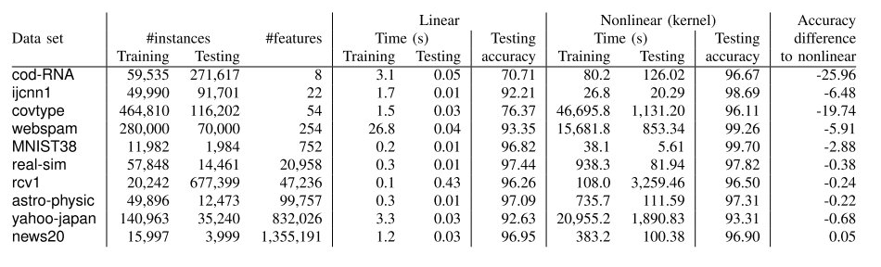
Comparison of performance
Performance gap goes down with increase in number of features
Training, testing time for linear classifiers is much faster
<number>
Notes:
Liblinear vs libsvm
<number>

