Slide 1

CS 295: Modern Systems
Efficient Use of High Performance Storage
Sang-Woo Jun
Spring, 2019

Slide 2
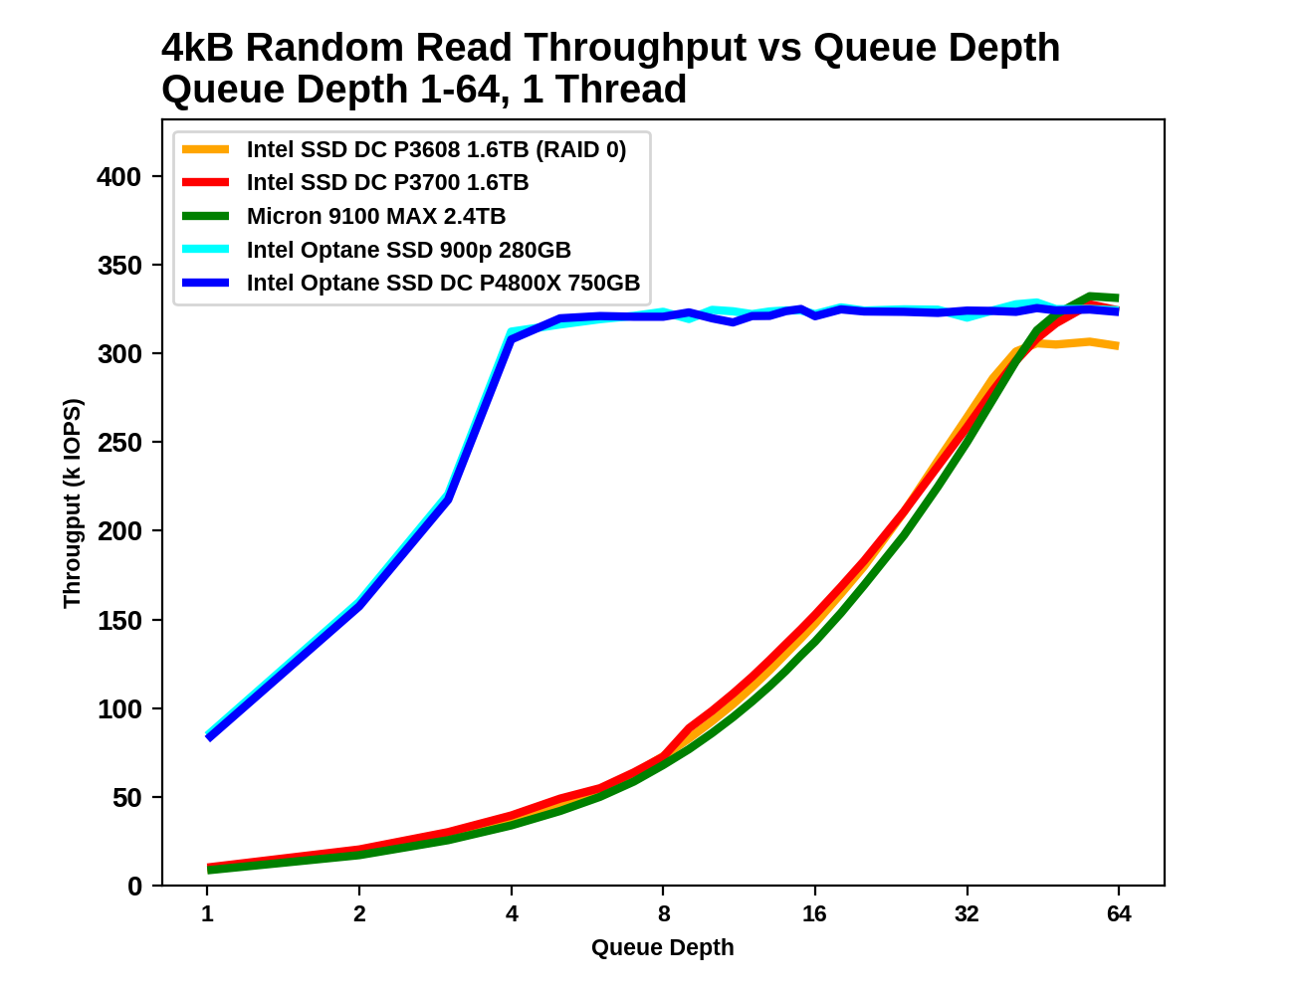
Queue Depth and Performance
For high bandwidth, enough requests must be in flight to keep many chips busy
  With fread/read/mmap, need to spawn many threads to have concurrent requests
  Traditionally with thread pool that makes synchronous requests (POSIX AIO library and many others)
Billy Tallis, “Intel Optane SSD DC P4800X 750GB Hands-On Review,” AnandTech 2017

Slide 3
Some Background – Page Cache
Linux keeps a page cache in the kernel that stores some pages previously read from storage
  Automatically tries to expand into unused memory space
  Page cache hit results in high performance
  Data reads involve multiple copies (Device → Kernel → User)
  Tip: Write “3” to /proc/sys/vm/drop_caches to flush all caches
Page cache can be bypasses via “direct mode”
  “open” syscall with O_DIRECT
  Lower operating system overhead, but no benefit of page cache hits
  Useful if application performs own caching, or knows there is zero reuse

Slide 4
Asynchronous I/O
Many in-flight requests created via non-blocking requests
  Generate a lot of I/O requests from a single thread
Storage
Host
Synchronous
Asynchronous with
queue depth >= 7

Slide 5
Asynchronous I/O
Option 1: POSIX AIO library
  Creates thread pool to offload blocking I/O operations – Queue depth limited by thread count
  Part of libc, so easily portable
  Can work with page caches
Option 2: Linux kernel AIO library (libaio)
  Asynchrony management offloaded to kernel (not dependent on thread pool)
  Despite efforts, does not support page cache yet (Only O_DIRECT)
  Especially good for applications that manage own cache (e.g., DBMSs)

Slide 6
Linux Kernel libaio
Basic flow
  aio_context_t created via io_setup
  struct iocb created for each io request, and submitted via io_submit
  Check for completion using io_getevents
Multiple aio_context_t may be created for multiple queues
  Best performance achieved by multiple contexts across threads, each with large nr_events
  Multi thread not because of aio overhead, but actual data processing overhead

Slide 7

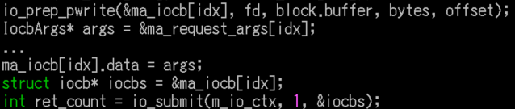

libaio Example
Create context
Send request
  Arguments to recognize results
Poll results
  Recognize results with arguments

Slide 8
Significant Performance Benefits!
Typically single thread can saturate NVMe storage
  If the thread is not doing any processing
Let’s look at performance numbers
  Surprisingly few applications use libaio, but many do

Slide 9
Data Structures for Storage
Most of what we learned about cache-oblivious data structures also work here

Slide 10
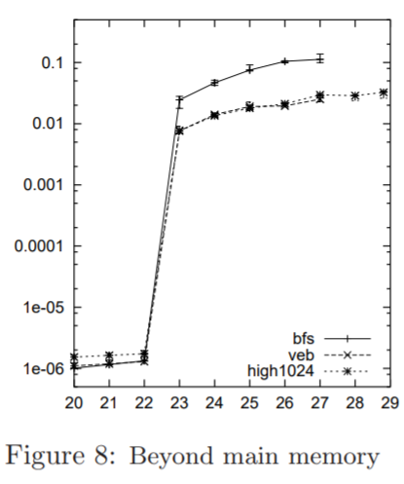
B-Tree
Generalization of a binary search tree, where each node can have more than two children
  Typically enough children for each node to fill a file system page (Data loaded from storage is not wasted)
  If page size is known, very effective data structure
    Remember the performance comparison with van Emde Boas tree
Brodal et.al., “Cache Oblivious Search Trees via Binary Trees of Small Height,” SODA 02

Slide 11
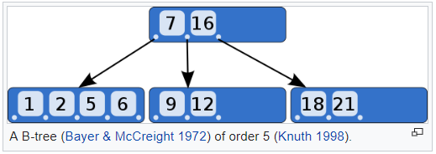
B-Tree – Quick Recap
Self-balancing structure!
Insertion is always done at a leaf
  If the leaf is full, it is split
  If leaf splitting results in a parent overflow, split parent, repeat upwards
  If root overflows, create a new root, and split old root
Tree height always increases from the root, balancing the tree

Slide 12
B-Tree – Quick Recap
Deletion is also always done on the leaf
  If leaf underflows (according to a set parameter), perform rotation to keep balance
Rotation always maintains balance
  If left sibling has enough children, take largest from it
    Element separating siblings in the parent is moved to current node to separate the new child
  If right sibling has enough children, take largest from it
    The same
  If no siblings have enough children, merge two siblings
    Remove the separating element in the parent. If this causes an underflow, repeat rotation at parent

Slide 13
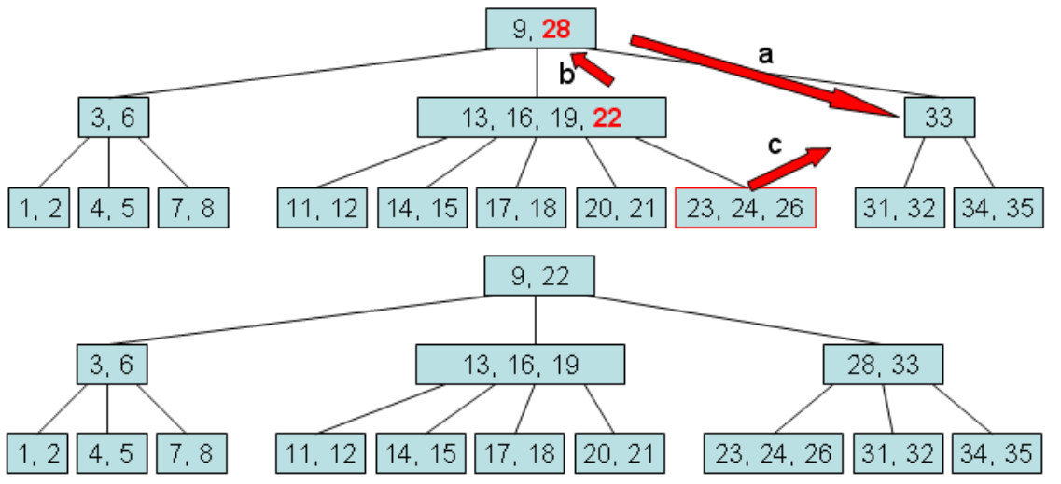
B-Tree – Quick Recap – Rotation
Dr. Fang Tang, “CS241: Data Structures and Algorithms II,” 2017

Slide 14
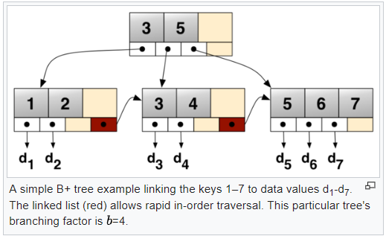
B+Tree
B-Tree modified to efficiently deal with key-value pairs
Two separate types of nodes: internal and leaf
  B-Tree had elements in both intermediate nodes and leaves
  Internal nodes only contain keys for keeping track of children
  Values are only stored in leaf nodes
  All leaves are also connected in a linked list,
  for efficient range querying-

Slide 15
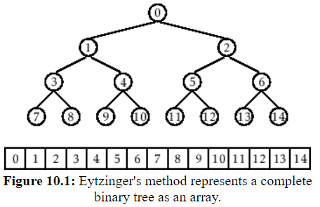
Implicit B+Tree
An implicit tree is when the structure of the tree is implicitly determined from the layout in memory
  For example, an implicit binary tree can be represented as an array, where elements are laid out in breadth-first order
  Wasted space if tree is not balanced
  B-Tree and variants are self-balancing
Implicit B+Tree node uses less memory
  Useful for when data is in storage,
  but index is in memory
  Useful when data is static!
opendatastructures.org

Slide 16
Log-Structured Merge (LSM) Tree
Storage-optimized tree structure
  Key component of many modern DBMSs (RocksDB,Bigtable,Cassandra, …)
Consists of mutable in-memory data structure, and multiple immutable external (in-storage) data structures
  Updates applied to in-memory data structure
  In-memory data structure regularly flushed to new instance in storage
  Lookups must search the in-memory structure, and potentially all instances in storage if not

Slide 17
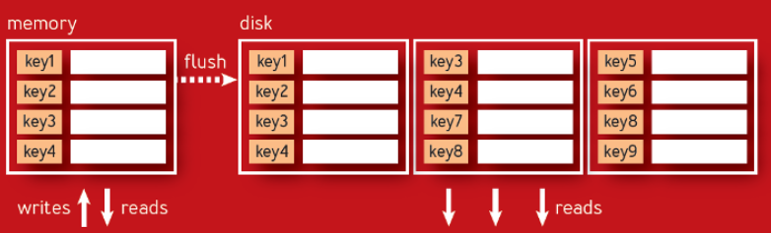
Log-Structured Merge (LSM) Tree
In-memory: mutable, search-optimized data structure like B-Tree
  After it reaches a certain size (or some time limit reached), flushed to storage and starts new
External component: many immutable trees
  Typically search optimized external structure like Sorted String Tables
  New one created every time memory flushes
  Updates are determined by timestamp, deletions by placeholder markers
  Search from newest file to old
Like clustered indices
Alex Petrov, “Algorithms Behind Modern Storage Systems,”
ACM Queue, 2018

Slide 18
Log-Structured Merge (LSM) Tree
Because external structures are immutable and only increase, periodic compaction is required
  Since efficient external data structures are sorted, typically simple merge-sort is efficient
  Key collisions are handled by only keeping new data

Slide 19
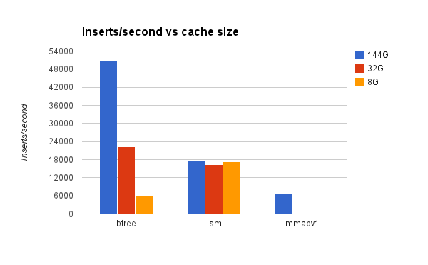
Some Performance Numbers
Data from iibench for MongoDB
Small Datum, “Read-modify-write optimized,” 2014 (http://smalldatum.blogspot.com/2014/12/read-modify-write-optimized.html)

Slide 20
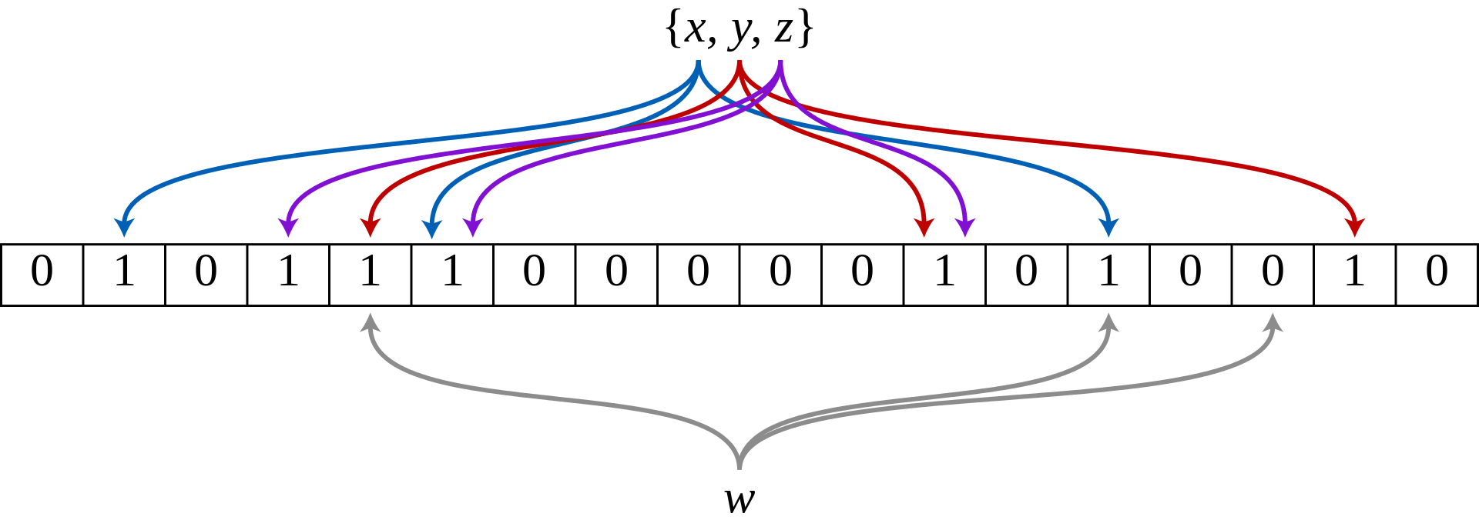
Bloom Filter
Probabilistic data structures to test if an element is a member of a set
  Not actually storage-aware algorithm
Maintain a relatively small m array of bits
  Insert: use k hash functions and set all hashed locations to 1
  Check: use k hash functions, if a hash location is not 1, the element definitely does not exist in the set
Effective with even small m
False positives, and becomes
less useful with more insertions
Source: Wikipedia

