Slide 1
Modeling and Implementation of Energy Neutral Sensing Systems
Marcin K. Szczodrak¹ Omprakash Gnawali² Luca P. Carloni¹
Columbia University¹ University of Houston²
ENSSys Workshop · Rome Italy · November 14, 2013

Slide 2
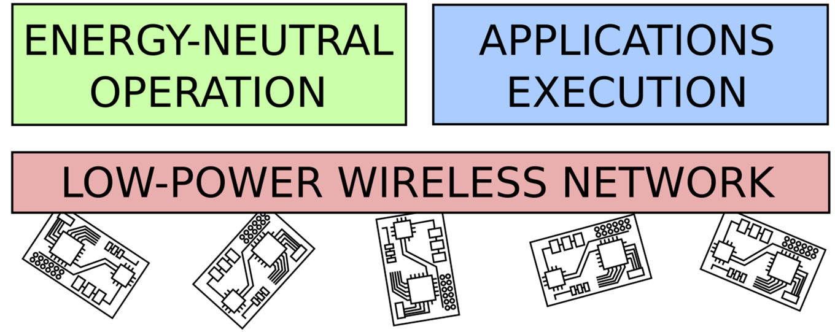
Motivation
Industry-Level Systems Require Both:
Operation with minimum energy and maintenance costs
Sophisticated applications
Notes:
Despite advances in wireless sensor network research and energy-harvesting methods, there are still few examples of successful technology transfers from research prototypes to actual commercial products.
One of the major challenges has been the difficulty of realizing industry-level wireless sensor networks that can operate reliable for a long time with minimum energy and maintenance cost while supporting sophisticated applications.
To address this problem it is necessary to develop methods for designing and implementing wireless sensing systems that can run effectively both application processes and energy-management processes across the same single network

Slide 3

Today’s Talk
A single wireless sensor network executing both
energy-management algorithms, and
sensing applications
Notes:
In today’s talk we present modeling, implementation and evaluation of a single wireless sensor network that executes energy-harvesting algorithms and sensing applications
Our work is based on Fennec Fox, therefore we start with reviewing necessary background information about this system
Then we introduce the feedback control model for energy-neutral system operation and discuss how it can be implemented in Fennec Fox
Finally, we present two case studies to show that the proposed system design and implementation methodology facilitates the composition of complex energy-harvesting systems with improved runtime performance.

Slide 4
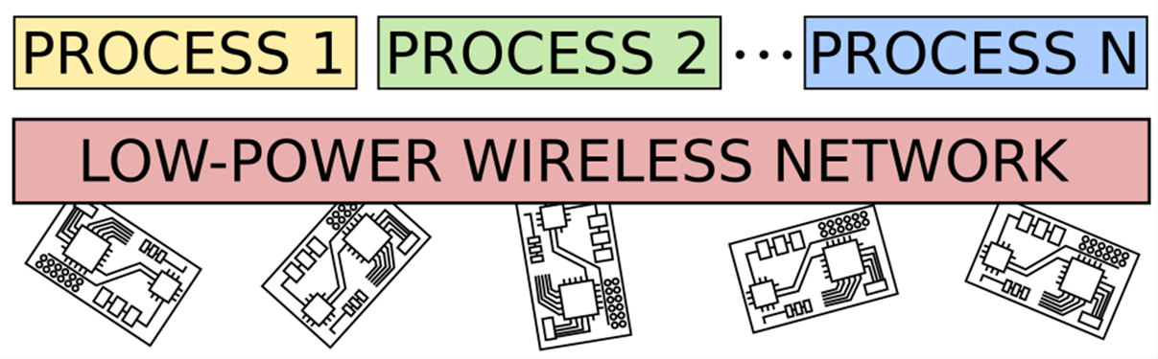
Fennec Fox:
Framework for Reconfigurable WSN
Multiple heterogeneous applications on the same WSN
Dynamic Reconfiguration of Wireless Sensor Networks to Support Heterogeneous Applications
Marcin K. Szczodrak, Omprakash Gnawali and Luca P. Carloni
Proc. IEEE DCOSS Conf., May, 2013.
Notes:
We developed Fennec Fox to run multiple heterogeneous application processes on the same wireless sensor network.
Fennec Fox creates an abstraction of a single system on top of which multiple processes are executing
As such, the process context-switch occurs not on a single node but across the whole network
With its network state synchronization algorithm, Fennec Fox ensures that all the motes are running with the same processes

Slide 5
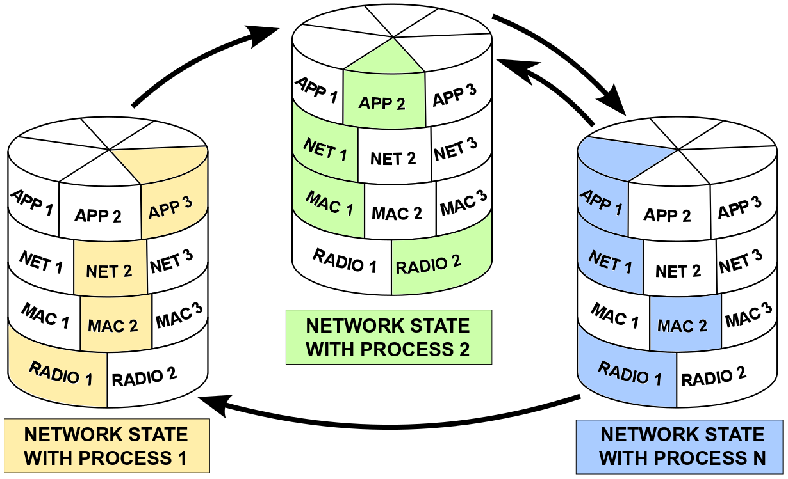
Fennec Fox: Protocol Stack
Each process has dedicated protocol stack
Notes:
In Fennec Fox, each process runs on a dedicated network protocol stack, consisting of the application code, its network and MAC protocols and the designated radio driver.
Therefore, when the process context-switch happens, not only the application code is restarted but also the communication mechanisms of this process.
At run-time, Fennec Fox follows the finite state machine model of computation, which is specified at design time with the Swift Fox programming language.
In Swift Fox, programmers define network states, where each state consist of processes to be executed.
The state transitions are triggered by the events defined in Swift Fox programs
So in conclusion, Fennec Fox provides mechanisms to program and execute multiple heterogeneous processes on the same network

Slide 6
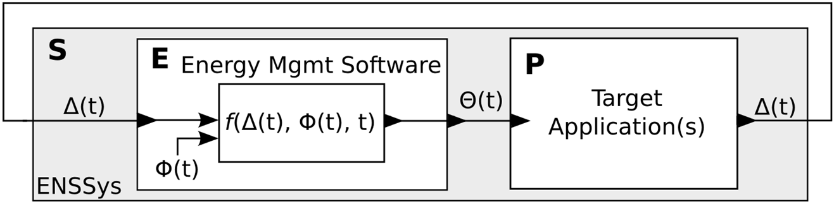
Energy-Neutral System:
Feedback Control Model
energy management function
energy consumed
energy harvested
energy control signal
Notes:
We propose to model the energy-neutral sensing network as a feedback control system, running with energy management software process and the target applications, consisting of sensing, actuating and computing processes.
In this model, the system energy is controlled by the energy-management software computing the energy management function
This function takes as input the information about the energy consumption and harvesting and returns energy control signals.
These signals control the network energy consumption during the execution of the target applications.

Slide 7
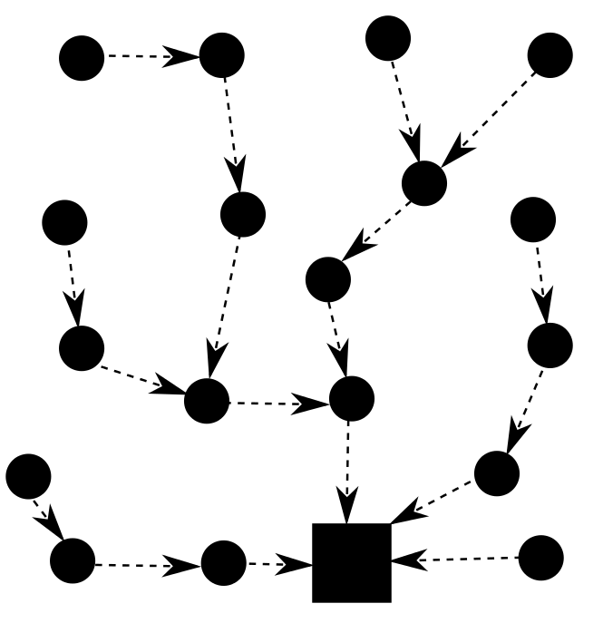

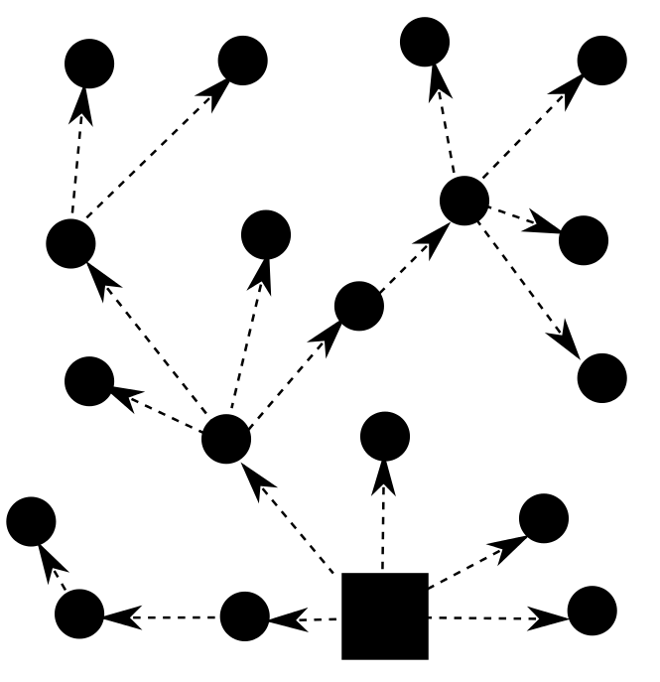

Energy-Neutral System:
Network Communication Conflicts
energy control signals computation
local
distributed
centralized
1.
2.
3.
collect energy information
compute energy management function
apply energy control signals
Notes:
Next we discuss how to translate the energy-neutral system model into wireless sensor network implementation
One of the challenges is to define communication requirements necessary to compute and apply the energy control signals
In the simplest case, every mote manages its energy by itself, so there are no network transmissions coming from the energy management software
However, when a group of motes collaborates and collectively make a decision about their energy resources, then they exchange among themselves information about the energy spending and harvesting, which requires communication support for distributed computation
Network communication support is also required when a single node centrally manages the system energy resources
To give a better intuition of the communication requirements, we show an example of a system energy managed centrally
On the figure, the circles represent sensor motes and the square box represents the central node
In the central computation, first, all the motes send to the central node information about the harvested energy
Then, the central node computes the management function and sends back to all the motes the energy control signals
The reason why it is important to keep in mind these alternative implementations is because the energy management software run-time communications may conflict with the ongoing transmissions from target applications running at the same time.
Consider this example.
The energy-management software transmits information over the carrier-sensing CSMA MAC protocol, while at the same time the application process sends packets over the time-division TDMA MAC.
These two medium access control protocols cannot simultaneously operate on the same network without performance degradation
Therefore energy management processes and target application processes may have conflicting communication requirements, which leads us to the implementation problem of running both of these processes on the same wireless network

Slide 8
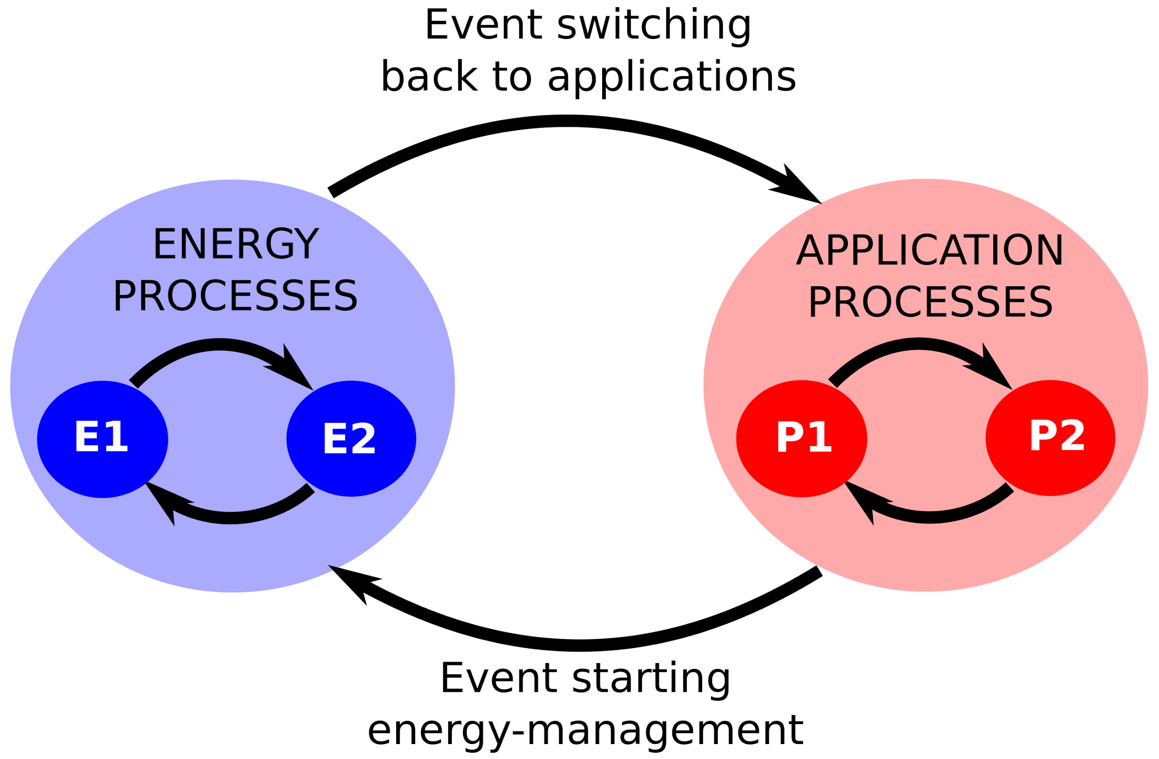
Asynchronous Execution of Energy Management and Application Tasks
Finite State Machine representation of the model
Notes:
To address the problem of running both the energy-management processes and the target application processes on the same network, we propose to schedule their execution asynchronously
In Swift Fox program we map the energy and application processes into separate network states, which forces them to execute separately
Then, we create the network state transition events to switch between the states running with the energy management software and states running with the target applications
This solves the problem of conflicting communication protocols
However, even when the energy and application processes communication protocols are not conflicting, we may still prefer to separate their execution to
reduce the performance degradation from concurrent processes execution
improve the energy-harvesting and consumption estimates
And to enable modular system design and code reuse

Slide 9

Habitat Monitoring
a petrel with chicks
Notes:
Next we apply the presented system design and implementation methodology into two wireless sensor network application case studies
First, we run a simulated replication of the wireless sensor network for habitat monitoring
Here, wireless sensors were deployed to collect environmental information that would enable life scientists to better understand conditions that impact Petrels breeding
From the technological perspective, the challenge of this work was to find the sensor sampling rate such that the network would operate for a sufficient amount of time on a given set of batteries.

Slide 10
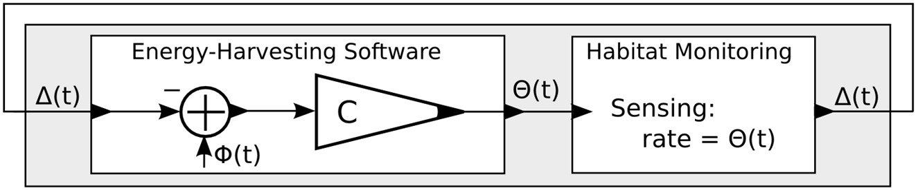
Workload Adaptation: Modeling
adjust the sensor sampling rate to the amount of available energy
sensing rate
scaling parameter
energy harvested
energy consumed
Notes:
Today, we can solve this limited and fixed energy resources problem by using solar energy-harvesting
We construct a sensing system where the sensor sampling rate is dynamically adjusted to the amount of the available energy.
One possible implementation of a controller computes the sensor sampling rate as a difference between the energy-harvesting and energy-consumption rate, multiplied by a scaling parameter.

Slide 11
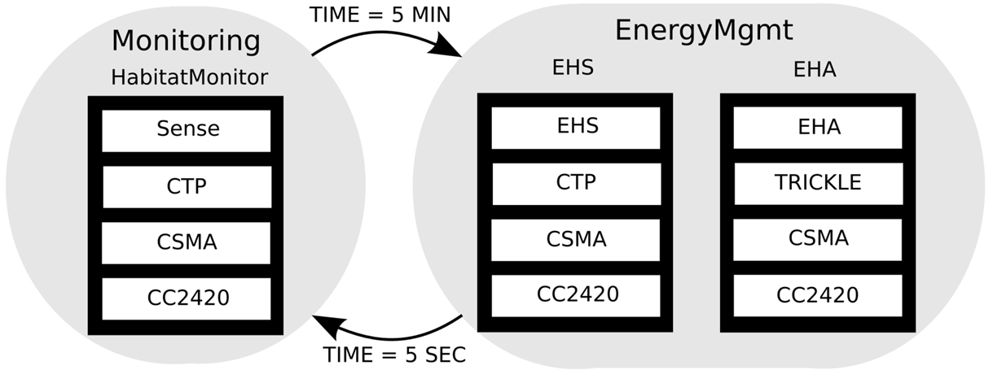
Workload Adaptation: Architecture
Network State
Transition Event
Application
Network
MAC
Radio
Processes, each with its protocol stack
Notes:
Once we define how the sensors sampling rate is computed, we specify when and where it is computed
We create separate states for the energy and application processes
Then we use timer events to every 5 minutes recompute the sensors sampling rate
In this example we chose to centrally compute the sensor sampling rate
This requires two energy management processes.
One centrally collecting the energy harvesting reports over the CTP protocol and one computing and disseminating the sensor sampling rates using the Trickle protocol

Slide 12

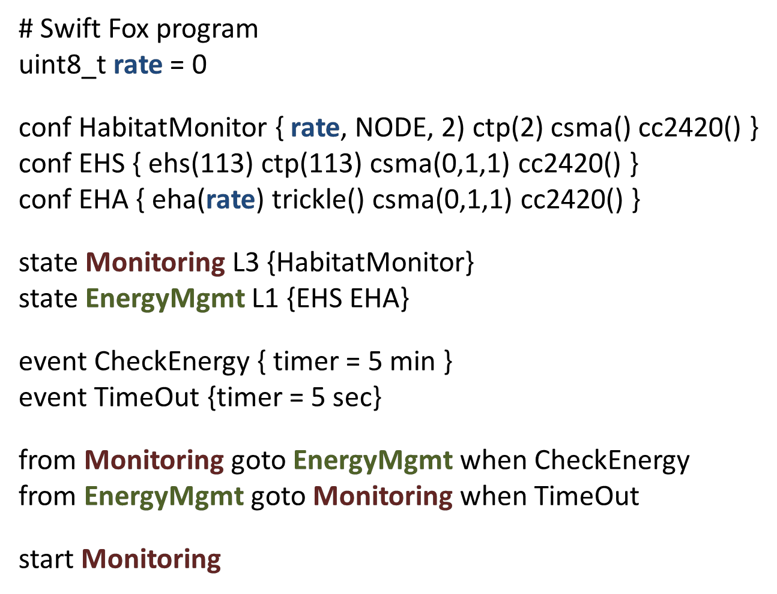

Workload Adaptation: Swift Fox Implementation
Notes:
On the slide we show the actual Swift Fox program used in this case study
In the top part of the program the energy processes compute sensing rate and pass it to the process with habitat monitoring application
The second part of the program defines the network states, their processes, and specifies the network state transition events
We verified the correct execution of the application and the energy-management software by compiling and executing the Swift Fox program on a testbed with Zolertia Z1 motes.
Because those motes do not provide any energy-harvesting capabilities, we used TOSSIM simulator to conduct wireless sensor network energy-management studies.
We extended TOSSIM to support simulation of the solar energy harvesting by accessing real-life irradiance traces

Slide 13
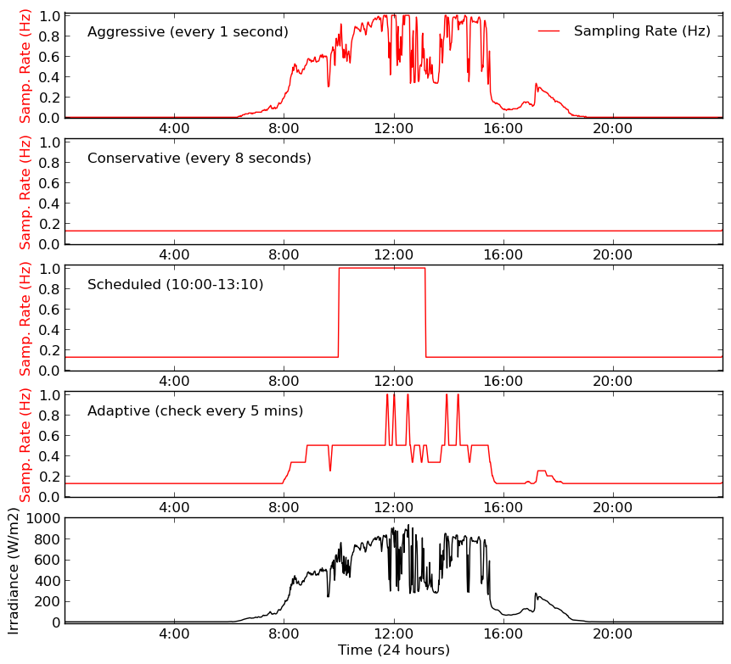
Fennec Fox Implementation with Workload Adaptation
Aggressive
- Fixed, high-rate
Conservative
- Fixed, low-rate
Scheduled
- Optimized high/low
Adaptive
Irradiance Traces
Notes:
In the experiments, we compared the performance of our implementation of the energy adaptive system dynamically adjusting the sensing rate, against three naive energy-management strategies.
The experiments were conducted on the same real life irradiance measurement traces, shown the bottom graph.
The upper graph shows the results of the first naive strategy called aggressive, with the red line denoting the sensor sampling rates
The Aggressive strategy sampled sensors as fast as possible, sending the largest amount of sensor measurements but it failed to operate once there was no energy to harvest
The next strategy called Conservative samples at a lower rate and it successes to operate 24 hours a day
However, this strategy sent only half of the number of samples than the Aggressive one did
The third strategy runs a scheduler with default low sampling rate that switches to high sampling rate when the solar cells harvests most of the energy
It manages to operate continuously and reports almost as many measurements as the Aggressive strategy
Unfortunately the scheduler is not that easy to deploy because to achieve these results one must run off-line search for optimal schedule
Finally, our Adaptive strategy has higher average sampling rate than the Scheduled strategy and comparing to the Aggressive strategy it transmits over 99% of the number of sensor reports
The Adaptive strategy also sustains continued sensing and transmitting operation, without requiring off-line schedule optimization

Slide 14

Smart Light Switch
need for smart light switch
Notes:
In the next example we simulate a smart lighting switch built with low-power energy-harvesting active tags
This smart lighting switch wirelessly communicates with a lamp, and runs two applications
The first application is called light switch and it sends a message to a lamp when the switch is pressed
The second application called Occupancy, periodically sends to a lamp a message with a motion sensor measurement

Slide 15
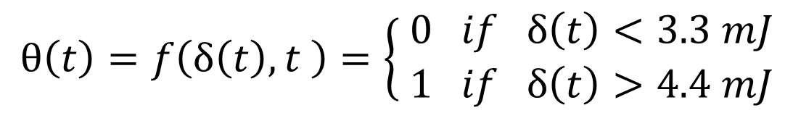
Smart Light Switch: Modeling
Prioritize Smart Switch Light over Occupancy Sensing
Execute Occupancy application or not
A mote’s residual energy
Notes:
The smart light switch tags operate on solar energy harvested in indoor deployments.
In a naive system implementation, the two applications run concurrently for as long as energy is available
A better system implementation would prioritize the execution of the switch application over the occupancy, such that motion measurements are reported only when there is enough energy reserved to manually press the light switch over the night time.
This system specification can be implemented as a controller, which on each mote locally computes a Boolean value specifying if the Occupancy application should execute or not, based on the mote’s energy resources

Slide 16
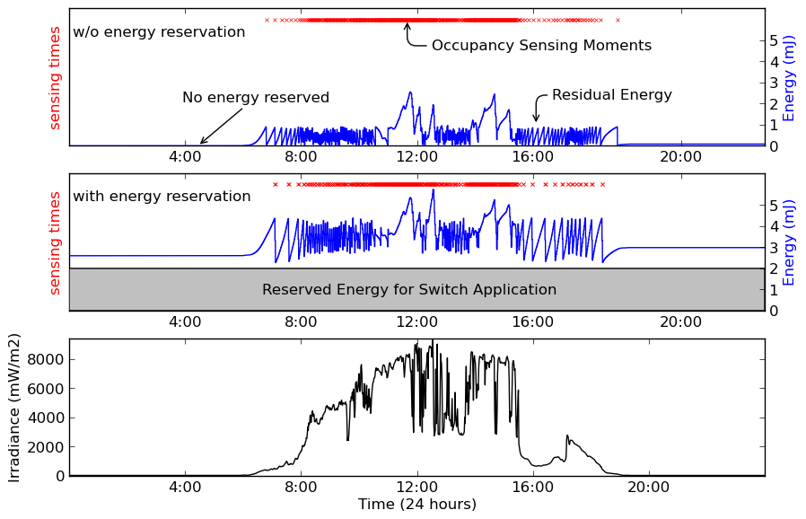
Fennec Fox Implementation with Execution Adaptation
Notes:
We implemented these two versions of the system, one with energy reservation and the other without it, and simulated them in TOSSIM.
The bottom graph shows the irradiance traces for indoor solar energy-harvesting
The upper graph shows the system concurrently executing both applications, without reserving energy for the switch application.
The red crosses denote the moments when Occupancy application was reporting motion sensor measurements and the blue line shows mote’s residual energy.
In this implementation the motes run out of energy by 7pm, and after that neither occupancy nor switch applications can execute
The middle graph shows the Fennec Fox based system implementation that reserves the energy resources for executing the light Switch application.
Here, the occupancy application was turned off every time when there was just enough energy to run the Switch application over the night time
As a result of reserving the energy, the Occupancy application sent 99% of the reports as the naive implementation did
At run-time, Fennec Fox switched between the states for 138 times, which itself consumed 28mJ.

Slide 17

Conclusion
Show how to execute energy-management algorithms and target applications on a single network
Model ENSSys as a feedback control system
Show how to implement the system model in Fennec Fox
Illustrate the design and implementation methodology on two case studies
Thank You,
Marcin Szczodrak
msz@cs.columbia.edu
Notes:
In conclusion, we addressed the problem of running both the energy-harvesting algorithms and sensing applications on the same wireless sensor network.
We proposed to model the energy-neutral network operation as a feedback control system.
The two applications case studies show how to implement different system models in Fennec Fox
Thank you for your attention

