Slide 1
Gecko: Hierarchical Distributed View of Heterogeneous Shared Memory Architectures
Millad Ghane¹, Sunita Chandrasekaran², Margaret S. Cheung^{1,3}
mghane@cs.uh.edu
University of Houston¹, University of Delaware²,
Center for Theoretical Biological Physics (CTBP), Rice University³
PMAM 2019 in conjunction with PPoPP 2019
Feb. 17, 2019

Slide 2
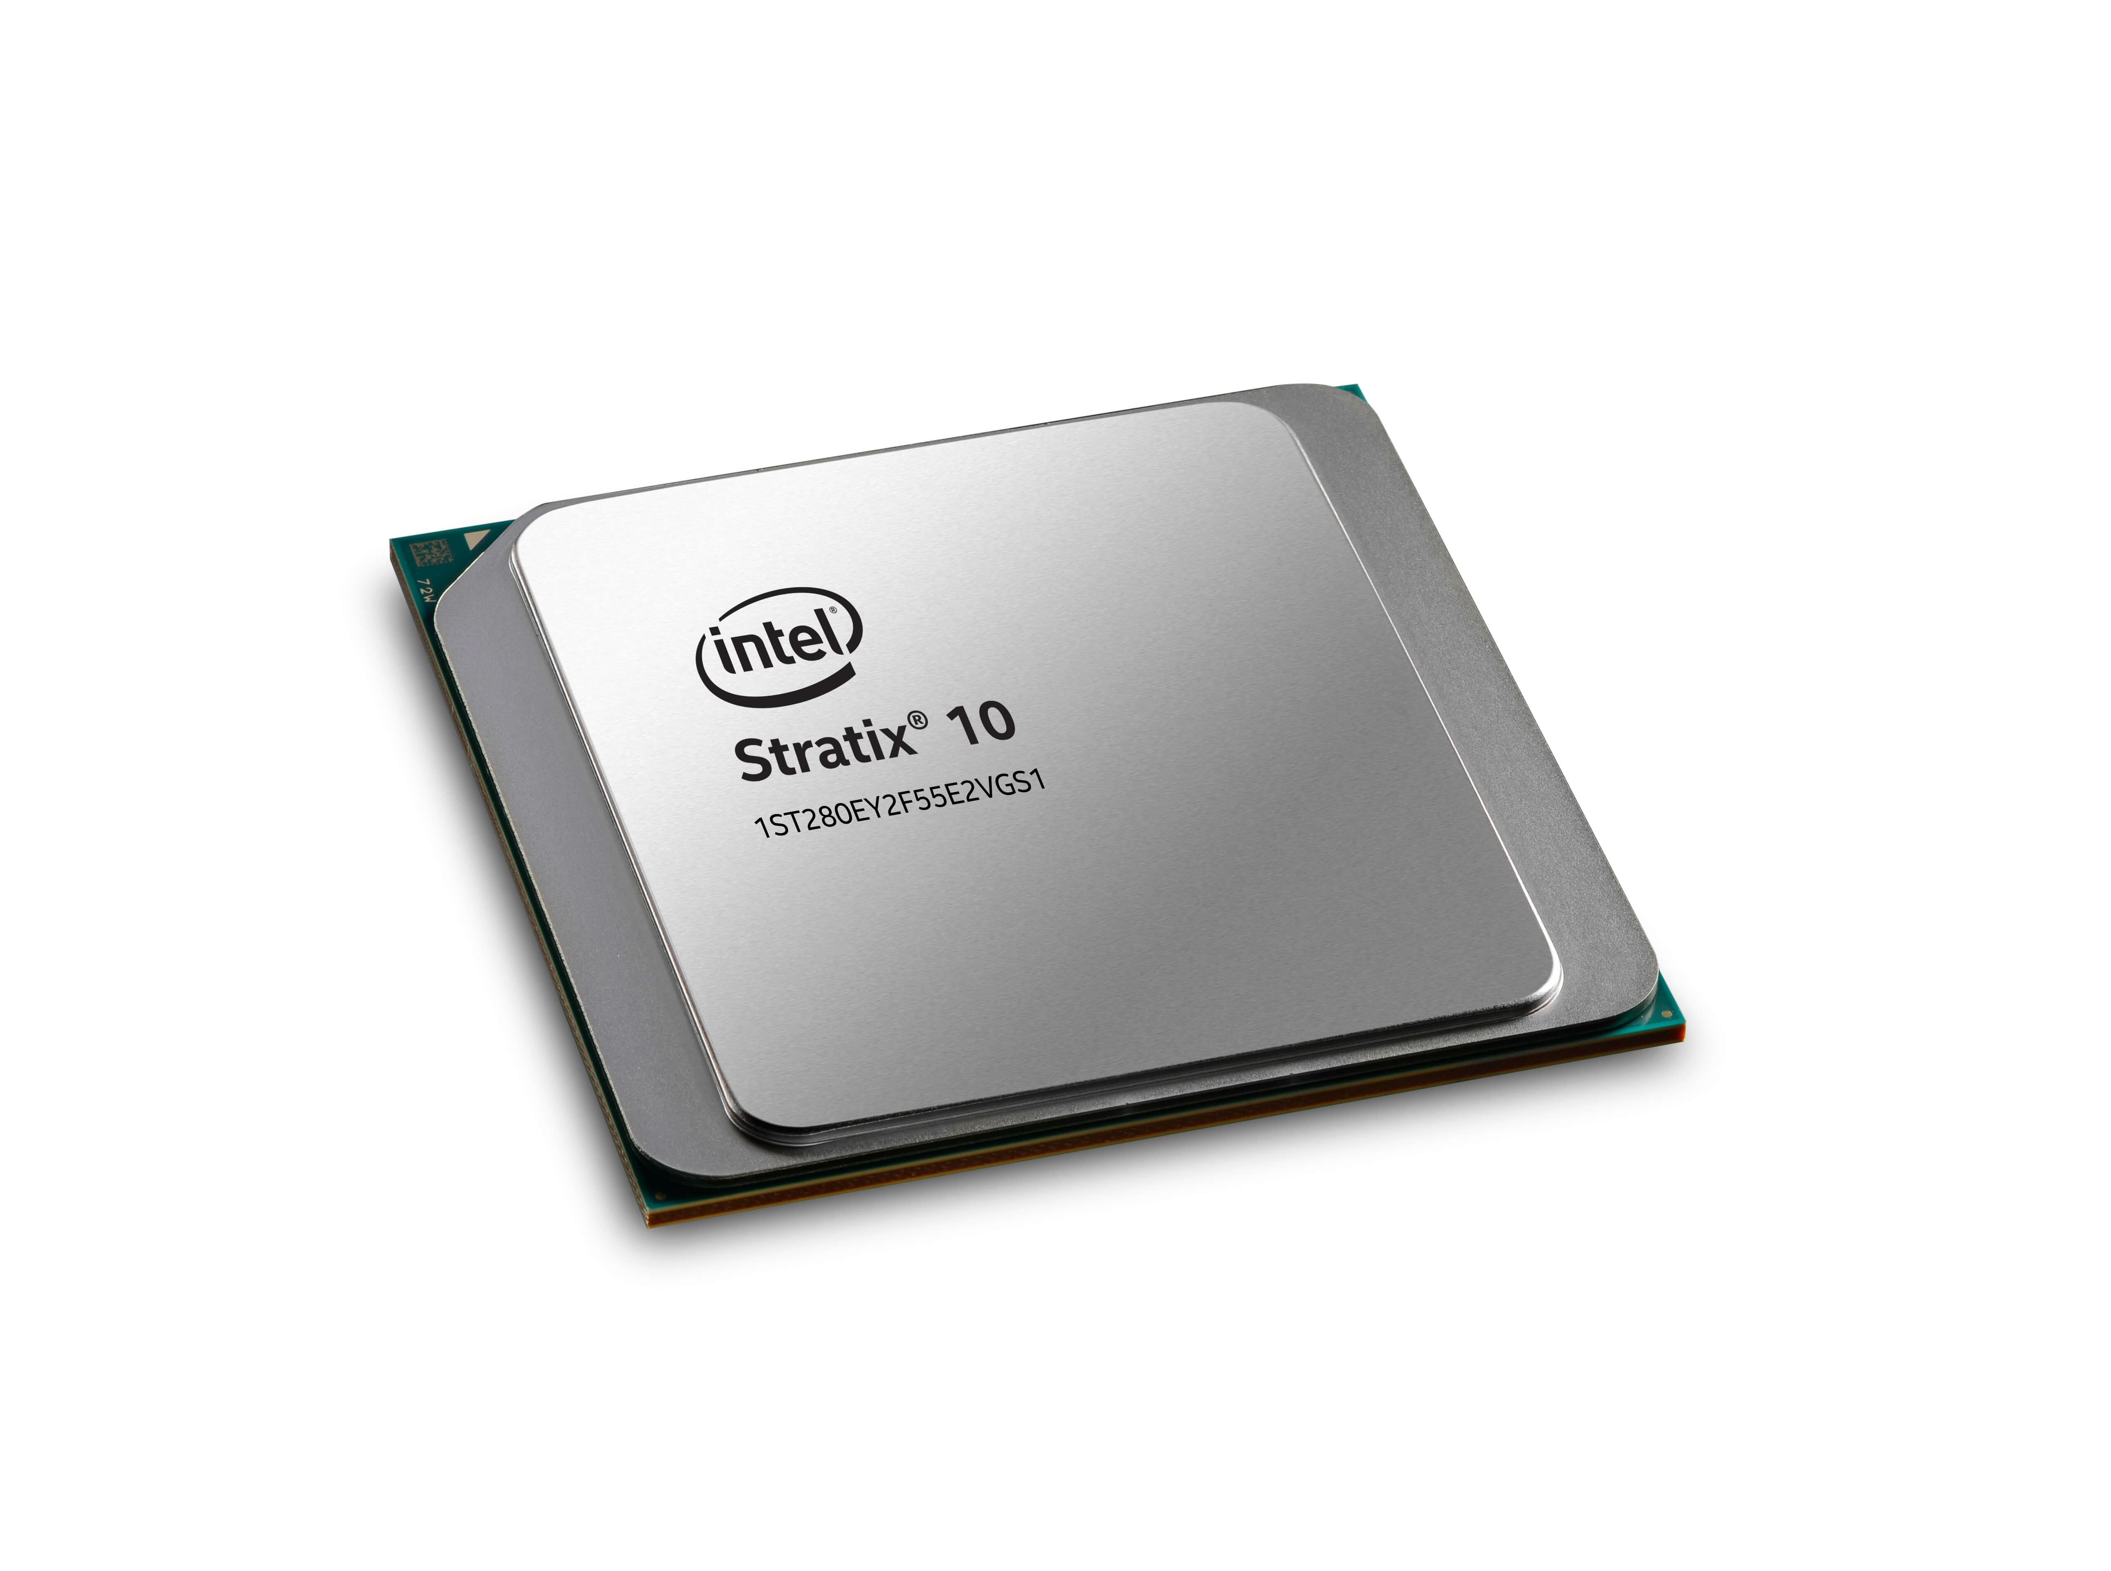
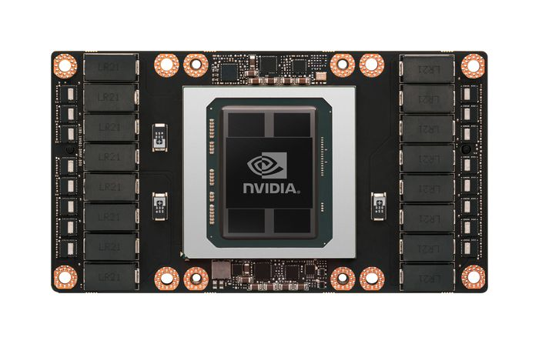

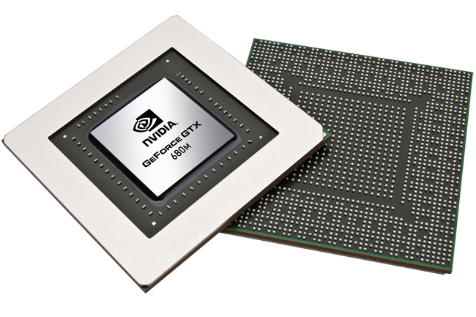




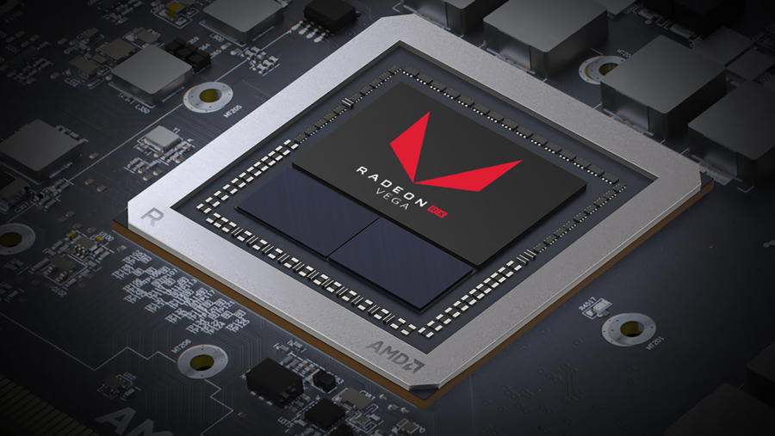
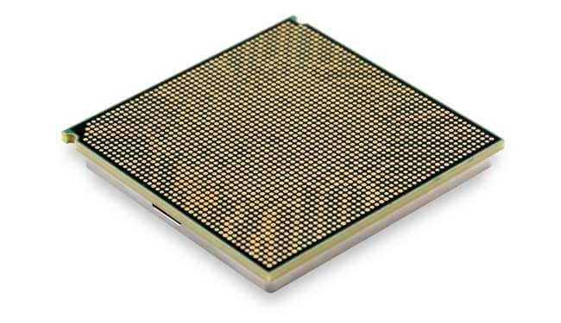


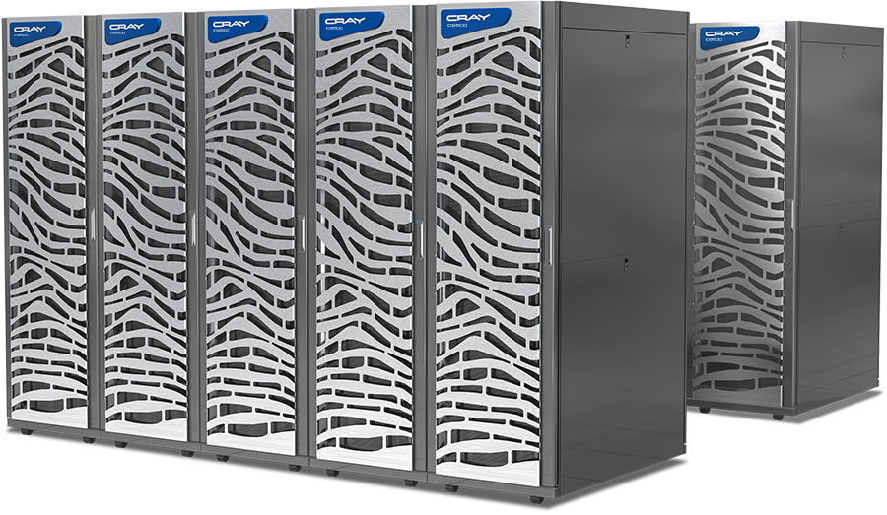
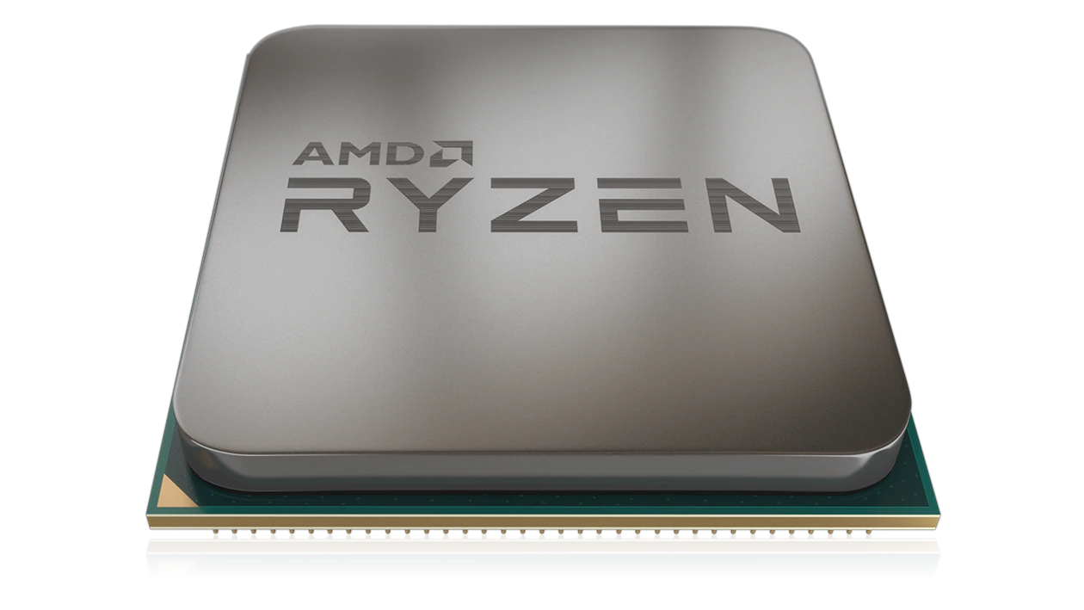

Heterogeneous Computing
Heterogeneous Computing is the mainstream trend in the design of supercomputers and clusters.

Slide 3
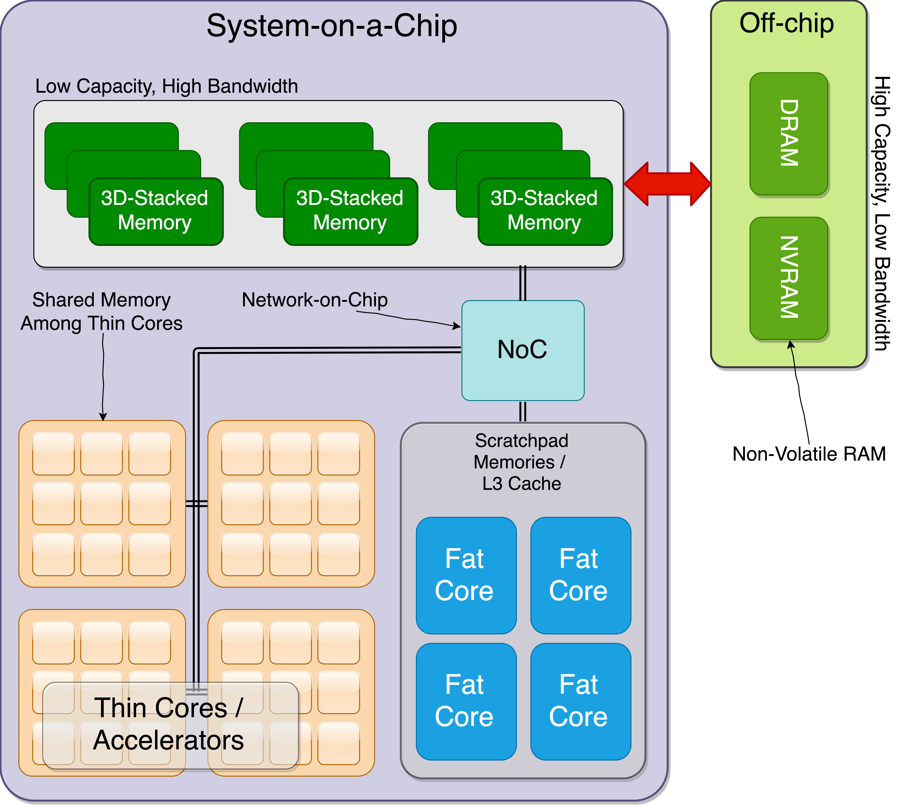
Future Generation of Computing
Put everything on the chip
Known as: System-on-a-Chip (SoC)
Main Processor
GPUs
Memories
Adapted from: J. A. Ang, et al., "Abstract machine models and proxy architectures for exascale computing,", CoHPC2014

Slide 4
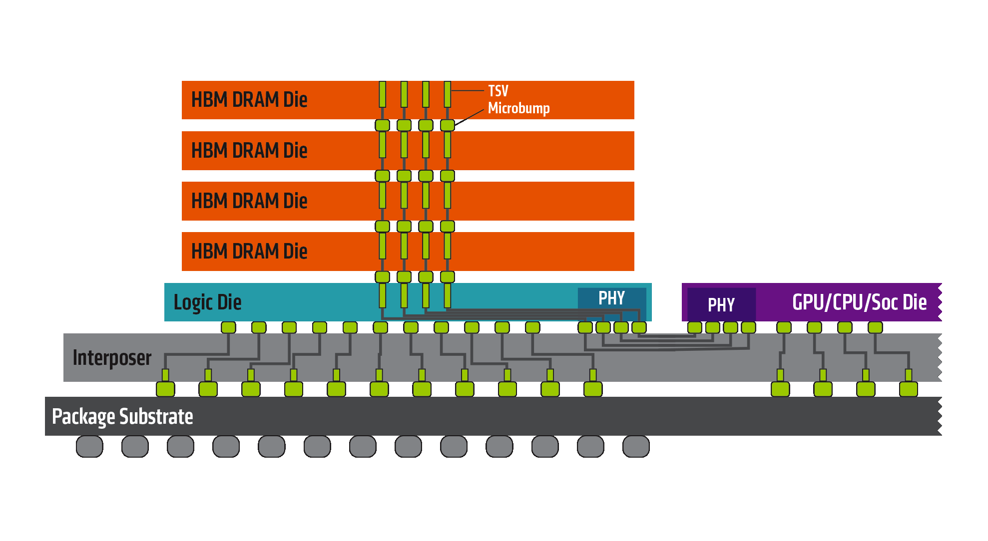
Heterogeneity in memory and computation
Emerging memory technologies of different types
Scratchpad, 3D-Stacked, HBM, NVM, Flash
Diverse set of computational resources
Conventional CPUs, GPUs, PIM (Processing-In-Memory)
AMD (https://www.amd.com/en/technologies/hbm)

Slide 5




Diversity in Programming Models
Diverse architectures require diverse programming models and libraries.

Slide 6
Challenges?
Different types of computational resources
Which one to use?
For how long?
How to distribute work?
Should all of them work at the same time?
Different types of memory resources
Which one to use?
Which one is closer?
Which one has more capacity or is faster?

Slide 7

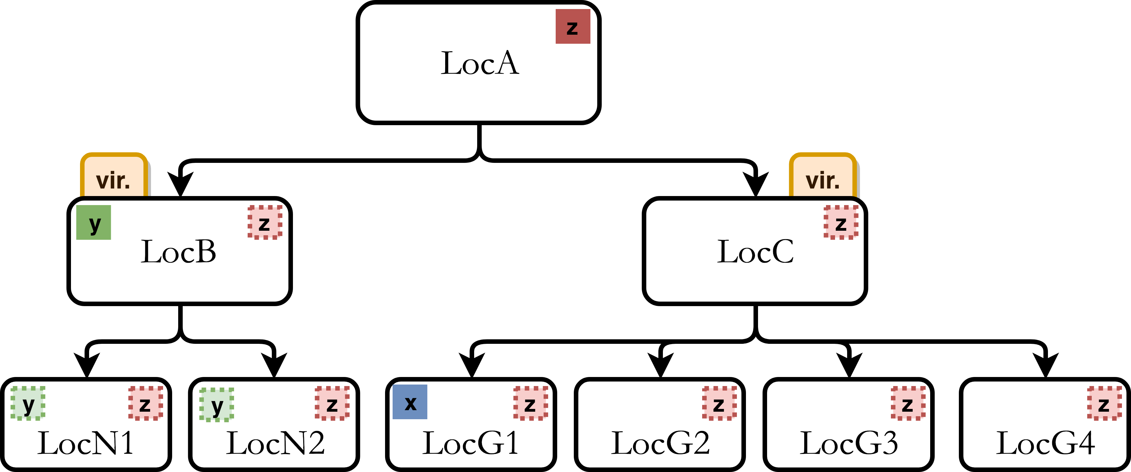
Abstract model: Gecko
Allocate “y”
A hierarchical model of available resources
Memory hierarchy
Compute cores
Key factor in design
A variable defined in location X is accessible to itself and its children.
Such variable is private to the parent.
Accessible by its children
Going down in hierarchy leads to better data locality.

Slide 8
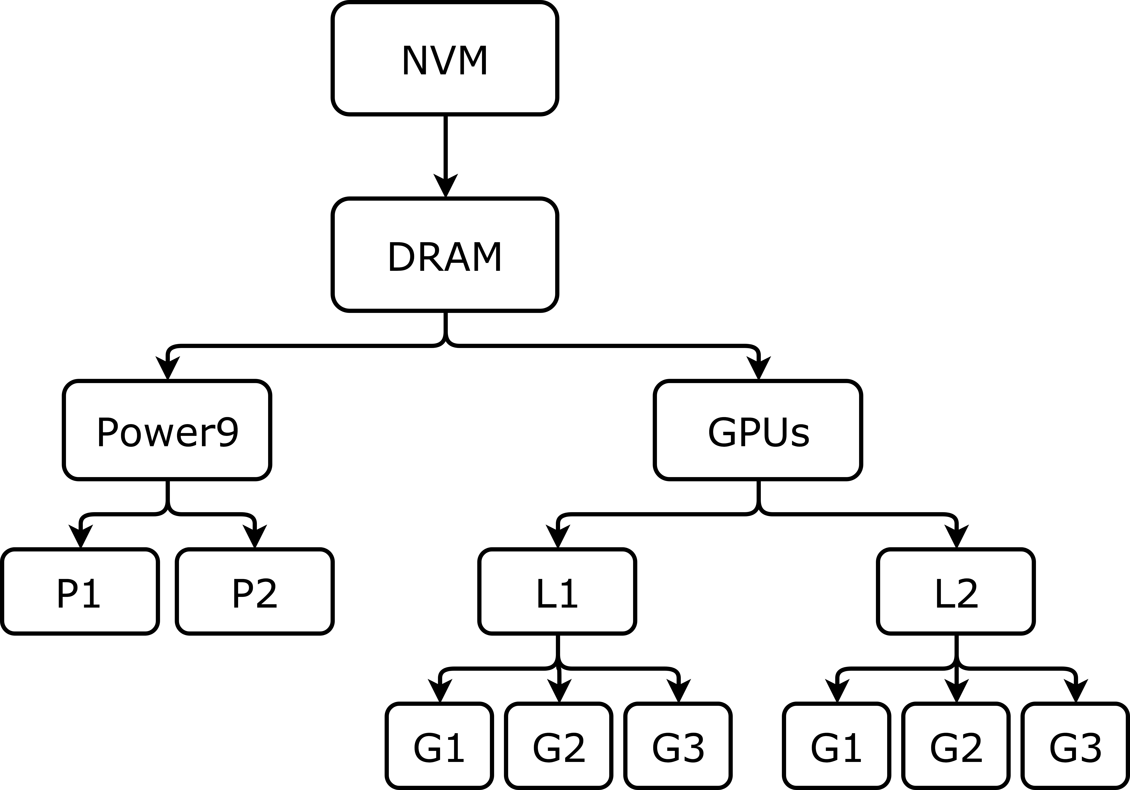
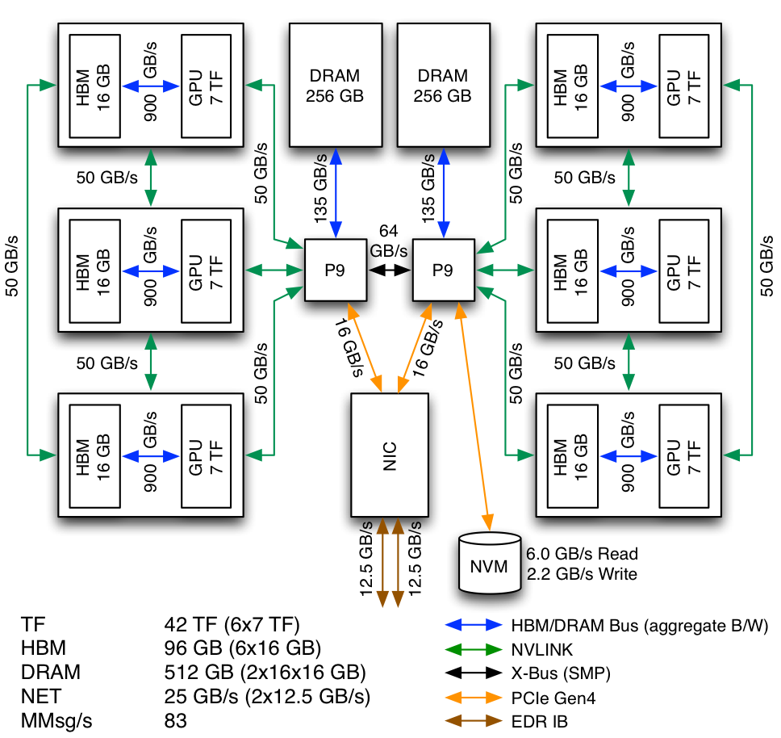
Big picture
Make software independent to underlying hardware
Summit Design – Courtesy of Oak Ridge National Lab. (ORNL)

Slide 9
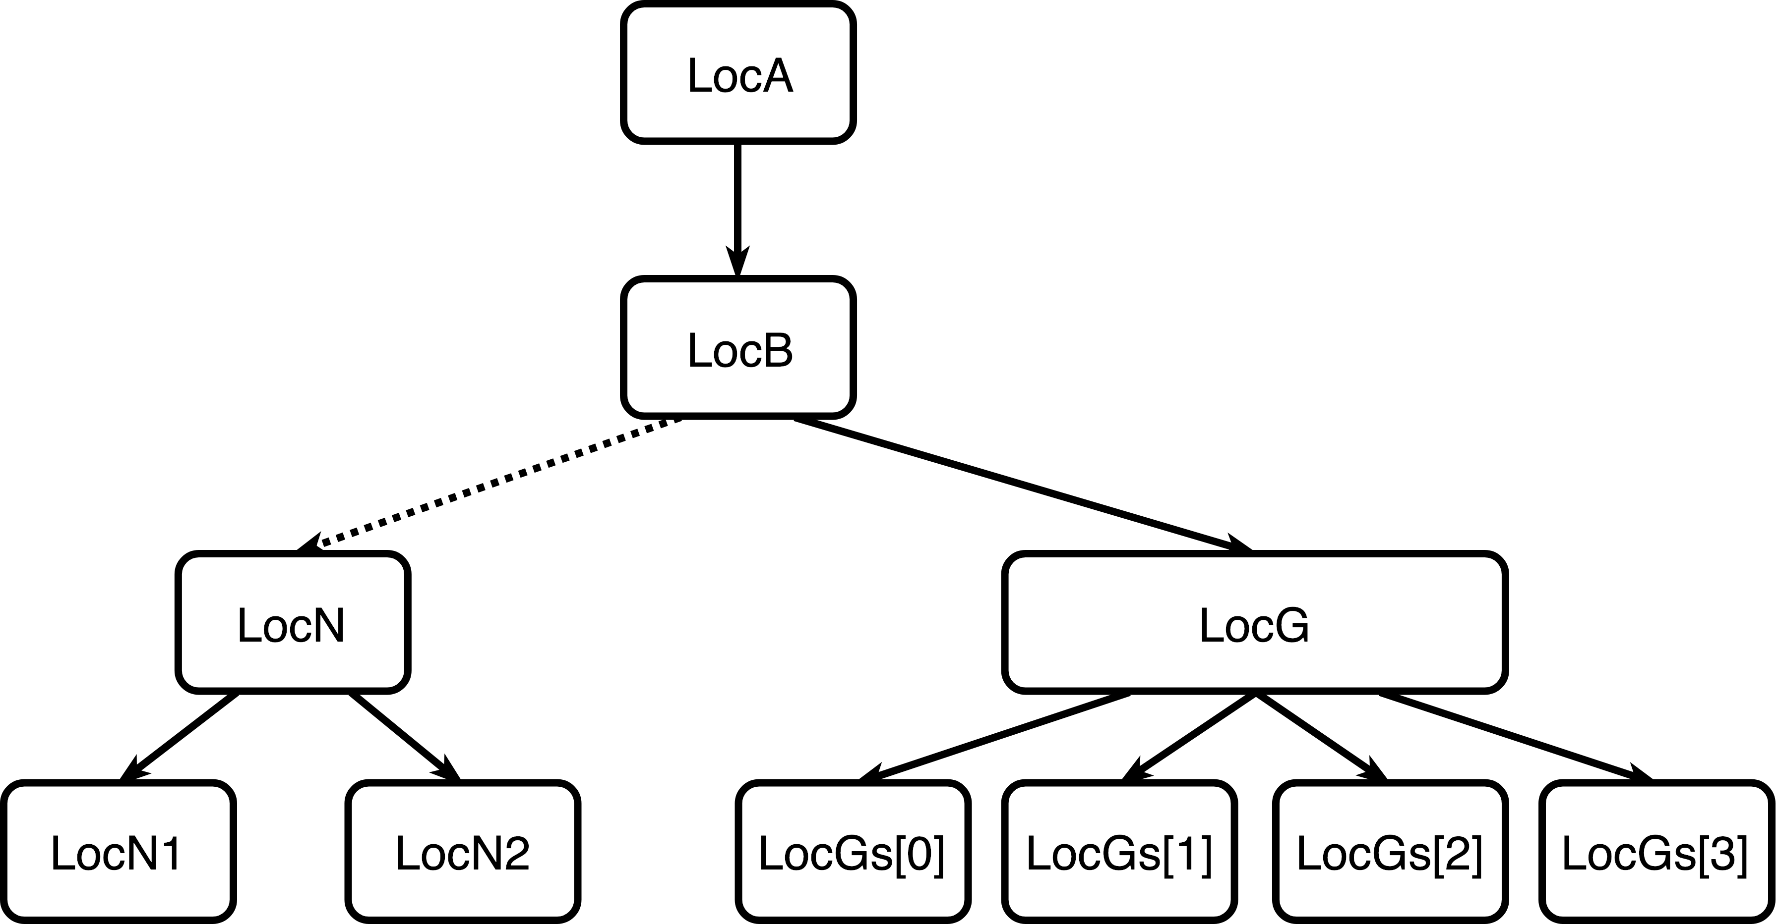
Sample source code

Slide 10
Key features (1/3)
Dynamic Hierarchy Tree

Slide 11
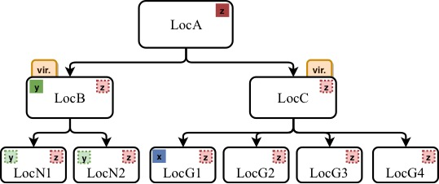
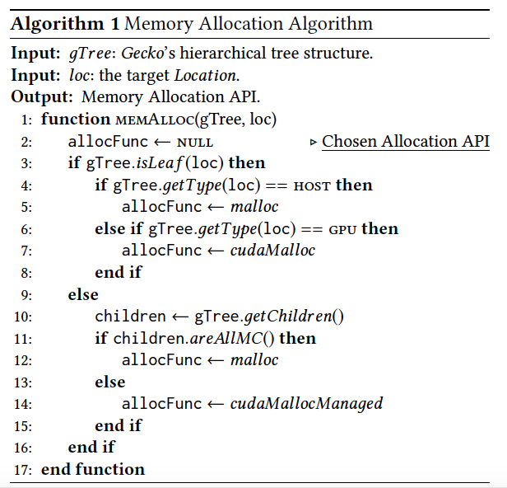
Key features (2/3)
Memory allocation
A challenging process
Full hierarchy is not known at compile time
Which API to call when an application asks for memory?

Slide 12
Key features (3/3)
Minimum code changes
Targeting LocA or LocC
Code remains untouched
Execution targets
Virtual locations
Leaf nodes

Slide 13
Sample source code

Slide 14
Evaluation
OpenACC
acc-managed: OpenACC code with UVM
acc: OpenACC code without UVM
Gecko
gecko-<N>
Utilizing N GPUs: changing config file
Using PSG cluster from Nvidia
Intel Haswell (one processor)
Nvidia Volta (four GPUs)
PGI Compiler (–acc –ta=tesla:cc70 –O3)

Slide 15
Results of Rodinia Workload
False-sharing has a negative effect on performance!
How to improve: Increasing granularity by reducing page size!

Slide 16
Results of Rodinia Workload (II)
Compute-intensive workloads benefit from multi-gpu platforms.

Slide 17
Results of Heterogeneous Execution
Some workloads are insensitive w.r.t. to the targeted platform.
Some perform better only if one single GPU is utilized.
Some still benefit from multi-GPUs only if host is not incorporating.

Slide 18
Takeaways
Abstraction is a good approach to code-reuse.
Makes life of developers easier.
With current advances in HW, it is a must.
It makes a good clean codebase as a starting point.
Further optimizations by close-to-metal programming.

Slide 19


Gecko: Hierarchical Distributed View of Heterogeneous Shared Memory Architectures
Millad Ghane¹ (mghane@cs.uh.edu),
Sunita Chandrasekaran² (schandra@udel.edu),
Margaret S. Cheung^{1,3} (mscheung@central.uh.edu )
University of Houston¹, University of Delaware²,
Center for Theoretical Biological Physics (CTBP), Rice University³
Feb. 17, 2019

Slide 20
Backup slides

Slide 21
Key features (3/3)
Minimum code changes
Targeting LocA or LocC
Code remains untouched
Execution targets
Virtual locations
Leaf nodes
Introducing distance concept
Near/Far memory
High Bandwidth/Low Latency memory
Run code where the data is placed

Slide 22
Gecko’s Programming Model
Defining location type
Declaring locations
Declaring hierarchy
#pragma gecko config file(“gecko.conf”)
Dynamism at run time
Memory allocations
Kernel execution
Synchronization
Memory releasing

Slide 23
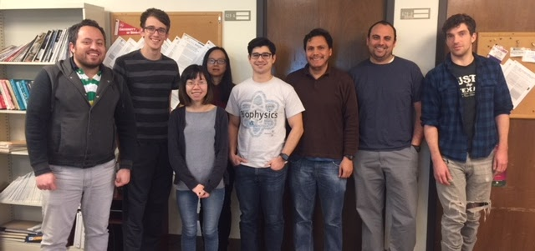


Acknowledgements
Cheung’s Group
Prof. Margaret S. Cheung
Dr. Pengzhi Zhang
Dr. Fabio Zegarra
Andrei Gasic
Jake Ezerski
Yossi Eliaz
Jacob Tinnin
Hoa Trinh
James Liman
Committee Members:
Dr. Margaret S. Cheung Dr. Sunita Chandrasekaran Dr. Larry Shi
Dr. Edgar Gabriel

