Slide 1
Laboratoire d’Informatique et d’Automatique pour les Systèmes
A Genetic Optimization Physical Planner for Big Data Warehouses
Soumia BENKRID, Yacine MESTOUI (Ecole nationale Superieure d’Informatique, Algeria)
Ladjel BELLATRECHE (ISAE-ENSMA, France)
Carlos ORDONEZ (University of Houston, USA)
IEEE BigData 2020
December 10-13, 2020 @ Now Taking Place Virtually
Notes:
Hello I’m soumia benkrid and pleased to share with you our work that brings A gentec ooptimization physical planner for Big data Warehouses
plēzd

Slide 2
Context: Parallel Big Data Warehouses
Input₁: DW
Fragmentation Phase
Input₂: W
Fragmentation Threshold
Input₃: Workload Q
SELECT
FROM WHERE
GOUP BY
SELECT
FROM WHERE
GOUP BY
SELECT
FROM WHERE
GOUP BY
SELECT
FROM WHERE
GOUP BY
Cost Model
Fragmentation Process
Input₄: Parallel Machine
Estimation of Processing cost of Q
Fragmentation Schema
Allocation Phase
Cost Model
Fragment Allocation Process
Allocation Schema
Limitations:
Not adapted to BI 2.0 (ad-hoc queries)
Static and a priori known queries
Self-adaptive Parallel DWs
Notes:
The process of designing a parallel data warehouse has two main steps: (1) fragmentation and (2) allocation of so-generated fragments at various nodes. Usually, we split the data warehouse horizontally, allocate fragments over nodes
Designing Parallel Big Data Warehouse consists in first fragmenting the RDW using any partitioning algorithm, and then allocating the so-generated fragments by means of any allocation algorithm
Today the BI joins the ”do-it-yourself” trend, it has become more difficult to achieve the best performance of the DW using this process based on predefined workload
Therefore, making a parallel DW self-adaptive with minimal human oversight is a crucial issue
Our works focus on data partitioning
The data placement is a rich field including the conventional data placement (round-robin, hash placement and range placement)

Slide 3
Data Partitioning
→Data fragmentation (DF) is a crucial phase of parallel DW design
Traditional Formalisation
Self-adaptive Fragmentation
Our 4-Inputs:
DW
Workload Q
Parallel Platform
Threshold W
Our 4-Inputs + 1
DW
Workload Q
Parallel Platform
Threshold W
Redesign Trigger
Static Fragmentation
Adaptive
Fragmentation
minimises overall query processing (Inputs/Outputs and Network Costs)
Fragmentation
Schema
Fragmentation
Schema
minimises overall query processing
and …
→The change of workload implies designer intervention ☹
→Several forms of triggers (e.g., Utility, User Feedbacks)

Slide 4
Agenda
Related Work on Adaptive Partitioning
Our Genetic Algorithm-based Approach
Experimental Study
Summary

Slide 5
State of Art
State of Art
Our Proposal
Experiments
Summary
Self-adaptive Partitioning
Query-driven Approaches
Data-driven Approaches
e.g., Teradata
Open-loop Learning
Workload Changes (Alarm)→ Repartitioning
e.g., Schism [VLDB10]
Closed-loop Learning
Alarm Management (Relevant Criteria → Usage of internal and external parameters)
Reinforcement Learning: e.g., Hilprecht [SIGMOD20]
Knowledge of whole workload
Time and energy overheads to explore a large search space.
Our Proposal for self-adaptive partitioning is based on a realistic hypothesis:
A set of a priori known queries (used as a training set)
A set of ad-hoc queries

Slide 6
Our Proposal
State of Art
Our Proposal
Experiments
Summary
Our Redesign Trigger = Utility of a fragmentation schema on workload at time t
→Utility-driven self-adaptive fragmentation with two objective functions
Our 4-Inputs + 1
DW
Workload Q (known and ad-hoc)
Parallel Platform
Threshold W
Utility Threshold
Adaptive
Fragmentation
Fragmentation
Schema
Minimises overall query processing (Inputs/Outputs and Network Costs)
Maximises Utility
Utility(Q_{t}, FS_{kt}): a measurement that captures the reduction of the processing cost of a Q_{t} over fragmentation schema FS_{kt} compared to the one obtained at (t-1) (Q_{(t-1)}, FS_{k(t-1)})
Utility threshold minimizes this reduction over two consecutive periods (t and t+1)

Slide 7
Illustration of Fragmentation in Big DW
State of Art
Our Proposal
Experiments
Summary
A Star Join Query
Star Schema Benchmark (SSB)
Select c_nation, s_nation, d_year, sum(lo_revenue) as revenue
from customer CU, lineorder LO, supplier SU, dates DA
where lo_custkey = cu_custkey (J₁)
and lo_suppkey = su_suppkey (J₂)
and lo_orderdate = da_datekey (J₃)
and cu_region = 'AMERICA’ (Selection Predicate)
and su_region = 'AMERICA’ (Selection Predicate)
and da_year ≥ 1993 and da_year ≤ 1998 (Selection Predicate)
group by cu_nation, su_nation, da_year
order by da_year asc, lo_revenue desc;
CUSTOMER (CU)
PART (PA)
CUSTKEY
NAME
ADDRESS
CITY
NATION
REGION
PHONE
MKTSEGMENT
PARTKEY
NAME
MFGR
CATEGORY
BRAND1
COLOR
TYPE
SIZE
CONTAINER
SF*6.000.000
LINEORDER (LO)
ORDERKEY
LINENUMBER
CUSTKEY
PARTKEY
SUPPKEY
ORDERDATE
ORDERPRIORITY
SHIPPINGPRIORITY
QUANTITY
EXTENDEDPRICE
ORDERDATE
DISCOUNT
REVENUE
SUPPLYCOST
TAX
COMMITDATE
SHIPMODE
SF*30.000
200.000*(1+log SF)
SF*2.000
SUPPLIER (SU)
2556
SUPPKEY
NAME
ADRESS
CITY
NATION
REGION
PHONE
DATE (DA)
DATEKEY
DATE
DAYOFWEEK
MONTH
YEAR
YEARMONTHNUM
YEARMONTH
DAYNUMBER
DAYNUMMONTH
MONTHNUMYEAR
WEEKNUMYEAR
SELLINGSEARSON
LASTDAYINMONTHFL
HOLIDAYFL
WEEKDAYFL
DAYNUMYEAR
A Fragmentation Procedure:
Fragment each dimension table using its selection predicates
Propagate all these fragmentations on the fact table
Example of Fragmentation Schemes (FSs) of Dimension Tables
d_year (DA) | 2018 | 2019 | 2020
c_region (CU) | AFRICA | EUROPE | AMERICA
p_category (P) | #13 | #14
→Fact Table (LINEORDER) is then partitioned into 18 fragments

Slide 8
Our Genetic Algorithm (GA)
State of Art
Our Proposal
Experiments
Summary
Our 4-Inputs + 1: DW, Known Workload, Parallel Platform, Threshold W, Utility Threshold U
Online Phase
Fitness
Evaluation
Ad-hoc queries
Population
{FS₁
FS₂
…
FS_{h}$\}$
Offline Phase
Crossover Mutation
Adaptation
Strategies
Selection
New Population
Inject adaptation strategy into last GA population
8

Slide 9
Elements of GA ^{(1/2)}
State of Art
Our Proposal
Experiments
Summary
d_year | 2018 | 2019 | 2020
c_region | AFRICA | EUROPE | AMERICA
p_category | #13 | #14
d_year | 1 | 2 | 3
c_region | 1 | 2 | 3
p_category | 1 | 2
Chromosome Coding
From 2 Fitness Functions to 1:
Minimisation of overall query processing cost (Inputs/Outputs and Network)
Constraints:
Number of Fact Fragments ≤ W
Utility ≥ Utility Threshold U
Illustration of the Utility
Execution time of new query q under FS_{t} is 10 ms
Execution time of another new query q’ under FS_{(t+1)} (by considering q) is 8 ms
Utility = 8/10 = 80%

Slide 10
Elements of GA ^{(2/2)}
State of Art
Our Proposal
Experiments
Summary
Workload
Initial population of GA
Workload is clustered into several groups
Fragmentation process for each group
Several clustering techniques may be used: lexical, physical, arrival rate
We propose lexicosemantic clustering based on the interaction between queries (common subexpressions)
Improvement of solution
Selection, crossover and mutation
Workload clustering
Workload Cluster ₁
Workload Cluster ₂
Workload Cluster _{k}
Workload Cluster _{n}
Horizontal Partitioning
Horizontal Partitioning
Horizontal Partitioning
Horizontal Partitioning
Building Partitioning Schema
FS 1
FS 2
FS 3
FS 4
Merging
Initial Population
Notes:
Initial Population
To efficiently produce several initial solutions, a heuristic based on workload clustering is designed to generate a special population
Identify queries groups
Generate a fragmentation schema using any partitioning algorithm[REF]
Workload clustering serves as a bridge between the predefined workload and ad-hoc queries. It consists to group similar queries together where each group contains queries that have similar features : (1) Lexical( tables, attributes, aggregate, order by…….), (2) Physical: (tuplesread, cpu, cache hit, index oages networkread,…), (3) arrival rate history
we propose the usage of common subexpressions among queries as features (called ”lexicosemantic”).
alternative solutions
Crossover
Mutation

Slide 11
Experimental Study
State of Art
Our Proposal
Experiments
Summary
Our Environment:
Deployment Infrastructure: Postgres-XL
1 GTM node
1 coordinator Node
8 Datanodes
Our Datasets:
Star Schema Benchmark
Scale Factor: 100 GB
440 Million Fact Rows
1000 queries generated from the 13 original queries
Data Allocation
Hashing allocation

Slide 12
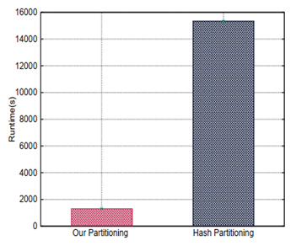
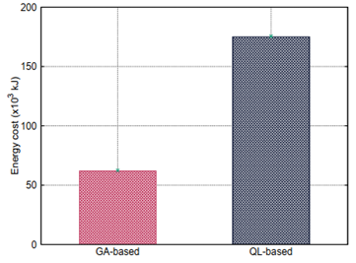
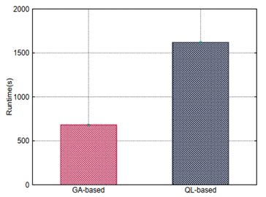
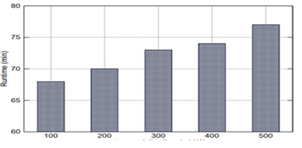
Quality of our Fragmentation
State of Art
Our Proposal
Experiments
Summary
W=200, 1000 predefined queries
Hash distribution
Energy
Adaptation time
Effect of W
Our proposal satisfies two nonfunctional requirements in Big Data:
Query performance
Energy consumption of our deployment platform
Importance to choose the right number of the target final fragments.
Notes:
Workload clustering improves significantly the performance of ad-hoc queries
Hash range partitioning improves also the performance
A high value of W significantly decreases the query performance (Union operations)
A High value of utility rate decreases the performance of ad-hoc queries.

Slide 13
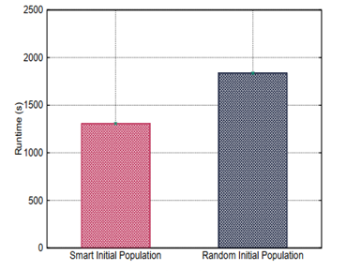
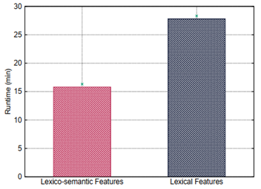
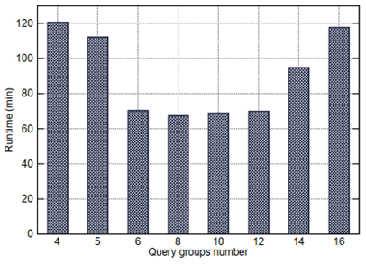
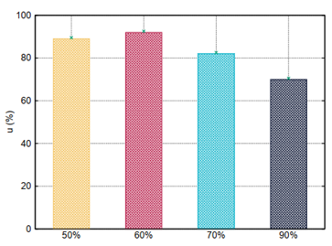
Impact of Workload Clustering
State of Art
Our Proposal
Experiments
Summary
W=200, 1000 predefined queries and 20 ad-hoc queries
Initial population
Features effects
Effect of query groups number
Utility Effect
Workload clustering improves significantly the performance of ad-hoc queries
Importance of choosing the right features and number of query groups
A high utility rate favors predefined queries.
Notes:
Large/Small query classes degrade overall workload performance.
Lexico-semantic features improve performance of ad-hoc queries

Slide 14
Summary
State of Art
Our Proposal
Experiments
Summary
Self-adaptive data fragmentation in parallel Big Data
Offline (training-like step) and online phases (for ad-hoc queries)
Genetic-based algorithm
Fragment allocation procedure
Query clustering as a service for managing ad-hoc queries
Intensive experiments
Improvement of fragment allocation by using AI techniques
Integration of our proposal in Spark

Slide 15
Soumia Benkrid Ecole nationale Superieure d’Informatique (ESI) Algeria s_benkrid@esi.dz

