Slide 1
Growing a FLOWER: Building a Diagram Unifying Flow and ER Notation for Data Science
Carlos Ordonez, Robin Varghese, Nguyen Phan
University of Houston
Wojciech Macyna
Wroclaw University of Technology
<number>/20

Slide 2
Motivation: data integration, maintaining code, reducing redundancy view diagram
ER fundamental tool, modern EER notation, beyond DB
Tons of diverse data (Variety) from heterogeneous sources; data warehousing old, data lakes old->cloud
Data pre-processing cannot be automated, significant human interaction required, time-consuming
Python code difficult to maintain, understand and debug
Data transformation/derivation, outside a relational database, not expressible in relational algebra or SQL
Previous work: Represent data transformation by SQL queries [Ordonez et al. DKE 2013]
<number>/20

Slide 3
Our proposed extended ER diagram
minimal extension to EER notation: arrow
diagram built from source code helped by HCI
Python language is more precise than natural language
O(1): |sourcecode|=O(1) << |data|: 1 second
Two classes of entities:
Source: Existing ER entities: data source entities
NEW Transformation: “data flow” value derivation, preserving keys (identifiers)
Keys: guess PKs, infer FKs. Intuition: file names, subscripts, feature/column names mapped to keys.
Add relationships connecting source and transformation entities, and chains of transformations. Goal: data set
<number>/20

Slide 4
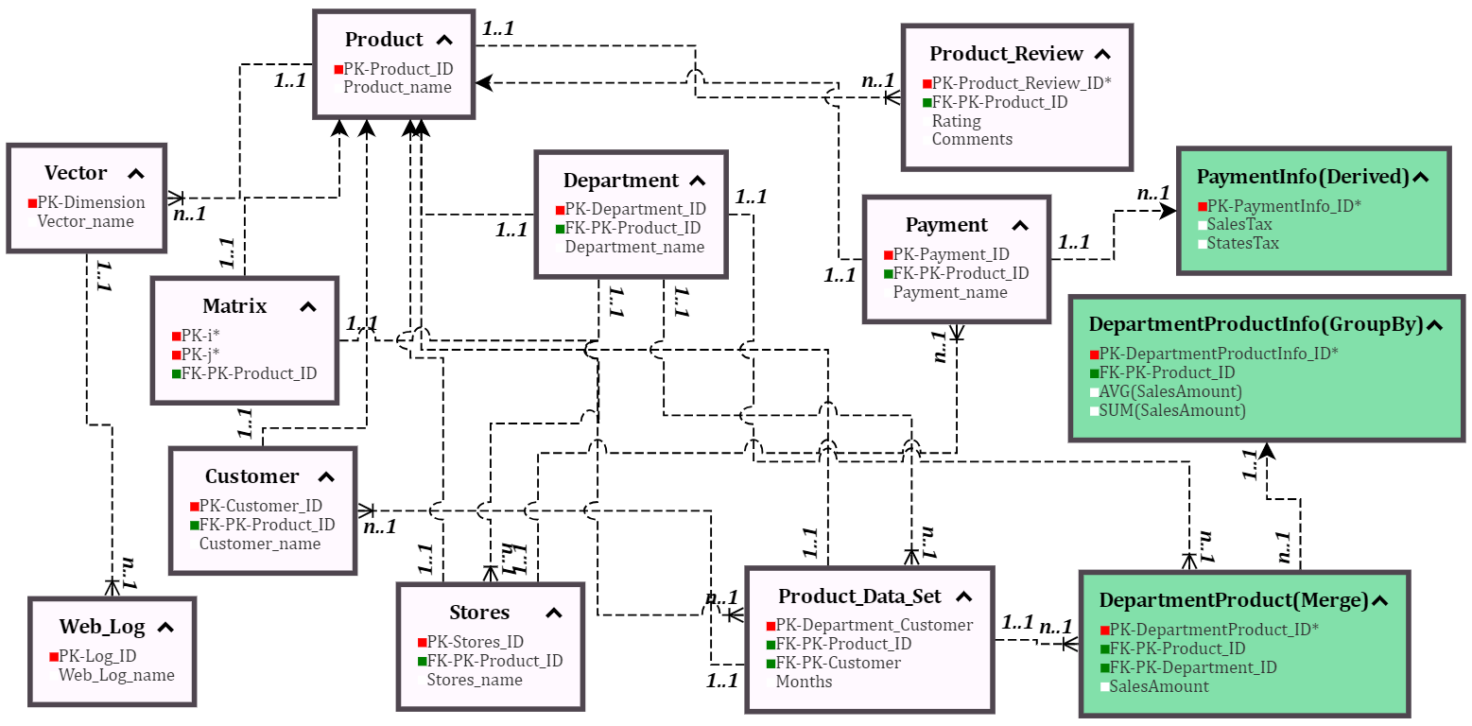
Old ER+FLOW Diagram on SQL database
<number>/20

Slide 5
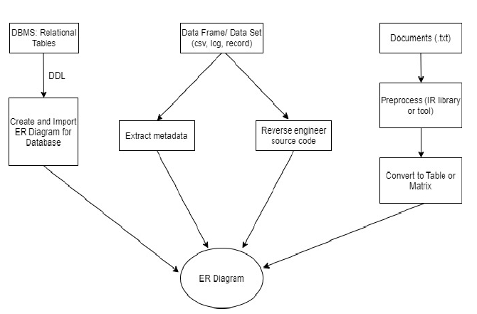
FLOW + ER: diverse data sources
<number>/20

Slide 6
Extending EER: advantages
FLOWER is an EER extension, not an alternative notation
Important assumption: files, matrices, vectors, table are manipulated with set semantics based on keys or subscripts
Intuition: CSV and JSON files can be transformed into SQL tables
Source code has embedded PK/FK information
Minimally disruptive: flow arrow is minimally invasive
Compatibility with other ER extensions: UML, crowfeet for relationships
Unlike previous ER research, incorporates external data into ER (even data incompatible with the relational model)
<number>/20

Slide 7
Entities Beyond a Relational DB
ER data source entities are unchanged
Transformation entities added based on pipeline tracing from source code (function calls, assignments) or tools (statistics, machine learning)
Consider relationships by attributes and identifiers
Map identifiers in other processing contexts as pseudo PKs in the relational model
Identify attributes based on subscript or key usage and known code patterns (embedded FDs)
<number>/20

Slide 8
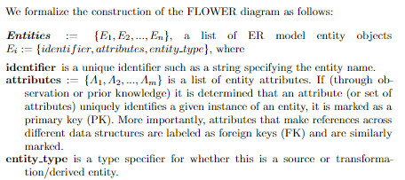
ER diagram components
<number>/20

Slide 9
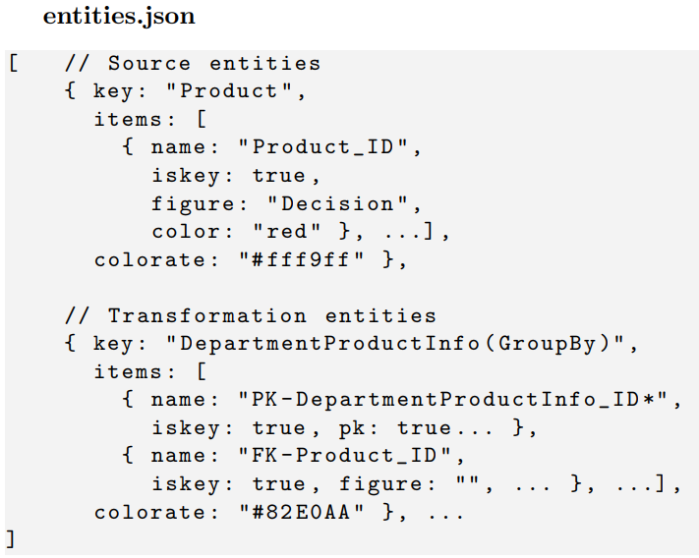
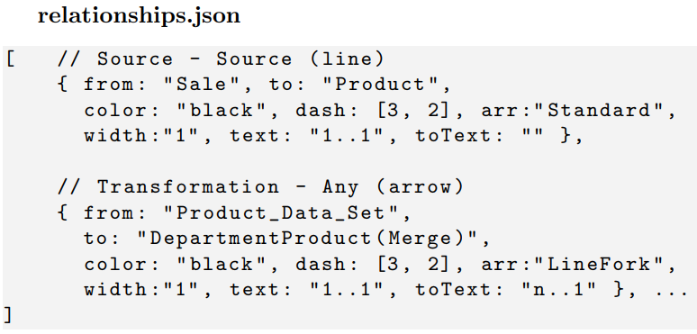
FLOWER Diagram Storage and Processing
Stored on two JSON files: entities and relationships
Cardinality and direction flow are object attributes
<number>/20

Slide 10
Identifying Data Flow on Python Code
Primitive LR parser
Static analysis of source code gives a glimpse of data flow
Considering only general variable assignments & inputs/outputs lets us analyze scripts in linear time
Data Science languages like Python and R are object oriented and imperative
Treat objects, functions as intermediate entities
Scripts are treated as a flow of operations
Data type inference: future work
<number>/20

Slide 11
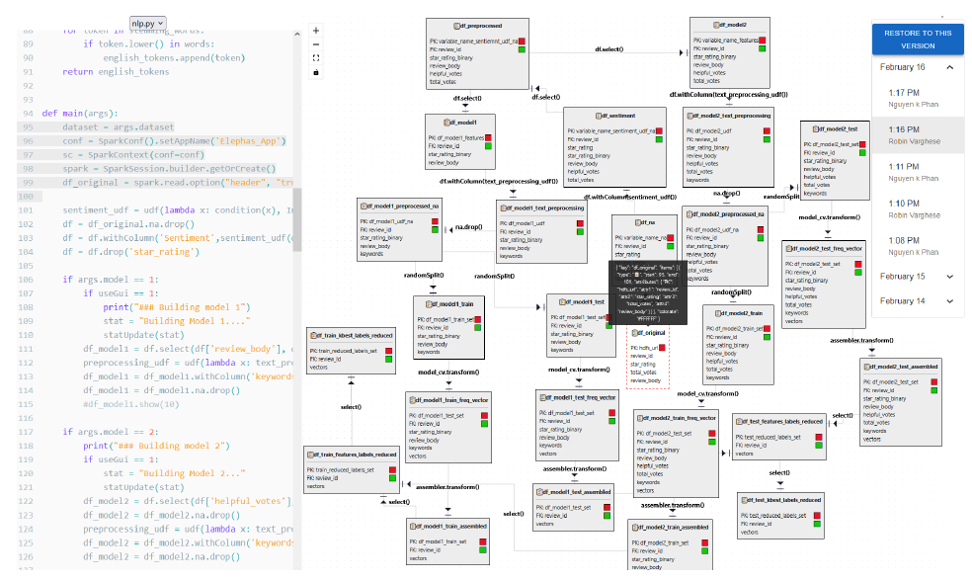
Our GUI: source code, diagram, log on Amazon reviews (NLP)

Slide 12
Conclusions
FLOWER extends and generalizes EER with data flow
Input: source code
Output: ER-style diagram
Data flow captured via an added arrow in ER relationships
Reverse engineering: go from source code to “data+flow” model
Two preliminary case studies in paper: NLP and biomed
Future work: differences between data frames, tables and matrices; study formal semantics; functional dependencies; data type inference
<number>/20

