Slide 1


Integrating Flow and Structure in Diagrams for
Data Science
Enea Vincenzo Napolitano¹ , Elio Masciari¹ , Carlos Ordonez²
1. University of Naples, Federico II
2. University of Houston

Slide 2
Introduction
Objective
Integrate data structure and flow into a unified model for data science workflows.
Problem
Static ER diagrams focus on data structure but fail to represent data transformation.
Dynamic DFDs capture data flow but lack structural detail.
Entity-Relationship (ER) diagrams, despite being the standard for database design, do not extend naturally to modeling data transformations, which are critical in modern workflows.

Slide 3
Context and Background
ER Diagrams: Structural modeling for databases (entities, attributes, relationships).
ER diagrams are more widely used than other notations due to their intuitive and flexible design.
Extending ER diagrams to include data transformations would bridge the gap between data modeling and workflow representation
DFDs: Represent data flow and processes (processes, data stores, external entities).
Current Limitations: Lack of unified view.

Slide 4
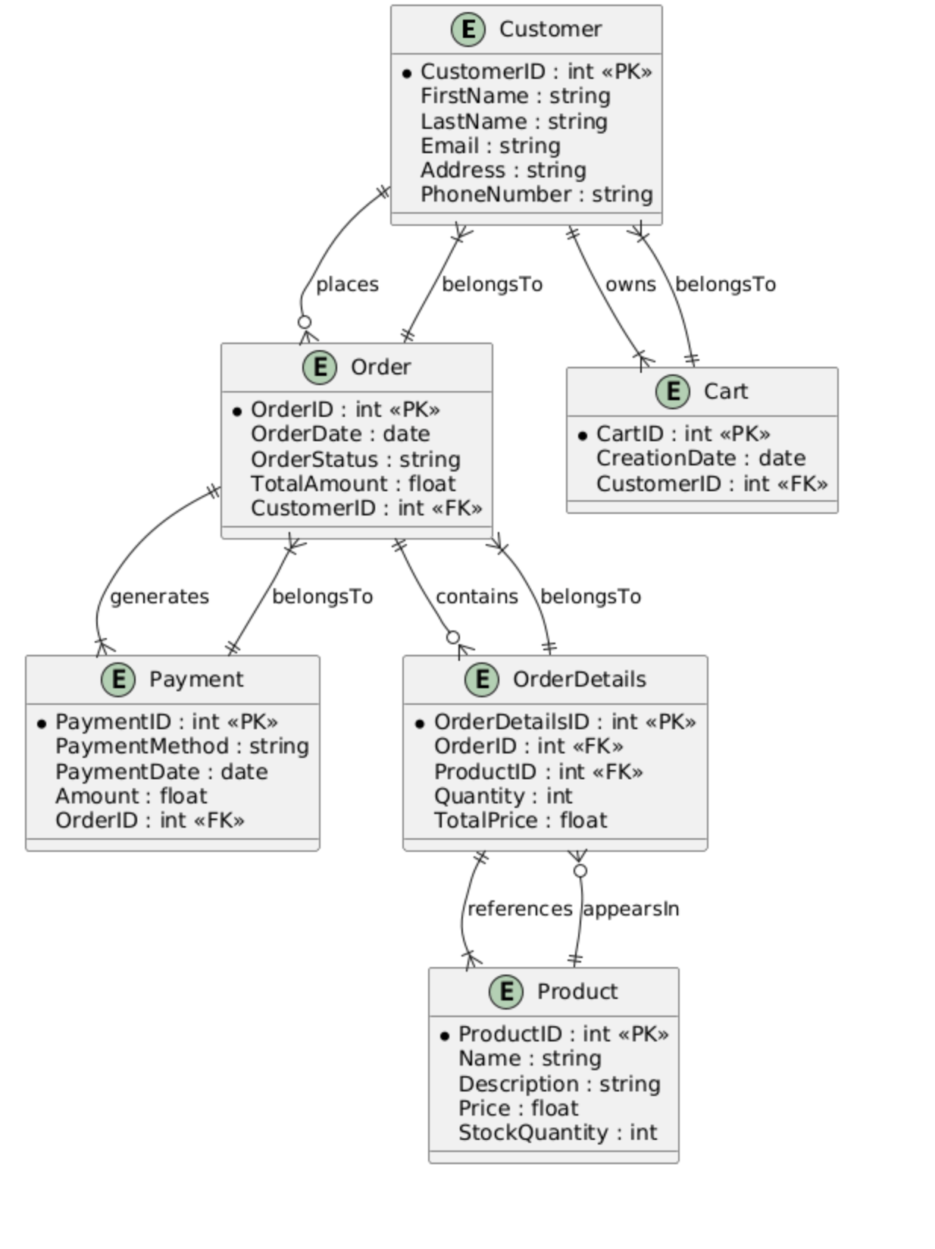
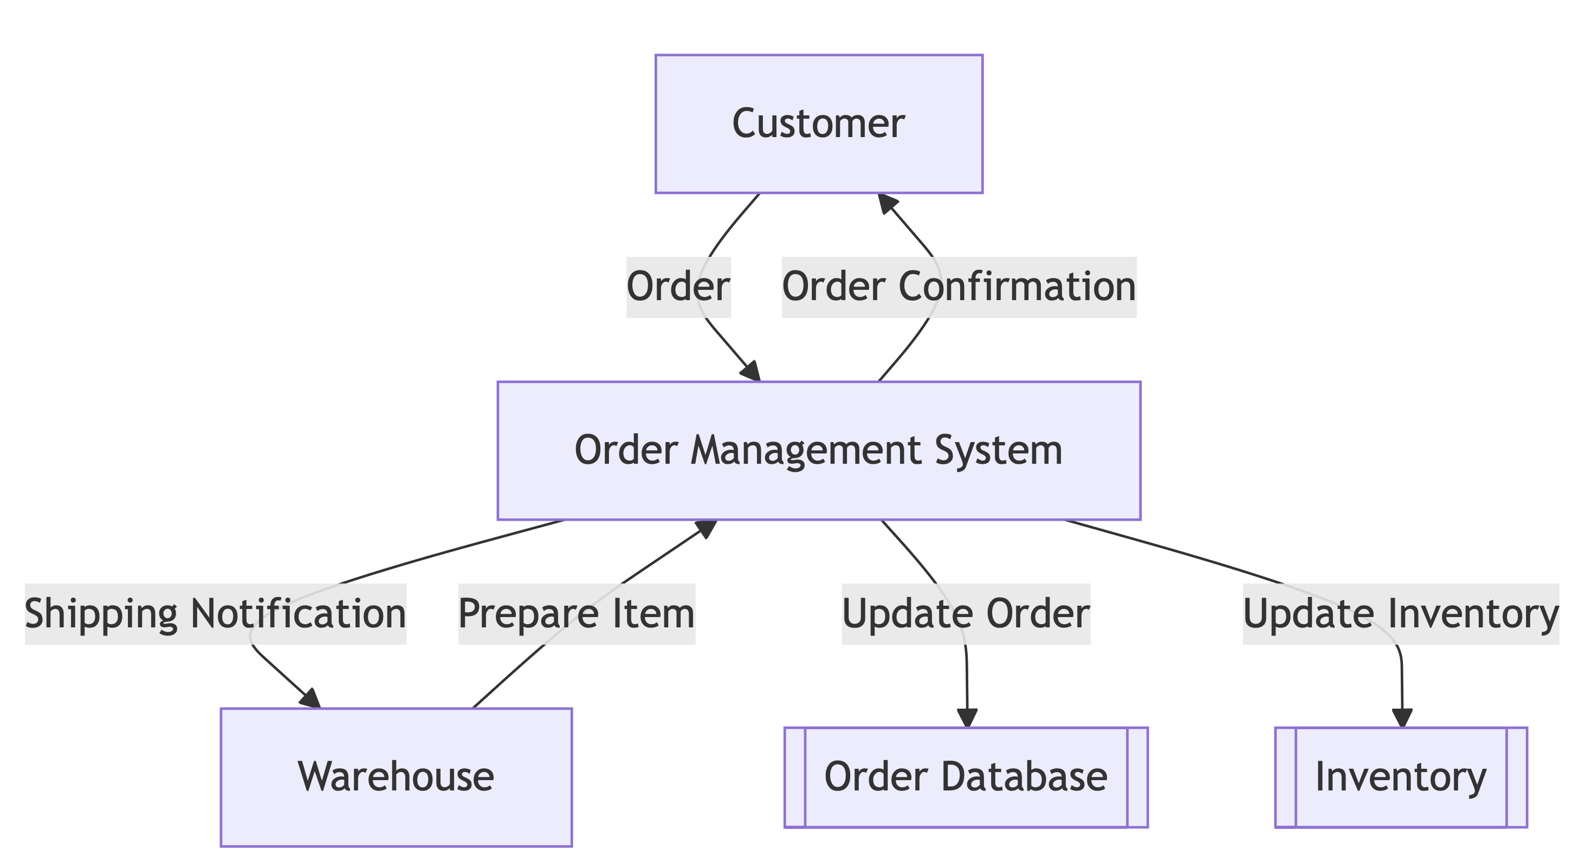
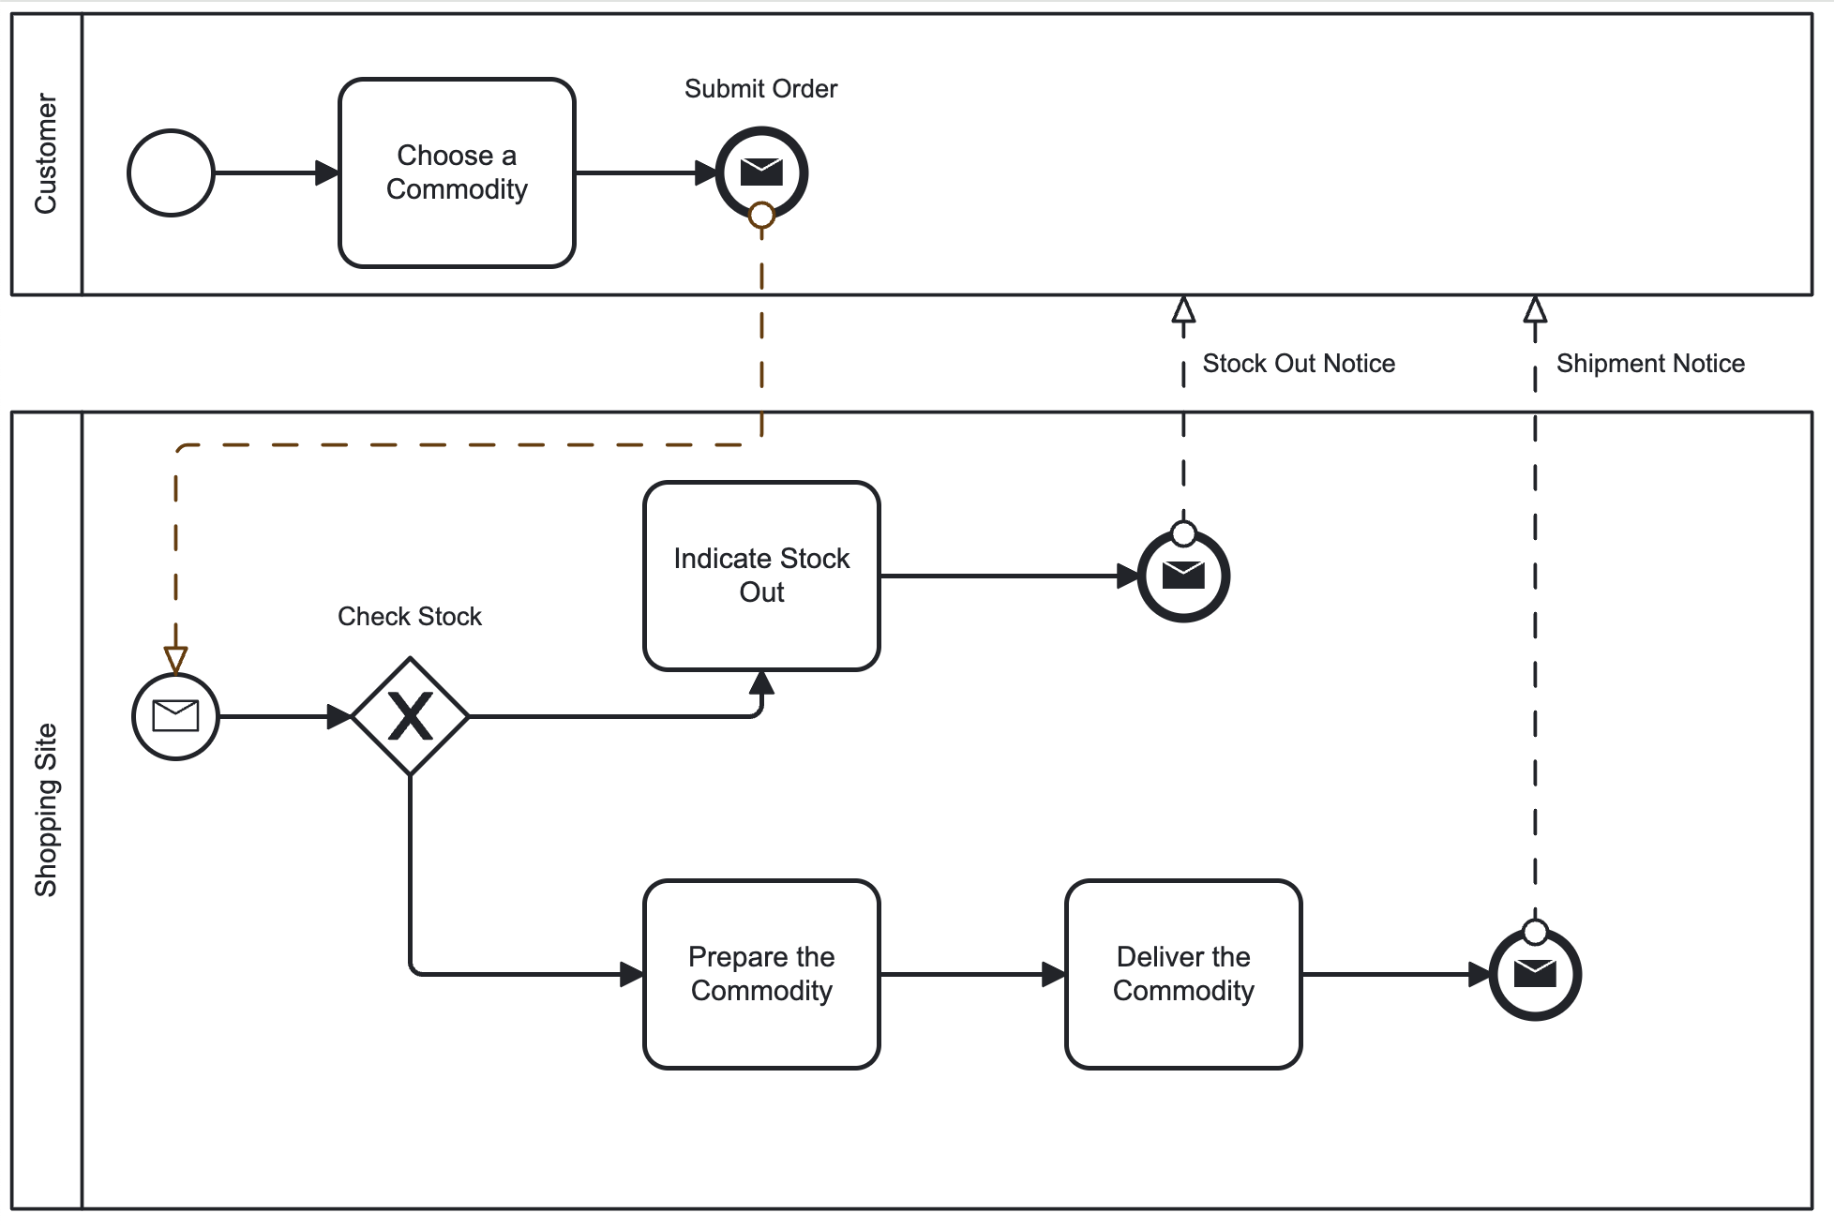
ER vs DFD vs BPMN
"ER diagrams are supported by a rich theoretical foundation and offer high abstraction, making them an ideal candidate for extensions rather than DFD or BPMN."

Slide 5
Proposal
Goal
Develop an integrated model combining:
  Structure: Entity-Relationship (ER) diagrams.
  Flow: Data Flow Diagrams (DFDs).
  Data Science Requirements: Support for matrices, vectors, and transformations.
Assumptions
The FLOWER approach is effective if an embedded primary key is present:
  This holds true after data preprocessing, where data is transformed into matrices or vectors with the primary key as a subscript.
Advantages
Improved understanding of both structure and flow.
Enhanced representation of complex operations in data science workflows.
UML's Notation: Clean, simple, and intuitive for minimal modifications.
Minimal Change: Adding arrows to represent data flow while preserving existing structure.

Slide 6
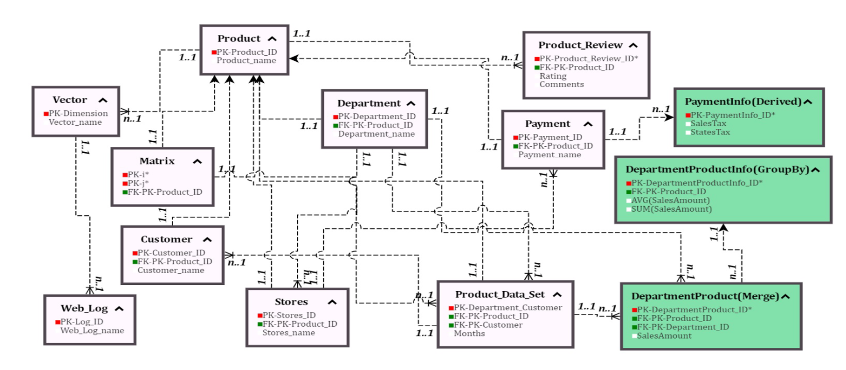
FLOWER

Slide 7
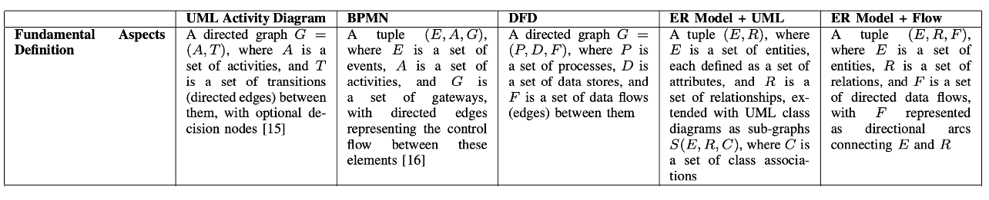
Definitions

Slide 8
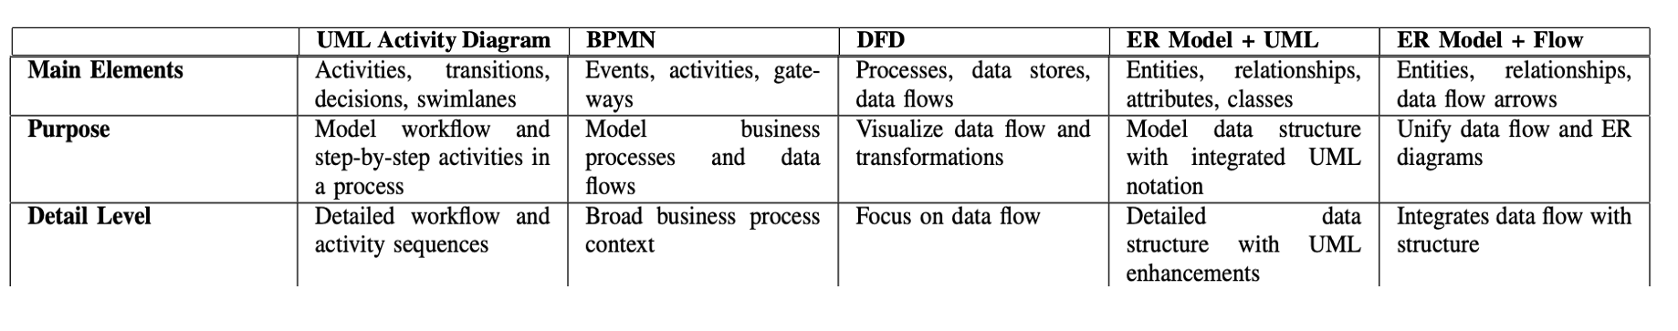
Main elements

Slide 9
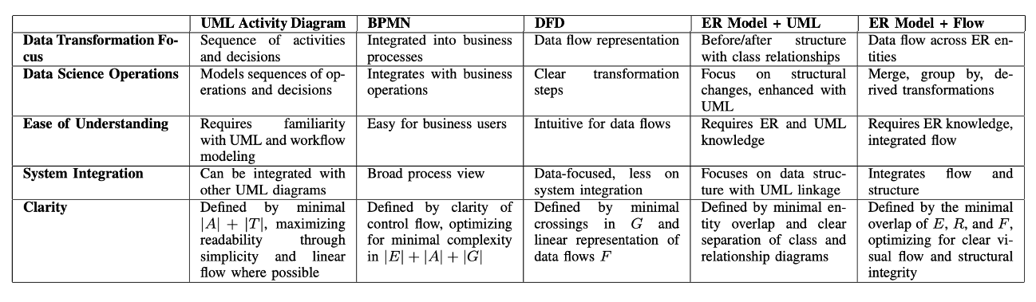
Data Science operations

Slide 10
Future Directions
Research
Extend BPMN to better integrate with emerging technologies.
Explore advanced techniques for dynamic modeling of complex workflows.
Objective
Develop models capable of handling unstructured data formats such as text, images, and hybrid datasets.
Support Python-based workflows in addition to SQL query modeling.
Challenges
Formalizing the problem through:
  Graph traversal methods for workflow optimization.
  Evaluation of modeling languages for scalability and adaptability.
  Extending solutions to non-relational data and non-database formats.
    Enabling topological sorting for structured yet flexible workflow representations.

Slide 11
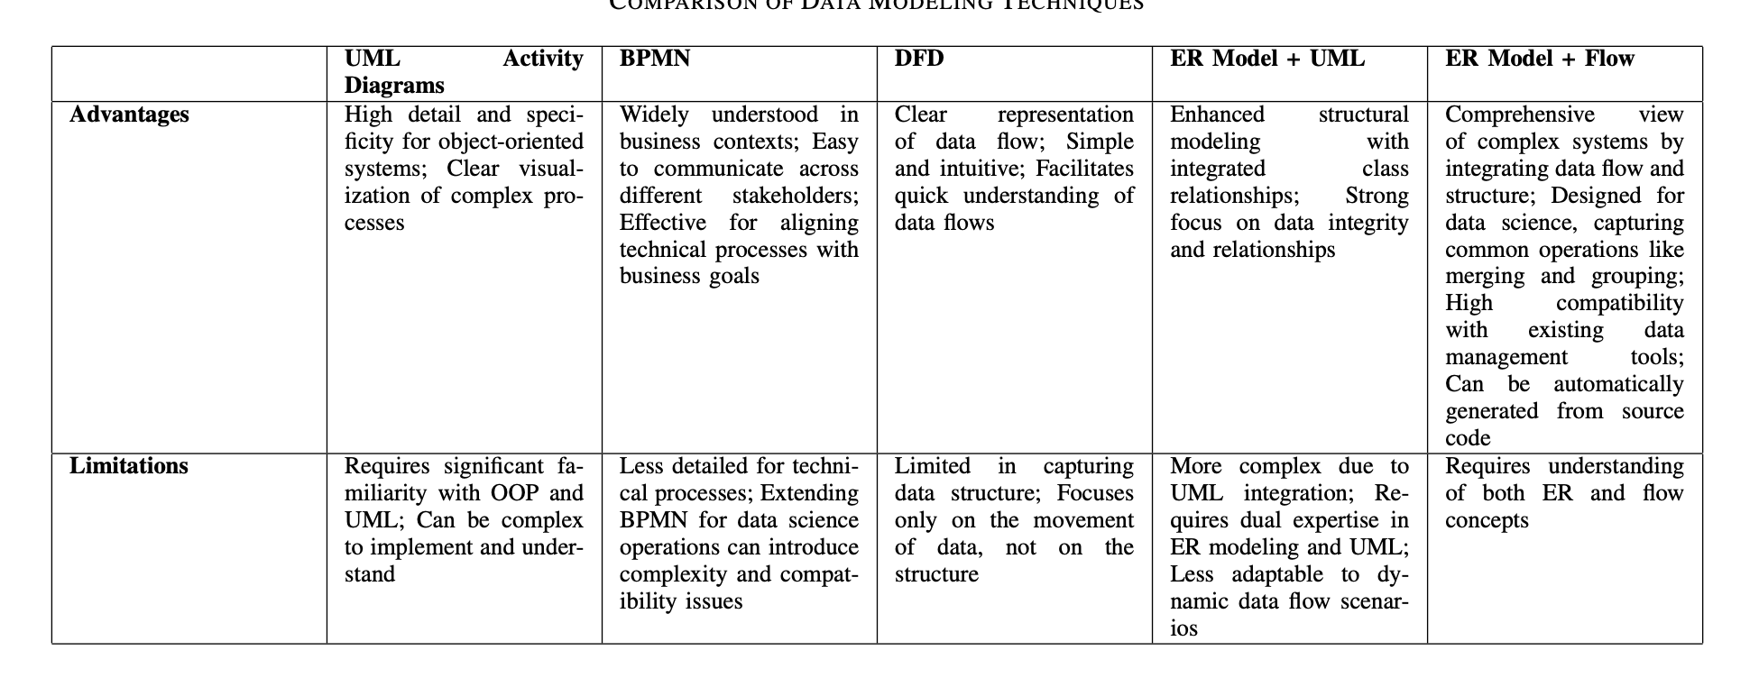
Summary

Slide 12
Conclusions and main ideas
Integrating structure and flow is essential for improved data management and analytics workflows.
Models like FLOWER represent a significant step forward in bridging static and dynamic representations.
Minimal Change, Maximum Impact:
  The addition of an arrow to represent data flow is a powerful yet minimal change.
  Diagrams inherently support keys, ensuring consistency and clarity.
  Diagrams can be automatically generated from source code, enhancing usability and reducing manual effort.
Call to Action
Revisit diagram-based approaches to emphasize database principles, rather than relying solely on increasing volumes of Python code without a coherent data model.

Slide 13
Thank you for your attention

