Slide 1



Green Analytics
Ladjel Bellatreche
LIAS/ISAE-ENSMA Poitiers, France
Wojciech Macyna
Wroclaw University
Poland
Carlos Ordonez
University of Houston
USA
Notes:
1

Slide 2

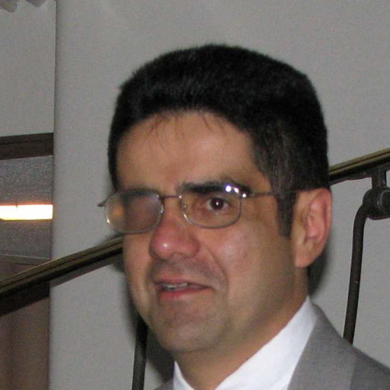
Our background
96:99 HKUST, China
Physical Database Design
2000 – Now: France
Data Science
1997- 2011: Software Companies: Database application developing
2005 – Wroclaw University of Technology: Indexing structures in Flash Databases, Key Value Databases
1998 - 2006: NCR:
Query Optimizer of Teradata Parallel DBMS
2006: New: University of Houston, USA
Big Data Systems Lab

Slide 3
Motivation: Database Query Optimizer
Applications
SQL
{tuples}
Server (Network, App Buffers, Security)
Query Processor
Transactions
(Locking, Logging)
Data Manager
(Indexes, Records)
Metadata Mgmt
(Schema, Stats)
Query Optimizer
Storage Manager
(Pages)
get/put
block
Storage System
(disks, SSDs, ...)
→Traditional Database Requirement:
« Demand speedy access to data, no matter how complex the queries are »
Notes:
3

Slide 4
Non Functional Requirements (NFR)
NFR define system properties and constraints e.g. reliability, response time and storage requirements.
NFR may be more critical than FR. If these are not met, the system may be useless.
Used NFR in Database World:
  Response time
  Maintenance Time
  Stockage Time
  Pricing (Cloud),
  But Absence of Energy Consumption

Slide 5
NFR Classification

Slide 6
Takeaways from Efforts in DB Physical Design
Definition analytical cost models to estimate
  Response time of database operations (e.g., join, selection)
  Maintenance cost
  Storage cost
Development of cost-based algorithms to select optimisation structures (e.g., indexes, materialized views)
Reproduction of this expertise to measure energy consumption

Slide 7


Database and ML Worlds
Data protection
Database World
ML World
Research question
Deployment and
Dissemination
Data preparation
Operations: Join, filter, union, sort
Data storage and management
Data analysis
Data Ethics and social policy
Operations: Extract, Retrieve, Merge, Union, Join, Filter, Convert, Aggregate, Store, …
7

Slide 8
Outline
Motivation
Energy background
Hardware
Software
Research issues
Notes:
8

Slide 9
1. Motivation
Slides: 20
Time: 15 min
Notes:
9

Slide 10
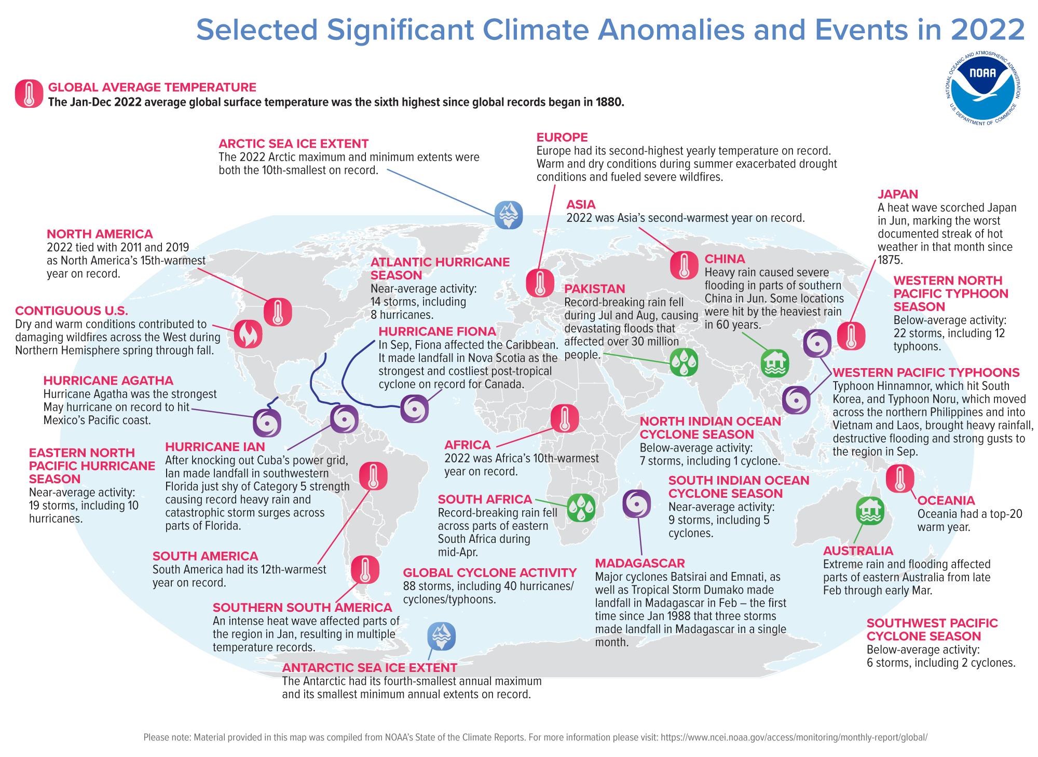
Global Warming
Notes:
10

Slide 11
Seven Causes of Global Warming
Power Generation by burning fossil fuels
Manufacturing industry is one of the largest contributors to greenhouse gas emissions worldwide
Cutting down forests reduces the absorption of carbon dioxide
Transportations that run on fossil fuels
Production of Food
Powering buildings that consume over half of all electricity: electricity consumption for lighting, appliances, and connected devices
Consuming too much: Our lifestyles have a profound impact on our planet. The wealthiest bear the greatest responsibility.
https://www.un.org/en/climatechange/science/causes-effects-climate-change
Notes:
11

Slide 12
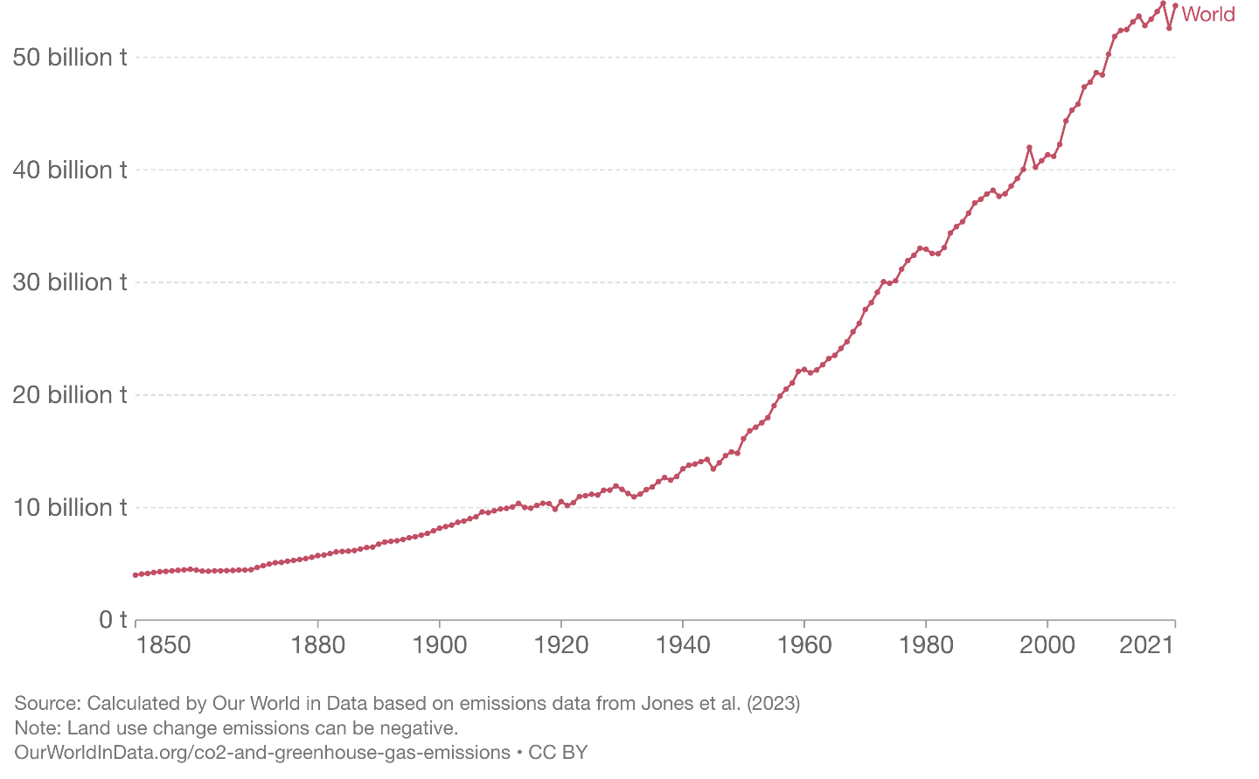
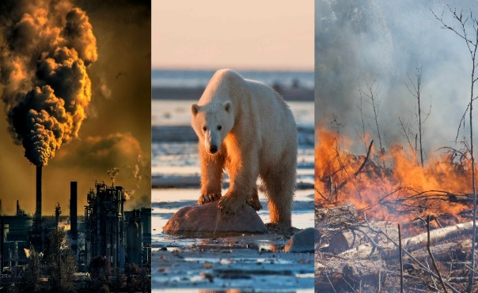
Global greenhouse gas emissions
Notes:
12

Slide 13
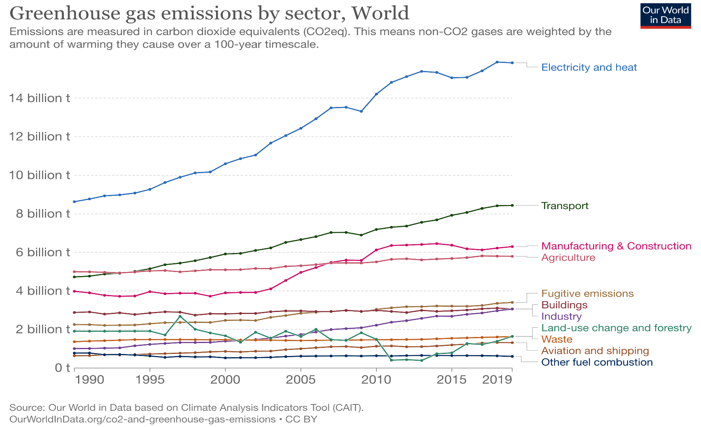
Greenhouse gas emission by sector
Notes:
13

Slide 14
Digitalization sector
7 pillars
Various non-functional properties
  Ethics
  Data Protection
  Social policies
  …
Notes:
14

Slide 15
Some numbers of Digitalization
 | 2015 | 2021 | Evolution
Internet users | 3 billon | 4,9 billion | +60%
Internet Traffic | 0,6 ZB | 3,4 ZB | +440%
Data center workloads | 180 Million | 650 Million | +260%
Data center energy use (excluding crypto) | 200 TWh | 220-320 TWh | +10-60%
Crypto mining energy use | 4 TWh | 100-140 TWh | +2300-3333%
Data transmission network energy use | 220 | TWh 260-340 TWh | +20-60%
7,33 billions mobile phone users in the world today*
https://www.bankmycell.com/blog/how-many-phones-are-in-the-world
Notes:
15

Slide 16
The high energy consumption
Computer Wattage | Hours per Year Run | Monthly Kwh of Electricity | Yearly KWh of Electricity
30 W | 2,920 hours | 7.3 kWh | 87.6 kWh
40 W | 2,920 hours | 9.7 kWh | 116.8 kWh
50 W | 2,920 hours | 12.2 kWh | 146.0 kWh
60 W | 2,920 hours | 14.6 kWh | 175.2 kWh
70 W | 2,920 hours | 17.0 kWh | 204.4 kWh
40 W | 2,920 hours | 9.7 kWh | 116.8 kWh
The global market for PC monitors is projected to reach 148.7 million units by 2028.
Energy consumption is: 148,7 * 87,6 13024 millions KWh more than UK consumption
Source: https://www.energysage.com/electricity/house-watts/how-many-watts-does-a-computer-use/
https://blog.gitnux.com/personal-computer-statistics/
16/88
Notes:
16

Slide 17
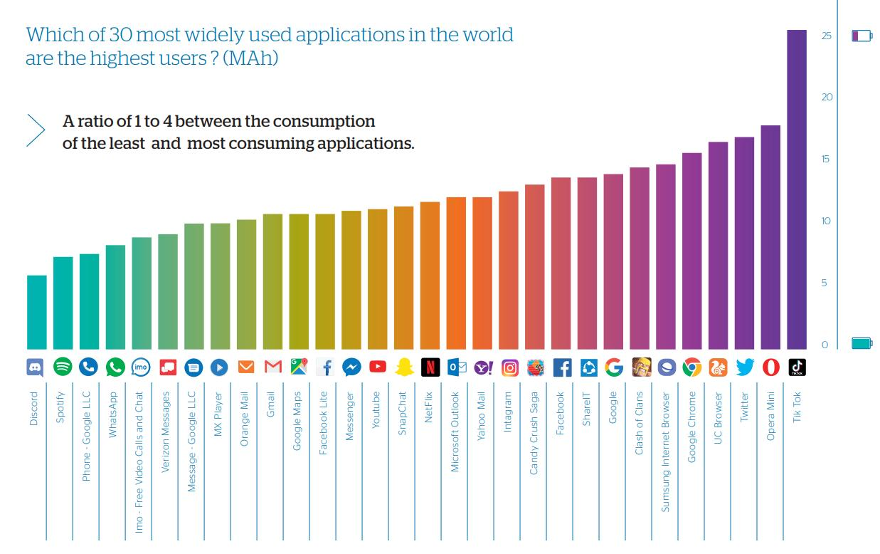
Energy Consumption of Mobile Devices
All mobile applications consume 20.3 terawatt-hours (excluding networks and datacenters servers), which is slightly less than the electricity consumption of a country like Ireland or the equivalent of 3 nuclear units.
https://greenspector.com/wp-content/uploads/2020/01/Atos-GREENSPECTOR-TOP30-benchmark-english.pdf
Notes:
17

Slide 18
Digitalization World: Data & Processes
Cloud
Computing
Blockchain
AI
Network
Digitalization
Big Data
IoT
STM²V
Data Science
Data
Data
Data
<<use
Process
Process
Process
Data-intensive applications
Workflow applications
Resources
CPU Input-Output Memory Network
Resources
CPU Input-Output Memory Network
Notes:
18

Slide 19
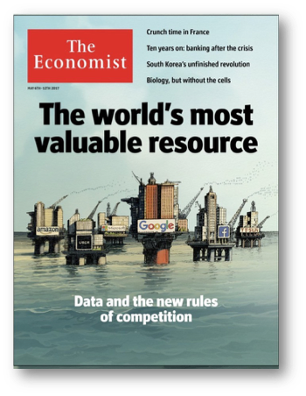
Data is a Valuable Digital Resource
“Data is a commodity like gold.”
Matt Shepherd
Head of Data Strategy, BBH London
“At the heart of the digital economy and society is the explosion of insight, intelligence and information – data.
Data is the lifeblood of the digital economy.
World Economic Forum
A New Paradigm for Business of Data BRIEFING PAPER - JUL Y 2020
“Data is the new oil.”
Clive Robert Humby
mathematician, entrepreneur, and Chief Data Scientist, Starcount
“Data is the new currency.”
Antonio Neri, President Hewlett Packard Enterprise
Notes:
19

Slide 20
Data Science Lifecycle
Data protection
Problem Definition
Application requirements
Dissemination of results
Explanation of data, processes, and results
Research question
Dataset determination Dataset selection
Data ingest
Data quality issues
Data provenance issues
Deployment and
Dissemination
Data preparation
Data integration
Large-scale distributed storage
Access interfaces
Data provenance management
Data storage and management
Statistical and ML Models
Feature Engineering
Model Validation
Data analysis
Similar to:
Microsoft Team Data Science Process Lifecycle
Data Ethics and social policy
M. Tamer Özsu: Data Science - A Systematic Treatment. Commun. ACM 66(7): 106-116 (2023)
Notes:
20

Slide 21


Data Science Lifecycle
Data protection
Research question
Deployment and
Dissemination
Data preparation
Data storage and management
Data analysis
Data Ethics and social policy

Slide 22
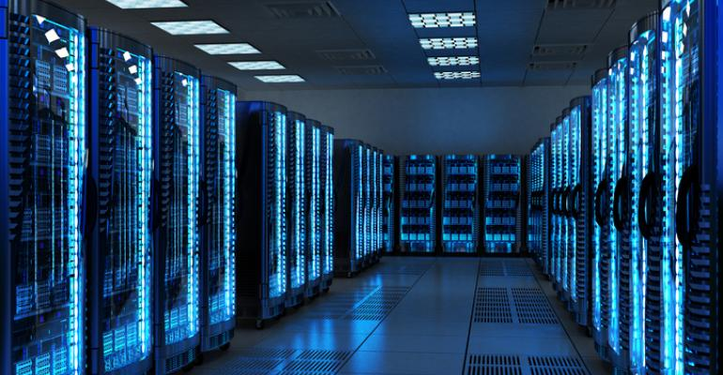
Data Processing: Data Centers
Data center (DC) is a physical facility that enterprises use to house computing and storage infrastructure in a variety of networked formats.
Main function is to deliver utilities needed
by the equipment and personnel:
  Power
  Cooling
  Shelter
  Security
Size of typical data centers:
  500 – 5000 sqm buildings
  1 MW to 10-20 MW power (avg 5 MW)
Data centers use approximately 200 terawatt hours of electricity: Around 1% of total global demand
Over 18 million servers in data centers globally.
Src: https://datacentremagazine.com/articles/how-measurement-enables-data-centre-energy-efficiency
Notes:
22

Slide 23
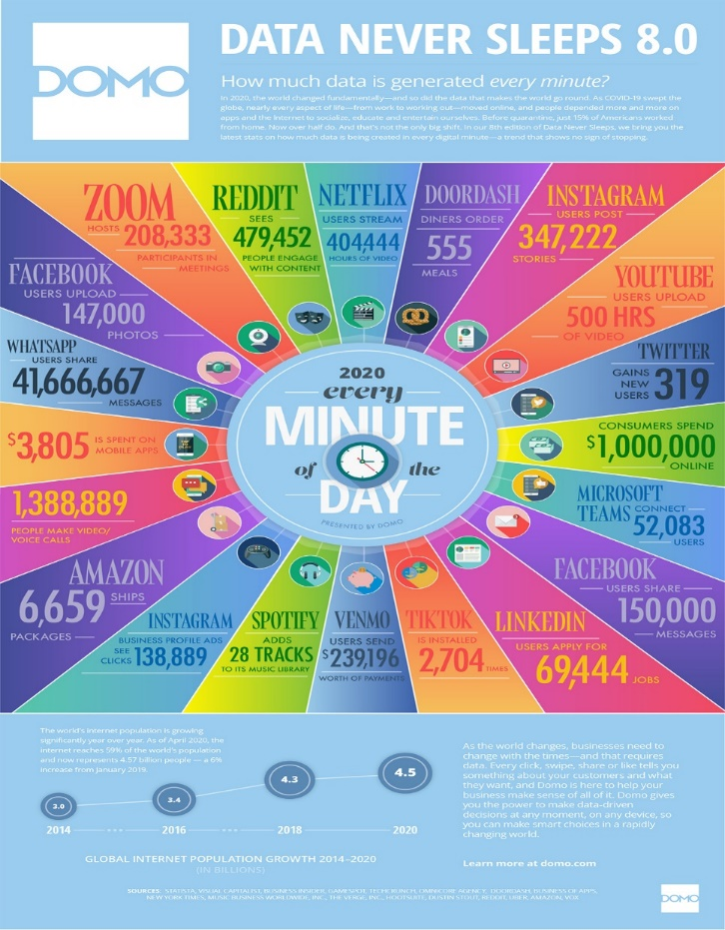

Cloud Databases
https://www.visualcapitalist.com/every-minute-internet-2020
Notes:
23

Slide 24
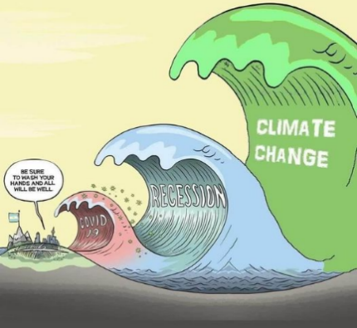
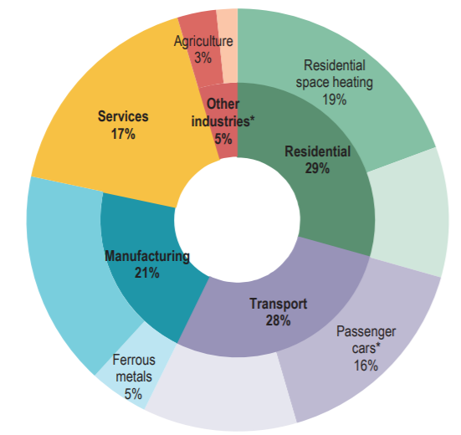
Initiatives & Practices
Energy Efficiency (EE)
Googling
"covid climate change"
~ 185 000 results
Source: IEA [2020]
EE: achievement of the same level of services while consuming less energy
CC is everyone’s business: green initiatives
Individuals
Scientists
National Institutions
<Governments, Associations>
International Institutions
COP (ex. COP21: Paris)
Green Shoots in Last French Elections (Lyon, Bordeaux, Poitiers, …)
Notes:
24

Slide 25
Data Science to the rescue
Usage of data-driven solutions for climate change in several sectors
  Microsoft report: the usage of AI to optimize energy consumption, it is estimated that emissions could be reduced by 1.5% to 4.4%, while also boosting global GDP by 3.1% to 4.4% by 2030.
  BCOOLER of Google’s DeepMind team enhanced the efficiency of cooling systems in data centers [12.7%]
Notes:
25

Slide 26
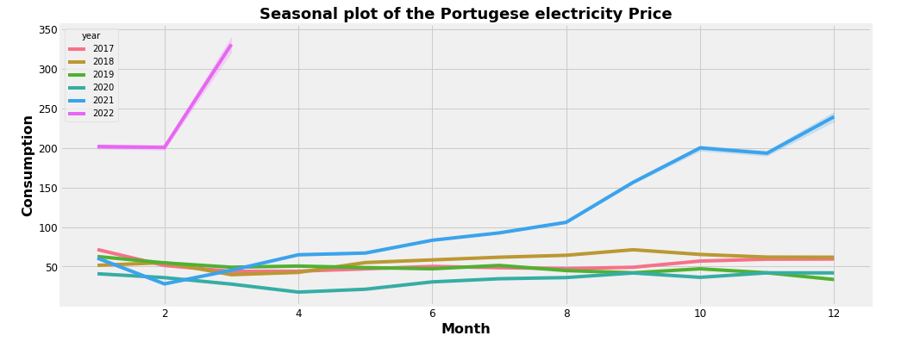
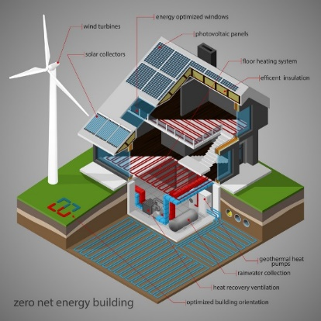
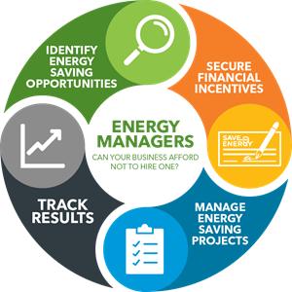
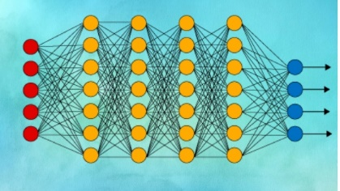

Data-driven solutions
Energy price forecasting
Energy consumption prediction
Traditional statistical methods
Machine learning methods
Deep learning methods
https://github.com/lias-laboratory/StableUnstableElectricityPriceForecasting
Tobajas, F. Garcia-Torres, P. Roncero-Sánchez, J. Vázquez, L. Bellatreche, E. Nieto, Resilience-oriented schedule of microgrids with hybrid energy storage system using model predictive control, Applied Energy, 118092, 306, Part B, 2022,
Notes:
26

Slide 27
Skepticism about computer energy usage
Cloud data centers in charge of storing and processing data, consumed approximately 205 terawatt-hours (TWh) of electricity in 2020, equivalent to roughly 1% of the world’s total electricity consumption
Network infrastructure components, including routers, switches, and wireless access points, also contribute to energy consumption, as they remain powered on and need cooling to maintain peak performance and avoid chip damage.
Heating, ventilation, and air conditioning (HVAC) are responsible for a significant percentage of global CO2 emissions
Workflow applications are energy intensive: training, building and deploying models
Model | Number of features | Data Center PUE | Power consumption changes | CO2 equivalent emissions
Gopher | 280B | 1,08 | 1,066 MWh | 322 tons
BLOOM | 176B | 1,2 | 433 MWh | 26 tons
GPT3 | 175B | 1,1 | 1,287 MWh | 502 tons
GPT | 175B | 1,09 | 324 WMh | 70 tons
Notes:
27

Slide 28
2. Energy background
Slides: 7
Time: 10 min
Notes:
28

Slide 29
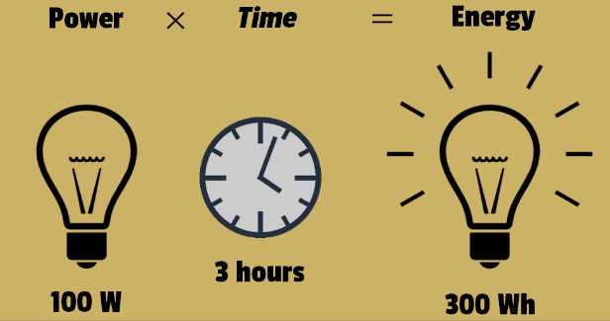
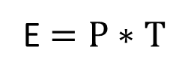
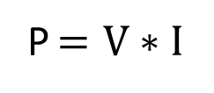
Physics definitions
Energy (E): is the ability to do work. It is measured in joules (J) or watts-hour (Wh).
Power (P): the rate of energy (E) per a unit of time (T). It is measured in watts.
Electric power can be calculated based on voltage (V) and current (I) as:
Notes:
29

Slide 30
Power definitions
Baseline Power: power consumption when the machine is idle.
Active Power: power consumption due to the execution of the workload
Peak power: represents the maximum power
Average power: average power consumed during execution
Power Usage Effectiveness (PUE): Total Power/IT Power
Energy efficiency refers to maximizing the amount of computational work completed for the amount of energy consumed and is typically measured in tasks per kilowatt-hour.
Notes:
30

Slide 31








PUE (Power Usage Effectiveness)
Measure of data center’s performance and efficiency
PUE =
Total Power/IT Power
DCiE =
IT Power/Total Power
How efficient is my facility in delivering power to IT equipment?
What % of facility power is delivered to my IT equipment?
PUE | DCIE | Level of Efficiency
3,0 | 33% | Very inefficient
2,5 | 40% | Inefficient
2,0 | 50% | Average
1,5 | 67% | Efficient
1,2 | 83% | Very Efficient
Power
  Switchgear
  UPS
  Battery Backup
  etc.
Cooling
  Chillers
  CRACs
  etc.
IT Equipment
  Servers
  Storage
  Telco
  etc.
Total
Facility
Power
IT Equipment Power
PUE & DCiE
For Efficient Facilities
Notes:
31

Slide 32
Energy-oriented benchmarks
TPC-Energy
  Measures the electrical energy requirement for a benchmark
  Provides an Energy Measurement System to aid in implementing the TPC Energy Specification
  Includes modules to interface with power instrumentation tools, to log and report power and temperature
SPECpower_ssj2008
  Measures the performance and power consumption of a system running Java-based workloads
Storage performance council
JouleSort
  It is an I/O-centric benchmark that measures the energy efficiency of systems at peak use
Notes:
32

Slide 33
Heat Dissipation in Electronic Devices
When an electronic device gets overheated, components with thermal ratings less than the temperature developed get damaged.
According to Newton’s law of cooling, the heat dissipation rate is proportional to the temperature difference between the body (electronic device) and the surroundings.
The operating temperature can be limited by artificially increasing the surface area of a high power density component.
Computers dissipate a lot of heat; in the order of hundreds of joules per second. Heat dissipation in computers increases with an increase in the number of processes the computer runs
=>High computational power in computers implies high heat dissipation.
Notes:
33

Slide 34
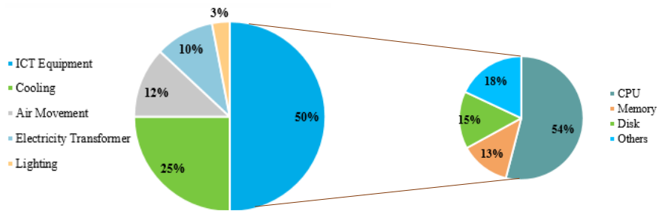
Energy consumption distribution
Data centers are one of the main energy consumers in IT:
  From a software point of view, this consumption is linked to the various components of the DBMSs hosted by these data centers.
  From a hardware point of view, processors are the most energy-consuming hardware components.
Notes:
34

Slide 35
Additive energy measurement models
Energy consumption (E) of Algorithm A is represented as a sum of CPU and memory energy consumption:
  E(A) = E_{cpu}(A) + E_{memory}(A)
  In consequence energy consumption of a server is the sum of energy consumption of its components:
    E = E_{cpu} + E_{memory} + E_{I/O}
    E = E_{cpu} + E_{memory} + E_{disk} + E_{NIC}
S. Roy, A. Rudra, and A. Verma, “An energy complexity model for algorithms,” in Proc. 4th Conf. ITCS, 2013, pp. 283–304.
Notes:
35

Slide 36
3. Hardware
Slides: 26
Time: 25 min
Notes:
36

Slide 37
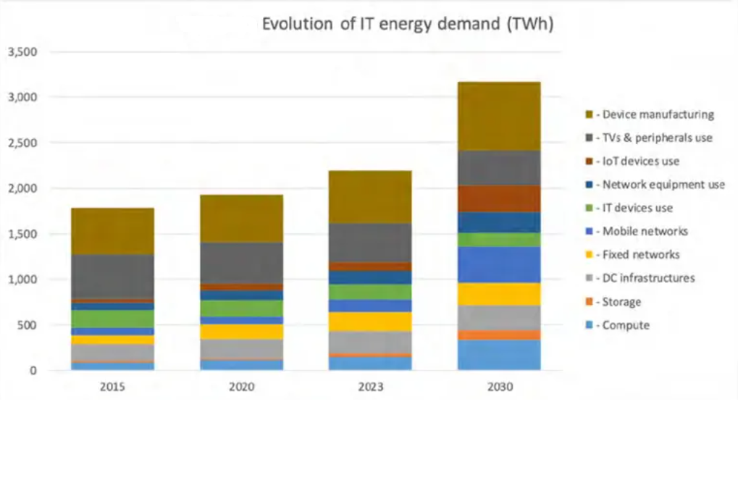
Evolution of IT energy demand (TWh)
2030 : IT sector electricity power demand will grow by 50 percent by 2030
2040 : IT carbon footprint could reach 14%, with data centers contributing to 50% of growth
https://www.i-scoop.eu/sustainability-sustainable-development/it-sector-electricity-demand/
Notes:
37

Slide 38
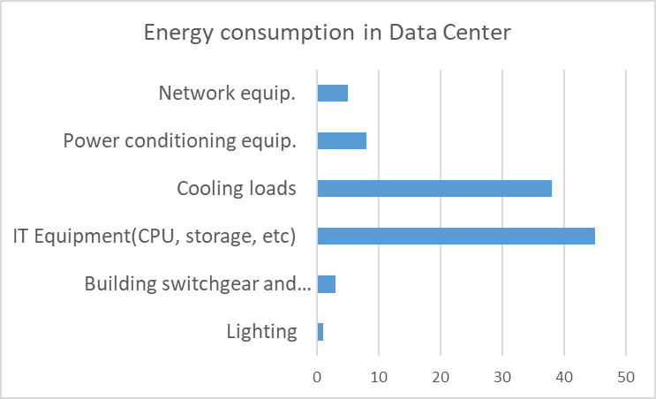
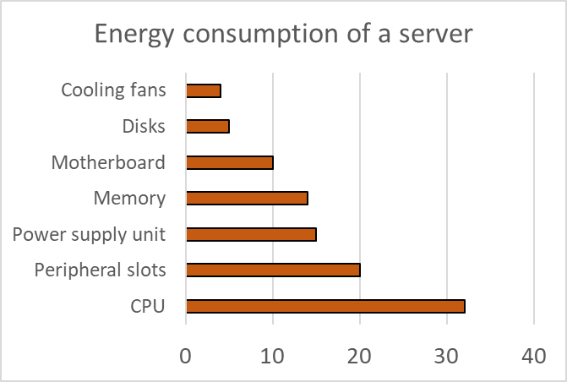
Energy consumption by components
Kazi Main Uddin Ahmed, Math Bollen, Manuel Alvarez, A Review of Data Centers Energy Consumption And Reliability Modeling, IEEE Access PP(99):1-1
November 2021
Notes:
38

Slide 39
Improving energy efficiency in hardware
Dynamic Power Management
  Dynamic component deactivation
  Dynamic performance scaling
Hardware accelerators
  Graphical Processing Unit (GPU)
  Field-Programmable Gate Array (FPGA)
  Tensor Processing Units (TPU)
Storage
Main Memory
Notes:
39

Slide 40
Dynamic Power Management
Observation: power states can be dynamically adjusted to meet current performance requirements
Dynamic component deactivation
disabling relevant hardware component(s) when they are idle
Dynamic performance scaling
the clock frequency of certain components, such as the CPU, can be decreased or increased
Notes:
40

Slide 41
Dynamic Performance Scaling (DynPS)
Dynamic Voltage and Frequency Scaling (DVFS) – one of the most popular techniques in DynPS
GOAL: It allows a system to adjust the frequency and supply voltage to particular components within the infrastructure computation
DVFS on a multi-core CPU
  System with only one global voltage for all cores (global DVFS) is energy-inefficient.
  Global DVFS and per-core DVFS architectures with multiple Voltage Frequency Islands (VFIs) have been proposed.
  The cores in an island share the same voltage and frequency, but different islands can be executed at various voltages and frequencies
Notes:
41

Slide 42


Graphical Processing Unit (GPU)
CPU | GPU
Central Processing Unit | Graphical Processing Unit
4-32 cores | 100s or 1000s of cores
Low latency | High throughput
Good for serial processing | Good for parallel processing
Quickly process tasks that require interactivity | Break jobs into separate tasks to process simultaneously
Traditional programming are written for CPU sequential execution | Requires additional software to convert CPU functions for parallel execution
Less power to operate but low performance | More power to operate but high performance
The energy advantage of the GPU varies between approximately 2 and 4 times, depending on the workload.
Notes:
42

Slide 43
Hardware Accelerators
Field-Programmable Gate Array (FPGA) is
  programmable hardware that contains an array of configurable logic blocks, memory elements, and interconnects
  unlike CPUs, FPGAs are truly parallel in nature. Each independent processing task is assigned to a dedicated section of the chip
  FPGAs provide a highly customizable and power-efficient solution for specific applications that demand hardware acceleration or real-time processing, or both
Notes:
43

Slide 44
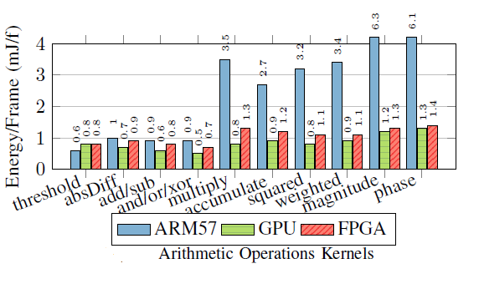
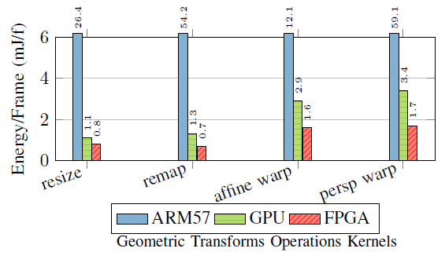
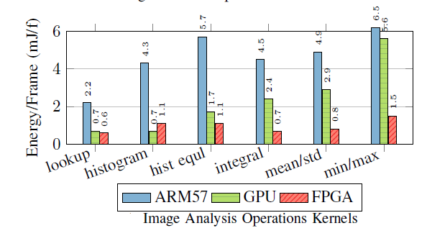
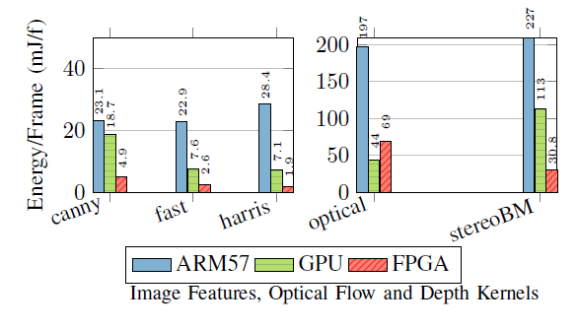
Comparing ARM57(CPU), GPU and FPGA
Murad Qasaimeh; Kristof Denolf; Jack Lo; Kees Vissers; Joseph Zambreno; Phillip H. Jones Comparing Energy Efficiency of CPU, GPU and FPGA Implementations for Vision Kernels, 2019 IEEE International Conference on Embedded Software and Systems (ICESS)

Slide 45
Hardware Accelerators
Tensor Processing Units (TPUs)
  TPUs are Application Specific Integrated Circuits (ASICs) tailored to perform tensor operations in machine learning tasks.
  TPUs typically have a higher memory bandwidth than GPUs, which allows them to handle large tensor operations more efficiently.
  they have better performance and energy efficiency compared to traditional CPUs and even GPUs.
  they can handle a large number of mathematical operations simultaneously, further improving energy efficiency.
Notes:
45

Slide 46
Hardware Architecures
CPU-GPU architecture:
  harnessing the parallel processing capabilities of GPUs
  offloading specific operations to the GPU
  allowing the CPU to focus on other aspects of the workload
FPGA – CPU architecture:
  increasing the speed of analytical processing
  reducing energy usage with resource provisioning and per-core CPU DVFS
Notes:
46

Slide 47
Storage: SSD vs HDD
 | Hard Disk | SSD (NAND) | SSD (3D Xpoint)
Read/write speed | 80MB - 160MB/s | 500 - 700 MB/s | 2200–2400 MB/s
Price per GB | 10,33$/TB | 47$/TB | 2,2$/GB
Max capacity | 22 TB | 100TB | 128GB
Energy consumption | medium | low | very low
Solid State Disks (SSDs) can use:
  page-addressable flash memory (NAND)
  byte-addressable 3D Xpoint
SSDs are more energy-efficient:
  SSDs contain no moving parts
  SSDs generate less heat and require less power for cooling
  SSDs spend most of their time in an idle state whereas hard disks must continually spin their disks for data access
Notes:
47

Slide 48
Memory techniques for energy saving
Problem:
  data movement between memory levels dominates energy consumption
Solution:
  maximally reusing data shifted from a higher energy-cost level to a lower one (like L1 cache memory)
Fetching data from HDD requires more time and energy than fetching from CacheL2
Notes:
48

Slide 49

Software: Revising Economic Models in the Cloud
SaaS is the most popular economic model used by data science in the cloud.
Energy should be included in this model by adopting the "polluter pays" principle.
This approach will encourage cloud providers to be more environmentally responsible.
In 2020, the global SaaS market was valued at $120.77 billion and is expected to reach $462.94 billion by 2028.
Notes:
49

Slide 50
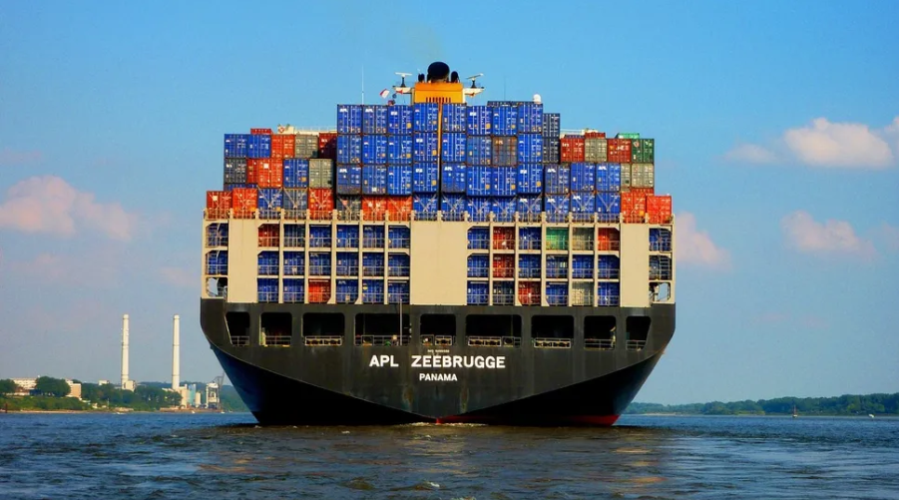
Container Technology
The popular containers like Docker, Apache Mesos, and Kubernetes are used by the major public cloud computing providers.
Efficient techniques for container/task placement on physical machines should take into account:
  CPU multicores
  memory
  storage
  network resources.
https://www.techradar.com/news/what-is-container-technology
Notes:
50

Slide 51
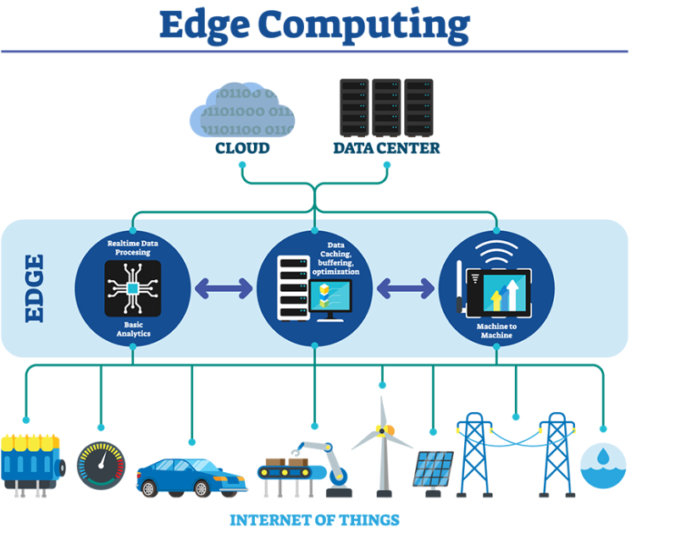
Energy-aware Edge Computing
Existing research focuses on singular objectives like:
  low latency,
  data privacy,
  power saving
Opportunities exist for optimizing multiple objectives, such as energy efficiency and low latency simultaneously.
https://innovationatwork.ieee.org/real-life-edge-computing-use-cases/
Notes:
51

Slide 52
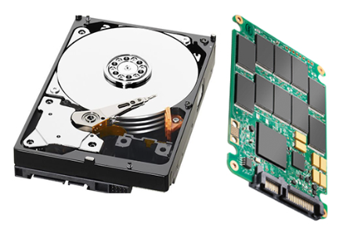
Hardware: Modern Storage Devices
Solid Storage Disks (SSD) have still the potential to decrease energy consumption (i.e. write operation)
SSDs come with their own set of challenges, including high costs and limited lifespan issues
Non-volatile memory (NVM) like PCM are more energy-consuming. Some research to decrease this is still needed
Notes:
52

Slide 53
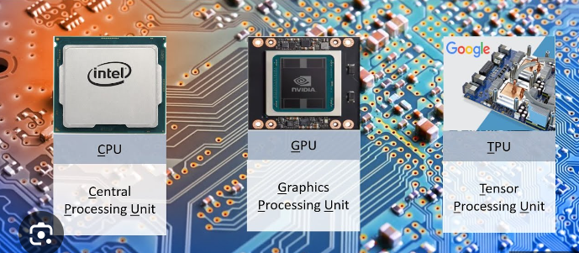
Software: Neural Network Energy Consumption
CPU, GPU and TPU integration can accelerate deep learning processes:
  Dynamic workload assignment to different processing unit as opposed to predefined configurations offered by cloud providers.
New machine learning techniques are needed:
  more energy-efficient
  but without sacrificing accuracy with cost-effective hardware
Notes:
53

Slide 54
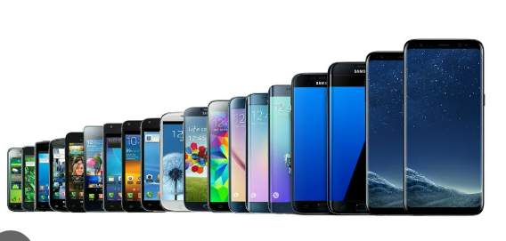
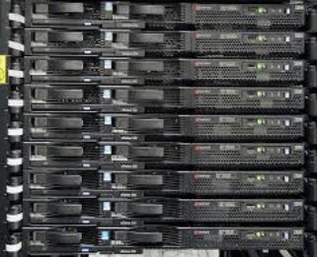
Computer spectrum: from small to big
IoT: Raspberry PI
Mobile devices: smartphones
Portable computers: laptop, netbook
Desktop computers: decreasing
Rack servers (on-premise): decreasing
IT centers (on-premise): decreasing
Cloud (becoming standard): trend
Notes:
54

Slide 55
CPU technology
CISC: high clock speed, powerful, symmetric cores (Intel, AMD)
RISC-I to IV: used before in workstations
RISC-V: current ARM processors: asymmetric cores, power efficient, slightly lower clock speed (Qualcomm Snapdragon)
VLSI: SoC (Adreno GPU on board, wireless, wifi)
GPUs: considered RISC, but different architecture with own memory (NVIDIA)
Notes:
55

Slide 56
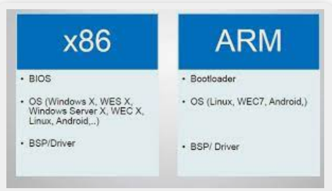
Dominating CPUs
Notes:
56

Slide 57
More cores means faster processing
4-8 cores is becoming the lower bound
Upper end: 32 cores in x86
100s-1000s cores in GPUs: >20k cores these days
Notes:
57

Slide 58
Large RAM enables more analytics
Large data sets can be maintained in RAM
2-8 GBs typical in mobile phones
8 GB-16 GB typical in personal computers
Parallel clusters: the norm before for OLAP and DWH
Main memory DBMSs: making a comeback
Cloud Servers: 8 VCPUs, 32-64 GBs for regular use, >100 GBs ML, AI: 256GB-1TB, 16-24 cores
Notes:
58

Slide 59
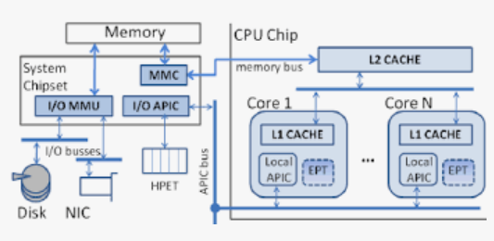
Computer architecture: CISC Intel x86
Notes:
59

Slide 60
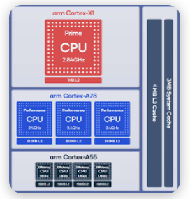
Computer architecture: RISC ARM Qualcomm Snapdragon
Notes:
60

Slide 61
CISC (x86) vs RISC (ARM)
Idle ARM CPU consumes <10% of power of x86 CPU
Caveat: ARM has 20%-50% lower CPU clock speed
x86 has symmetric cores; ARM has 2 sets of cores (some more powerful)
ARM: GPU, Wifi, NiC are integrated; x86: separate, gradually entering portable computers
Most DBMS, ML, math still runs on x86
UC/Berkeley (RISC inventors) states RISC-V is inminent
Notes:
61

Slide 62
Saving energy
Accelerating processing of code bottlenecks
CPU core deactivation
Changing clock speed (CPU scaling)
Minimizing I/O (DBMS job)
Interleaving I/O with CPU (e.g. double buffering)
Avoid cores being idle (main challenge these days)
Assigning less demanding tasks to slower cores (ARM)
Notes:
62

Slide 63
4. Software
Slides: 27
Time: 35 min
Notes:
63

Slide 64
Energy Efficiency Techniques in Data Centers
Virtual Machine Migration
Workload categorization and prediction
Containerization
Notes:
64

Slide 65
Virtual Machine Migration
Virtual machine (VM) migration - sending the VM from one host to another by remaining connected with the application or client.
Consolidation of virtual machines - technique for lowering energy usage based on peak, off-peak, or average CPU use of VMs in order to execute them on the least number of servers while preserving service quality.
Notes:
65

Slide 66
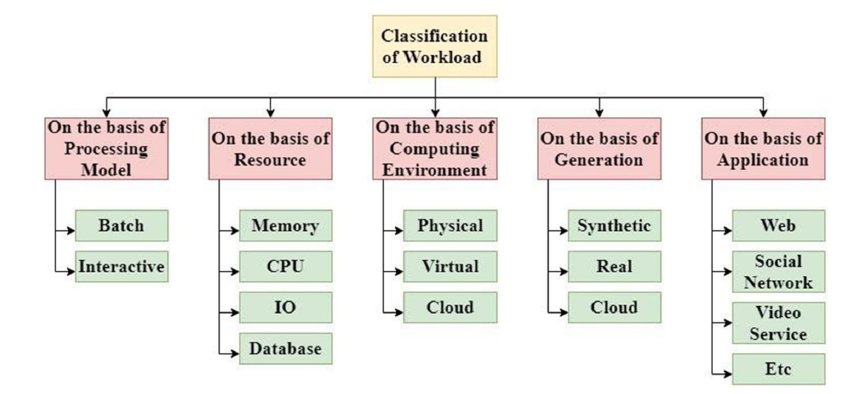
Workload Categorization and Prediction
Effective workload management improves system scalability, throughput and energy efficiency by limiting over-provisioning of virtual resources
Avita Katal , Susheela Dahiya, Tanupriya Choudhury: Energy efficiency in cloud computing data centers: a survey on software technologies. Clust. Comput. 26(3): 1845-1875 (2023)
Notes:
66

Slide 67
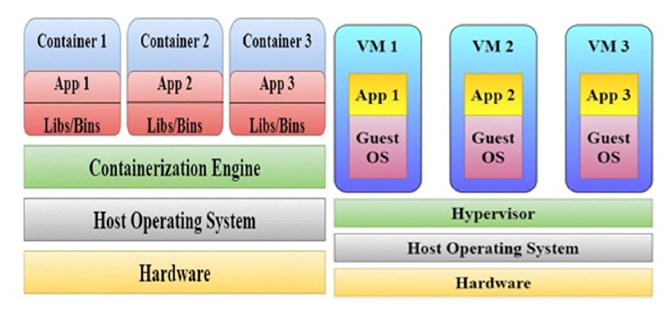
Virtualization vs Containerization
Avita Katal , Susheela Dahiya, Tanupriya Choudhury: Energy efficiency in cloud computing data centers: a survey on software technologies. Clust. Comput. 26(3): 1845-1875 (2023)
Notes:
67

Slide 68
Virtual Machine vs Container
Parameters | Virtual machine | Container
Guest operating system | Hypervisor allows multiple and distinct OS to run on the same host. Each VM is allocated with a specified amount of memory on which the Kernel functions. | All the guests share the same base OS and its Kernel. The image of the Kernel is loaded into the physical memory.
Performance | The VMs have a small overhead when compared to containers as the translation of machine instructions occurs from the host OS to guest OS. | There is little to no overhead in using containers as the applications are executed in the base OS itself.
Isolation | Hypervisor isolates each VM from host OS as well as from other VMs. This means files, libraries etc. cannot be shared between guests and the host. | Each container has its own set of file systems that can be shared between other applications.
Storage | VMs take ample storage as the whole Kernel and the secondary programs associated with the OS need to be installed. | Since the base OS is shared, containers require less storage.
A container model needs fewer racks, less energy for cooling and power, less software licenses, less maintenance.
Avita Katal , Susheela Dahiya, Tanupriya Choudhury: Energy efficiency in cloud computing data centers: a survey on software technologies. Clust. Comput. 26(3): 1845-1875 (2023)
Notes:
68

Slide 69
Software: SLA in Data Centers
Service level agreement (SLA) assumes:
  achieving low access latencies
  meeting task deadlines
  providing secure, dependable, and effective data management
SLA may conflict with
  low-cost hardware designs
  Energy-efficient capacity planning tactics
Service level agreement (SLA) should assume:
  energy consumption as an additional important factor
Notes:
69

Slide 70
Accelerating processing to save energy
Rationale: faster algorithms (with lower O() or less iterations) can save energy, up to a limit
energy and CPU computation time are generally correlated: a busy CPU on long time intervals uses more energy, shorter busy time intervals means less energy
Optimizing C++ compiler: vectorized ops, parallel loops, exploiting L1 L2 cache (maintainaing coherence)
Exploiting differences between CISC and RISC instructions => tweaking C++ compiler optimizations
Notes:
70

Slide 71
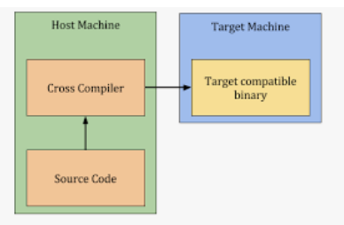
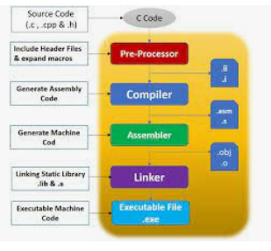
C++ development
Notes:
71

Slide 72
Typical Data Science project
Pre-process data: clean, integrate, get web data
Explore data: sampling, queries, visualization
Descriptive statistics: understand probablistic distribution, detect and repair DQ issues, correlation
Reduce dimensionality and/or summarize data
Analytic Goal: Predictive ML models vs graphs
Advanced: variable selection, selecting subgraphs
Deployment: predict news cases, tune model parameters, produce daily/weekly reports, make decisions
Notes:
72

Slide 73
Reducing energy consumption
Avoiding full recomputation
Profiling long analytic pipelines
Accelerating bottlenecks
Decreasing iterations
Notes:
73

Slide 74
Time performance
Time-consuming: Pre-process data, ML or graph analysis: iterative to train and test
Fast: Explore data set, descriptive statistics, add delta to data sets (day to day ETL), model deployment
Slow: training large neural networks on language data sets or images
Domain-dependent: Detect and repair DQ issues. In general, DB data is cleaner, natural language is not, image DQ varies significantly.
Notes:
74

Slide 75
Energy-hungry CPU-intensive processing
Integrating lots of files, with DQ issues
Joining large highly normalized tables
Running image segmentation on many images
Neural networks on natural language (many documents)
Labeling data sets for classification
Analyzing highly connected graphs: summarization, transitive closure
Notes:
75

Slide 76
Specific CPU-intensive tasks
Join/merge computation
Matrix multiplication. dense vs sparse matrix multiplication
Sorting: in RAM, on disk
Building and rebuilding an index
Factorizing matrices
Graphs: Traversing, detecting maximal cliques
Tensor computations, sliced into matrices
Notes:
76

Slide 77
Detailed view of QP
Applications
SQL
{tuples}
Server (Network, App Buffers, Security)
Query Processor
Transactions
(Locking, Logging)
Data Manager
(Indexes, Records)
Metadata Mgmt
(Schema, Stats)
Query Optimizer
Storage Manager
(Pages)
get/put
block
Storage System
(disks, SSDs, ...)
Notes:
77

Slide 78
Analytical queries
Star Schema Benchmark (SSB)
Query example
CUSTOMER (CU)
PART (PA)
CUSTKEY
NAME
ADDRESS
CITY
NATION
REGION
PHONE
MKTSEGMENT
PARTKEY
NAME
MFGR
CATEGORY
BRAND1
COLOR
TYPE
SIZE
CONTAINER
SELECT c_nation, s_nation, d_year, sum(lo_revenue)
FROM customer CU, lineorder LO, supplier SU, dates DA
WHERE lo_custkey = cu_custkey (J₁)
AND lo_suppkey = su_suppkey (J₂)
AND lo_orderdate = da_datekey (J₃)
AND cu_region = 'AMERICA’ (S₁)
AND su_region = 'AMERICA’ (S₂)
AND da_year ≥ 1993 and da_year ≤ 1998 (S₃)
GROUP BY cu_nation, su_nation, da_year
ORDER BY da_year asc, lo_revenue desc;
SF*6.000.000
LINEORDER (LO)
ORDERKEY
LINENUMBER
CUSTKEY
PARTKEY
SUPPKEY
ORDERDATE
ORDERPRIORITY
SHIPPINGPRIORITY
QUANTITY
EXTENDEDPRICE
ORDERDATE
DISCOUNT
REVENUE
SUPPLYCOST
TAX
COMMITDATE
SHIPMODE
SF*30.000
200.000*(1+log SF)
SF*2.000
SUPPLIER (SU)
2556
SUPPKEY
NAME
ADRESS
CITY
NATION
REGION
PHONE
DATE (DA)
DATEKEY
DATE
DAYOFWEEK
MONTH
YEAR
YEARMONTHNUM
YEARMONTH
DAYNUMBER
DAYNUMMONTH
MONTHNUMYEAR
WEEKNUMYEAR
SELLINGSEARSON
LASTDAYINMONTHFL
HOLIDAYFL
WEEKDAYFL
DAYNUMYEAR
Data-intensive computations (joins, selections)
Notes:
78

Slide 79





QP: a hard task
→Variety of Query Trees
πc_nation, s_nation, d_year, sum(lo_revenue)
  Cascading of selections
  Commutation of selections
  Associative of joins
  …
⑅
⑅
⑅
CU LO SU DA
Notes:
79

Slide 80
From query tree to query plan
Unary operations
  Selection
    Sequential scan
    Index
Binary operations
  Join
    Nested-loop
    Indexed nested-loop
    Sort-Merge
    Hash
    …
Choice based on cost estimate
A query plan:
  Query tree in which each node has is annotated by its implementation algorithm
  Multiple algorithm per node
L. Bellatreche. Optimization and tuning in data warehouses. Encyclopedia of Database Systems (2nd ed.), Springer 2018
Notes:
80

Slide 81




Hardness of query optimizers
Example of a query plan:
πc_nation, s_nation, d_year, sum(lo_revenue)
Sort Merge
⑅
Traditional vision: demand speedy access to data, no matter how complex the queries are
Hash Join
⑅
Index
⑅
Index
Index
Full Scan
CU
LO
SU
Problem of finding the best plan
  NP-hard
  Dynamic Programming
  Greedy Heuristics
DA
Notes:
81

Slide 82
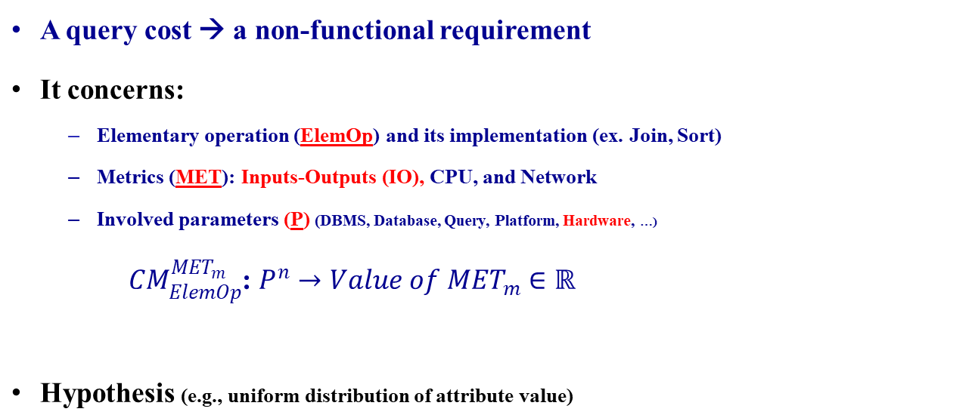
Estimation of a query cost
A. Ouared, Y. Ouhammou, L. Bellatreche: QoSMOS: QoS metrics management tool suite. Computer Languages, Systems & Structures Journal, Elsevier, 54, 236-251, 2018
Notes:
82

Slide 83


Example
Number of IO (Pages) of: SELECT * FROM T
Query optimizer functioning [row-store]
  The CPU can only work on tuples that are in memory
  Tuples must first be transferred from disk to memory
  Data is transferred from disk to memory (and back) in whole blocks at the time
  The disk can hold D blocks, at most M blocks can be in Buffer at the same time (M << D)
Disk-oriented DBMS
Data
Is_stored
Disk
Is_divided
Blocs
Contains
Tuples
Notes:
83

Slide 84
Energy estimation
Energy consumption cost model
  CPU, Inputs-Outputs (IO), network
Principle
  Understand algorithms used by each SQL operator (join, sort, …)
    estimate available main memory buffers
    estimate the size of inputs, intermediate results
  Composition of cost of operators:
    Aggregation of resource consumption
Total power: 46 watts
π
3 watts +
43 watts
15 watts +
28 watts
⋈
Energy of the current node + Inherited one
10 watts +
13 watts
⋈
σ
σ
3 watts +
2 watts
5 watts +
3 watts
Sales
Customer
Product
3 watts
5 watts
2 watts
Xu’13 Model
Notes:
84

Slide 85
On the top of DBMS vision
Notes:
85

Slide 86

Energy models for Databases
Notes:
86

Slide 87
Software: Cost Models in Databases
ML for tuning parameters in DBMS
  predictive models that use ML to adjust system parameters in DBMS
Integration of environment-level parameters:
  hardware age,
  trademark,
  room temperature hosting the data store.
Notes:
87

Slide 88
5. Recommendations
Slides: 1
Time: 10 min
Notes:
88

Slide 89
Recommendations from Wojciech
Virtualization and containarization technologies can reduce the overall energy consumption of data centers.
Dynamic Voltage and Frequency Scaling can reduce the overall energy consumption of data servers.
Hardware accelerators (GPU, FPGA and TPU) should be extensively utilized for computationally intensive tasks, such as neural networks.
Notes:
89

Slide 90
Recommendations from Carlos
Learning hardware aspects is necessary
Data science will keep growing in # computers, users and data volume
But data science can help can saving energy via energy prediction or learning optimized evaluation
Many opportunities to optimize time or energy or both
DB systems theory and programming should be leveraged, not reinvented
Notes:
90

Slide 91
Recommendations from Ladjel
Public sentiment
  Data Science optimists
  Data science skepticism
  Audits
  How data is processed? (Join, Filter, Aggregate)
  How Processes are composed? (Joins, Merge,)
  Tactics
  Software
  Hardware
  Good Practices
Modeling and Measurements
  Modeling of: computing, storage and data management, network, infrastructures, software and hardware
  Measurement tools: (1) Real measurements, (2) Mathematical cost models, (3) Data driven approaches
  Variability
  As Whole (Black Box)
  What-if Analysis: variation of data storage systems, algorithms, CPU frequency, # of Cores, …
Notes:
91

