Slide 1


Accelerating Python Code with
Parallel I/O
Robin Varghese
University of Houston, Houston, USA
Hashirul Quadir
University of Houston, Houston, USA
Ladjel Bellatreche
LIAS/ISAE-ENSMA, Poitiers, France
Carlos Ordonez
University of Houston, Houston, USA
Prepared By: Hashirul Quadir, University of Houston
<number>
Notes:
<number>

Slide 2
Motivation
Python is the dominant data science language
Python can now process files with millions of rows
Python runtime was defined for single core CPU.
Python libraries are wrapped by fast C/C++ code, optimizing python computation.
Python offers some C-like libraries
<number>
Notes:
<number>

Slide 3
Our contributions
Adapt basic DB mechanisms to Python
Improve Python I/O bottleneck with block-based reads and parallelization
Focus model: Study linear regression (LR) as a representative and fundamental AI model. Neural networks may build upon linear regression by combining many regressions across layers with nonlinear functions.
Computation: data set summarization to compute a model on a large data set, stored in a CSV file.
Benchmarking on a typical cloud server.
<number>
Notes:
<number>

Slide 4
Definitions
Input Matrix and Model
Input data set is defined as X, a d × n matrix consisting of a set of n column vectors each with d dimensions.
Machine learning model = , in this case vector .
<number>
Notes:
<number>

Slide 5
Fundamental Role of Chunks for Parallel Processing
Assigning each chunk to a thread enables concurrent execution.
Avoid thread scheduling overhead with partitioning.
Parallel execution by distributing chunks across threads; without chunks, task distribution would be inefficient.
Chunks allow processing with files larger than RAM and efficient parallelism by balancing workload, improving cache locality.

Slide 6

Model computation
To compute data summarization matrix Γ for LR we do the following:
Augment X with a row of ones to produce a (d + 1) × n matrix X
is computed
The serial computation of the model is done in two phases:
<number>
Notes:
<number>

Slide 7
Hardware and Storage: today
All modern computers have multicore CPUs.
RAM can reach 100s of Gbs and even TBs
Storage advances, with SSDs providing 3X, NVMs providing 10X, faster read speed than HDDs. HDDs are left behind.
Cloud is gradually replacing parallel clusters in many projects.
<number>
Notes:
<number>

Slide 8
Python runtime
Python code processing is done by multi-core CPUs supporting vectorized instructions.
Systems with/without distributed memory (i.e. a cluster of computers) use multi-threaded processing as the primary parallelization strategy.
However, practical limitations such as Python’s Global Interpreter Lock (GIL) create a need for alternative parallelism.
<number>
Notes:
<number>

Slide 9
Python: chunks
Pandas library us to divide data into smaller chunks so we do not load the entire dataset into memory, effectively overcoming memory limitations and enabling processing of very large datasets.
Through Chunks we enable parallel I/O, where multiple threads read different segments of the input file at the same time, reducing data-loading bottlenecks and improving overall throughput.

Slide 10


Parallel I/O Efficient Algorithm
Phase 1:
  Compute Γ in parallel, dynamically building in main memory.
  Updating in main memory reading from persistent storage in blocks.
  Data set X is uniformly partitioned among the p processors on n points.
Phase 2:
  Compute Θ using Γ in intermediate computations, instead of X.
  Iterate method until convergence exploiting Γ in intermediate matrix computations
<number>
Notes:
<number>

Slide 11


Complexity and Speedup Analysis
Phase 1: serial; and Θ(d^2 n/p) parallel, assuming d<n.
Phase 2: serial, hence it is negligible.

Slide 12
Profiling Computation Steps to Identify Bottlenecks
Goal of profiling is to analyze how the number of threads improves speed
Results:
90% of the whole computation time is due to I/O and this fraction is bigger for large n
Increasing the number of threads accelerates the summarization computation, but to a limit
=> there is a complex interaction among number of vCPUs, number of threads, data set size and chunk size.
<number>
Notes:
<number>

Slide 13
Evaluation setup
Cloud Server Configuration:
  Experiments ran on 3 cloud servers provided by Amazon AWS.
  Physical server CPU 18 and 24 cores
  Cloud server vCPU configurations: 2,4, and 8 vCPUs.
  Memory configurations range from 16 to 32 GB,
Python Data Science Libraries:
  Pandas for I/O operations.
  NumPy for numerical computations.
  Threading for multi-threaded parallelism.
<number>
Notes:
<number>

Slide 14
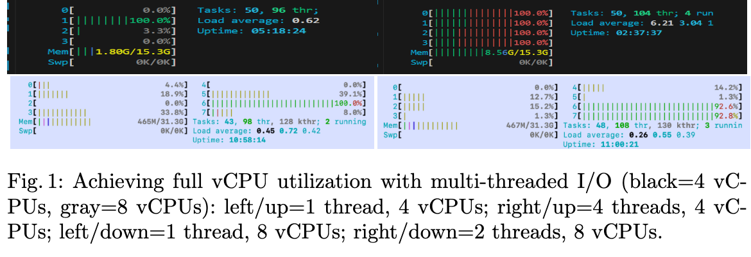
Accelerating I/O Speed with Parallelization and Chunks
Our next experiments aims to find out how many threads “saturate” the CPU.
Figure 1 compares CPU core saturation with 1 thread versus the optimal number of threads, obtained from Table 1.
As can be seen, 4 threads are optimal for the 4 vCPU server, but only 2 threads are optimal for the 8 vCPU server.
<number>
Notes:
<number>

Slide 15
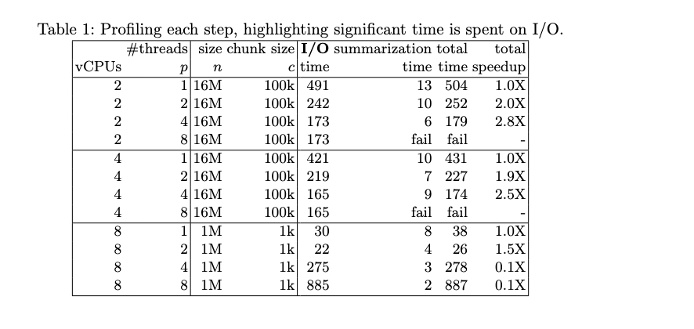
Parallel processing analysis
<number>

Slide 16
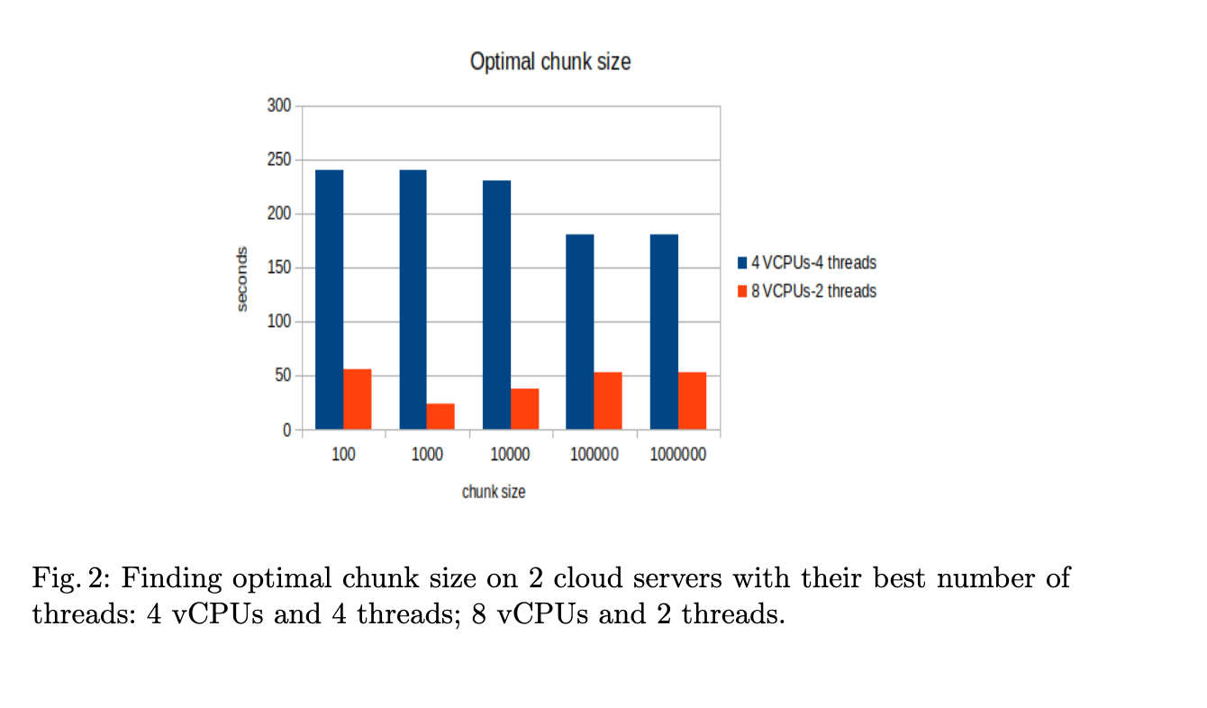
Identifying optimal chunk size
Our last experiments explore chunk size on two cloud servers(4vCPU,8vCPU), shown in Figure 2.
For the 4vCPUs server increasing c decreases time, but the impact is not look significant. A large chunk size c =100k gives optimal time, but it does not improve when chunk size c approaches n = 1M .
On the other hand, a smaller chunk size around c = 100 is best for the 8 vCPUs server and then performance decreases as n grows.
<number>

Slide 17
Conclusions
Parallel I/O does work
Python benefits from parallel I/O on 2 or 4 vCPUs.
Parallelization does not work well on servers with 8 VCPUs.

Slide 18
Future work
Theory for parallel I/O
Determine optimal chunk size based on server characteristics
Convert input file to a memory format better for multicore CPUs
Study how to leverage more threads
I/O cost models and parallel speedup limits

