Slide 1
Laboratoire d’Informatique et d’Automatique pour les Systèmes
A Genetic Optimization Physical Planner for Big Data Warehouses
Soumia BENKRID, Yacine MESTOUI (Ecole nationale Superieure d’Informatique, Algeria)
Ladjel BELLATRECHE (ISAE-ENSMA, France)
Carlos ORDONEZ (University of Houston, USA)
IEEE BigData 2020
December 10-13, 2020 @ Now Taking Place Virtually
Notes:
Hello I’m soumia benkrid and pleased to share with you our work that brings A gentec optimization physical planner for Big data Warehouses
plēzd

Slide 2
Context: Parallel Big Data Warehouses
Input₁: DW
Fragmentation Phase
Input₂: W
Fragmentation Threshold
Input₃: Workload Q
SELECT
FROM WHERE
GOUP BY
SELECT
FROM WHERE
GOUP BY
SELECT
FROM WHERE
GOUP BY
SELECT
FROM WHERE
GOUP BY
Cost Model
Fragmentation Process
Input₄: Parallel Machine
Estimation of Processing cost of Q
Fragmentation Schema
Allocation Phase
Cost Model
Fragment Allocation Process
Allocation Schema
Limitations:
Static and a priori known queries
Not adapted to BI 2.0 (ad-hoc queries)
Self-adaptive Parallel DWs
Notes:
Designing Parallel Data Warehouse consists in first fragmenting the DW using any partitioning algorithm, and then allocating the so-generated fragments over Parallel data processing nodes
Today the BI joins the ”do-it-yourself” trend, it has become more difficult to achieve the best performance of the DW using this static process based on predefined workload
Therefore, making a parallel DW is a crucial issue

Slide 3
Data Partitioning
→Data fragmentation (DF) is a crucial phase of parallel DW design
Traditional Formalisation
Self-adaptive Fragmentation
Our 4-Inputs:
DW
Workload Q
Parallel Platform
Threshold W
Our 4-Inputs + 1
DW
Workload Q
Parallel Platform
Threshold W
Redesign Trigger
Static Fragmentation
Adaptive
Fragmentation
minimises overall query processing (Inputs/Outputs and Network Costs)
Fragmentation
Schema
Fragmentation
Schema
minimises overall query processing
and …
→The change of workload implies designer intervention ☹
→Several forms of triggers (e.g., Utility, User Feedbacks)
Notes:
In this works we focus on data partitioning which is the core of // DW design
Traditional Data partitioning problem is formalized as an optimization problem given 4 inputs DW Workload W Parallel platform and a maintenance constraint W representing the number of fragments that the designer considers relevant for his target allocation process such that the total cost of executing all the queries in Q can be minimized
As we said above, this formulation assumes a static environment where design is conducted only once and this design can persist
To make this problem self-adaptive, a new constraint related to redesign trigger like utility or user feedback is added to the formalization

Slide 4
Agenda
Related Work on Adaptive Partitioning
Our Genetic Algorithm-based Approach
Experimental Study
Summary
Notes:
In this presentation we first provide an overview on adaptive partitioning
Then , I will directly explain our genetic algorithm-based approach with all contributions within
Finally, after a summary of the experimental results, I conclude with some open challenges

Slide 5
State of Art
State of Art
Our Proposal
Experiments
Summary
Self-adaptive Partitioning
Query-driven Approaches
Data-driven Approaches
e.g., Teradata
Open-loop Learning
Workload Changes (Alarm)→ Repartitioning
e.g., Schism [VLDB10]
Closed-loop Learning
Alarm Management (Relevant Criteria → Usage of internal and external parameters)
Reinforcement Learning: e.g., Hilprecht [SIGMOD20]
Knowledge of whole workload
Time and energy overheads to explore a large search space.
Our Proposal for self-adaptive partitioning is based on a realistic hypothesis:
A set of a priori known queries (used as a training set)
A set of ad-hoc queries
Notes:
the approaches related to self-adapt issue are mainly oriented data or workload, Most of the work in this area has focused on Query driven approaches,
In this category, we identify two lines
The first line uses open-loop learning methods, if the workload changes, the designer must often take the entire DW offline for repair.
The second category of work uses external mechanisms to maintain a form of closed-loop control. Most of these solutions yield promising results. But at a price: they require significant time and energy to explore a big search space.
Our challenge is to propose a self-adaptive partitioning based on A set of a priori predefined queries and also A set of ad-hoc queries

Slide 6
Our Proposal
State of Art
Our Proposal
Experiments
Summary
Our Redesign Trigger = Utility of a fragmentation schema on workload at time t
→Utility-driven self-adaptive fragmentation with two objective functions
Our 4-Inputs + 1
DW
Workload Q (known and ad-hoc)
Parallel Platform
Threshold W
Utility Threshold
Adaptive
Fragmentation
Fragmentation
Schema
Minimises overall query processing (Inputs/Outputs and Network Costs)
Maximises Utility
Utility threshold seeks to maximize profit of a query, generally, over two consecutive time t and t + 1
Example
Execution time of new query q at time t+1 under FS_{t} is 10 ms
Execution time of this q under FS_{(t+1)} (by considering q) is 8 ms
Utility = 8/10 = 80%
Notes:
with the aim of maximizing the usefulness of the data partitioning schema for predefined and ad-hoc queries we propose a Utility-driven self-adaptive fragmentation with two objective functions,
Minimises overall query processing (Inputs/Outputs and Network Costs) and Maximises Utility
For that,, we use utility as a redesign trigger
Just we notice that the Utility threshold seeks to maximize profit of a query, generally, over two consecutive time t and t + 1
For example,
The execution time of new query q at time t+1 under FS deployed at time t is 10 ms
And the execution time of this q under FS selected at time t+1 by considering q as known query is 8 ms
Then the utiliy of FS of time t is 80 percent (pərˈsent)

Slide 7
Our Proposal
State of Art
Our Proposal
Experiments
Summary
To select horizontal partitioning schema, we use the genetic algorithm.
GA is a learning method inspired by evolutionary biology totally stochastic
Online Phase
Fitness
Evaluation
Ad-hoc queries
Population
{FS₁
FS₂
…
FS_{h}$\}$
Offline Phase
Crossover Mutation
Adaptation
Strategies
Selection
New Population
Inject adaptation strategy into last GA population
Notes:
To resolve our robust optimization problem, we propose the use of a genetic algorithm, GA is the most widely used meta-heuristics method to solve stochastic optimization problems .
Our planner is genetic based it is first used to precompute and generate an ideal data partitioning schema to handle predefined queries. In the case of performance, the planner is triggered to dynamically generate a new data partitioning schema
Our key insight is that the same set of experiences generated by the genetic population in the offline stage is exploited in the online stage in order to improve the genetic algorithm learning ability
The genetic algorithm consists of several stages, starting from the encoding stage, initial population initialization, selection, crossing, and mutation. First step consists to find a suitable chromosome representation

Slide 8
Elements of GA ^{(1/3)}
State of Art
Our Proposal
Experiments
Summary
A Star Join Query
Star Schema Benchmark (SSB)
Select c_nation, s_nation, d_year, sum(lo_revenue) as revenue
from customer CU, lineorder LO, supplier SU, dates DA
where lo_custkey = cu_custkey (J₁)
and lo_suppkey = su_suppkey (J₂)
and lo_orderdate = da_datekey (J₃)
and cu_region = 'AMERICA’ (Selection Predicate)
and su_region = 'AMERICA’ (Selection Predicate)
and da_year ≥ 1993 and da_year ≤ 1998 (Selection Predicate)
group by cu_nation, su_nation, da_year
order by da_year asc, lo_revenue desc;
CUSTOMER (CU)
PART (PA)
CUSTKEY
NAME
ADDRESS
CITY
NATION
REGION
PHONE
MKTSEGMENT
PARTKEY
NAME
MFGR
CATEGORY
BRAND1
COLOR
TYPE
SIZE
CONTAINER
SF*6.000.000
LINEORDER (LO)
ORDERKEY
LINENUMBER
CUSTKEY
PARTKEY
SUPPKEY
ORDERDATE
ORDERPRIORITY
SHIPPINGPRIORITY
QUANTITY
EXTENDEDPRICE
ORDERDATE
DISCOUNT
REVENUE
SUPPLYCOST
TAX
COMMITDATE
SHIPMODE
SF*30.000
200.000*(1+log SF)
SF*2.000
A Fragmentation Procedure:
Fragment each dimension table using its selection predicates
Propagate all these fragmentations on the fact table
SUPPLIER (SU)
2556
SUPPKEY
NAME
ADRESS
CITY
NATION
REGION
PHONE
DATE (DA)
DATEKEY
DATE
DAYOFWEEK
MONTH
YEAR
YEARMONTHNUM
YEARMONTH
DAYNUMBER
DAYNUMMONTH
MONTHNUMYEAR
WEEKNUMYEAR
SELLINGSEARSON
LASTDAYINMONTHFL
HOLIDAYFL
WEEKDAYFL
DAYNUMYEAR
Example of Fragmentation Schemes (FSs) of Dimension Tables
d_year | 1 | 2 | 3
c_region | 1 | 2 | 3
p_category | 1 | 2
d_year (DA) | 2018 | 2019 | 2020
c_region (CU) | AFRICA | EUROPE | AMERICA
p_category (P) | #13 | #14
Chromosome Coding
Notes:
In the genetic algorithm, each individual represents every possible solution of the problem, here the chromosome represents a fragmentation schema
To split our data warehouse, we use a referecing partitiong because this methodology takes into consideration the star join queries requirements,
In more detail, each dimension table is first partitioned using its selection predicates. Then, the fact table is partitioned using foreign keys referencing the partitioned dimension tables.
Our solution is represented by multidimensional arrays, where each array represents the domain partitioning of a fragmentation attribute.
This fragmentation technique generates a large number of fragments of the fact table. For example, suppose we have: Customer dimension table partitioned into 3 fragments using the c_region attribute
Date into 3 fragments using d_year and part into 2 fragments using d_category
therefore the fact table will be fragmented into 18 fragmnents 3 multiplied by 3 multiplied by 2

Slide 9
Elements of GA ^{(2/3)}
State of Art
Our Proposal
Experiments
Summary
Workload
Initial population of GA
Workload is clustered into several groups
Fragmentation process for each group
Several clustering techniques may be used: lexical, physical, arrival rate
We propose lexicosemantic clustering based on the interaction between queries (common subexpressions)
Workload clustering
Workload Cluster ₁
Workload Cluster ₂
Workload Cluster _{k}
Workload Cluster _{n}
Horizontal Partitioning
Horizontal Partitioning
Horizontal Partitioning
Horizontal Partitioning
Building Partitioning Schema
FS 1
FS 2
FS 3
FS 4
Merging
Initial Population
Notes:
The second step consists to create an initial population of individuals for evolution , In order to minimize the need of adaptation we propose a heuristic based on workload clustering to generate a special population
The Workload clustering serves as a bridge between the predefined workload and ad-hoc queries. It consists to group similar queries together where each group contains queries that have similar features : (1) Lexical( tables, attributes, aggregate, order by…….), (2) Physical: (tuplesread, cpu, cache hit, index oages networkread,…), (3) arrival rate history
we propose the usage of common subexpressions among queries as features (called ”lexicosemantic”).

Slide 10
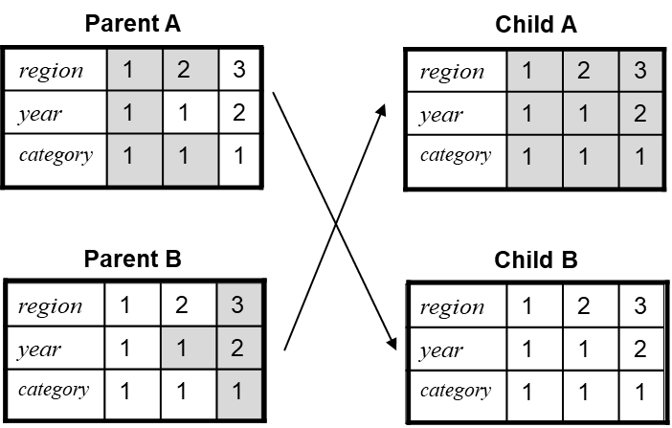
Elements of GA ^{(3/3)}
State of Art
Our Proposal
Experiments
Summary
Improvement of solution
Crossover, mutation and Selection
Crossover Mutation
Fitness function :
Minimisation of overall query processing cost (Inputs/Outputs and Network)
And satisfying constraints
Number of Fact Fragments ≤ W
Utility ≥ Utility Threshold U
Notes:
Starting from this initial population, the genetic operators guide the evolution of chromosomes (which represent the solution set in this case) to the optimum solution.
Selection is used to determine which individual will survive based on a fitness function
The fitness function is a function used to measure the value of a solution. In this study, the objective function aims to calculate the overall query processing cost and satisfy maintenance constraints

Slide 11
Experimental Study
State of Art
Our Proposal
Experiments
Summary
Our Environment:
Deployment Infrastructure: Postgres-XL
1 GTM node
1 coordinator Node
8 Datanodes
Our Datasets:
Star Schema Benchmark
Scale Factor: 100 GB
440 Million Fact Rows
1000 queries generated from the 13 original queries
Data Allocation
Hashing allocation
Notes:
To evaluate our planner, we considered a PostgresXL database cluster environment with 8 datanodes.
We have used the dataset from the SSB benchmark characterized with a scale factor of 100
We have considered also1000 queries
The so-generated fragments are allocated using hash distribution

Slide 12
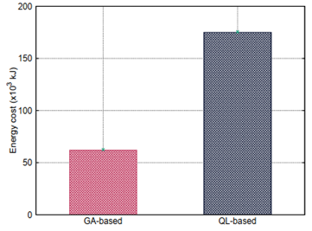
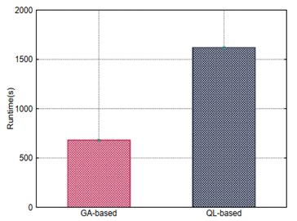
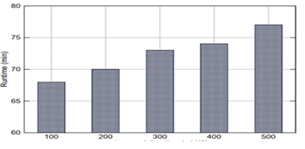
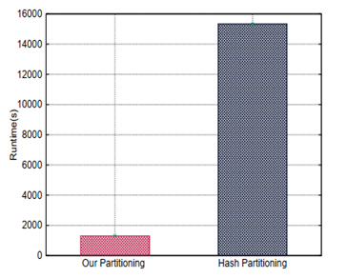
Quality of our Fragmentation
State of Art
Our Proposal
Experiments
Summary
W=200, 1000 predefined queries
Energy
Adaptation time
Effect of W
Hash distribution
Our proposal satisfies two nonfunctional requirements in Big Data:
Query performance
Energy consumption of our deployment platform
Importance to choose the right number of the target final fragments.
Hash range partitioning improves also the performance
Notes:
In the first experiment, we focus on the performance of the offline stage
As shown in the Figure
Our proposal satisfies two nonfunctional requirements in Big Data:
Query performance
Energy consumption of our deployment platform
Hash range partitioning improves also the performance Hash partining
A high value of W significantly decreases the query performance

Slide 13
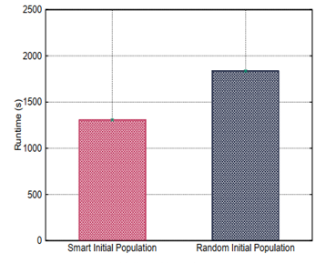
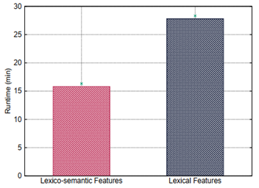
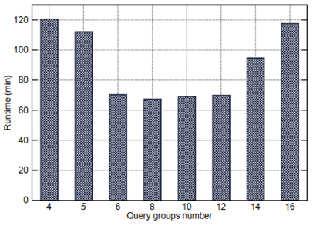
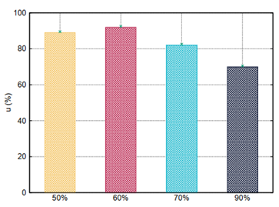
Impact of Workload Clustering
State of Art
Our Proposal
Experiments
Summary
W=200, 1000 predefined queries and 20 ad-hoc queries
Initial population
Features effects
Effect of query groups number
Utility Effect
Workload clustering improves significantly the performance of ad-hoc queries
Importance of choosing the right features and number of query groups
A high utility rate favors predefined queries.
Notes:
In the second experiment, we focused on online stage As shown in the figures
Workload clustering improves expressively the performance of ad-hoc queries
Lexico-semantic features improve performance of ad-hoc queries
Large/Small query classes degrade overall workload performance.
A High value of utility rate decreases the performance of ad-hoc queries.

Slide 14
Summary
State of Art
Our Proposal
Experiments
Summary
Self-adaptive data fragmentation in parallel Big Data
Offline (training-like step) and online phases (for ad-hoc queries)
Genetic-based algorithm
Query clustering as a service for managing ad-hoc queries
Intensive experiments
Improvement of fragment allocation by using AI techniques
Integration of our proposal in Spark
Notes:
In this work, we have proposed a two-step approach based on genetic algorithms to design a Self-adaptive parallel data warehouse
To improve the performance of ad-hoc queries , the initial population is cleverly initialized by clustering the benchmark queries and identifying initial solutions of good quality for each cluster.
The validation of our planner shows promising results
Future work is mainly oriented

