Slide 1
CS 267 Dense Linear Algebra: Parallel Gaussian Elimination and QR
James Demmel
www.cs.berkeley.edu/~demmel
Notes:
Start at minute 16 in 2016, so total time was 1:23 – 0:16 = 1:07
Start at minute 23 in 2014

Slide 2
Outline
Recall optimization goals
Review Gaussian Elimination (GE) for solving Ax=b
“Conventional” optimization of GE for caches on sequential machines
using matrix-matrix multiplication (BLAS and LAPACK)
Minimizing communication for sequential GE
Recursive LU minimizes bandwidth (latency possible)
Data layouts on parallel machines
Parallel Gaussian Elimination (ScaLAPACK)
Minimizing communication for parallel GE
Not ScaLAPACK, but “Comm-Avoiding LU” (CALU in SLATE)
Similar idea for sequential GE
Summarize rest of dense linear algebra, including QR (in SLATE)
LU for Heterogeneous computers (CPU + GPU)
Dynamically scheduled LU for Multicore
Notes:
Recursive LU: dgetrf2, Nov 2015

Slide 3
Outline
Recall optimization goals
Review Gaussian Elimination (GE) for solving Ax=b
“Conventional” optimization of GE for caches on sequential machines
using matrix-matrix multiplication (BLAS and LAPACK)
Minimizing communication for sequential GE
Recursive LU minimizes bandwidth (latency possible)
Data layouts on parallel machines
Parallel Gaussian Elimination (ScaLAPACK)
Minimizing communication for parallel GE
Not ScaLAPACK (yet), but “Comm-Avoiding LU” (CALU)
Similar idea for sequential GE
Summarize rest of dense linear algebra, including QR
LU for Heterogeneous computers (CPU + GPU)
Dynamically scheduled LU for Multicore
SIAM Activity Group on Supercomputing
Best Paper Prize in 2016 for
Communication-Optimal GE and QR
Best Student Paper (2008) and Test of Time Award (2019) at Supercomputing
Notes:
Recursive LU: dgetrf2, Nov 2015
Dynamic scheduling approach not part of OpenMP standard
1167 citations of Best Student paper as of Mar 2025.

Slide 4
Optimization Goals
Minimize communication
Do (about) the same number of flops
Get the “right answer” (modulo roundoff)
Sequential communication goals:
#words moved = Θ(n³/M^{1/2})
#messages = Θ(n³/M^{3/2})
Parallel communication goals, with minimum memory n²/P
#words moved = Θ(n²/P^{1/2})
#messages = Θ(P^{1/2})
Parallel communication goals, with c x minimum memory
#words moved = Θ(n²/(cP)^{1/2})
#messages = Θ(P^{1/2} / c^{3/2}) ?
Need to change algorithms (eg replace partial pivoting)
Notes:
Will do O(n^2) more flops, but ok since O(n^3) algorithm

Slide 5
Optimization Goals
Minimize communication
Do (about) the same number of flops
Get the “right answer” (modulo roundoff)
Sequential communication goals:
#words moved = Θ(n³/M^{1/2})
#messages = Θ(n³/M^{3/2})
Parallel communication goals, with minimum memory n²/P
#words moved = Θ(n²/P^{1/2})
#messages = Θ(P^{1/2})
Parallel communication goals, with c x minimum memory
#words moved = Θ(n²/(cP)^{1/2})
#messages = Θ(P^{1/2} / c^{3/2}) Θ((cP)^{1/2}) for LU and QR
Need to change algorithms (eg replace partial pivoting)
Notes:
Since then, people have proposed randomized altermatives that might be faster,
But only provide guarantees with high probability, often good enough

Slide 6
Gaussian Elimination (GE) for solving Ax=b
Add multiples of each row to later rows to make A upper triangular
Solve resulting triangular system Ux = c by substitution
… for each column i
… zero it out below the diagonal by adding multiples of row i to later rows
for i = 1 to n-1
… for each row j below row i
for j = i+1 to n
… add a multiple of row i to row j
tmp = A(j,i);
for k = i to n
A(j,k) = A(j,k) - (tmp/A(i,i)) * A(i,k)
0
.
.
.
0
0
.
.
.
0
0
.
.
.
0
…
0
.
.
.
0
0
.
.
.
0
0
.
.
.
0
0
.
.
.
0
0
.
0
0
.
0
0
0
0
After i=1
After i=2
After i=3
After i=n-1
Notes:
Start with familiar version, change into 3 lines of code, that call BLAS

Slide 7
Refine GE Algorithm (1/5)
Initial Version
Remove computation of constant tmp/A(i,i) from inner loop.
… for each column i
… zero it out below the diagonal by adding multiples of row i to later rows
for i = 1 to n-1
… for each row j below row i
for j = i+1 to n
… add a multiple of row i to row j
tmp = A(j,i);
for k = i to n
A(j,k) = A(j,k) - (tmp/A(i,i)) * A(i,k)
for i = 1 to n-1
for j = i+1 to n
m = A(j,i)/A(i,i)
for k = i to n
A(j,k) = A(j,k) - m * A(i,k)
i
m
j

Slide 8
Refine GE Algorithm (2/5)
Last version
Don’t compute what we already know: zeros below diagonal in column i
for i = 1 to n-1
for j = i+1 to n
m = A(j,i)/A(i,i)
for k = i to n
A(j,k) = A(j,k) - m * A(i,k)
for i = 1 to n-1
for j = i+1 to n
m = A(j,i)/A(i,i)
for k = i+1 to n
A(j,k) = A(j,k) - m * A(i,k)
i
m
j
Do not compute zeros

Slide 9
Refine GE Algorithm (3/5)
Last version
Store multipliers m below diagonal in zeroed entries for later use
for i = 1 to n-1
for j = i+1 to n
m = A(j,i)/A(i,i)
for k = i+1 to n
A(j,k) = A(j,k) - m * A(i,k)
for i = 1 to n-1
for j = i+1 to n
A(j,i) = A(j,i)/A(i,i)
for k = i+1 to n
A(j,k) = A(j,k) - A(j,i) * A(i,k)
i
m
j
Store m here
Notes:
Inner loop: subscripts look like matmul, we’ll use that to optimize later

Slide 10
Refine GE Algorithm (4/5)
Last version
for i = 1 to n-1
for j = i+1 to n
A(j,i) = A(j,i)/A(i,i)
for k = i+1 to n
A(j,k) = A(j,k) - A(j,i) * A(i,k)
Split Loop
for i = 1 to n-1
for j = i+1 to n
A(j,i) = A(j,i)/A(i,i)
for j = i+1 to n
for k = i+1 to n
A(j,k) = A(j,k) - A(j,i) * A(i,k)
i
j
Store all m’s here before updating rest of matrix

Slide 11
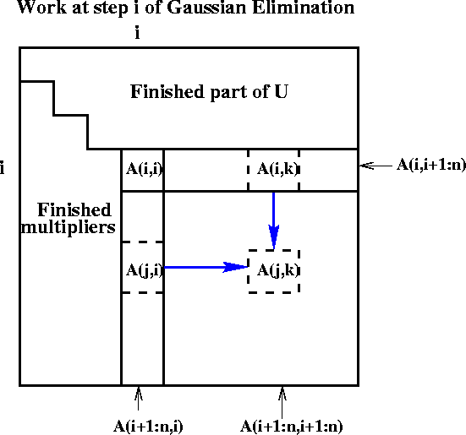
Refine GE Algorithm (5/5)
for i = 1 to n-1
for j = i+1 to n
A(j,i) = A(j,i)/A(i,i)
for j = i+1 to n
for k = i+1 to n
A(j,k) = A(j,k) - A(j,i) * A(i,k)
Last version
Express using matrix operations (BLAS)
for i = 1 to n-1
A(i+1:n,i) = A(i+1:n,i) * ( 1 / A(i,i) )
… BLAS 1 (scale a vector)
A(i+1:n,i+1:n) = A(i+1:n , i+1:n )
- A(i+1:n , i) * A(i , i+1:n)
… BLAS 2 (rank-1 update)

Slide 12
What GE really computes
for i = 1 to n-1
A(i+1:n,i) = A(i+1:n,i) / A(i,i) … BLAS 1 (scale a vector)
A(i+1:n,i+1:n) = A(i+1:n , i+1:n ) - A(i+1:n , i) * A(i , i+1:n) … BLAS 2 (rank-1 update)
Call the strictly lower triangular matrix of multipliers M, and let L = I+M
Call the upper triangle of the final matrix U
Lemma (LU Factorization): If the above algorithm terminates (does not divide by zero) then A = L*U
Solving A*x=b using GE
Factorize A = L*U using GE (cost = 2/3 n³ flops)
Solve L*y = b for y, using substitution (cost = n² flops)
Solve U*x = y for x, using substitution (cost = n² flops)
Thus A*x = (L*U)*x = L*(U*x) = L*y = b as desired
=
*
Notes:
Why not compute inverse and multiply by it?
Triples cost and gives less accurate answer

Slide 13
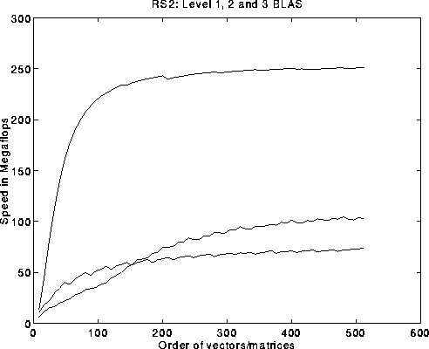
Problems with basic GE algorithm
for i = 1 to n-1
A(i+1:n,i) = A(i+1:n,i) / A(i,i) … BLAS 1 (scale a vector)
A(i+1:n,i+1:n) = A(i+1:n , i+1:n ) … BLAS 2 (rank-1 update)
- A(i+1:n , i) * A(i , i+1:n)
What if some A(i,i) is zero? Or very small?
Result may not exist, or be “unstable”, so need to pivot
Current computation all BLAS 1 or BLAS 2, but we know that BLAS 3 (matrix multiply) is fastest (earlier lecture…)
Peak
BLAS 3
BLAS 2
BLAS 1
Notes:
Fixing pivoting will impact whether we can hit lower bound or not

Slide 14
Pivoting in Gaussian Elimination
A = [ 0 1 ] fails completely because can’t divide by A(1,1)=0
[ 1 0 ]
But solving Ax=b should be easy!
When diagonal A(i,i) is tiny (not just zero), algorithm may terminate but get completely wrong answer
Numerical instability
Roundoff error is cause
Cure: Pivot (swap rows of A) so |A(i,i)| large
Notes:
Choosing largest entry in column to be A(i,i) is called partial pivorting,
What all standard software has done for decades, but can’t get to lower bound

Slide 15
Gaussian Elimination with Partial Pivoting (GEPP)
Partial Pivoting: swap rows so that A(i,i) is largest in column
for i = 1 to n-1
find and record k where |A(k,i)| = max{i ≤ j ≤ n} |A(j,i)|
… i.e. largest entry in rest of column i
if |A(k,i)| = 0
exit with a warning that A is singular, or nearly so
elseif k ≠ i
swap rows i and k of A
end if
A(i+1:n,i) = A(i+1:n,i) / A(i,i) … each |quotient| ≤ 1
A(i+1:n,i+1:n) = A(i+1:n , i+1:n ) - A(i+1:n , i) * A(i , i+1:n)
Lemma: This algorithm computes A = P*L*U, where P is a permutation matrix.
This algorithm is numerically stable in practice
For details see LAPACK code at
http://www.netlib.org/lapack/single/sgetf2.f
Standard approach – but communication costs?
Notes:
Point out that searching for largest entry will be
obstacle to hitting communication lower bound later.

Slide 16
Problems with basic GE algorithm
What if some A(i,i) is zero? Or very small?
Result may not exist, or be “unstable”, so need to pivot
Current computation all BLAS 1 or BLAS 2, but we know that BLAS 3 (matrix multiply) is fastest (earlier lectures…)
for i = 1 to n-1
A(i+1:n,i) = A(i+1:n,i) / A(i,i) … BLAS 1 (scale a vector)
A(i+1:n,i+1:n) = A(i+1:n , i+1:n ) … BLAS 2 (rank-1 update)
- A(i+1:n , i) * A(i , i+1:n)
Peak
BLAS 3
BLAS 2
BLAS 1

Slide 17
Converting BLAS2 to BLAS3 in GEPP
Blocking
Used to optimize matrix-multiplication
Harder here because of data dependencies in GEPP
BIG IDEA: Delayed Updates
Save updates to “trailing matrix” from several consecutive BLAS2 (rank-1) updates
Apply many updates simultaneously in one BLAS3 (matmul) operation
Same idea works for much of dense linear algebra
Not eigenvalue problems or SVD – need more ideas
First Approach: Need to choose a block size b
Algorithm will save and apply b updates
b should be small enough so that active submatrix consisting of b columns of A fits in cache
b should be large enough to make BLAS3 (matmul) fast
Notes:
Need column 1 to update column 2, but don’t need to update column 100 yet.
Ditto for columns 2 and 3.

Slide 18
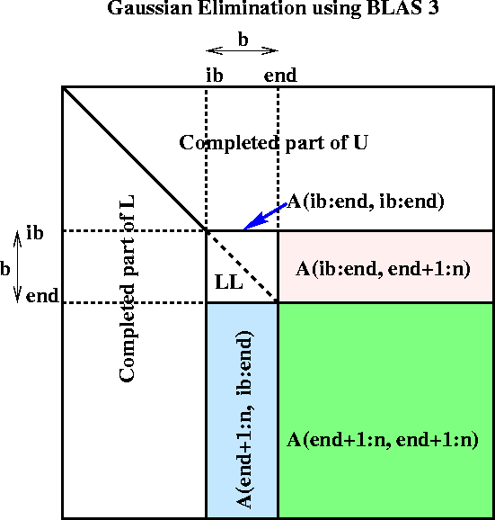
Blocked GEPP (www.netlib.org/lapack/single/sgetrf.f)
for ib = 1 to n-1 step b … Process matrix b columns at a time
end = ib + b-1 … Point to end of block of b columns
apply BLAS2 version of GEPP to get A(ib:n , ib:end) = P’ * L’ * U’
… let LL denote the strict lower triangular part of A(ib:end , ib:end) + I
A(ib:end , end+1:n) = LL⁻¹ * A(ib:end , end+1:n) … update next b rows of U
A(end+1:n , end+1:n ) = A(end+1:n , end+1:n )
- A(end+1:n , ib:end) * A(ib:end , end+1:n)
… apply delayed updates with single matrix-multiply
… with inner dimension b
*
=
(For a correctness proof, see on-line notes from CS267 / 1996.)
Notes:
Need to apply row interchanges from A(ib:n, ib:end) to trailing submatrix

Slide 19
Efficiency of Blocked GEPP (all parallelism “hidden” inside the BLAS)
Notes:
N=1000 is problem size
Comments:
Green: matmul vs HW peak
Red: LAPACK LU vs matmul
Why drop from 95% to 50% on Cray C90 from 1 to 16 procs?
can’t keep 16 procs busy
Blue: LAPACK LU vs best effort: 60% to 100% of peak.

Slide 20
Communication Lower Bound for GE
Matrix Multiplication can be “reduced to” GE
Not a good way to do matmul but it shows that GE needs at least as much communication as matmul
Does blocked GEPP minimize communication?
I 0 -B I I 0 -B
A I 0 = A I · I A·B
0 0 I 0 0 I I

Slide 21
Does LAPACK’s GEPP Minimize Communication?
for ib = 1 to n-1 step b … Process matrix b columns at a time
end = ib + b-1 … Point to end of block of b columns
apply BLAS2 version of GEPP to get A(ib:n , ib:end) = P’ * L’ * U’
… let LL denote the strict lower triangular part of A(ib:end , ib:end) + I
A(ib:end , end+1:n) = LL⁻¹ * A(ib:end , end+1:n) … update next b rows of U
A(end+1:n , end+1:n ) = A(end+1:n , end+1:n )
- A(end+1:n , ib:end) * A(ib:end , end+1:n)
… apply delayed updates with single matrix-multiply
… with inner dimension b
Case 1: n ≥ M - huge matrix – attains lower bound
b = M^{1/2} optimal, dominated by matmul
Case 2: n ≤ M^{1/2} - small matrix – attains lower bound
Whole matrix fits in fast memory, any algorithm attains lower bound
Case 3: M^{1/2} < n < M - medium size matrix – not optimal
Can’t choose b to simultaneously optimize matmul and BLAS2 GEPP of n x b submatrix
Worst case: Exceed lower bound by factor M^{1/6} when n = M^{2/3}
Detailed counting on backup slides
Notes:
Need a different approach: use algorithm similar to recursive matmul

Slide 22
Alternative cache-oblivious GE formulation (1/2)
A = L * U
Toledo (1997)
Describe without pivoting for simplicity
“Do left half of matrix, then right half”
function [L,U] = RLU (A) … assume A is m by n
if (n=1) L = A/A(1,1), U = A(1,1)
else
[L1,U1] = RLU( A(1:m , 1:n/2)) … do left half of A
… let L11 denote top n/2 rows of L1
A( 1:n/2 , n/2+1 : n ) = L11⁻¹ * A( 1:n/2 , n/2+1 : n )
… update top n/2 rows of right half of A
A( n/2+1: m, n/2+1:n ) = A( n/2+1: m, n/2+1:n )
- A( n/2+1: m, 1:n/2 ) * A( 1:n/2 , n/2+1 : n )
… update rest of right half of A
[L2,U2] = RLU( A(n/2+1:m , n/2+1:n) ) … do right half of A
return [ L1,[0;L2] ] and [U1, [ A(.,.) ; U2 ] ]
U1
L11⁻¹*
A(·,·)
L11
L11
A(·,·)
U2
A(·,·)
A(·,·) - =
A(·,·) *
A(·,·)
L1
L2
Notes:
Easier D&C for matmul, Similar D&C for QR decomposition
Similar D&C idea for All-Pairs-Shortest-Path based on Floyd-Warshall,
see “Minimizing Communication in All Pairs Shortest Path”, bebop.cs.berkeley.edu

Slide 23
Alternative cache-oblivious GE formulation (2/2)
function [L,U] = RLU (A) … assume A is m by n
if (n=1) L = A/A(1,1), U = A(1,1)
else
[L1,U1] = RLU( A(1:m , 1:n/2)) … do left half of A
… let L11 denote top n/2 rows of L1
A( 1:n/2 , n/2+1 : n ) = L11⁻¹ * A( 1:n/2 , n/2+1 : n )
… update top n/2 rows of right half of A
A( n/2+1: m, n/2+1:n ) = A( n/2+1: m, n/2+1:n )
- A( n/2+1: m, 1:n/2 ) * A( 1:n/2 , n/2+1 : n )
… update rest of right half of A
[L2,U2] = RLU( A(n/2+1:m , n/2+1:n) ) … do right half of A
return [ L1,[0;L2] ] and [U1, [ A(.,.) ; U2 ] ]
W(m,n) = W(m,n/2) + O(max(m·n,m·n²/M^{1/2})) + W(m-n/2,n/2)
≤ 2 · W(m,n/2) + O(max(m·n,m·n²/M^{1/2}))
= O(m·n²/M^{1/2} + m·n·log M)
= O(m·n²/M^{1/2} ) if M^{1/2}·log M = O(n)
Still doesn’t
minimize
latency,
but fixable
Notes:
Of 2 terms in next to last line, latter is cost of touching all the data log M times,
so (roughly) unavoidable; former is cost of doing matmuls etc.
Former term is dominant unless nxn matrix (almost) fits in fast memory.
But what about latency? Neither formulation minimizes latency
2 fixes: a more complicate data structure (skip details),
Or use a different pivoting scheme, that we will show for the parallel case.
Next: How to minimize latency in parallel case, same idea works for sequential
CLASS PROJECT

Slide 24
Explicitly Parallelizing Gaussian Elimination
Parallelization steps
Decomposition: identify enough parallel work, but not too much
Assignment: load balance work among threads
Orchestrate: communication and synchronization
Mapping: which processors execute which threads (locality)
Decomposition
In BLAS 2 algorithm nearly each flop in inner loop can be done in parallel, so with n² processors, need 3n parallel steps, O(n log n) with pivoting
This is too fine-grained, prefer calls to local matmuls instead
Need to use parallel matrix multiplication
Assignment and Mapping
Which processors are responsible for which submatrices?
for i = 1 to n-1
A(i+1:n,i) = A(i+1:n,i) / A(i,i) … BLAS 1 (scale a vector)
A(i+1:n,i+1:n) = A(i+1:n , i+1:n ) … BLAS 2 (rank-1 update)
- A(i+1:n , i) * A(i , i+1:n)

Slide 25
Different Data Layouts for Parallel GE
0 | 1 | 2 | 3
0 | 1 | 2 | 3 | 0 | 1 | 2 | 3 | 0 | 1 | 2 | 3 | 0 | 1 | 2 | 3
Bad load balance:
P0 idle after first
n/4 steps
Load balanced, but can’t easily use BLAS3
1) 1D Column Blocked Layout
2) 1D Column Cyclic Layout
Can trade load balance
and BLAS3
performance by
choosing b, but
factorization of block
column is a bottleneck
0 | 1 | 2 | 3 | 0 | 1 | 2 | 3
0 | 1 | 2 | 3
3 | 0 | 1 | 2
2 | 3 | 0 | 1
1 | 2 | 3 | 0
Complicated addressing,
May not want full parallelism
In each column, row
b
4) Block Skewed Layout
3) 1D Column Block Cyclic Layout
Bad load balance:
P0 idle after first
n/2 steps
0 | 1
2 | 3
0 | 1 | 0 | 1 | 0 | 1 | 0 | 1
2 | 3 | 2 | 3 | 2 | 3 | 2 | 3
0 | 1 | 0 | 1 | 0 | 1 | 0 | 1
2 | 3 | 2 | 3 | 2 | 3 | 2 | 3
0 | 1 | 0 | 1 | 0 | 1 | 0 | 1
2 | 3 | 2 | 3 | 2 | 3 | 2 | 3
0 | 1 | 0 | 1 | 0 | 1 | 0 | 1
2 | 3 | 2 | 3 | 2 | 3 | 2 | 3
The winner!
6) 2D Row and Column Block Cyclic Layout
5) 2D Row and Column Blocked Layout
Notes:
Another problem with Skewed Layout: BLAS3 updates all nonlocal!
Bad load balance in smaller trailing submatrices

Slide 26
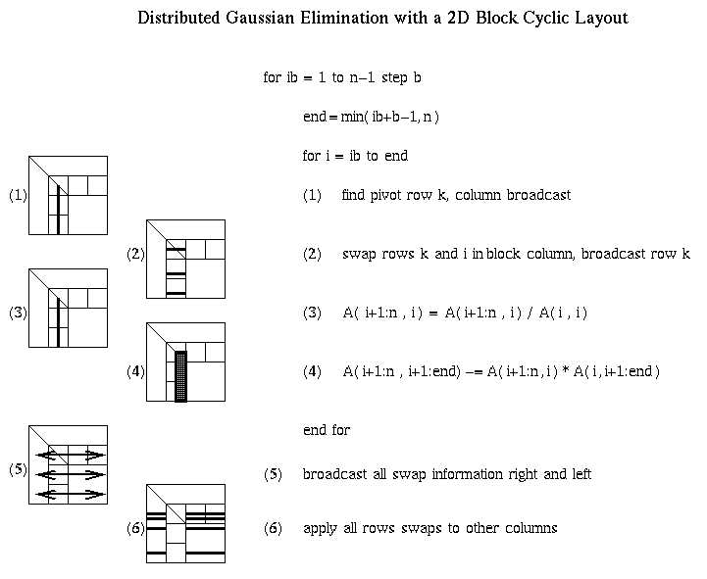
Distributed GE with a 2D Block Cyclic Layout

Slide 27
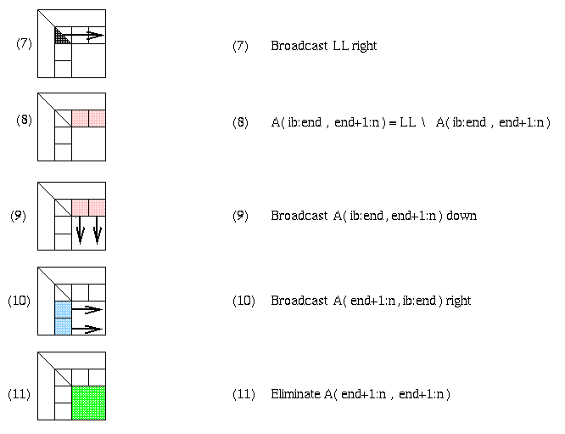
Matrix multiply of
green = green - blue * pink
Notes:
Hits bandwidth lower bound of O(n^2/sqrt(p)), but not latency lower bound O(sqrt(p))

Slide 28
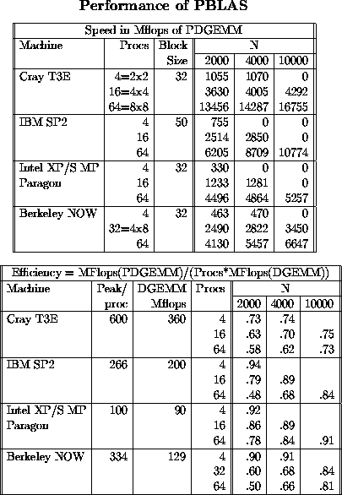
Review of Parallel MatMul
Want Large Problem Size Per Processor
PDGEMM = PBLAS matrix multiply
Observations:
For fixed N, as P increasesn Mflops increases, but less than 100% efficiency
For fixed P, as N increases, Mflops (efficiency) rises
DGEMM = BLAS routine
for matrix multiply
Maximum speed for PDGEMM
= # Procs * speed of DGEMM
Observations:
Efficiency always at least 48%
For fixed N, as P increases, efficiency drops
For fixed P, as N increases, efficiency increases
Notes:
Review: Measure efficiency(n,p) for matmul

Slide 29
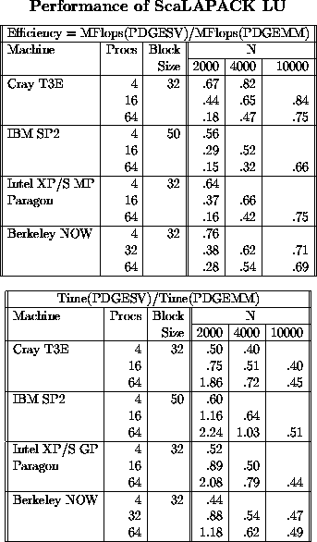
PDGESV = ScaLAPACK Parallel LU
Since it can run no faster than its
inner loop (PDGEMM), we measure:
Efficiency =
Speed(PDGESV)/Speed(PDGEMM)
Observations:
Efficiency well above 50% for large enough problems
For fixed N, as P increases, efficiency decreases (just as for PDGEMM)
For fixed P, as N increases efficiency increases (just as for PDGEMM)
From bottom table, cost of solving
Ax=b about half of matrix multiply for large enough matrices.
From the flop counts we would expect it to be (2*n³)/(2/3*n³) = 3 times faster, but communication makes it a little slower.

Slide 30
Does ScaLAPACK Minimize Communication?
Lower Bound: O(n² / P^{1/2} ) words sent in O(P^{1/2} ) mess.
Attained by Cannon and SUMMA (nearly) for matmul
ScaLAPACK:
O(n² log P / P^{1/2} ) words sent – close enough
O(n log P ) messages – too large
Why so many? One reduction costs O(log P) per column to find maximum pivot, times n = #columns
Need to replace partial pivoting to reduce #messages
Suppose we have n x n matrix on P^{1/2} x P^{1/2} processor grid
Goal: For each panel of b columns spread over P^{1/2} procs, identify b “good” pivot rows in one reduction
Call this factorization TSLU = “Tall Skinny LU”
Several natural bad (numerically unstable) ways explored, but good way exists
SC08, “Communication Avoiding GE”, D., Grigori, Xiang

Slide 31
Choosing Rows by “Tournament Pivoting”
W₁
W₂
W₃
W₄
P₁·L₁·U₁
P₂·L₂·U₂
P₃·L₃·U₃
P₄·L₄·U₄
Choose b pivot rows of W₁, call them W₁’
Choose b pivot rows of W₂, call them W₂’
Choose b pivot rows of W₃, call them W₃’
Choose b pivot rows of W₄, call them W₄’
W^{nxb} =
=
W₁’
W₂’
W₃’
W₄’
P₁₂·L₁₂·U₁₂
P₃₄·L₃₄·U₃₄
Choose b pivot rows, call them W₁₂’
Choose b pivot rows, call them W₃₄’
=
W₁₂’
W₃₄’
= P₁₂₃₄·L₁₂₃₄·U₁₂₃₄
Choose b pivot rows
Go back to W and use these b pivot rows
(move them to top, do LU without pivoting)
Not the same pivots rows chosen as for GEPP
Need to show numerically stable (D., Grigori, Xiang, ‘11)
Notes:
Tournament pivoting, by analogy to sports

Slide 32
Minimizing Communication in TSLU
W₁
W₂
W₃
W₄
LU
LU
LU
LU
LU
Parallel:
W =
LU
LU
W₁
W₂
W₃
W₄
LU
Sequential:
LU
W =
LU
LU
W₁
W₂
W₃
W₄
LU
LU
Dual Core:
LU
W =
LU
LU
LU
LU
Multicore / Multisocket / Multirack / Multisite / Out-of-core: ?
Can Choose reduction tree dynamically
Notes:
Take-away – sometimes best parallel algorithm is same numerically as
Best sequential algorithm, sometimes it isn’t.
Do algebra on board: Eq(1) in TSQR paper
Note: Q left as implicit tree

Slide 33
Performance vs ScaLAPACK or SLATE LU
TSLU
IBM Power 5
Up to 4.37x faster (16 procs, 1M x 150)
Cray XT4
Up to 5.52x faster (8 procs, 1M x 150)
CALU
IBM Power 5
Up to 2.29x faster (64 procs, 1000 x 1000)
Cray XT4
Up to 1.81x faster (64 procs, 1000 x 1000)
See INRIA Tech Report 6523 (2008), paper at SC08
SLATE (Jan 2022): 11% to 14% faster on 100K to 300K matrices on 16 nodes of a Cray XC40
http://www.icl.utk.edu/publications/swan-018
Notes:
Cray XC40 – Shaheen-II at KAUST

Slide 34
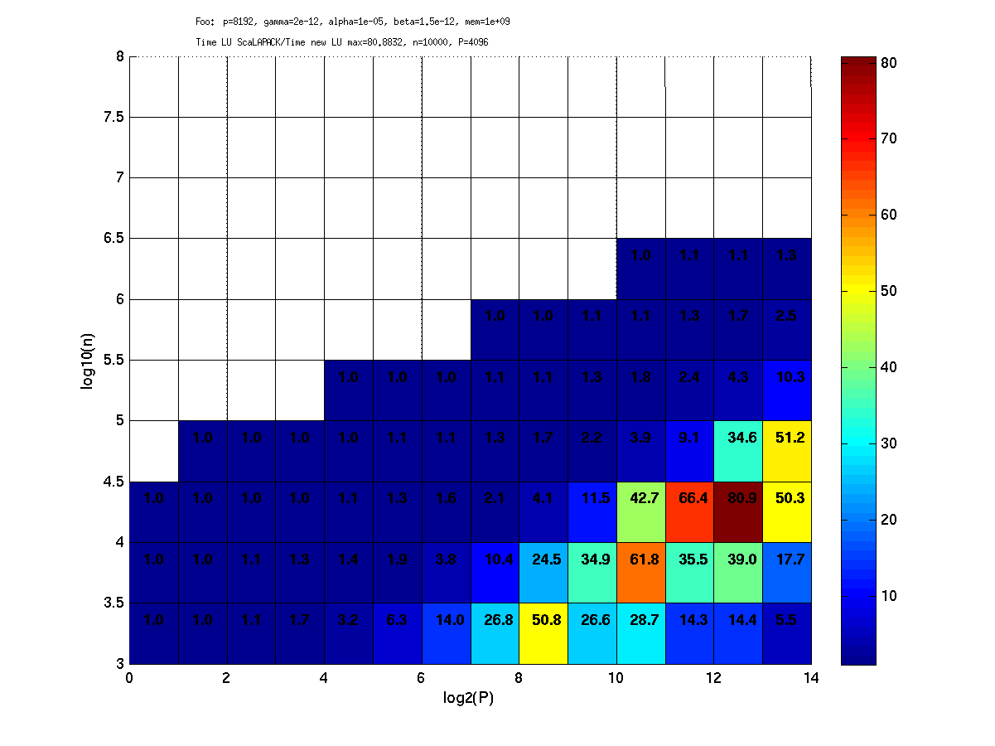
CALU speedup prediction for a Petascale machine - up to 81x faster
P = 8192
Petascale machine with 8192 procs, each at 500 GFlops/s, a bandwidth of 4 GB/s.
Notes:
Left to right is strong scaling
Omit? Minute 1:03 in 2014

Slide 35
Same idea for TSQR: QR of a Tall, Skinny matrix
W₀
W₁
W₂
W₃
Q₀₀ R₀₀
Q₁₀ R₁₀
Q₂₀ R₂₀
Q₃₀ R₃₀
Q₀₀
Q₁₀
Q₂₀
Q₃₀
R₀₀
R₁₀
R₂₀
R₃₀
W =
=
=
.
R₀₀
R₁₀
R₂₀
R₃₀
Q₀₁ R₀₁
Q₁₁ R₁₁
Q₀₁
Q₁₁
R₀₁
R₁₁
=
=
.
R₀₁
R₁₁
=
Q₀₂ R₀₂
Notes:
Recall Gram-Schmidt

Slide 36
Same idea for TSQR: QR of a Tall, Skinny matrix
W₀
W₁
W₂
W₃
Q₀₀ R₀₀
Q₁₀ R₁₀
Q₂₀ R₂₀
Q₃₀ R₃₀
Q₀₀
Q₁₀
Q₂₀
Q₃₀
R₀₀
R₁₀
R₂₀
R₃₀
W =
=
=
.
R₀₀
R₁₀
R₂₀
R₃₀
Q₀₁ R₀₁
Q₁₁ R₁₁
Q₀₁
Q₁₁
R₀₁
R₁₁
=
=
.
R₀₁
R₁₁
=
Q₀₂ R₀₂
Output = { Q₀₀, Q₁₀, Q₂₀, Q₃₀, Q₀₁, Q₁₁, Q₀₂, R₀₂ }

Slide 37
TSQR: An Architecture-Dependent Algorithm
W₀
W₁
W₂
W₃
R₀₀
R₁₀
R₂₀
R₃₀
R₀₁
Parallel:
W =
R₀₂
R₁₁
W₀
W₁
W₂
W₃
R₀₀
Sequential:
R₀₁
W =
R₀₂
R₀₃
W₀
W₁
W₂
W₃
R₀₀
R₀₁
Dual Core:
R₀₁
W =
R₀₂
R₁₁
R₀₃
R₁₁
Multicore / Multisocket / Multirack / Multisite / Out-of-core: ?
Can choose reduction tree dynamically
Notes:
Oldest reference for idea of tree: Golub/Plemmons/Sameh 1988,
But didn’t avoid communication

Slide 38
TSQR Performance Results
Parallel
Intel Clovertown
Up to 8x speedup (8 core, dual socket, 10M x 10)
Pentium III cluster, Dolphin Interconnect, MPICH
Up to 6.7x speedup (16 procs, 100K x 200)
BlueGene/L
Up to 4x speedup (32 procs, 1M x 50)
Tesla C 2050 / Fermi
Up to 13x (110,592 x 100)
Grid – 4x on 4 cities vs 1 city (Dongarra, Langou et al)
Cloud – (Gleich and Benson) ~2 map-reduces
Sequential
“Infinite speedup” for out-of-core on PowerPC laptop
As little as 2x slowdown vs (predicted) infinite DRAM
LAPACK with virtual memory never finished
SVD costs about the same
Joint work with Grigori, Hoemmen, Langou, Anderson, Ballard, Keutzer, others
Data from Grey Ballard, Mark Hoemmen, Laura Grigori, Julien Langou, Jack Dongarra, Michael Anderson
Notes:
Transition: TSQR -> CAQR
Cloud: Hadoop and Python based Dumbo MapReduce interface on 40-core mapreduce cluster at Stanford
Been incorporated into Spark, Intel Data Analytics Library, Facebook,

Slide 39
Summary of dense sequential O(n³) algorithms attaining communication lower bounds
References are from Table 3.1 in “Communication lower bounds and
optimal algorithms for numerical linear algebra”, Ballard et al, 2014
#words moved = Ω(n³/M^{1/2}), #messages = Ω(n³/M^{3/2})
Cache-oblivious, Ours, LAPACK, Randomized
Computation | 2-Level Mem |  | Multiple Level
 | Min #Words | Min# Messages | Min #Words | Min #Messages
BLAS-3 | [1,2] | [1,2] | [1,2] | [1,2]
Cholesky | [3,4,5,6] | [3,5,6] | [3,5,6] | [3,5,6]
LU | [6,7,8,9] | [7,8] | [6,7,9] | [7]
Sym Indef | [10] | [10] | [10] | [10]
QR | [7,11,12,13] | [7,11,13] | [7,12,13] | [7,13]
Eig(A=A^{T}) | [14,15] | [14,15] | [14] | [14]
SVD | [14,15,16] | [14,15,16] | [14,16] | [14,16]
Eig(A) | [14] | [14] | [14] | [14]
Notes:
Ballard, Carson, Demmel, Hoemmen, Knight, Schwartz,
“Communication lower bounds and optimal algorithms for numerical linear algebra”
Acta Numerica, Vol. 23, May 2014
The locally written papers are available at bebop.cs.berkeley.edu
[4] LAPACK sometimes, not always, depending on M and n,
attains lower bound on #words for 2 level mem for LU and QR
[7] Shape morphing from columnwise to blockwise and back and forth
[9] Recursive LU
[12] Recursive (2 way) QR vs [13] 4 way QR, which minimizes messages too,
but does 3x flops
[1 & 7] Ballard, Demmel, Lipshitz, Schwartz, Toledo,
“Comm Eff GEPP with Shape Morphing”, SPAA 2013
[2] Frigo, Leiserson, Prokop, Ramchandran,
“Cache Oblivious Algorithms”, FOCS 1999
[3] Ahmed, Pingali
“Automatic Generation of block recursive codes”, EuroPar 2000
[4] LAPACK, www.netlib.org/lapack
[5] Ballard, Demmel, Holtz, Schwartz,
“Comm-opt parallel and sequential Cholesky”, SISC 2010
[6] Gustavson
“Recursion leads to automatic variable blocking for dense LA”, IBM J. Res. Dev.
[8] Grigori, Demmel, Xiang
“CALU: Comm Opt LU”, SIMAX 2011
[9] Toledo, “Locality of reference in LU with PP”, SIMAX 1997
[10] Ballard, Becker, Demmel, Dongarra, Druinsky, Peled, Schwartz, Toledo, Yamazaki
“Comm-Avoiding symmetric indefinite factorization”, SIMAX 2014, UCB/EECS-2013-127
[11] Demmel, Grigori, Hoemmen, Langou,
“Comm-opt parallel and sequential QR and LU”, SISC 2012
SIAG Supercomputing Best Paper Prize 2016
[12] Elmroth, Gustavson
“New serial and parallel recursive QR”, Lecture Notes in Computer Sci., vol. 1541, Springer, 1998
[13] Frens, Wise
“QR factorization with Morton-ordered quadtree matrices”, ACM Sigplan Notices 38, 2003
[14] Ballard, Demmel, Dumitriu
“Comm-opt parallel and sequential eigenvalue and SVD algorithms”, UCB EECS-2011-14
[15] Ballard, Demmel, Knight,
“Avoiding comm in successive band reduction”, ACM Trans Par Comp, 2015; UCB EECS-2013-131
[16] Haidar, Luszczek, Kurzak, Dongarra,
“An improved parallel SVD for multicore,” LAPACK Working Note 283, 2013

Slide 40
Summary of dense sequential O(n³) algorithms attaining communication lower bounds
References are from Table 3.1 in “Communication lower bounds and
optimal algorithms for numerical linear algebra”, Ballard et al, 2014
#words moved = Ω(n³/M^{1/2}), #messages = Ω(n³/M^{3/2})
Cache-oblivious, Ours, LAPACK, Randomized
Computation | 2-Level Mem |  | Multiple Level
 | Min #Words | Min# Messages | Min #Words | Min #Messages
BLAS-3 | [1,2] | [1,2] | [1,2] | [1,2]
Cholesky | [3,4,5,6] | [3,5,6] | [3,5,6] | [3,5,6]
LU | [6,7,8,9] | [7,8] | [6,7,9] | [7]
Sym Indef | [10] | [10] | [10] | [10]
QR | [7,11,12,13] | [7,11,13] | [7,12,13] | [7,13]
Eig(A=A^{T}) | [14,15] | [14,15] | [14] | [14]
SVD | [14,15,16] | [14,15,16] | [14,16] | [14,16]
Eig(A) | [14,17,18] | [14,17,18] | [14,17,18] | [14,17,18]
Notes:
Ballard, Carson, Demmel, Hoemmen, Knight, Schwartz,
“Communication lower bounds and optimal algorithms for numerical linear algebra”
Acta Numerica, Vol. 23, May 2014
The locally written papers are available at bebop.cs.berkeley.edu
[4] LAPACK sometimes, not always, depending on M and n,
attains lower bound on #words for 2 level mem for LU and QR
[7] Shape morphing from columnwise to blockwise and back and forth
[9] Recursive LU
[12] Recursive (2 way) QR vs [13] 4 way QR, which minimizes messages too,
but does 3x flops
[1 & 7] Ballard, Demmel, Lipshitz, Schwartz, Toledo,
“Comm Eff GEPP with Shape Morphing”, SPAA 2013
[2] Frigo, Leiserson, Prokop, Ramchandran,
“Cache Oblivious Algorithms”, FOCS 1999
[3] Ahmed, Pingali
“Automatic Generation of block recursive codes”, EuroPar 2000
[4] LAPACK, www.netlib.org/lapack
[5] Ballard, Demmel, Holtz, Schwartz,
“Comm-opt parallel and sequential Cholesky”, SISC 2010
[6] Gustavson
“Recursion leads to automatic variable blocking for dense LA”, IBM J. Res. Dev.
[8] Grigori, Demmel, Xiang
“CALU: Comm Opt LU”, SIMAX 2011
[9] Toledo, “Locality of reference in LU with PP”, SIMAX 1997
[10] Ballard, Becker, Demmel, Dongarra, Druinsky, Peled, Schwartz, Toledo, Yamazaki
“Comm-Avoiding symmetric indefinite factorization”, SIMAX 2014, UCB/EECS-2013-127
[11] Demmel, Grigori, Hoemmen, Langou,
“Comm-opt parallel and sequential QR and LU”, SISC 2012
SIAG Supercomputing Best Paper Prize 2016
[12] Elmroth, Gustavson
“New serial and parallel recursive QR”, Lecture Notes in Computer Sci., vol. 1541, Springer, 1998
[13] Frens, Wise
“QR factorization with Morton-ordered quadtree matrices”, ACM Sigplan Notices 38, 2003
[14] Ballard, Demmel, Dumitriu
“Comm-opt parallel and sequential eigenvalue and SVD algorithms”, UCB EECS-2011-14
[15] Ballard, Demmel, Knight,
“Avoiding comm in successive band reduction”, ACM Trans Par Comp, 2015; UCB EECS-2013-131
[16] Haidar, Luszczek, Kurzak, Dongarra,
“An improved parallel SVD for multicore,” LAPACK Working Note 283, 2013
[17] Banks, Garza-Vargas, Kulkarni, Srivastava,
“Pseudospectral shattering, the sign function and diagonalization in nearly matrix multiplication time”,
Found. Comp. Math, 2023
[18] Schneider, Dumitriu, Demmel,
“Generalized pseudospectral shattering and inverse-free matrix pencil diagonalization”,
Found. Comp. Math, Dec 2024

Slide 41
Summary of dense parallel O(n³/p) algorithms attaining communication lower bounds
References are from Table 3.2 in “Communication lower bounds and
optimal algorithms for numerical linear algebra”, Ballard et al, 2014
Assume nxn matrices on p procs, minimum memory per proc: M = O(n²/p)
#words moved = Ω(n²/p^{1/2}), #messages = Ω(p^{1/2}),
Ours, ScaLAPACK, Randomized
ScaLAPACK sends > n/p^{1/2} times too many messages (except Cholesky)
Computation | Minimizes # Words | Minimizes # Messages
BLAS3 | [1,2,3,4] | [1,2,3,4]
Cholesky | [2] | [2]
LU | [2,5,10,11] | [5,10,11]
Symmetric Indefinite | [2,6,9] | [6,9]
QR | [2,7] | [7]
Eig(A=A^{T}) and SVD | [2,8,9] | [8,9]
Eig(A) | [8,12,13] | [8,12,13]
Notes:
Ballard, Carson, Demmel, Hoemmen, Knight, Schwartz,
“Communication lower bounds and optimal algorithms for numerical linear algebra”
Acta Numerica, Vol. 23, May 2014
The locally written papers are available at bebop.cs.berkeley.edu
ScaLAPACK sends > sqrt(p) words than lower bound for eig
[1] Agarwal, Gustavson, Zubair,
“A high performance matrix-multiplication algorithm on a distributed-memory parallel computer”
IBM J. Res. Dev., 1994
[2] ScaLAPACK, www.netlib.org/scalapack
[3] Cannon, “A cellular computer to implement the Kalman Filter Algorithm”,
PhD Thesis, Montana State U., 1969
[4] Van de Geijn, Watts, “SUMMA: Scalable Universal Matrix Multiplication Algorithm”,
Concurrency: Prac. Exp., 1997
[5] Grigori, Demmel, Xiang
“CALU: Comm Opt LU”, SIMAX 2011
[6] Ballard, Becker, Demmel, Dongarra, Druinsky, Peled, Schwartz, Toledo, Yamazaki
“Comm-Avoiding symmetric indefinite factorization”, SIMAX 2014, UCB/EECS-2013-127
[7] Demmel, Grigori, Hoemmen, Langou,
“Comm-opt parallel and sequential QR and LU”, SISC 2012
[8] Ballard, Demmel, Dumitriu
“Comm-opt parallel and sequential eigenvalue and SVD algorithms”, UCB EECS-2011-14
[9] Ballard, Demmel, Knight,
“Avoiding comm in successive band reduction”, ACM Trans Par Comp, 2015; UCB EECS-2013-131
[10] Solomonik, Demmel
“Comm-opt parallel 2.5D matrix multiplication and LU factorization routines”, EuroPar 2011
[11] Tiskin, “Bulk Synchronous parallel Gaussian Elimination”, J. Math. Sci, 2002
[12] Banks, Garza-Vargas, Kulkarni, Srivastava,
“Pseudospectral shattering, the sign function and diagonlization in nearly matrix multiplication time”,
Found. Comp. Math, 2023
[13] Schneider, Dumitriu, Demmel,
“Generalized pseudospectral shattering and inverse-free matrix pencil diagonalization”,
Found. Comp. Math, Dec 2024

Slide 42
Summary of dense parallel O(n³/p) algorithms attaining communication lower bounds
References are from Table 3.2 in “Communication lower bounds and
optimal algorithms for numerical linear algebra”, Ballard et al, 2014
Assume nxn matrices on p procs, minimum memory per proc: M = O(n²/p)
#words moved = Ω(n²/p^{1/2}), #messages = Ω(p^{1/2}),
Ours, ScaLAPACK, Randomized
ScaLAPACK sends > n/p^{1/2} times too many messages (except Cholesky)
Computation | Minimizes # Words | Minimizes # Messages
BLAS3 | [1,2,3,4] | [1,2,3,4]
Cholesky | [2] | [2]
LU | [2,5,10,11] | [5,10,11]
Symmetric Indefinite | [2,6,9] | [6,9]
QR | [2,7] | [7]
Eig(A=A^{T}) and SVD | [2,8,9] | [8,9]
Eig(A) | [8,12,13] | [8,12,13]
CLASS PROJECTS
Notes:
Ballard, Carson, Demmel, Hoemmen, Knight, Schwartz,
“Communication lower bounds and optimal algorithms for numerical linear algebra”
Acta Numerica, Vol. 23, May 2014
The locally written papers are available at bebop.cs.berkeley.edu
ScaLAPACK sends > sqrt(p) words than lower bound for eig
[1] Agarwal, Gustavson, Zubair,
“A high performance matrix-multiplication algorithm on a distributed-memory parallel computer”
IBM J. Res. Dev., 1994
[2] ScaLAPACK, www.netlib.org/scalapack
[3] Cannon, “A cellular computer to implement the Kalman Filter Algorithm”,
PhD Thesis, Montana State U., 1969
[4] Van de Geijn, Watts, “SUMMA: Scalable Universal Matrix Multiplication Algorithm”,
Concurrency: Prac. Exp., 1997
[5] Grigori, Demmel, Xiang
“CALU: Comm Opt LU”, SIMAX 2011
[6] Ballard, Becker, Demmel, Dongarra, Druinsky, Peled, Schwartz, Toledo, Yamazaki
“Comm-Avoiding symmetric indefinite factorization”, SIMAX 2014, UCB/EECS-2013-127
[7] Demmel, Grigori, Hoemmen, Langou,
“Comm-opt parallel and sequential QR and LU”, SISC 2012
[8] Ballard, Demmel, Dumitriu
“Comm-opt parallel and sequential eigenvalue and SVD algorithms”, UCB EECS-2011-14
[9] Ballard, Demmel, Knight,
“Avoiding comm in successive band reduction”, ACM Trans Par Comp, 2015; UCB EECS-2013-131
[10] Solomonik, Demmel
“Comm-opt parallel 2.5D matrix multiplication and LU factorization routines”, EuroPar 2011
[11] Tiskin, “Bulk Synchronous parallel Gaussian Elimination”, J. Math. Sci, 2002
[12] Banks, Garza-Vargas, Kulkarni, Srivastava,
“Pseudospectral shattering, the sign function and diagonlization in nearly matrix multiplication time”,
Found. Comp. Math, 2023
[13] Schneider, Dumitriu, Demmel,
“Generalized pseudospectral shattering and inverse-free matrix pencil diagonalization”,
Found. Comp. Math, Dec 2024

Slide 43
Can we do even better?
Assume nxn matrices on p processors
Use c copies of data: M = O(cn² / p) per processor
Increasing M reduces lower bounds:
#words_moved = Ω( (n³/ P) / M^{1/2} ) = Ω( n² / (c^{1/2} P^{1/2} ) )
#messages = Ω( (n³/ P) / M^{3/2} ) = Ω( P^{1/2} / c^{3/2} )
Attainable for Matmul
Not attainable for LU, Cholesky, QR
Thm: #words_moved * #messages = Ω( n² )
Lowering #words by factor c^{1/2} must increase #messages by same factor
Cor: Perfect strong scaling impossible for LU, Cholesky,QR
Both lower bounds attainable for Cholesky, LU, QR:
#words_moved = Ω( n² / (c^{1/2} P^{1/2} ) )
#messages = Ω( c^{1/2} P^{1/2} )
Notes:
LU with or without pivoting
With pivoting requires a probabilistic analysis regarding which
processors own pivot rows; assume reasonably evenly distributed to attain lower bound.
ScaLAPACK assumes best block size chosen
Many references, green are ours

Slide 44
Can we do even better?
Assume nxn matrices on p processors
Use c copies of data: M = O(cn² / p) per processor
Increasing M reduces lower bounds:
#words_moved = Ω( (n³/ P) / M^{1/2} ) = Ω( n² / (c^{1/2} P^{1/2} ) )
#messages = Ω( (n³/ P) / M^{3/2} ) = Ω( P^{1/2} / c^{3/2} )
Attainable for Matmul
Not attainable for LU, Cholesky, QR
Thm: #words_moved * #messages = Ω( n² )
Lowering #words by factor c^{1/2} must increase #messages by same factor
Cor: Perfect strong scaling impossible for LU, Cholesky,QR
Both lower bounds attainable for Cholesky, LU, QR:
#words_moved = Ω( n² / (c^{1/2} P^{1/2} ) )
#messages = Ω( c^{1/2} P^{1/2} )
CLASS PROJECTS
Notes:
LU with or without pivoting
With pivoting requires a probabilistic analysis regarding which
processors own pivot rows; assume reasonably evenly distributed to attain lower bound.
ScaLAPACK assumes best block size chosen
Many references, green are ours

Slide 45
LU Speedups from Tournament Pivoting and 2.5D

Slide 46
2.5D vs 2D LU With and Without Pivoting

Slide 47
Dense Linear Algebra on Other Architectures
GPUs
Heterogeneous computer: consists of functional units (CPU and GPU) that are good at different tasks
How do we divide the work between the GPU and CPU to take maximal advantage of both?
Challenging now, will get more so as platforms become more heterogeneous
Multicore
How do we schedule all parallel tasks to minimize idle time?
Notes:
Eg: GPUs good at matmul less so for BLAS2,
also GPUs like rowwise data layout, CPUs columnwise
Vote: Proof of lower bound(<<8), Multicore (8), or GPU (>>8)?

Slide 48
Dense Linear Algebra on GPUs
Source: Vasily Volkov’s SC08 paper
Best Student Paper Award (over 1100 citations)
Test-of-Time Award at Supercomputing’19
New challenges
More complicated memory hierarchy
Not like “L1 inside L2 inside …”,
Need to choose which memory to use carefully
Need to move data manually
GPU does some operations much faster than CPU, but not all
CPU and GPU fastest using different data layouts
Notes:
GPU good at BLAS3, not so much BLAS1/2
CPU likes column major, GPU likes row major order

Slide 49
GPU Memory Hierarchy
Register file is the fastest and largest on-chip memory
Constrained to vector operations only
Shared memory permits indexed and shared access
However, 2-4x smaller and 4x lower bandwidth than registers
Only 1 operand in shared memory is allowed versus 4 register operands
Some instructions run slower if using shared memory
Notes:
Eg saxpy could take one operand from shared, others from register files

Slide 50
Motivation
NVIDIA released CUBLAS 1.0 in 2007, which is BLAS for GPUs
This enables a straightforward port of LAPACK to GPU
Consider single precision only
Goal: understand bottlenecks in the dense linear algebra kernels
Requires detailed understanding of the GPU architecture
Result 1: New coding recommendations for high performance on GPUs
Result 2: New , fast variants of LU, QR, Cholesky, other routines
Notes:
a*b+c – saxpy
Cost of moving data from CPU to GPU to do slow matmul meant using GPU was not worth it
New coding recommendation, contradicting GPU manual

Slide 51
(Some new) NVIDIA coding recommendations
Minimize communication with CPU memory
Keep as much data in registers as possible
Largest, fastest on-GPU memory
Vector-only operations
Use as little shared memory as possible
Smaller, slower than registers; use for communication, sharing only
Speed limit: 66% of peak with one shared mem argument
Use vector length VL=64, not max VL = 512
Strip mine longer vectors into shorter ones
Final matmul code similar to Cray X1 or IBM 3090 vector codes
Notes:
First two recommendations same as NVIDIA
Contrasts: NVIDIA recommended
using shared memory as much as possible
as long vectors as possible
trouble with big VL is that all scalars are replicated VL times,
VL = 64 gets peak performance for less memory

Slide 52
__global__ void sgemmNN( const float *A, int lda, const float *B, int ldb, float* C, int ldc, int k, float alpha, float beta )
{
A += blockIdx.x * 64 + threadIdx.x + threadIdx.y*16;
B += threadIdx.x + ( blockIdx.y * 16 + threadIdx.y ) * ldb;
C += blockIdx.x * 64 + threadIdx.x + (threadIdx.y + blockIdx.y * ldc ) * 16;
__shared__ float bs[16][17];
float c[16] = {0,0,0,0,0,0,0,0,0,0,0,0,0,0,0,0};
const float *Blast = B + k;
do
{
#pragma unroll
for( int i = 0; i < 16; i += 4 )
bs[threadIdx.x][threadIdx.y+i] = B[i*ldb];
B += 16;
__syncthreads();
#pragma unroll
for( int i = 0; i < 16; i++, A += lda )
{
c[0] += A[0]*bs[i][0]; c[1] += A[0]*bs[i][1]; c[2] += A[0]*bs[i][2]; c[3] += A[0]*bs[i][3];
c[4] += A[0]*bs[i][4]; c[5] += A[0]*bs[i][5]; c[6] += A[0]*bs[i][6]; c[7] += A[0]*bs[i][7];
c[8] += A[0]*bs[i][8]; c[9] += A[0]*bs[i][9]; c[10] += A[0]*bs[i][10]; c[11] += A[0]*bs[i][11];
c[12] += A[0]*bs[i][12]; c[13] += A[0]*bs[i][13]; c[14] += A[0]*bs[i][14]; c[15] += A[0]*bs[i][15];
}
__syncthreads();
} while( B < Blast );
for( int i = 0; i < 16; i++, C += ldc )
C[0] = alpha*c[i] + beta*C[0];
}
Compute pointers to the data
Declare the on-chip storage
Read next B’s block
The bottleneck:
Read A’s columns
Do Rank-1 updates
Store C’s block to memory
Notes:
Red inner loop is doing at 16x16 rank-1 update, where all the time goes

Slide 53
New code vs. CUBLAS 1.1
Performance in multiplying two NxN matrices on GeForce 8800 GTX:
Notes:
Need to use shared memory
Was adopted in CuBLAS 2.0
Industry practice: Vivek’s sparse-dense tensor contraction for equivariant neural nets
beat Nvidia’s by 2x, they adopted it too

Slide 54
The Progress So Far
Achieved predictable performance in SGEMM
Which does O(N³) work in LU factorization
But LU factorization (naïve SGETRF) still underperforms
Must be due to the rest O(N²) work done in BLAS1 and BLAS2
Why does O(N²) work take so much time?

Slide 55
Row-Pivoting in LU Factorization
Exchange two rows of an NxN matrix (SSWAP in CUBLAS 2.0):
Row pivoting in column-major layout on GPU is very slow
This alone consumes half of the runtime in naïve SGETRF
Notes:
Column layout natural for partial pivoting, LU in general is columnwise
Need different layouts on GPU and CPU

Slide 56
BLAS1 Performance
Scale a column of an NxN matrix that fits in the GPU memory
(assumes aligned, unit-stride access)
Peak bandwidth of these GPUs differs by a factor of 4.4
But runtimes are similar
Small tasks on GPU are overhead bound
Notes:
Just calling subroutine on GPU costs 4 microseconds
So can only call routines that take a long time, probably not BLAS1 or BLAS2

Slide 57
Panel Factorization
Factorizing Nx64 matrix in GPU memory using LAPACK’s SGETF2:
Invoking small BLAS operations on GPU from CPU is slow
Can we call a sequence of BLAS operations from GPU?
Requires barrier synchronization after each parallel BLAS operation
Barrier is possible but requires sequential consistency for correctness
Notes:
CPU faster up to N = 8K or 10K rows.
Bound is upper bound on speed from performance model

Slide 58
Design of fast matrix factorizations on GPU
Use GPU for matmul only, not BLAS2 or BLAS1
Factor panels on CPU
Use “look-ahead” to overlap CPU and GPU work
GPU updates matrix while CPU factoring next panel
Use row-major layout on GPU, column-major on CPU
Convert on the fly
Substitute triangular solves LX= B with multiply by L⁻¹
For stability CPU needs to check || L⁻¹ ||
Use variable-sized panels for load balance
For two GPUs with one CPU, use column-cyclic layout on GPUs
Notes:
Invert L on CPU, send to GPU

Slide 59
Raw Performance of Factorizations on GPU
Notes:
2 different kinds of GPUs

Slide 60
Speedup of Factorizations on GPU over CPU
GPU only useful on large enough matrices
Notes:
Speedup starts around N=1024

Slide 61
Where does the time go?
Time breakdown for LU on 8800 GTX

Slide 62
Importance of various optimizations on GPU
Slowdown when omitting one of the optimizations on GTX 280
Notes:
Batch pivoting means moving multiple rows at once

Slide 63
Results for matmul, LU on NVIDIA
What we’ve achieved:
Identified realistic peak speed of GPU architecture
Achieved a large fraction of this peak in matrix multiply
Achieved a large fraction of the matrix multiply rate in dense factorizations
Notes:
Got to this slide at minute 1:23 in 2016

Slide 64
Multicore: Expressing Parallelism with a DAG
DAG = Directed Acyclic Graph
S1 → S2 means statement S2 “depends on” statement S1
Can execute in parallel any Si without input dependencies
For simplicity, consider Cholesky A = LL^{T}, not LU
N by N matrix, numbered from A(0,0) to A(N-1,N-1)
“Left looking” code: at step k, completely compute column k of L
for k = 0 to N-1
for n = 0 to k-1
A(k,k) = A(k,k) – A(k,n)*A(k,n)
A(k,k) = sqrt(A(k,k))
for m = k+1 to N-1
for n = 0 to k-1
A(m,k) = A(m,k) – A(m,n)*A(k,n)
A(m,k) = A(m,k) / A(k,k)
Notes:
Adopted by OpenMP 4.0
A statement could be a line of code, or a task like a small matmul

Slide 65
Expressing Parallelism with a DAG - Cholesky
for k = 0 to N-1
for n = 0 to k-1
A(k,k) = A(k,k) – A(k,n)*A(k,n)
A(k,k) = sqrt(A(k,k))
for m = k+1 to N-1
for n = 0 to k-1
A(m,k) = A(m,k) – A(m,n)*A(k,n)
A(m,k) = A(m,k) · A(k,k)⁻¹
S₁(k,n)
S₂(k)
S₃(k,m,n)
S₄(k,m)
n
S₁(k,n)
DAG has ≈N³/6 vertices:
S₁(k,n) → S₂(k) for n=0:k-1
S₃(k,m,n) → S₄(k,m) for n=0:k-1
S₂(k) → S₄(k,m) for m=k+1:N
S₄(k,m) → S₃ (k’,m,k) for k’>k
S₄(k,m) → S₃(k,m’,k) for m’>m
k
S₂(k)
S₃(k,m,n)
S₄(k,m)
m
Notes:
The DAG has as many vertices as floating point operations,
Namely n^3/6, so much to big to want to actually build, store, process,
Even if a lot of parallelism is exposed, overhead of a process executing
Just one statement is too high.
Edges in DAG:
first 3 are inside one k loop
4th is from loop k to k’ > k
5th is inside one k loop, but from one m loop to m’ > m

Slide 66
Expressing Parallelism with a DAG – Block Cholesky
Each A[i,j] is a b-by-b block
for k = 0 to N/b-1
for n = 0 to k-1
A[k,k] = A[k,k] – A[k,n]*A[k,n]^{T}
A[k,k] = unblocked_Cholesky(A[k,k])
for m = k+1 to N/b-1
for n = 0 to k-1
A[m,k] = A[m,k] – A[m,n]*A[k,n]^{T}
A[m,k] = A[m,k] · A[k,k]⁻¹
SYRK:
POTRF:
GEMM:
TRSM:
S₁(k,n)
S₂(k)
S₃(k,m,n)
S₄(k,m)
n
S₁(k,n)
Same DAG, but only ≈(N/b)³/6 vertices
k
S₂(k)
S₃(k,m,n)
S₄(k,m)
m
Notes:
The DAG has as many vertices as floating point operations,
Namely n^3/6, so much to big to want to actually build, store, process,
Even if a lot of parallelism is exposed, overhead of a process executing
Just one statement is too high.

Slide 67
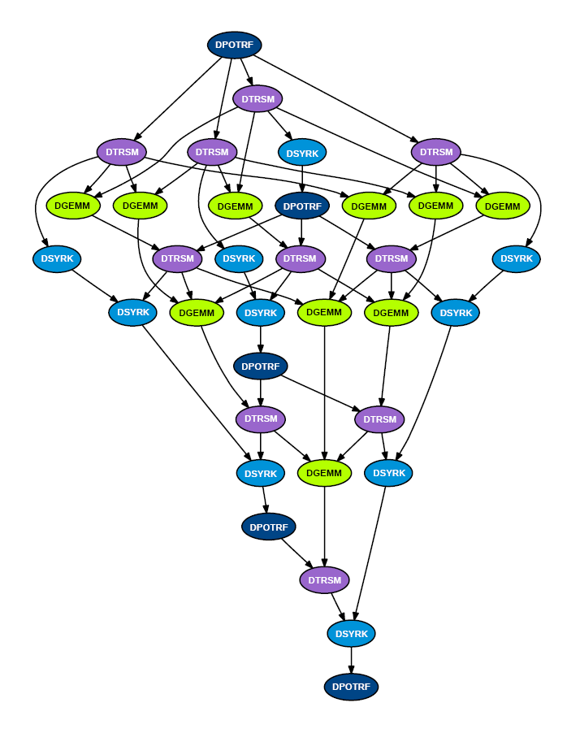
Sample Cholesky DAG with #blocks in any row or column = N/b = 5
Note implied order of summation from left to right
Not necessary for correctness, but it does reflect what the sequential code does
Can process DAG in any order respecting dependences
Slide courtesy of Jakub Kurzak, UTK
Notes:
Dark blue is bxb Cholesky, green is gemm, etc

Slide 68
Scheduling options
Static (pre-assign tasks to processors) vs Dynamic (idle processors grab ready jobs from work-queue)
If dynamic, does scheduler take user hints/priorities?
Respect locality (eg processor must have some task data in its cache) vs not
Build and store entire DAG to schedule it (which may be very large, (N/b)³ ), vs Build just the next few “levels” at a time (smaller, but less information for scheduler)
Programmer builds DAG & schedule vs Depend on compiler or run-time system
Ease of programming, vs not exploiting user knowledge
If compiler, how conservative is detection of parallelism?
Generally useful, not just linear algebra
CS267 Lecture 16
Notes:
Now in OpenMP 4.0

Slide 69
Schedulers tested
Cilk
programmer-defined parallelism
spawn – creates independent tasks
sync – synchronizes a sub-branch of the tree
SMPSs
dependency-defined parallelism
pragma-based annotation of tasks (directionality of the parameters)
PLASMA (Static Pipeline)
programmer-defined (hard-coded)
apriori processing order
stalling on dependencies
OpenMP 4.0
Slide courtesy of Jakub Kurzak, UTK
Notes:
CILK: “language of C ilk”
Charles Leiserson at MIT, acquired by Intel
Does work stealing
SMPS – Barcelona Supercomputer Center
PLASMA - Jack Dongarra, Jakub Kurzak et al at UTK
OpenMP 4.0: 2013
OpenMP 5.0: 2018

Slide 70
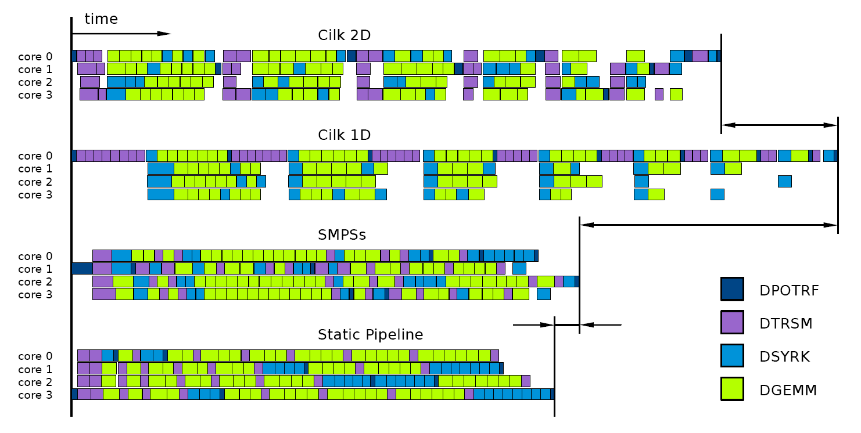
Measured Results for Tiled Cholesky
PLASMA:
Measured on Intel Tigerton 2.4 GHz
Cilk 1D: one task is whole panel, but with “look ahead”
Cilk 2D: tasks are blocks, scheduler steals work, little locality
PLASMA works best
Slide courtesy of Jakub Kurzak, UTK

Slide 71
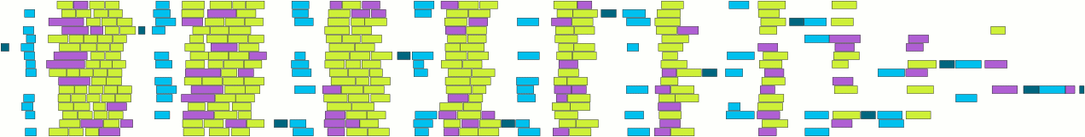
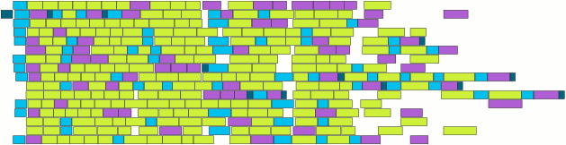
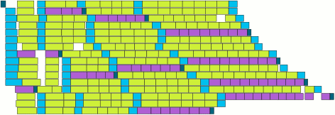
More Measured Results for Tiled Cholesky
Measured on Intel Tigerton 2.4 GHz
Cilk
SMPSs
PLASMA (Static Pipeline)
Slide courtesy of Jakub Kurzak, UTK

Slide 72
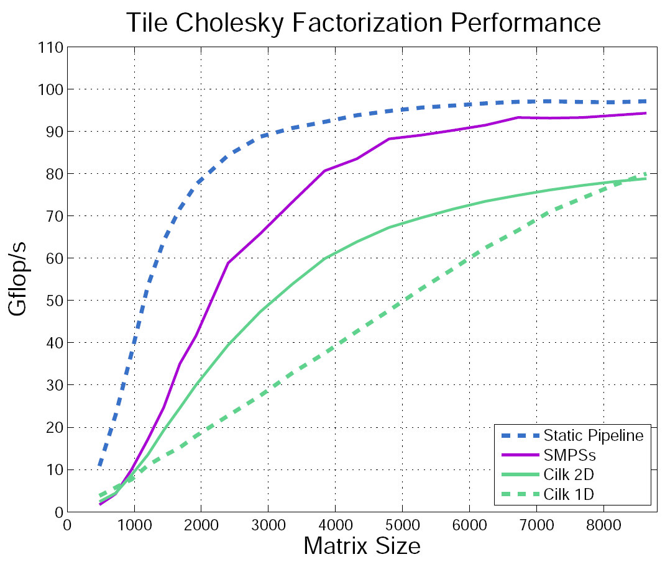
Still More Measured Results for Tiled Cholesky
PLASMA (static pipeline) – best
SMPSs – somewhat worse
Cilk 2D – inferior
Cilk 1D – still worse
quad-socket, quad-core (16 cores total) Intel Tigerton 2.4 GHz
Slide courtesy of Jakub Kurzak, UTK

Slide 73
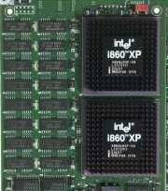
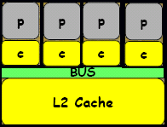
Intel’s Clovertown Quad Core
3 Implementations of LU factorization
Quad core w/2 sockets per board, w/ 8 Threads
3. DAG Based (Dynamic Scheduling)
2. ScaLAPACK (Mess Pass using mem copy)
1. LAPACK (BLAS Fork-Join Parallelism)
8 Core Experiments
Source: Jack Dongarra

Slide 74
Class Projects
Pick one (of many) functions/algorithms
Pick a target parallel platform (TPU, …)
Pick a “parallel programming framework”
LAPACK – all parallelism in BLAS
ScaLAPACK or SLATE – distributed memory using MPI
Spark, Ray, …
Design, implement, measure, model and/or compare performance
Can be missing entirely on target platform
May exist, but with a different programming framework
For information about recent related NSF project:
http://www.netlib.org/lapack/lawnspdf/lawn297.pdf
Notes:
Google (Inderjit Dhillon) interested in using TPUs

Slide 75
Class Projects
Pick one (of many) functions/algorithms
Pick a target parallel platform
Pick a “parallel programming framework”
LAPACK – all parallelism in BLAS
ScaLAPACK – distributed memory using MPI
DPLASMA – DAG scheduling distributed parallel systems
Parallel Linear Algebra for Scalable Multi-core Architectures
http://icl.cs.utk.edu/dplasma/
MAGMA – DAG scheduling for heterogeneous platforms
Matrix Algebra on GPU and Multicore Architectures
http://icl.cs.utk.edu/magma/
Spark, SLATE, Elemental, …
Design, implement, measure, model and/or compare performance
Can be missing entirely on target platform
May exist, but with a different programming framework

Slide 76
Scheduling on Multicore – Next Steps
PLASMA 2.8.0 released 12/2015
Includes BLAS, Cholesky, QR, LU, LDL^{T}, eig, svd
icl.cs.utk.edu/plasma/
Future of PLASMA
Continue adding functions
Add dynamic scheduling
QUARK dynamic scheduler released 12/2011
DAGs for eigenproblems are too complicated to do by hand
Plan to adopt OPenMP4.0 DAG scheduling features
Still assume homogeneity of available cores
What about GPUs, or mixtures of CPUs and GPUs?
MAGMA for GPUs
icl.cs.utk.edu/magma
DPLASMA for distributed memory heterogeneous systems
icl.cs.utk.edu/dplasma
CLASS PROJECTS
CS267 Lecture 16

