Slide 1
AEGEAN: REPLICATION BEYOND THE CLIENT-SERVER
Remzi Can Aksoy, Manos Kapritsos
SOSP 2019

Slide 2
Paper contributions
Current consistency models for replicated data fail when transactions involve non-replicated third parties
Credit card payment subsystem
Server-shim, response-durability and spec-tame
Contribute to provide a single correct machine abstraction
Request pipelining
Achieves replica consistency without sequential execution

Slide 3
The problem
Many replicated services interact with non-replicated services
Nested transaction
Current protocols are both inefficient and incorrect
Credit card svc
(non-replicated)
Client
Replicated
service

Slide 4
Why?
Extant replication protocols
Use State Machine Replication model
Provide clients with the illusion they are interacting with a single correct machine (SCM)
Do not provide same abstraction to other external entities
!!!

Slide 5
Performance issues
Extant replication protocols require requests to be executed in a well-defined order
Each request must finish executing before the next request can start
Servers must remain idle while one of their requests is processed by another service
Limits throughput

Slide 6
Client-middle-backend model
Middle
Backend
Client

Slide 7
Middle service replicated with primary-backup
What if primary sends a nested payment request then crashes?
Backend service will process the request
Not reflected in the state of the middle service
When backup copy becomes the new primary
Will not know that the request was sent and processed
Will reissue it!
Problem is that primary performs an OUTPUT commit without first ensuring that request was propagated o the backup

Slide 8
Middle service replicated with Paxos-like protocols
Paxos, Raft and many others
All replicas execute all requests
Backend may end receiving and executing multiple copies of each nested request
Will be identical
Duplicate detection will work
Problem still remain

Slide 9
Middle service replicated with speculative execution
Some replicated services execute requests before an agreement is reached
Faster
Roll back if agreement cannot be reached
Works well as long as the client is not exposed to inconsistent states resulting from speculations that failed
What about backend services?

Slide 10
The issues
Replicated requests should be treated as a single logical request
Replicas cannot finalize execution of backend responses before obtaining a consensus from a quorum of their peers
Nested request should never be based on a speculative state

Slide 11
An alternative solution
Make the middle service
Unreplicated
Stateless
In case of crashes, can restart another instance of the server
Typically combined it with a fault-tolerant backend store

Slide 12
System model (I)
Middle servers
Can be synchronous or asynchronous
Can be designed to tolerate all kind of failures
Including Byzantine failures
We assume synchronous intervals during which messages sent by correct nodes are received and processed
Required for liveness

Slide 13
Refresher
Non-Byzantine
Failed nodes stop communicating with other nodes
Omission failures
Fail-stop behavior
Byzantine
Failed nodes will keep sending messages
Incorrect and potentially misleading
Failed node becomes a traitor

Slide 14
System model (II)
Backend service
Can be replicated or unreplicated

Slide 15
System model (III)
Failure model
System will remain live
Provide replies to client requests
In the presence of up to u simultaneous failures of any kind
System will remain safe (but not necessarily live)
Not provide incorrect replies to its clients
In the presence of up to r simultaneous Byzantine failures and an arbitrary number of omission failures

Slide 16
System model (IVI)
Correctness
Does not want to use serial execution
Too limiting
Undistinguishability
A replicated service is correct if its outcomes are undistinguishable from those of an unreplicated service

Slide 17
Server shim (I)
Interposed between middle service and backend service
When middle service issue a request
Server shim authenticates the request
Waits until request gets a quorum of matching requests before forwarding it to the backend service
Discards request copies sent after that

Slide 18
Server shim (II)
When it gets a response from the backend service, shim broadcasts it to all replicas
Must ensure that no message is lost in the network
Maintains a per-client-thread reply cache
Resends response if needed

Slide 19
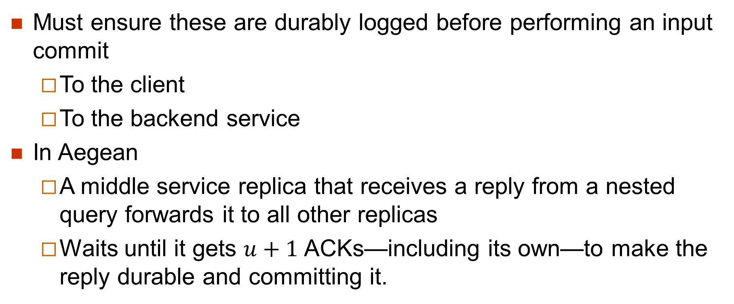
Durability of nested responses
Must ensure these are durably logged before performing an input commit
To the client
To the backend service
In Aegean
A middle service replica that receives a reply from a nested query forwards it to all other replicas
Waits until it gets $u+1$ACKs—including its own—to make the reply durable and committing it.

Slide 20
Spec-tame
Allows replicated services to use speculation while still providing single correct machine abstraction to all backend service
Key idea
Not to perform any output commit until speculation is resolved

Slide 21
Case study: taming Eve’s speculation
Not covered

Slide 22
Agree-execute architecture
Used by most replication protocols
Replicas first agree on ordering of requests, then execute them sequentially in that order
Forces middle service to remain idle while its nested transactions are forwarded to and processed by backend service
Single-threaded servers performing physical I/Os have the same issue
Main motivation for multithreaded servers

Slide 23
An example

Slide 24
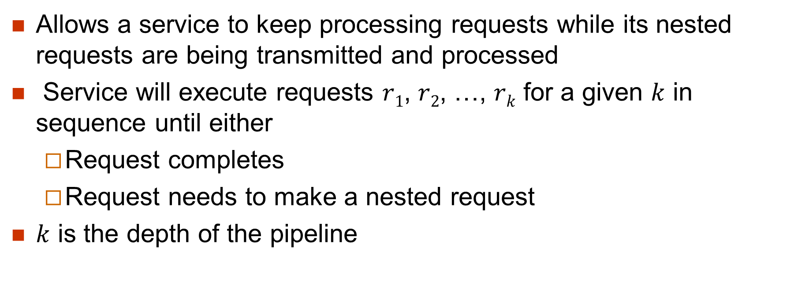
Request pipelining (I)
Allows a service to keep processing requests while its nested requests are being transmitted and processed
Service will execute requests $r1$, $r2$, …, $rk$ for a given $k$ in sequence until either
Request completes
Request needs to make a nested request
$k$ is the depth of the pipeline

Slide 25
Request pipelining (II)
After the replies to the nested requests have arrived, the requests that were waiting are processed in the pipeline order
Not in the order the nested replies have arrived

Slide 26
Example

Slide 27
Implementation
Not covered

Slide 28
Experimental results
Multithreading works!

Slide 29
Conclusion
From the paper
In a world of large-scale systems and microservices, it becomes imperative to rethink our replication protocols to allow for interactions between multiple components.

