Slide 1
CEPH: A SCALABLE, HIGH-PERFORMANCE DISTRIBUTED FILE SYSTEM
S. A. Weil, S. A. Brandt, E. L. Miller D. D. E. Long, C. Maltzahn
U. C. Santa Cruz
OSDI 2006

Slide 2
Paper highlights
Yet another distributed file system using object storage devices
Designed for scalability
Main contributions
Distributed dynamic metadata management through hashing
Pseudo-random data distribution function replaces object lists

Slide 3
System objectives
Excellent performance and reliability
Unparallel scalability thanks to
Distribution of metadata workload inside metadata cluster
Use of object storage devices (OSDs)
Designed for very large systems
Petabyte scale (10⁶ gigabytes)

Slide 4
Characteristics of very large systems
Built incrementally
Node failures are the norm
Quality and character of workload changes over time

Slide 5
System overview
System architecture
Key ideas
Decoupling data and metadata
Metadata management
Autonomic distributed object storage

Slide 6
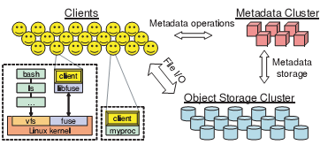
System Architecture (I)

Slide 7
System Architecture (II)
Clients
Export a near-POSIX file system interface
Cluster of OSDs
Store all data and metadata
Communicate directly with clients
Metadata server cluster
Manages the namespace (files and directories)
Security, consistency and coherence

Slide 8
Key ideas
Separate data and metadata management tasks
- Metadata cluster does not have object lists
Dynamic partitioning of metadata data tasks inside metadata cluster
Avoids hot spots
Let OSDs handle file migration and replication tasks

Slide 9
Decoupling data and metadata
Metadata cluster handles metadata operations
Clients interact directly with OSD for all file I/O
Low-level bloc allocation is delegated to OSDs
Other OSD still require metadata cluster to hold object lists
Ceph uses a special pseudo-random data distribution function (CRUSH)

Slide 10
Old School
File xyz?
Metadata
server cluster
Client
Where to find the container objects
Metadata server keeps track of the locations of all containers

Slide 11
Ceph with CRUSH
File xyz?
Metadata
server cluster
Client
How to find the container objects
Client uses CRUSH and
data provided by MDS
cluster to find the file

Slide 12
Ceph with CRUSH
Metadata
server cluster
File xyz?
Here is how to find these
container objects
Client
Client uses CRUSH and
data provided by MDS
cluster to find the file

Slide 13
Metadata management
Dynamic Subtree Partitioning
Lets Ceph dynamically share metadata workload among tens or hundreds of metadata servers (MDSs)
Sharing is dynamic and based on current access patterns
Results in near-linear performance scaling in the number of MDSs

Slide 14
Autonomic distributed object storage
Distributed storage handles data migration and data replication
Leverages the computational resources of OSDs
Achieves reliable highly-available scalable object storage
Reliable implies no data losses
Highly available implies being accessible almost all the time

Slide 15
THE CLIENT
Performing an I/O
Client synchronization
Namespace operations

Slide 16
Performing an I/O
When client opens a file
Sends a request to the MDS cluster
Receives an i-node number, information about file size and striping strategy and a capability
Capability specifies authorized operations on file
Not yet encrypted
Client uses CRUSH to locate object replicas
Client releases capability at close time

Slide 17
Client synchronization (I)
POSIX requires
One-copy serializability
Atomicity of writes
When MDS detects conflicting accesses by different clients to the same file
Revokes all caching and buffering permissions for that file
Requires synchronous I/O to the file

Slide 18
Client synchronization (II)
Synchronization handled by OSDs
Locks can be used for writes spanning object boundaries
Synchronous I/O operations have huge latencies
Many scientific workloads do significant amount of read-write sharing
POSIX extension lets applications synchronize their concurrent accesses to a file

Slide 19
Namespace operations
Managed by the MDSs
Read and update operations are all synchronously applied to the metadata
Optimized for common case
readdir returns contents of whole directory (as NFS readdirplus does)
Guarantees serializability of all operations
Can be relaxed by application

Slide 20
The MDS cluster
Storing metadata
Dynamic subtree partitioning
Mapping subdirectories to MDSs

Slide 21
Storing metadata
Most requests likely to be satisfied from MDS in-memory cache
Each MDS lodges its update operations in lazily-flushed journal
Facilitates recovery
Directories
Include i-nodes
Stored on a OSD cluster

Slide 22
Dynamic subtree partitioning
Ceph uses primary copy approach to cached metadata management
Ceph adaptively distributes cached metadata across MDS nodes
Each MDS measures popularity of data within a directory
Ceph migrates and/or replicates hot spots

Slide 23
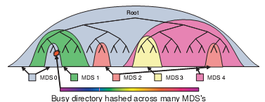
Mapping subdirectories to MDSs

Slide 24
Replicating “hot” directories
Heavily read directories
Many file accesses
Selectively replicated over different nodes
Heavily written directories
Many file creations
Hashed across the cluster

Slide 25
Distributed object storage
Data distribution with CRUSH
Replication
Data safety
Recovery and cluster updates
EBOFS

Slide 26
Data distribution with CRUSH (I)
Wanted to avoid storing object addresses in MDS cluster
Ceph firsts maps objects into placement groups (PG) using a hash function
Placement groups are then assigned to OSDs using a pseudo-random function (CRUSH)
Clients know that function

Slide 27
Data distribution with CRUSH (II)
To access an object, client needs to know
Its placement group
The OSD cluster map
The object placement rules used by CRUSH
Replication level
Placement constraints

Slide 28
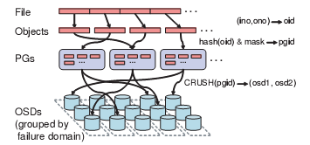
How files are striped

Slide 29
Replication
Ceph’s Reliable Autonomic Data Object Store autonomously manages object replication
First non-failed OSD in object’s replication list acts as a primary copy
Applies each update locally
Increments object’s version number
Propagates the update

Slide 30
Data safety
Achieved by update process
Primary forwards updates to other replicas
Sends ACK to client once all replicas have received the update
Slower but safer
Replicas send final commit once they have committed update to disk

Slide 31
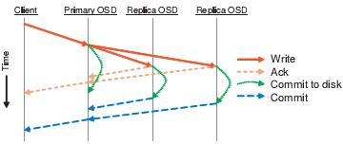
Committing writes

Slide 32
Recovery and cluster updates
RADOS (Reliable and Autonomous Distributed Object Store) monitors OSDs to detect failures
Recovery handled by same mechanism as deployment of new storage
Entirely driven by individual OSDs

Slide 33
Low-level storage management
Most DFS use an existing local file system to manage low-level storage
Hard to understand when object updates are safely committed on disk
Could use journaling or synchronous writes
Big performance penalty

Slide 34
Low-level storage management
Each Ceph OSD manages its local object storage with EBOFS (Extent and B-Tree based Object File System)
B-Tree service locates objects on disk
Block allocation is conducted in term of extents to keep data compact
Well-defined update semantics

Slide 35
Performance and scalability
Want to measure
Cost of updating replicated data
Throughput and latency
Overall system performance
Scalability
Impact of MDS cluster size on latency

Slide 36
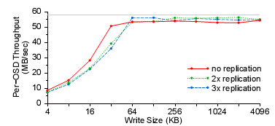
Impact of replication (I)

Slide 37
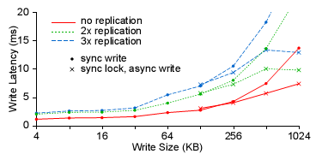
Impact of replication (II)
Transmission times dominate for large synchronized writes

Slide 38
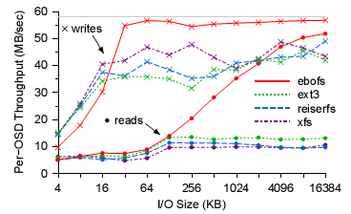
File system performance

Slide 39
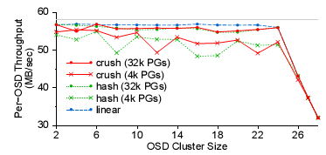
Scalability
Switch is saturated at 24 OSDs

Slide 40
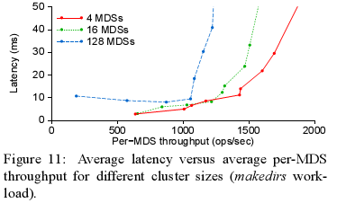
Impact of MDS cluster size on latency

Slide 41
Conclusion
Ceph addresses three critical challenges of modern DFS
Scalability
Performance
Reliability
Achieved though reducing the workload of MDS
CRUSH
Autonomous repairs of OSD

Slide 42
Why this strange name?
Ceph stands for cephalopod
Reminds of
Multitasking of octopus
Banana slug, the official UCSC mascot

