Slide 1
DYNAMO: AMAZON'S HIGHLY AVAILABLE KEY-VALUE STORE
G. DeCandia, D. Hastorun, M. Jampani, G. Kakulapati, A. Lakshman, A. Pilchin, S. Sivasubramanian, P. Vosshall, W. Vogels
Amazon.com

Slide 2
Overview
A highly-available massive key-value store
Emphasis on reliability and scaling needs
Dynamo uses
Write always approach
Consistent hashing for distributing workload

Slide 3
System requirements (I)
Query Model: Reading and updating single data items identified by their unique key
ACID Properties: (Atomicity, Consistency, Isolation, Durability)
Ready to trade weaker consistency for higher availability
Isolation is a non-issue

Slide 4
System requirements (II)
Efficiency: stringent latency requirements
Measured at 99.9th percentile
Other: internal non-hostile environment

Slide 5
Service-Level Agreement
Formally negotiated agreement where a client and a service agree on several parameters of the service
Client expected request rate distribution for a given API
Expected service latency
Example:
Response within 300ms for 99.9% of requests for a peak client load of 500 requests/second.

Slide 6
Why percentiles?
Performance SLAs often specified in terms of
Average and standard deviation
Median
of response time
Not enough if goal is to build a system where all customers have a good experience
Choice of 99.9 percent based on a cost-benefit analysis

Slide 7
Combine outputs of multiple services
(typically stateless)

Slide 8
Design considerations (I)
Choosing between
Strong consistency (and poor availability)
Optimistic replication techniques
Background propagation of updates
Occasional concurrent disconnected work
Conflicting updates can lead to inconsistencies
Problem is when to resolve them and who should do it

Slide 9
Design considerations (II)
When to resolve update conflicts
Traditional approach
Use quorums to validate writes
Relatively simple reads
Dynamo approach
Do not reject customer updates
Reconcile inconsistencies when data are read
Much more complex reads

Slide 10
Design considerations (III)
Who should resolve update conflicts
Data store
Limited to crude policies
Latest write wins
Application
Knowns semantics of operations
Can merge conflicting shopping carts
Not always wanted by the application

Slide 11
Design considerations (IV)
Other key principles
Incremental scalability
One storage node at a time
Symmetry
All nodes share same responsibilities
Decentralization of control
Heterogeneity
Can handle nodes with different capacities

Slide 12
Previous work
Peer-to-Peer Systems
Routing mechanisms
Conflict resolution
Distributed File Systems and Databases
Farsite was totally decentralized
Coda, Bayou and Ficus allow disconnected operations
Coda and Ficus perform system-level conflict resolution
Bayou lets applications perform conflict resolution

Slide 13
Dynamo specificity
Always writable storage system
No security concerns
In-house use
No need for hierarchical name spaces
Stringent latency requirements
Cannot route requests through multiple nodes
Dynamo is a zero-hop distributed hash table

Slide 14
Distributed hashing
Key
Go next!
Organize storage nodes into a ring
Let $maxK$ be the key value associated with the position of node $k$ on the ring
Node $k$ handles keys greater than $\max_{k−1}$ and lesser than or equal to $\max_{k}$
Node $k+1$ handles keys greater than $\max_{k}$ and lesser than or equal to $\max_{k+1}$
…

Slide 15
Consistent hashing (I)
Used in distributed hashing schemes to eliminate hot spots
Traditional approach:
Each node corresponds to a single bucket
If a node fails, all its workload is transferred to its successor
Will often overload it

Slide 16
Consistent hashing (II)
We associate with each physical node a set of random disjoint buckets:
Virtual nodes
Spreads better the workload
Number of virtual nodes assigned to each physical node depends on its capacity
Additional benefit of node virtualization

Slide 17
Adding replication
Each data item is replicated at $N$ virtual nodes
Each key is assigned a coordinator node
Holds a replica
In charge of replication
Replicates the key at its $N−1$ clockwise successors on the ring
Preference list
Must check that the $N$ virtual nodes correspond to distinct physical nodes

Slide 18
Nodes B, C and D define a preference list
for keys in range (A, B)

Slide 19
Putting everything together
Each physical node hosts several virtual nodes
Each of these virtual nodes has different successors
Hosted on separate physical nodes
When a physical node fails
The workload of all its virtual nodes is taken by their successors
Extra burden is shared by several physical nodes

Slide 20
Data versioning
Dynamo provides eventual consistency
Can have temporary inconsistencies
Some applications can tolerate inconsistencies
Add to cart operations can never be forgotten
Inconsistent carts can late be merged
Dynamo treats each update as a new immutable version of the object
Syntactic reconciliation when each new version subsumes the previous ones

Slide 21
Handling version branching
Updates can never be lost
Dynamo uses vector clocks
Can find out whether two versions of an object are on parallel branches or have causal ordering
Clients that want to update an object must specify which version they are updating

Slide 22
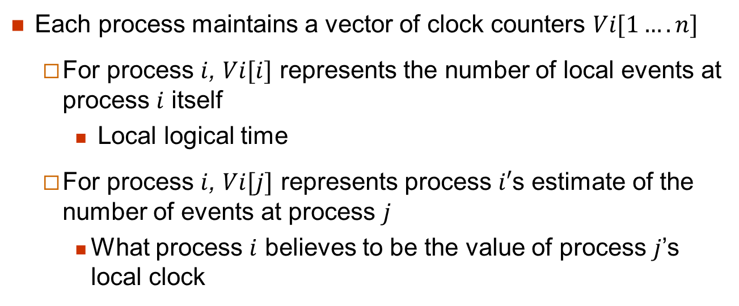
Vector clocks
Each process maintains a vector of clock counters $Vi[1….n]$
For process $i$, $Vi[i]$ represents the number of local events at process $i$ itself
Local logical time
For process $i$, $Vi[j]$ represents process $i′$s estimate of the number of events at process $j$
What process $i$ believes to be the value of process $j$’s local clock

Slide 23
Vector clock update rules
Process $Pi$increments its local clock on all internal events
Process $Pi$ increments its local clock on a send event and piggybacks its vector clock on to the message
When Pi receives a message $m$, it increments :
$Vi[i] = Vi[i] +1$
$Vi\left[j\right]=\max\left(Vi\left[j\right], Vm\left[j\right]\right)$ for any $i ≠ j$
t

Slide 24
Updates D1 and D2 are subsumed by following updates
D3 and D4 are inconsistent

Slide 25
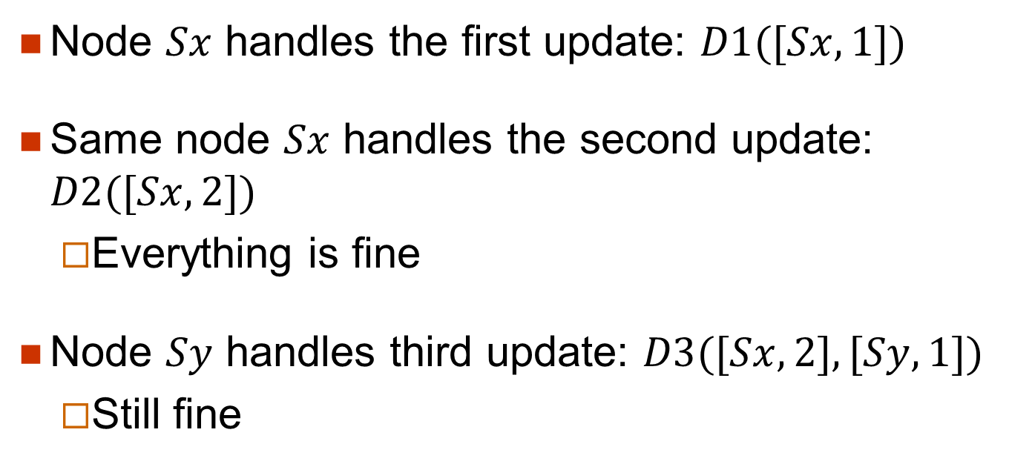
Explanations (I)
Node $Sx$ handles the first update: $D1([Sx, 1])$
Same node $Sx$ handles the second update: $D2([Sx, 2])$
Everything is fine
Node $Sy$ handles third update: $D3([Sx, 2], [Sy, 1])$
Still fine

Slide 26
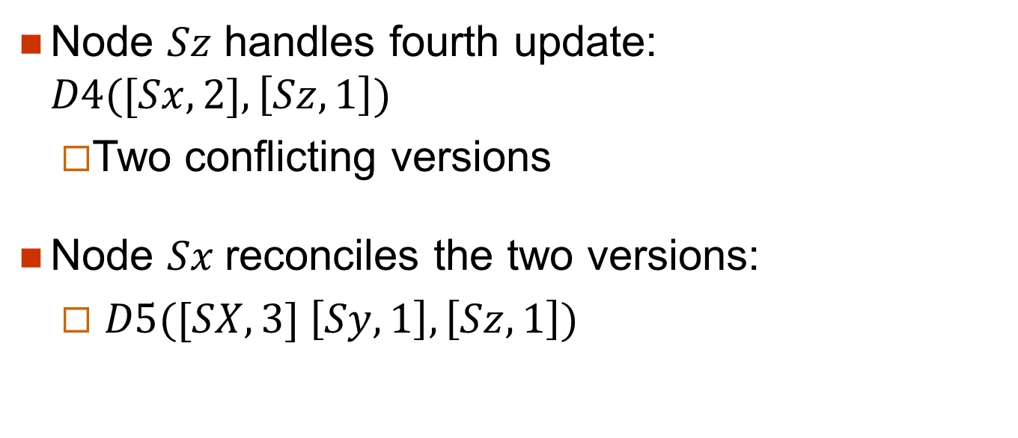
Explanations (I)
Node $Sz$ handles fourth update: $D4([Sx, 2], \left[Sz, 1\right])$
Two conflicting versions
Node $Sx$reconciles the two versions:
$D5([SX, 3] \left[Sy, 1\right],\left[Sz, 1\right])$

Slide 27
Clock truncation scheme
Vector clocks could become too big
Not likely
Remove oldest pair when
Number of (node, counter) pairs exceeds a threshold
Could lead to inefficient reconciliations
Did not happen yet

Slide 28
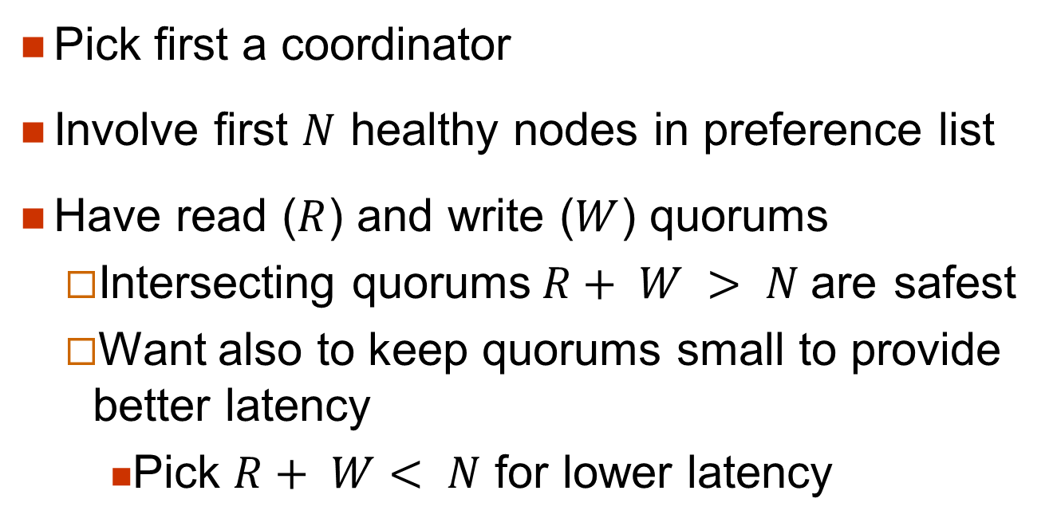
get() and put() operations (I)
Pick first a coordinator
Involve first $N$ healthy nodes in preference list
Have read ($R$) and write ($W$) quorums
Intersecting quorums$R+ W > N$are safest
Want also to keep quorums small to provide better latency
Pick $R+ W< N$ for lower latency

Slide 29
get() and put() operations (II)
When coordinator receives a put() request
Generates the vector clock for the new version of the object
Writes it locally
Sends it to the first $N$ healthy nodes in preference list
Waits for $W$ replies

Slide 30
get() and put() operations (III)
When coordinator receives a get() request
Requests all versions of the object from the first $N$ healthy nodes in preference list
Waits for R replies
If it ends with multiple versions of the data
Returns all the versions it deems causally unrelated
Conflicting versions
“Sloppy quorums”

Slide 31
Implementation
Not covered
Each storage node has three components
Request coordination
Membership
Failure detection
All written in Java
Read operations can be require syntactic reconciliation
More complex

Slide 32
Balancing performance and durability
A non-trivial task
A few customer-facing services require high level of performance
Use buffered writes
Writes are stored in a buffer
Periodically written to storage by a writer thread

Slide 33
One tick each
12 hours

Slide 34
Buffered writes are essential

Slide 35
Ensuring uniform load distribution
Not covered

Slide 36
Divergent versions
Not that frequent
99.94% of requests saw exactly one version
0.00057% saw two versions
0.00047% saw three versions
…

Slide 37
Client-driven or server-driven coordination
Dynamo has a request coordination component
Any Dynamo node can coordinate read requests
Write requests must be coordinated by a node in the key’s current preference list
Because we use version numbers (logical time stamps)
Or let client coordinate requests

Slide 38
Client-driven or server-driven coordination
Client-driven coordination is clearly better

Slide 39
Discussion
In use for two years
Main advantage is providing R, W and N tuning parameters
Maintaining routing tables is not a trivial task
Gossiping overhead increase with scale of system

Slide 40
Conclusions
Dynamo
Can provide desired levels of availability and performance
Can handle
server failures
data center failures
network partitions
Both incrementally scalable and customizable

