Slide 1
F2FS: A NEW FILE SYSTEM FOR FLASH STORAGE
C. Lee, D. Sim, J.-Y. Hwang, and S. Cho
Samsung
FAST 2015

Slide 2
Paper highlights
Presents a Linux-compatible file system for NAND flash drives
Log-structured file system
i-node map is not on the log(s)
i-node map keeps track of the location of indirect blocks
Solves the wandering tree problem
Data stored on multiple logs
According to their hotness factor
Better segment cleaning

Slide 3
NAND flash
Started by using “bare” flash memory
Added a dedicated flash controller
Can manage multiple flash chips
Implements a flash translation layer (FTL)
Logical block mapping
Wear levelling
Page cleaning

Slide 4
Remaining issues
Frequent random writes
Incur internal fragmentation
Degrade sustained performance
Very common in mobile applications
Facebook, Twitter, … use SQLite
Many fsync calls
Will
Affect SSD write latency
Reduce the devise lifetime

Slide 5
Two solutions
Use
Log-structured file system
Copy-on-write
Conventional log-structured file systems
Much better but still sub-optimal
Ignore specifics of NAND flash media

Slide 6
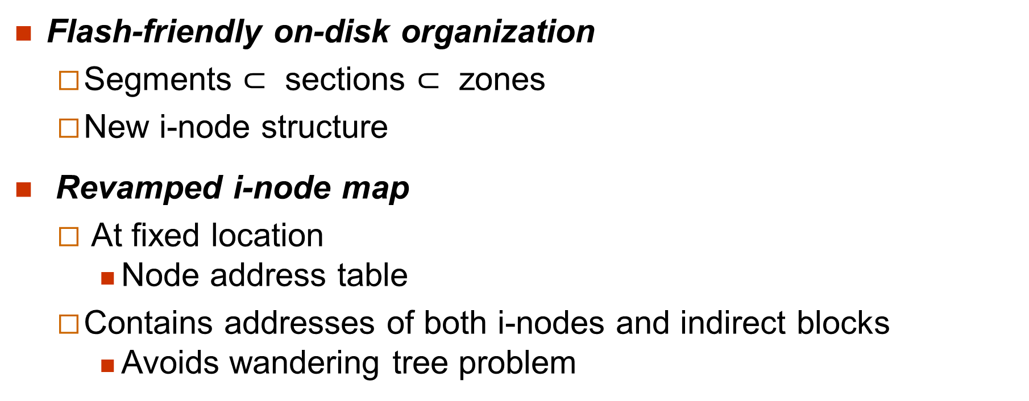
F2FS Highlights (I)
Flash-friendly on-disk organization
Segments $⊂$ sections $⊂$ zones
New i-node structure
Revamped i-node map
At fixed location
Node address table
Contains addresses of both i-nodes and indirect blocks
Avoids wandering tree problem

Slide 7
F2FS Highlights (II)
Multi-head logging
Up to six active log segments
To separate hot and cold data
Adaptive logging
Append-only logging
Normal case
Threaded logging
High storage utilization

Slide 8
F2FS Highlights (II)
fsync optimization with roll-forward recovery
fsync does not trigger a checkpoint
Only updates data blocks and indirect blocks containing block addresses (direct nodes)
Leaves a flag inside other indirect blocks (indirect nodes)
Roll-forward recovery takes care of everything
Updates indirect blocks and other metadata

Slide 9
F2FS status
A part of the Linux kernel since 3.7.1
Used in several commercial products
Motorola Mobility, Google, Huawei and ZTE phones
See Wikipedia entry
https://en.wikipedia.org/wiki/F2FS

Slide 10
On-disk layout

Slide 11
The six areas (I)
Superblock
Two copies unchanged from SSD format time
Checkpoint Area
Two checkpoint packs
File system status
Bitmaps for valid NAT and SIT sets
Orphaned inode lists
Summary entries of currently active segments

Slide 12
The six areas (II)
Segment information table (SIT)
Number of valid blocks in each segment
Bitmaps identifying these valid segments
Node address table (NAT)
i-node map on steroids
Contains addresses of
i-nodes
Indirect blocks (direct nodes and indirect nodes)

Slide 13
The six areas (III)
Segment summary area (SSA)
Keeps track of owner information for all blocks in main area
Parent i-node , offset, …
Main area
4KB blocks
Can be
Node blocks
Ordinary data blocks

Slide 14
Looking up for “/dir/file”
Get address of root i-node block from NAT
Search for “dir” entry in data blocks of root i-node
Get i-node number for “dir”
Get address of “dir” i-node block from NAT
Search for “file” entry in data blocks of root i-node
Get i-node number for “file”
Get address of “file” i-node block from NAT

Slide 15
File structure
Node address table has addresses of
i-nodes
Indirect blocks containing addresses of data blocks
Direct nodes
Indirect blocks containing addresses of other indirect blocks
Indirect nodes

Slide 16
F2FS file structure (I)

Slide 17
F2FS file structure (II)
Larger i-nodes
Plenty of direct block addresses or
3,682 bytes of direct data (copied from NTFS)
Two single-indirect pointers
Two double-indirect pointers
One triple indirect pointer
200 bytes for extended attributes

Slide 18
Motivation
i-node and indirect nodes replace other node addresses by their indexes (node IDs)
i-nodes contain both block addresses and node IDs
Indirect nodes contain node IDs
Direct nodes contain block addresses

Slide 19
A conventional LFS
i-node
Other stuff
0
1
1
2
3
11
12
13
14
…
Triple indirection
blocks
…
…
…
…
blocks
…
…
blocks
…
…
Data

Slide 20
We update a data block (I)
i-node
Other stuff
0
1
1
2
3
11
12
13
14
…
Triple indirection
blocks
…
…
…
…
blocks
…
…
blocks
…
…
Updated data block
at new address
Data

Slide 21
We update a data block (II)
i-node
Other stuff
0
1
1
2
3
11
12
13
14
…
Triple indirection
blocks
…
…
…
…
…
…
Updated address block
at new address
blocks
blocks
…
…
Updated data block
at new address
Data

Slide 22
We update a data block (III)
i-node
Other stuff
0
1
1
2
3
11
12
13
14
…
Triple indirection
blocks
Updated address block
at new address
…
…
…
…
…
…
Updated address block
at new address
blocks
blocks
…
…
Updated data block
at new address
Data

Slide 23
We update a data block (IV)
Updated i-node
i-node
Other stuff
0
1
1
2
3
11
12
13
14
…
Triple indirection
blocks
Updated address block
at new address
…
…
…
…
…
…
Updated address block
at new address
blocks
blocks
…
…
Updated data block
at new address
Data

Slide 24
The F2FS solution
i-node
Other stuff
0
1
1
2
3
11
12
13
14
…
Triple indirection
blocks
…
…
…
…
blocks
…
…
blocks
…
…
Data

Slide 25
We update a data block (I)
i-node
Other stuff
0
1
1
2
3
11
12
13
14
…
Triple indirection
blocks
…
…
…
…
blocks
…
…
blocks
…
…
Data

Slide 26
We update a data block (II)
i-node
Other stuff
0
1
1
2
3
11
12
13
14
…
Triple indirection
blocks
…
…
…
Updated direct node
at new address
keeps its ID
Must now update address
of direct node in NAT
…
blocks
…
…
blocks
…
…
Data

Slide 27
Directory structure
4KB directory entries contain
A bitmap
Two arrays of slots and names
Bitmap entries identify valid slots
Slots contain
A hash , a i-node number, the file name length and type
Directories are organized as multilevel hash tables
Allows O(log # of dentries) searches

Slide 28
Multi-head logging
Typically six separate logs
Used to separate hot and cold blocks
F2FS identifies has cold
Data blocks that have been moved by the segment cleaner
Data blocks labelled as cold by their owner
Multimedia file data

Slide 29
The six default logs

Slide 30
FTL issues
Must take into account characteristics of Flash Translation Layer
F2FS maps active logs to different zones to separate tem in the FTL

Slide 31
Cleaning
Can be
Foreground
Only when there are not enough free sections
Background

Slide 32
Main cleaning steps
Identifying the victim section
Greedy policy for foreground cleaning
Minimizes delay
Cost-benefit for background cleaning
Valid block identification and migration
Per-segment validity bitmap in Segment Information Table
Background cleaning does not issues writes to migrate valid blocks
Puts them in I/O cache and marks tem dirty

Slide 33
Adaptive logging
Append-only logging
Normal case
Just like Sprite LFS
Threaded logging
High storage utilization

Slide 34
fsync optimization
fsync does not trigger a checkpoint
Only updates data blocks and indirect blocks containing block addresses (direct nodes)
Leaves a flag inside other indirect blocks (indirect nodes)
Roll-forward recovery takes care of everything
Updates indirect blocks and other metadata

Slide 35
Performance evaluation
Four benchmarks on a mobile system
Four benchmarks on a server
Compare them with
EXT 4 (JFS)
BTRFS (copy-on-write file system)
NILFS2 (log structured file system)

Slide 36
The mobile system

Slide 37
The server system

Slide 38
Other observations
Write amplification factor is not dramatically increased at high utilization levels
Adaptive logging is essential

