Slide 1
FAWN: A FAST ARRAY OF WIMPY NODES
D. G. Andersen¹, J. Franklin¹, M. Kaminsky²
A. Phanishayee¹, L. Tan¹, V. Vasudevan¹
¹CMU
²Intel Labs

Slide 2
Paper highlights
An energy efficient solution for I/O intensive workloads
  Low-power processors
  Limited DRAM capacity
  All-flash storage
Technical contributions
  Consistent hashing (as in Dynamo)
  Data log architecture

Slide 3
Motivation
Need to limit energy consumption of online servers
  Environmental considerations
  Three-year TCO to be dominated by power
Mismatch between 2009 architectures and needs of I/O-intensive workloads
  Fast and power hungry CPUs
  Large and power-hungry DRAM
  Slow and power-hungry magnetic disks

Slide 5
The problems
Increasing CPU-I/O gap
  Faster CPUs
  Not so fast magnetic disks
CPU power consumption grows super-linearly with speed
  More instructions per second
  Fewer instructions per Joule
    10⁸ instructions/Joule for 2009 fastest CPUs
    10⁹ instructions/Joule 2009 for lower-frequency in-order CPUs

Slide 6
The problems
Dynamic power scaling on conventional architectures does not work
  A system running at 20% of its capacity still consume up to 50% of its peak power
  Powering on/off does not satisfy SLAs of most online workloads

Slide 7
FAWN

Slide 8
The goal

Slide 9
Rebalancing the system

Slide 10
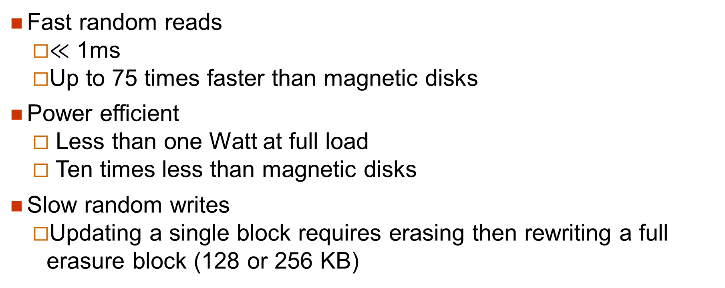
Flash storage
Fast random reads
  $≪$ 1ms
  Up to 75 times faster than magnetic disks
Power efficient
  Less than one Watt at full load
  Ten times less than magnetic disks
Slow random writes
  Updating a single block requires erasing then rewriting a full erasure block (128 or 256 KB)

Slide 11
Finding the most energy-efficient CPUs

Slide 12
Overall architecture

Slide 13
Data log architecture
FAWN nodes have two constraints
  Small memory
  Poor performance of flash drives for random writes
FAWN data log architecture
  Minimizes its RAM footprint
  All writes are append-only

Slide 14
Mapping a key to a value
Through an in-memory hash table
FAWN uses 160-bit keys:
  i least significant bits are index bits
  Next 15 low-order bits are key fragment
Index bits are used to select a bucket
Key fragment is stored in bucket entry
  15 bits + valid bit + 32-bit data log address = 48 bits
Key fragment
Valid
Data log address

Slide 15
The data log
One data log per virtual node
Data log entries consist of
  A full 160-bit key
  A length field
  The actual data
Key (20B)
Len
Data

Slide 16
Basic data store functions
Store:
  Adds an entry to the log and updates corresponding hash table entry
Lookup:
  Locates a data log entry and checks full key
Invalidate:
  Marks hash table entry invalid
  Adds a delete entry to the log (for durability)

Slide 17
The store

Slide 18
Maintenance functions
Split:
  Splits a data store between existing virtual node and a new virtual node
  Can take place while the data store is active
    All writes are appends
Merge
  Merge two data stores into one
Compact:
  Compacts data log and updates all hash table entries
    Similar to segment cleaning in LFS and F2FS

Slide 19
Split

Slide 20
Split

Slide 21
Impact of Virtual IDs
As one physical node supports multiple virtual nodes
  Each virtual node has its own datalog
  Some writes are non-sequential
    Semi-random writes

Slide 22
Consistent hashing (I)
Used in distributed hashing schemes to tolerate the loss of one or more servers
Traditional approach:
  Organize key space as a ring
  Each server node corresponds to a single bucket
    Assign to each bucket a key value
    Bucket handles all key values higher than key value of precedcing bucket but lesser than its own key value.
  If a node dies,
    We lose a bucket
    Must update the hash function for all nodes

Slide 23
Consistent hashing (II)
Have several buckets per node
  Nodes A, B and D have three buckets
  Node C has two buckets
Each bucket has a successor
  Bucket B1 is successor of bucket A1
  …
If a bucket is unavailable
  Select next bucket
B3
A1
D3
B1
A3
C1
B2
D1
D2
A2
C2

Slide 24
Consistent hashing (III)
Potential problem
  Neighboring bucket will become overloaded
Not if we associate with each physical node a set of random disjoint buckets:
  Virtual nodes
When a physical node fails, its workload get shared by several other physical nodes

Slide 25
Performance evaluation

Slide 26
Processing queries

Slide 27
Impact of background maintenance ops

Slide 28
Comparing costs

Slide 29
Finding the best solution

Slide 30
Explanation
Ratio of query rate to data size defines the best solution
These data reflect the 2009 state of the art
  Disk capacity
  Flash capacity
  …

Slide 31
Conclusion
Can provide both
  Low-energy consumption
  Fast response time
  for I/O-intensive workloads
Thanks to
  Datalog architecture
  Efficient replication and fail-over

