Slide 1
LEASES: AN EFFICIENT FAULT-TOLERANT MECHANISM FOR DISTRIBUTED FILE CACHE CONSISTENCY
Cary G. Gray
David R. Cheriton
Stanford University

Slide 2
Paper highlights
Best mechanism for maintain consistency in distributed systems
Tolerates failures and network partitions
Used in many distributed systems
Ceph, GFS, …
Paper presents a write-though scheme
Many variants have appeared since

Slide 3
Leases (I)
“A lease is a contract that gives its holder specified rights over property for a limited period of time.”
“ A lease grants to its holder control over writes to the covered datum during the term of the lease, such that the server must obtain the approval of the leaseholder before the datum may be written.”

Slide 4
Leases
“When a leaseholder grants approval for a write, it invalidates its local copy of the datum.
…
“When a client writes a datum, the server must defer the request until each leaseholder has granted approval or the term of its lease has expired.”

Slide 5
An example (I)
Server
Grants a lease
Requests a lease
Duration of lease
Alice controls the file
Must now
renew it
Alice
Time

Slide 6
An example (II)
Server
Also requests a lease
Got a lease
Bob
Alice
Time

Slide 7
An example(III)
Server
Also requests a lease
Got a lease
Try to break the lease
Bob
Alice
Time

Slide 8
First case: Server can reach Alice
Server
Also requests a lease
Got a lease
Try to break the lease
Bob
Alice
The lease is broken Alice invalidates her cache
Bob gets a lease
Time

Slide 9
Second case: server cannot reach Alice
Server
Also requests a lease
Got a lease
Bob must wait
Try to break the lease
Bob
Alice
Bob’s lease
Time

Slide 10
Big advantages of leases
Both more rigorous and cheaper then NFS solution
Consistency is guaranteed
Little or no overhead as long as the file is not shared
Solution is not stateless
No problem as long as lease durations are shorter than minimum server reboot time

Slide 11
When not to use leases
When availability is more important than consistency
Want to let client keep operating when disconnected
“Infinite leases”
Clients do not have to renew leases
Not true leases, better to call them “callbacks”

Slide 12
Discussion
Leases are short
Require well synchronized clocks and reasonable transmission delays
Can require/obtain leases for collections of items
A directory and all its files.

Slide 13
An example
When server receives Bob's request,
It will try to contact Alice and break the lease
Alice will invalidate the contents of her cache
If Alice does not answer, server must wait until Alice's lease expires

Slide 14
Write-through or write-back caches
Gray and Cheriton assume caches are write-through
“Clean failure semantics”
A client that breaks/loses a lease has one thing to do:
Invalidate its local copy of the datum
Could also have write-back caches
Work best with clients having a local disk/SSD
A client that breaks/loses a lease has one more thing to do:
Send update copy of datum to server

Slide 15
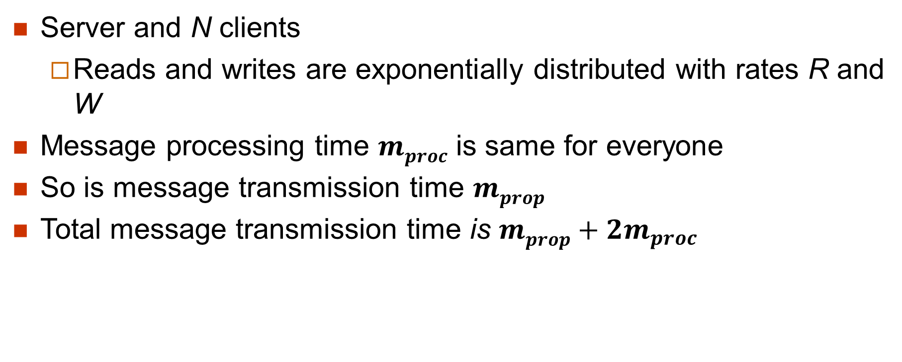
Analytic Model (I)
Server and N clients
Reads and writes are exponentially distributed with rates R and W
Message processing time $mproc$ is same for everyone
So is message transmission time $mprop$
Total message transmission time is $mprop+2m_{proc}$
Sender processes the message
Message is transmitted
Receiver processes the message

Slide 16
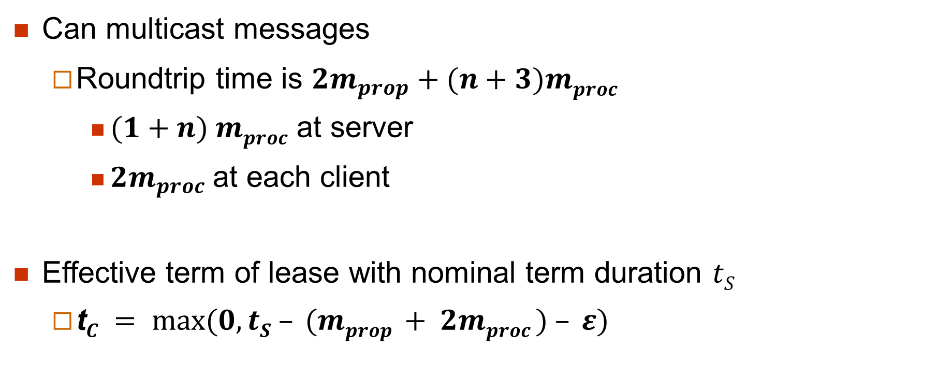
Analytic Model (II)
Can multicast messages
Roundtrip time is $2m_{prop}+(n+3)mproc$
$(1+n) mproc$ at server
${2m}_{proc}$ at each client
Effective term of lease with nominal term duration $tS$
t$C = max⁡(0, tS – (mprop + 2mproc ) – ε)$

Slide 17
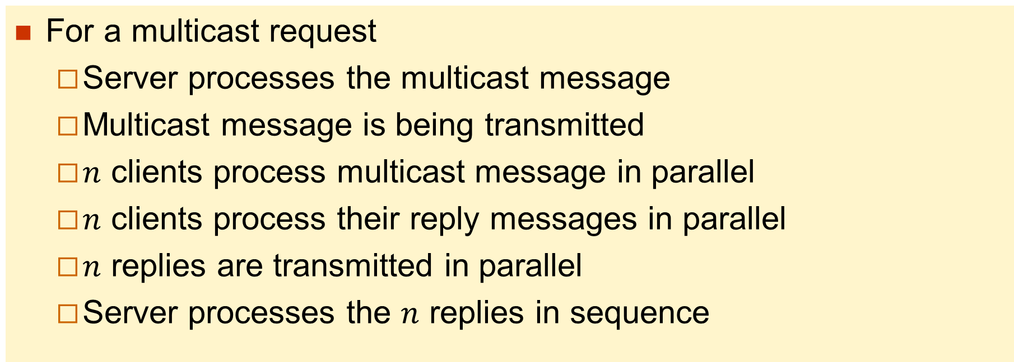
Explanations
For a multicast request
Server processes the multicast message
Multicast message is being transmitted
$n$ clients process multicast message in parallel
$n$ clients process their reply messages in parallel
$n$ replies are transmitted in parallel
Server processes the $n$ replies in sequence

Slide 18
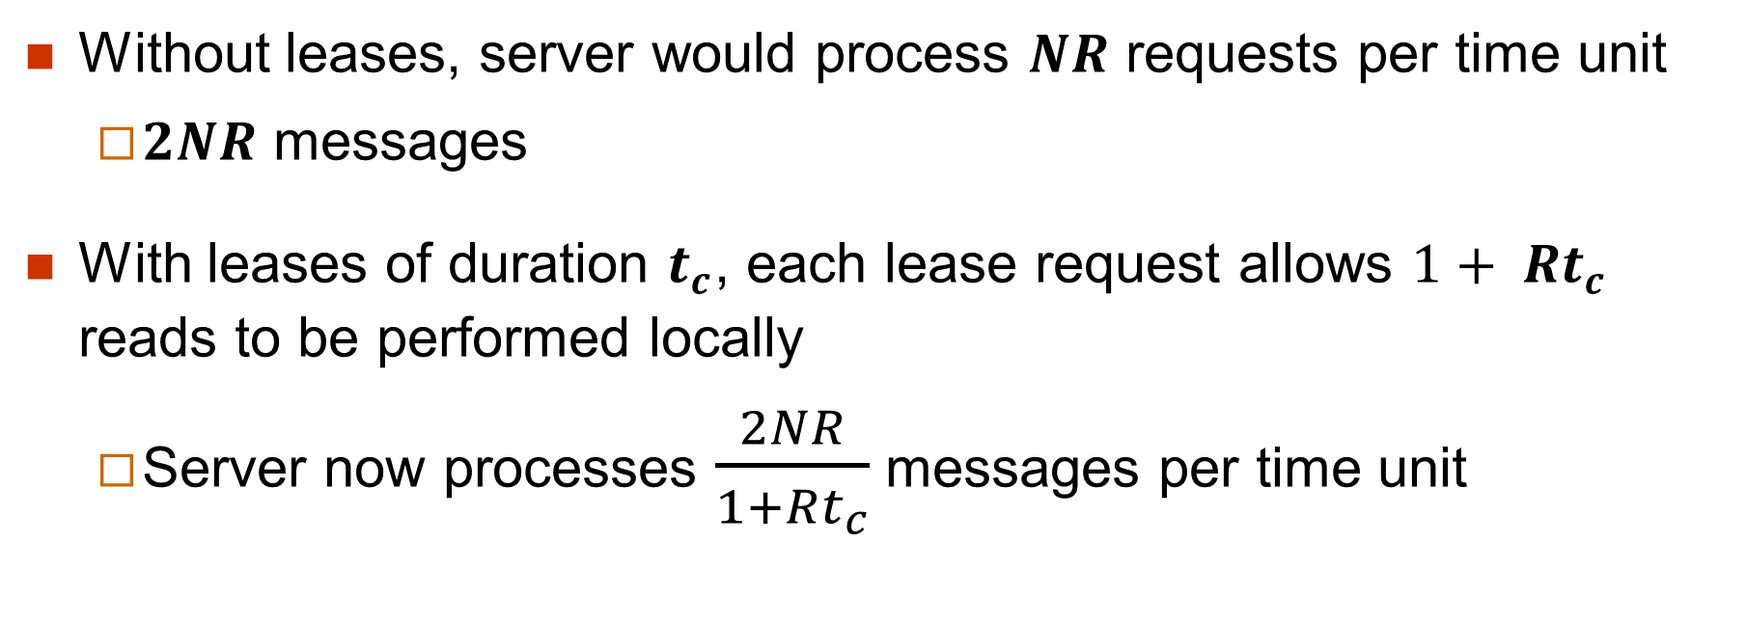
Read lease overhead (I)
Without leases, server would process $NR$ requests per time unit
$2NR$ messages
With leases of duration $t_{c}$, each lease request allows $1+ Rt_{c}$ reads to be performed locally
Server now processes $\frac{2NR}{1+Rt_{c}}$ messages per time unit

Slide 19
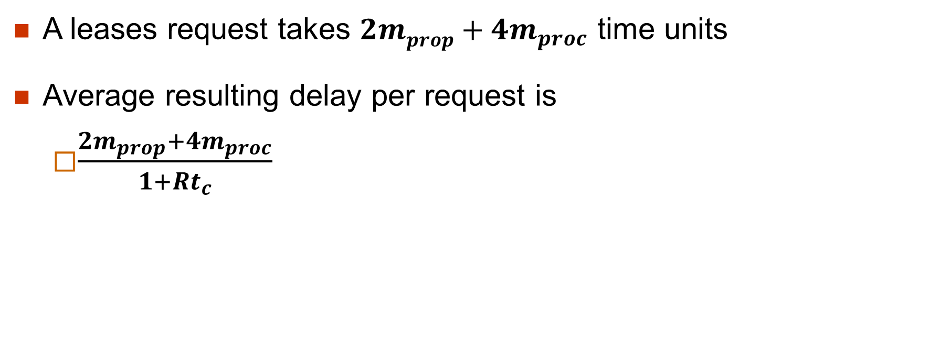
Read lease overhead (II)
A leases request takes $2mprop+4m_{proc}$ time units
Average resulting delay per request is
$\frac{2m_{prop}+4m_{proc}}{1+Rt_{c}}$

Slide 20
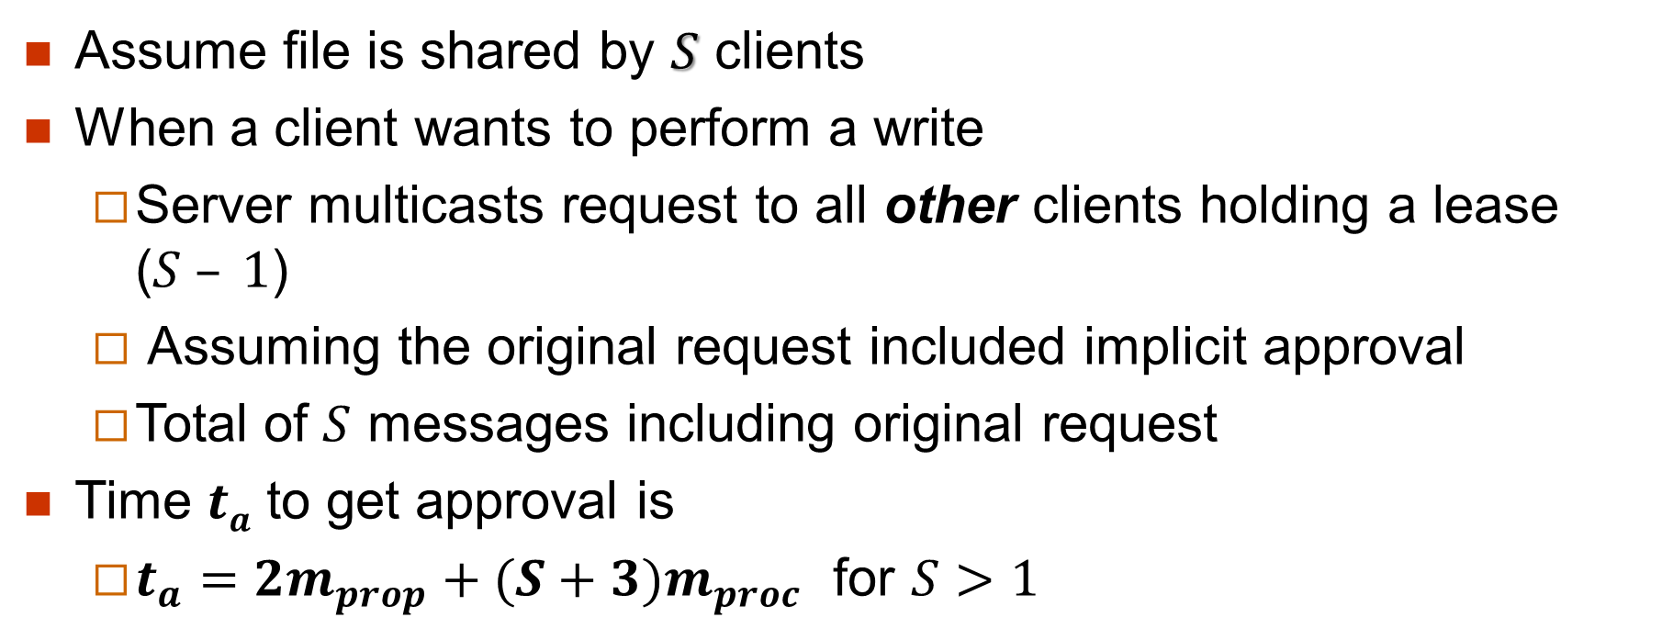
Write lease overhead
Assume file is shared by $S$ clients
When a client wants to perform a write
Server multicasts request to all other clients holding a lease ($S – 1$)
Assuming the original request included implicit approval
Total of $S$ messages including original request
Time $ta$ to get approval is
$t_{a}=2m_{prop}+(S+3)m_{proc}$ for $S>1$

Slide 21
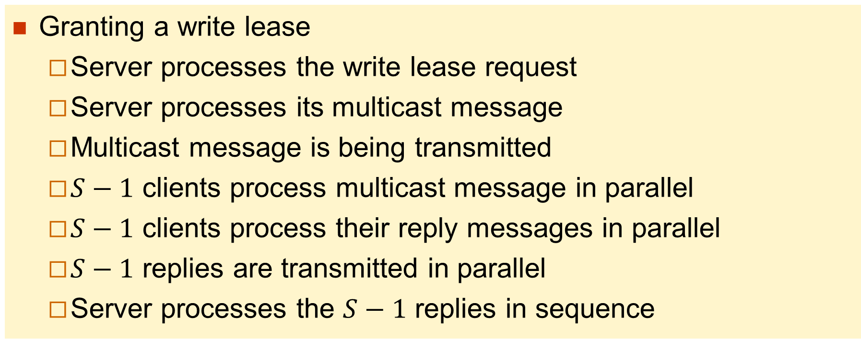
Explanations
Granting a write lease
Server processes the write lease request
Server processes its multicast message
Multicast message is being transmitted
$S−1$ clients process multicast message in parallel
$S−1$ clients process their reply messages in parallel
$S−1$ replies are transmitted in parallel
Server processes the $S−1$ replies in sequence

Slide 22
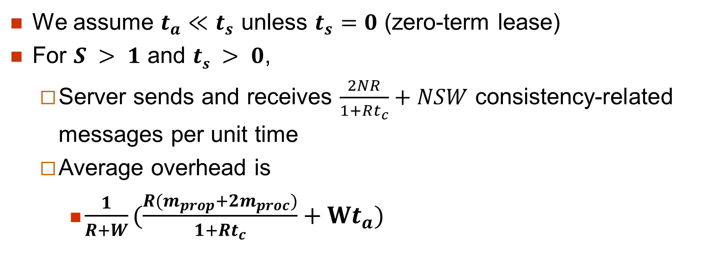
Combining both
We assume $t_{a}≪t_{s}$ unless $t_{s}=0$ (zero-term lease)
For $S > 1$ and $ts > 0$,
Server sends and receives $\frac{2NR}{1+Rt_{c}}+NSW$ consistency-related messages per unit time
Average overhead is
$\frac{1}{R+W}(\frac{R(m_{prop}+2m_{proc})}{1+Rt_{c}}+Wt_{a})$

Slide 23
Number of caches in which the file is shared
Lower is better
10 seconds seems to be the best choice

Slide 24
Infinite “leases”
Clients do not need to renew them
Can still access the data in disconnected mode
When the server tries to break a lease and the client does not answer, the server breaks the lease anyways
Can—and will—result in inconsistencies
Solution privileges availability in the presence of partitions over data consistency
Was used by AFS and Coda

Slide 25
Conclusions
Leases are the best mechanism for managing client caches in distributed file systems
Low overhead
Guarantee data consistency
Multiple variants have been proposed and implemented
Have read leases and write leases
…

