Slide 1
AN ANALYSIS OF LINUX SCALABILITY TO MANY CORES
Silas Boyd-Wickizer, Austin T. Clements, Yandong Mao, Aleksey Pesterev, M. Frans Kaashoek, Robert Morris, Nickolai Zeldovich (MIT)
OSDI 2010

Slide 2
Paper highlights
Asks whether traditional kernel designs apply to multicore architectures
Do they allow efficient usage of architecture?
Investigated 8 different applications
Running on a 48-core computer
Concluded that most kernel bottlenecks could be eliminated using standard parallelizing techniques
Added a new one: sloppy counters

Slide 3
The challenge
Multicore architectures
Do we need new kernel designs?
Barrelfish, Corey, fox, …
Can we use traditional kernel architectures?

Slide 4
The approach
Try to scale up various system applications on
A 48-core computer
Running a conventional Linux kernel
Measure scalability of 8 applications (MOSBENCH) using unmodified kernel
Try to fix scalability bottlenecks
Measure scalability of applications once fixes have been applied

Slide 5
Scalability
Application speedup/Number of cores ratio
Ideally, but rarely, 100%
Typically lesser due to
Inherently sequential part(s) of the application
Other bottlenecks
Obtaining locks on shared variables, …
Unnecessary sharing

Slide 6
Amdahl’s Law
$Sl$ theoretical speedup of the execution of the whole task;
$s$ speedup of the part of the task that benefits from improved system resources
$p$ fraction of execution time that the part benefiting from improved resources originally occupied
$S_{l}=\frac{1}{\left(1−p\right)+\frac{p}{s}}$

Slide 7
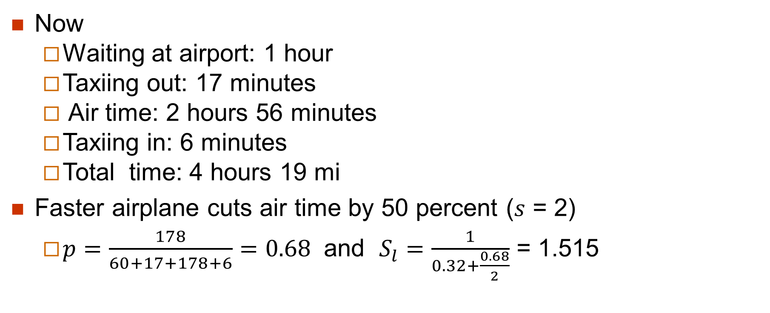
Example: Flying Houston-New York
Now
Waiting at airport: 1 hour
Taxiing out: 17 minutes
Air time: 2 hours 56 minutes
Taxiing in: 6 minutes
Total time: 4 hours 19 mi
Faster airplane cuts air time by 50 percent ($s$ = 2)
$p=\frac{178}{60+17+178+6}=0.68$ and $S_{l}=\frac{1}{0.32+\frac{0.68}{2}}$ = 1.515

Slide 8
MOSBENCH Applications
Mail Server:
Exim
Single master process waits for incoming TCP connections
Forks a child process for each new connection
Child handles the incoming mail coming on a connection
Include access to a set of shared spool directories and a shared log file
Spends 69% of its time in the kernel

Slide 9
MOSBENCH Applications
Object cache:
memcached
In-memory key-value store
Single memcached server would not scale up
Bottleneck is the internal lock handling the KV hash table
Run multiple memcached servers
Clients deterministically distribute key lookups among servers
Spends 80% of its time processing packets in the kernel at one core

Slide 10
MOSBENCH Applications
Web server:
Apache
Single instance listening on port 80
Uses a thread pool to process connections
Configuration stresses the network stack and the file system (directory name lookups)
Running on a single core, it spends 60 percent of its time in the kernel

Slide 11
MOSBENCH Applications
Database:
Postgres
Makes extensive internal use of shared data structures and synchronization
Should exhibit little contention for read-mostly workloads
For read-only workloads
With one core: spends 1.5% of its time in the kernel
With 48 cores 82%

Slide 12
MOSBENCH Applications
File indexer:
Psearchy
parallel version of searchy, a program to index and query Web pages
Focus on the indexing component of psearchy (pedsort)
More system intensive
With one core, pedsort spends only 1.9% of its time in the kernel
Grows to 23% at 48 cores

Slide 13
MOSBENCH Applications
Parallel build:
gmake
Creates many more processes than they are cores
Execution time dominated by the compiler it runs
Running on a single core, it spends 7.6 percent of its time in the kernel

Slide 14
MOSBENCH Applications
MapReduce:
Metis
MapReduce library for single multicore servers
Workload allocates large amount of memory to hold temporary tables
With one core: spends 3% of its time in the kernel
With 48 cores: 16%

Slide 15
Common scalability issues (I)
Tasks may lock a shared data structure
Tasks may write into a shared memory location
Cache coherence issues even in lock-free shared data structures.
Tasks may compete for space in a limited-size shared hardware cache
Happens even if tasks never share memory

Slide 16
Common scalability issues (II)
Tasks may compete for other shared hardware resources
Inter-core interconnect, DRAM, …
Too few tasks to keep all cores busy
Cache consistency issues:
When a core uses data that other cores have just written
Delays

Slide 17
Hard fixes
When everything else fails
Best approach is to change the implementation
In the stock Linux kernel
Set of runnable threads is partitioned into mostly-private per-core scheduling queues
FreeBSD low-level scheduler uses similar approach

Slide 18
Easy fixes
Well-known techniques such as
Lock-free protocols
Fine-grained locking

Slide 19
Multicore packet processing
Want each packet, queue, and connection be handled by just one core
Use Intel’s 82599 10Gbit Ethernet (IXGBE) card network card
Multiple hardware queues
Can configure Linux to assign each hardware queue to a different core
Uses sampling to send packet to right core
Works with long-term connections
Configured the IXGBE to direct each packet to a queue (and core) using a hash of the packet headers

Slide 20
Sloppy counters
Speed up increment/decrement operations on a shared counter
One local counter per core
Represents number of pre-allocated references allocated to that specific core
Global counter represents total number of committed references
In use or pre-allocated
2
0
0
2
8

Slide 21
In the paper
Counter used to keep track of reference count to an object
Main idea is to pre-allocate spare references to cores
In our example,
8 references
4 of them are pre-allocated references

Slide 22
Incrementing the sloppy counter (I)
If the core has spare pre-allocated references
Subtract increment from local counter
1
0
0
2
8
First core used one of its pre-allocated references Global counter remains unchanged

Slide 23
Incrementing the sloppy counter (II)
If the core does not have any spare pre-allocated reference
Add increment to global counter
1
0
0
2
9
Second core requested and obtained one additional reference Global counter is updated

Slide 24
Decrementing the sloppy counter
Always
Add decrement to local value of counter
1
1
0
2
9
Second core releases a reference Increments its number of pre-allocated references
Does not update the global counter

Slide 25
Releasing pre-allocated references
Always
Subtract same value from global and local counter
1
1
0
0
7
Fourth core released its two pre-allocated references

Slide 26
How they work (I)
Represent one logical counter as
A single shared central counter
A set of per-core counts of spare references
When a core increments a sloppy counter by V
First tries to acquire a spare reference by decrementing its per-core counter by V
If the per-core counter is greater than or equal to V , the decrement succeeds.
Otherwise the core increments the shared counter by V

Slide 27
How they work (II)
When a core decrements a sloppy counter by V
Increments its per-core counter by V
If the local count grows above some threshold
Spare references are released by decrementing both the per-core count and the central count.
Sloppy counters maintain the invariant:
The sum of per-core counters and the number of resources in use equals the value in the shared counter.
sloppiness

Slide 28
Meaning
Local counts keep track of the number of spare references held by each core
Act as local reserve
Global count keeps track of total number of references issued
For a local reserve and being used

Slide 29
Example (I)
Local count is equal to 2
Global count is equal to 6
Core uses 0 references
Core needs 2 extra references
Decrement local count by 2
Local count is equal to 0
Global count is equal to 6
Core now uses 2 references
Core needs 2 extra references
Increment global count by 2
…
2
6
…
0
6

Slide 30
Example (II)
Local count is equal to 0
Global count is equal to 8
Core now uses 4 references
Core releases 2 references
Increment local count by 2
Local count is now equal to 2
Global count is equal to 8
Core now uses 2 references
Core releases 2 references
Increment local count by 2
…
0
8
…
2
8

Slide 31
Example (III)
Local count is equal to 4
Global count is equal to 8
Core uses no references
Local count is too high
Return two pre-allocated references
Decrement both counts by 2
Local count is equal to 2
Global count is equal to 6
Core uses no references
…
4
8
…
2
6

Slide 32
A more general view
For your
information
only
Replace a shared counter by
A global counter
One local counter per thread
When a thread wants to increments the counter
It increments its local value (protected by a local lock)
Global value becomes out of date
From time to time,
Local values are transferred to the global counter
Local counters are reset to zero

Slide 33
Example (I)
0
0
0
0
0
1
0
0
0
0
1
1
0
0
0

Slide 34
Example (II)
1
2
0
0
0
1
2
0
0
0
0
0
0
0
3

Slide 35
Lock-free comparison (I)
Observed low scalability for name lookups in the directory entry cache.
Directory entry cache speeds up lookups by mapping a directory and a file name to a dentry identifying the target file’s inode
When a potential dentry is located
Lookup code gets a per-dentry spin lock to atomically compare dentry contents with lookup function arguments
Causes a bottleneck

Slide 36
Lock-free comparison (II)
Use instead a lock-free protocol
Similar to Linux lock-free page cache lookup protocol
Add a generation counter
Incremented after every modification to the dentry
Temporary set to zero during the update

Slide 37
Lock-free comparison (III)
If generation counter is 0
Fall back to locking protocol
Otherwise
Remember generation counter value
Copy the fields of the dentry to local variables
When generation differs from the remembered value
Fall back to the locking protocol.

Slide 38
Lock-free comparison (IV)
Compare the copied fields to the arguments.
If there is a match
If reference count greater than zero
Increment the reference count and return the dentry
Else
Fall back to the locking protocol.

Slide 39
Per-core data structures
To reduce contention
Split the per-super-block list of open files into per-core lists.
Works in most cases
Added per-core vfsmount tables, each acting as a cache for a central vfsmount table
Used per core free lists to allocate packet buffers (skbuffs) in the memory system closest to the I/O bus.

Slide 40
Eliminating false sharing
Problems occurred because kernel had located a variable it updated often on the same cache line as a variable it reads often
Cores contended for the falsely shared line
Degraded Exim per-core performance
memcached, Apache, and PostgreSQL faced similar false sharing problems
Placing the heavily modified data on separate cache lines solved the problem

Slide 41
Evaluation
(after)

Slide 42
Note
We skipped the individual discussions of the performances of each application
There will not be on any test

Slide 43
Conclusion
Can remove most kernel bottlenecks by slight modifications to the applications or the kernel
Except for sloppy counters, most of changes are applications of standard parallel programming techniques
Results suggest that traditional kernel designs may be able to achieve application scalability on multicore computers
Subject to limitations of study

