Slide 1
TWIZZLER: A DATA-CENTRIC OS FOR NON-VOLATILE MEMORY
D. Bittman and P. Alvaro, UCSC Pankaj Mehra, IEEE Member D. D. E. Long, UCSC Ethan L. Miller, UCSC / Pure Storage USENIX ATC20

Slide 2
Paper highlights
Paper introduces a new operating system for NVRAM
Fast, non-volatile and byte-addressable
Shows why conventional file systems and even mapped files fail to take advantage of NVRAM properties
Proposes a new architecture
Moves many file system functions into user-space
Replaces process address space by modules (“objects”)
Linked by permanent pointers

Slide 3
NVRAM
Main characteristics
Non-volatile
Almost as fast as DRAM
100-300ns
Byte-addressable
Can be used to store persistent data
Contents can be operated on directly
Without bringing them first into DRAM

Slide 4
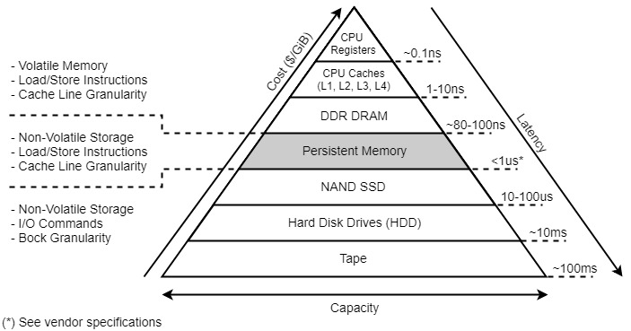
NVRAM
https://docs.pmem.io/persistent-memory/getting-started-guide/what-is-pmdk

Slide 5
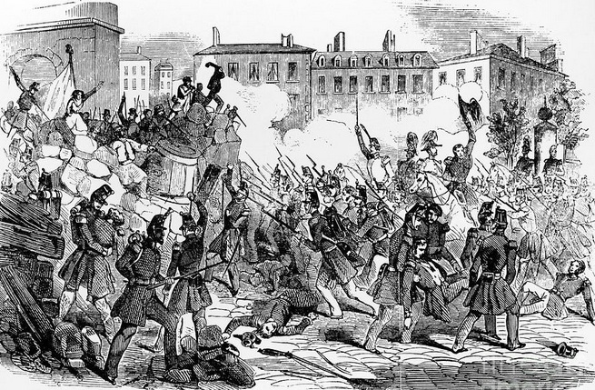
Will revolutionize file systems
Out with the old,
In with the new!

Slide 6
Extant approaches are inadequate (I)
POSIX file access primitives
open(), read(), write(), …
Overhead of system calls ( ~ 1μs) exceeds access time
Mapped files
A step in the right direction but
Must still copy the data in NVRAM (and save them later!)
Cannot save data structures containing pointers
Must linearize data before saving them

Slide 7
Extant approaches are inadequate (II)
PMDK
Persistent Memory Development Kit
Collection of libraries and tools to simplify managing and accessing persistent memory devices
Limitations
Data objects are not self-contained
Limited object ID space
64-bit IDs

Slide 8
Twizzler
Proposes to replace process address space by a collection of “objects”
Persistent and non-persistent
Form a “view”
Still provides support for legacy applications
Through libraries

Slide 9
Twizzler overview
Offers choice between
Direct access
POSIX access through twix library
Uses MMU for access control

Slide 10
Object management (I)
Persistent/ephemeral
4KB to 1MB
Unit of access control
Read, write, execute
The key idea is to have threads access data in NVRAM in the same way as data in DRAM

Slide 11
Object management (II)
Can contain one or many data structures
With or without pointers
Both internal and external
Pointers are made persistent
Kernel handles object creation and deletion
create(), delete()
Offers option to create clones of an existing object
Through copy-on-write

Slide 12
Address space management (I)
A thread address space consists of a collection of objects
Concept of process fades away
Layout of these objects is defined in a “view”
Shared by the thread and the kernel
Table with one entry per slot in the thread address space
Each entry contains
An object ID
Read, write and execute protection bits

Slide 13
Address space management (II)
Whenever a page fault occurs
Fault handler will try to handle the fault by
Doing copy-on-write
Checking permissions
Try to map the object into a slot.
and return control to libtw if it cannot resolve the fault
Threads can add entries to their view w/o kernel intervention
Must notify the kernel when they change or delete them

Slide 14
Persistent pointers
Conventional pointer have values that
Depend on the object location in main memory
Meaningless once the process address space goes away
Need location-independent pointers
They can be saved
Should contain pair (object ID, offset)
Object ID
Offset

Slide 15
The PMDK solution
128-bit permanent pointer
64 + 64
Very long pointers
64 bits not enough for assigning universal IDs to objects
Object ID
Offset

Slide 16
The Twizzler solution
64-bit permanent pointer
32 + 32
Much smaller pointers
Object IDs are indexes in a Foreign Object Table
Zero ID reserved for local pointers
Addresses within the object
Object ID
Offset

Slide 17
The Foreign Object Table(I)

Slide 18
The Foreign Object Table (II)
Adding one level of indirection does the trick
Flags specify the requested access rights
Can even have symbolic names
To be resolved using a specific resolver
Implementation is orthogonal to Twizzler

Slide 19
The Foreign Object Table(III)

Slide 20
Security
Through cryptographically signed capabilities
Tickets
Do not require authenticating owner
Kernel cannot create them but will verify them
All enforcement must be done by the hardware
MMU will trap all illegal access attempts

Slide 21
Other Twizzler features
Not discussed in class

Slide 22
Evaluation: SQLite
SQL-LMDB uses mmap’ed files

Slide 23
Evaluation: SQLite
SQL-LMDB uses mmap’ed files

Slide 24
Conclusion
Effective use of NVRAM will require rethinking
File system organization
Memory management

