Slide 1
UNIX and LINUX
Jehan-François Pâris
jfparis@uh.edu

Slide 2
Why UNIX?
First OS that
was portable
was written in a “high-level” language (C)
allowed its users to access—and modify—its source code
offered a great time-sharing experience on relatively inexpensive hardware
Ideal platform for OS research
Offers unsurpassed tools
Has influenced all recent systems

Slide 3
Historic overview
Four steps of evolution
The early beginnings (early 70’s)
Coming out of age (late 70’s)
The triumphant decade (80’s)
The transition to Linux (90’s)

Slide 4
The early beginnings (I)
MULTICS
Large OS project started in the 60’s
Involved MIT, AT&T and General Electric
Wanted to provide a “computing utility” for vast communities of users
Led to many advances in OS technology
Too ambitious for the time

Slide 5
The early beginnings (II)
AT&T quickly withdrew from MULTICS
K. Thompson, having nothing better to do, writes a simple OS for an unused machine
UNIX went through several revisions
Rewritten in C by K. Thompson and D. Ritchie
Ported to a 16-bit machine (PDP-11)
Presented at ACM SOSP in 1973

Slide 6
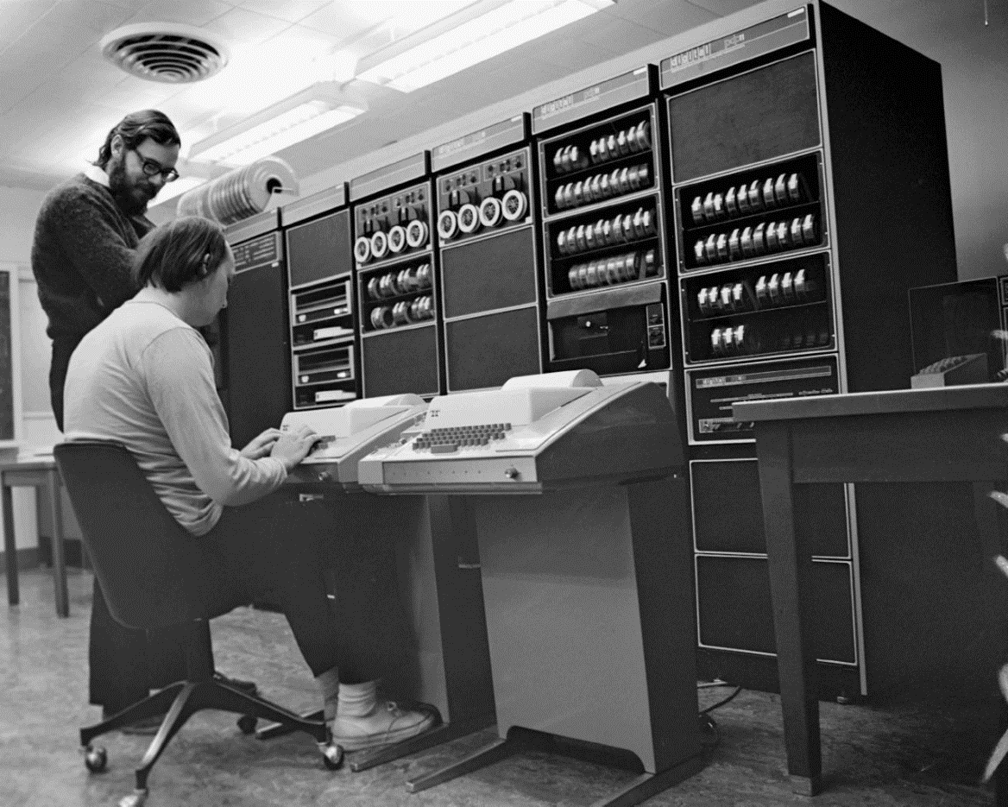
How it was

Slide 7
Coming out of age
AT&T could not at that time sell any computing services
Made UNIX available at cost to universities
Universities liked it:
Free time-sharing system
Running on a “cheap” minicomputer
Easy to modify

Slide 8
The triumphant decade (I)
DEC VAX
More powerful version of PDP-11
32 bit architecture
Virtual memory
Ö. Babaoğlu and W. Joy (U .C. Berkeley) added virtual memory support to UNIX
DARPA decided to have all ARPANET development done on UNIX

Slide 9
The triumphant decade (II)
UNIX became de facto standard OS for
Minicomputers
Workstations (W. Joy went to Sun)
Internet servers
Two different traditions appeared
Berkeley UNIX (BSD 4.2, 4.3 and 4.4)
AT&T System III and System V

Slide 10
The transition to Linux (I)
MS-DOS did not hurt UNIX:
Smaller and simpler subset of UNIX commands
Windows 3.1 and later did:
More intuitive graphical user interface
UNIX had its own problem:
Very fragmented market prevented development of cheap commercial software

Slide 11
The transition to Linux (II)
Free versions of UNIX:
Based on Berkeley UNIX: FreeBSD, BSD Lite
Written from scratch: GNU/ Linux
Commercial versions of Unix
Derived from Bell Lab Unix
HP-UX, AIX, Solaris

Slide 12
Linux
Built upon work of GNU Project
Rewrote most Unix utilities (gcc, …)
Failed to produce a GNU kernel
Linus Torvalds built from scratch a
Monolithic kernel
Tailored to x86 instruction set
Quickly adopted in supercomputing
Ran on clusters of PCs
Heresies at that time!

Slide 13
Other Unix traditions
Commercial versions of Unix
Derived from Bell Lab Unix
HP-UX, AIX, Solaris
Offspring of BSD
FreeBSD, NetBSD, OpenBSD
NextStep
Reincarnated in Mac OS X

Slide 14
Key features of UNIX
“Small is beautiful” philosophy
Most tasks can be accomplished by combining existing small programs
echo `who | wc -l` users
Written in a high-level language
Modular design
Great file system

Slide 15
Explanations
echo `who | wc -l` users
Displays on the console the output of who | wc –l followed by the string users
who lists the names of the users on the system
wc –l displays the number of lines in its input
The pipe symbol | makes the output of who become the input of wc –l
who | wc –l returns the number of users on the system

Slide 16
Discussion
How do you use it?
What is your favorite distribution?
What do you like/dislike?

Slide 17
My take
I like
Powerful file manipulation tools
ASCII-oriented
Ease of installing Ubuntu
I dislike
Cryptic on-line manual
Cryptic apt line-oriented interface
Lack of a great office suite

Slide 18
How I use it
Windows Subsystem for Linux on all my PCs
Just shifted to WSL 2
Real Linux kernel
Virtualized ext4 file system
Use it for
Program development
ASCII file manipulation

Slide 19
THE FILE SYSTEM USER INTERFACE

Slide 20
TYPES OF FILES
Three types of files
ordinary files: uninterpreted sequences of bytes
directories: accessed through special system calls
special files: allow access to hardware devices

Slide 21
Ordinary files (I)
Five basic file operations are implemented:
open() returns a file descriptor
read() reads so many bytes
write() writes so many bytes
lseek() changes position of current byte
close() destroys the file descriptor

Slide 22
Ordinary files (II)
All reading and writing are sequential.
The effect of direct access is achieved by manipulating the offset through lseek()
Files are stored into fixed-size blocks
Block boundaries are hidden from the users Same as in MS-DOS/Windows

Slide 23
The file metadata
Include file size, file owner, access rights, last time the file was modified, … but not the file name
Stored in the file i-node
Accessed through special system calls: chmod(), chown(), ...

Slide 24
I/O buffering
UNIX caches in main memory
I-nodes of opened files
Recently accessed file blocks
Delayed write policy
Increases the I/O throughput
Will result in lost writes whenever a process or the system crashes.
Terminal I/O are buffered one line at a time.

Slide 25
Directories (I)
Map file names with i-node addresses
Do not contain any other information!
Name
i-node
emacs
510
pico
306
vi
975
…
…

Slide 26
Directories (II)
Two directory entries can point to the same i-node
Directory subtrees cannot cross file system boundaries unless a new file system is mounted somewhere in the subtree.
To avoid loops in directory structure, directory files cannot have more than one pathname

Slide 27
“Mounting” a file system
Root partition
/
mount
Other partition
usr
bin
bin
After mount, root of second partition
can be accessed as /usr

Slide 28
Directories (III)
With BSD symbolic links, you can write
ln -s /bin/emacs /usr/local/bin/emacs
even tough /usr/local/bin/emacs and /bin/emacs are in two different partitions
Symbolic links point to another directory entry instead of the i-node.
Same concept as Windows shortcuts

Slide 29
Special files
Map file names with system devices:
/dev/tty your terminal screen
/dev/kmem the kernel memory
/dev/sd*1 first partition of SATA or removable device *
Allows accessing these devices as if they were files:
No separate I/O constructs for devices
Poor solution for flash drives

Slide 30
Protection
Simplified access control list
File owner can specify three access rights
read
write
execute
for
herself (user)
a group in /etc/group (group)
all other users (other)

Slide 31
Example
rwx------
rw-r-----
rw-rw-r—

Slide 32
Example
rwx------
Owner has full access
rw-r-----
rw-rw-r—

Slide 33
Example
rwx------
Owner has full access
rw-r-----
Owner can read and modify
Group members can read
rw-rw-r--

Slide 34
Example
rwx------
Owner has full access
rw-r-----
Owner can read and modify
Group members can read
rw-rw-r—
Owner and group members can read and modify
All users can read

Slide 35
Limitations
No append right
Only the system administrator can change group membership
Works well for stable groups
Cannot add and remove authorized users without sysadm intervention

Slide 36
The set user-ID bit (I)
Suppose I want to let you access your grades but not those of your classmates:
First solution is having one file per student and create as many groups in /etc/group as there are students
Too complicated!
Better having restrictions enforced by an user program

Slide 37
Protected
file
myprogram
Users
myprogram enforces all access restrictions

Slide 38
The set user-ID bit (II)
Solution does not work because myprogram will be not able to access the data when students run it
Set user-ID bit can specify that any executable should be executed using the rights of the owner of the file and not the rights of the user executing it

Slide 39
Protected
file
myprogram
with SUID
Users
myprogram now runs as if I was running it

Slide 40
Security risk of SUID
Assume that myprogram can be modified by other users
One of them could replace it by her version of the shell
Whenever she executes her new version of myprogram, she has access to all my files
Be very careful with SUID programs!

Slide 41
File locking
Allows to control shared access to a file
We want a one writer/multiple readers policy
Older versions of UNIX did not allow file locking
System V allows file and record locking at a byte-level granularity through fcntl()
Berkeley UNIX has advisory file locks: ignored by default
Like asking people to knock before entering

Slide 42
Discussion
File access
Simple and general
Fairly limited
Access control
Space-efficient

Slide 43
THE FAST FILE SYSTEM (FFS)

Slide 44
Version 7 Implementation
Each disk partition contains:
a superblock containing the parameters of the file system disk partition
an i-list with one i-node for each file or directory in the disk partition and a free list.
the data blocks (512 bytes)

Slide 45
A disk partition (“filesystem”)
Superblock
I-nodes
Data Blocks

Slide 46
The i-node (I)
Each i-node contains:
The user-id and the group-id of the file owner
The file protection bits,
The file size,
The times of file creation, last usage and last modification,
All file accesses modify the file inode

Slide 47
The i-node (II)
The number of directory entries pointing to the file, and
A flag indicating if the file is a directory, an ordinary file, or a special file.
Thirteen block addresses
The file name(s) can be found in the directory entries pointing to the i-node.

Slide 48
Storing block addresses (I)
13 block addresses
Other stuff
0
1
1
2
3
9
10
11
12
…
For
TRIPLE
indirect blocks
10 direct block addresses
…
…
…
…
128 indirect block addresses
…
…
…
…
Block size = 512 B
128 ×128 DOUBLE indirect block addresses

Slide 49
Storing block addresses (II)
13 block addresses
Other stuff
0
1
1
2
3
9
10
11
12
…
(128)³×512 = 2⁷⁺⁷⁺⁷⁺⁹ =
1 GB
10×512 = 5 KB
…
…
…
…
128×512 = 64 KB
…
…
…
…
Block size = 512 B
128 ×128 ×512 = 2⁷⁺⁷⁺⁹ = 8 MB

Slide 50
How it works (I)
For your information
First ten blocks of file can be accessed directly from i-node
10×512= 5,120 bytes
Indirect block contains 512/4 = 128 addresses
128×512= 64 kilobytes
With two levels of indirection we can access 128×128 = 16K blocks
16K×512 = 8 megabytes

Slide 51
How it works (II)
With three levels of indirection we can access 128×128×128 = 2M blocks
2M×512 = 1 gigabyte
Maximum file size is 1 GB + 8 MB + 64KB + 5KB

Slide 52
Explanation
File sizes can vary from a few hundred bytes to a few gigabytes with a hard limit of 4 gigabytes
The designers of UNIX selected an i-node organization that
Wasted little space for small files
Allowed very large files

Slide 53
Discussion
What is the true cost of accessing large files?
UNIX caches i-nodes and data blocks
When we access sequentially a very large file we fetch only once each block of pointers
Very small overhead
Random access will result in more overhead

Slide 54
FFS
BSD introduced the “fast file system” (FFS) in the early 80’s
Superblock is replicated on different cylinders of disk
Disk is divided into cylinder groups
Contain i-nodes and data blocks
It minimizes disk arm motions
Free list replaced by bit maps

Slide 55
Cylinder groups (I)
In the old UNIX file system i-nodes were stored apart from the data blocks
Data blocks
Too many long seeks
Affected disk throughput
Inodes

Slide 56
Cylinder groups (II)
FFS partitions the disk into cylinder groups containing both i-nodes and data blocks
Most files have their data blocks in the same cylinder group as their i-node
Problem solved

Slide 57
The new i-node
I-node has now 15 block addresses
Minimum block size is 4K
15th block address is never used

Slide 58
The new organization (I)
FYI
15 block addresses
Other stuff
0
1
1
2
3
11
12
13
14
…
Not used
12 direct block addresses
…
…
…
…
1,024 indirect block addresses
…
…
…
…
Block size =4 KB
1,024×1,024 DOUBLE indirect block addresses

Slide 59
The new organization (I)
15 block addresses
Other stuff
0
1
1
2
3
11
12
13
14
…
Not used
48 KB
…
…
…
…
4 MB
…
…
…
…
Block size =4 KB
Enough block addresses for 4 more GB

Slide 60
The bit maps
Each cylinder group contains a bit map of all available blocks in the cylinder group
The file system will attempt to keep consecutive blocks of the same file on the same cylinder group

Slide 61
Block sizes
FFS uses larger blocks allows the division of a single file system block into 2, 4, or 8 fragments that can be used to store
Small files
Tails of larger files

Slide 62
Explanations (I)
Increasing the block size to 4K eliminates the third level of indirection
Keeping consecutive blocks of the same file on the same cylinder group reduces disk arm motions

Slide 63
Explanations (II)
Allocating full blocks and block fragments
allows efficient sequential access to large files
minimizes disk fragmentation
Using 4K blocks without allowing 1K fragment would have wasted 45.6% of the disk space
This would not be necessarily true today

Slide 64
Limitations of Approach (I)
Traditional UNIX file systems do not utilize full disk bandwidth
Crashes may leave the file system in an inconsistent state
Must check the consistency of the file system at boot time

Slide 65
Limitations of Approach (II)
Most of the good performance of FFS is due to its extensive use of I/O buffering
Physical writes are totally asynchronous
Metadata updates must follow a strict order
Cannot create new directory entry before new i-node it points to
Cannot delete old i-node before deleting last directory entry pointing to it

Slide 66
Example: Creating a file (I)
i-node-1
abc
ghi
i-node-3
Assume we want to create new file tuv

Slide 67
Example: Creating a file (II)
i-node-1
abc
ghi
i-node-3
tuv
?
Cannot write to disk tuv directory entry before i-node is initialized

Slide 68
Limitations of Approach (III)
Out-of-order metadata updates can leave the file system in temporary inconsistent state
Not a problem as long as the system does not crash between the two updates
Systems are known to crash
FFS performs synchronous updates of directories and i-nodes
Requires many more seeks
Performance bottleneck

Slide 69
Better Solutions
Log-structured file systems
Never took off: BSD-LFS
Journaling file systems
Most popular approach: NTFS, ext3, ext4
Soft updates
Some versions of UFS-2
Copy-on-write
ZFS

Slide 70
Journaling File Systems
Key Idea:
Record metadata updates
First on a log (the journal )
Later at their proper location
When recovering from a crash, use the journal to finalize all incomplete metadata updates

Slide 71
Step 1: update buffer and journal
Process
I/O Buffer
Metadata update
Journal
File System

Slide 72
Step 2: update the file system
Process
Can now remove
update record
from the journal
I/O Buffer
Journal
File System
X

Slide 73
Explanations
Metadata updates are written twice on disk (or any storage device)
First in the journal
Then, and only then, at the proper place in the file system
All other updates remain asynchronous

Slide 74
Advantage
Writing metadata updates twice is still cheaper than using a single blocking write because
Journal is organized as a log and all writes are sequential
Second update is non-blocking

Slide 75
Implementation rules
Journaling file system must ensure that
Every update is written first in the journal before the file system is updated
Journal entries corresponding to updates that have been propagated to the file system are removed from the journal
Complicates I/O buffer design

Slide 76
Synchronous JFSes
Write all metadata updates one by one in the journal without any delay
Guarantee file system will always recover to a consistent state
Guarantee that metadata updates will never be lost

Slide 77
Asynchronous JFSes
Writes to the journal are buffered until an entire buffer is full
Guarantee file system will always recover to a consistent state
Do not guarantee that metadata updates will never be lost
Are much faster than synchronous JFS

Slide 78
Soft updates
Use delayed writes (write back)
Maintain dependency information about cached pieces of metadata:
This i-node block must be updated before/after this directory entry
Guarantee that metadata blocks are written to disk in the required order

Slide 79
First problem
Synchronous writes guaranteed that metadata operations were durable once the system call returned
Soft Updates guarantee that file system will recover into a consistent state but not necessarily the most recent one
Some updates could be lost

Slide 80
Second problem
Cyclical dependencies:
Same directory block contains entries to be created and entries to be deleted
These entries point to i-nodes in the same block

Slide 81
Example (I)
Block A
Block B
def
---
----
NEW xyz
NEW i-node-3
We want to delete file “def” and create new file “xyz”

Slide 82
Example (II)
Cannot write block A before block B:
Block A contains a new directory entry pointing to block B
Cannot write block B before block A:
Block A contains a deleted directory entry pointing to block B

Slide 83
The solution (I)
Roll back metadata in one of the blocks to an earlier, safe state
(Safe state does not contain new directory entry)
def
---
Block A’

Slide 84
The solution (II)
Write first block with metadata that were rolled back (block A’ of example)
Write blocks that can be written after first block has been written (block B of example)
Roll forward block that was rolled back
Write that block
Breaks the cyclical dependency but must now write twice block A

Slide 85
The solution (III)
First, block A’
Then, block B
Last, block A
---
---
def
---
NEW i-node-3
NEW xyz

Slide 86
UFS-2
Evolved from FFS
64-bit block addresses
256-byte i-nodes
Enough space for pointers to
“True” access control list
Mandatory access control (MAC)
Documents have security levels
Prevents copying a TOP SECRET file into UNRESTRICTED file

Slide 87
UFS-2(II)
UFS-2
Implements soft updates
Much more complicated than sketched here
Twelve specialized functions are used to track dependencies

Slide 88
Copy-on-write file systems
Shadow-paging file systems
Write modified pages somewhere on the device
Not in-place
Faster writes
Slower reads

Slide 89
ZFS
Combined file system and logical volume manager
Designed by now-defunct Sun Microsystems
Supported by FreeBSD
Started as an closed-source software
Licensed as open-source software in 2005
Oracle stopped releasing updated source code for new OpenSolaris and ZFS
OpenZFS manages an open-source version

Slide 90
Highlights
Both a FS and a logical volume manager
Includes
Protection against data corruption
Support for high storage capacities
Efficient data compression
Snapshots and copy-on-write clones
Continuous integrity checking and automatic repair
RAID-Z (every block is its own RAID stripe)
Native NFSv4 ACLs

Slide 91
Discussion
So many file systems!
More recent challenges
Shingled disk drives
Writing erases some ahead tracks
Handled by disk firmware
Flash drives
Much faster reads
More complex writes

Slide 92
PROCESSES

Slide 93
Process creation
Two basic system calls
fork() creates a carbon-copy of calling process sharing its opened files
exec() overwrites the contents of the process address space with the contents of an executable file

Slide 94
fork()
fork()
Parent:
fork()
returns
PID of
child
Child:
fork()
returns
0
fork()
opened files

Slide 95
Typical usage
int pid; if ((pid = fork()) == 0) { // child process ... execv(...); _exit(1); // if execv() failed
} while (pid != wait(0)); // parent waits

Slide 96
exec
Whole set of exec() system calls
Most interesting are
execv(pathname, argv)
execve(pathname, argv, envp)
execvp(filename, argv)
All exec() calls perform the same basic tasks
Erase current address space of process
Load specified executable

Slide 97
execv
execv(pathname, argv)
char pathname[]
full pathname of file to be loaded: /bin/ls instead o f ls
char argv[][]
the argument vector: passed to the program to be loaded

Slide 98
Argument vector (I)
an array of pointers to the individual argument strings
arg_vector[0] contains the name of the program as it appears in the command line
other entries are parameters
end of the array is indicated by a NULL pointer

Slide 99
Argument vector (II)
argv
argv[0]
“ls”
argv[1]
“-alg”
NULL
char argv[][];
char **argv;

Slide 100
execve and execvp
execve(pathname, argv, envp)
Third argument points to a list of environment variables
execvp(argv[0], argv)
Lets user specify a filename instead of a full pathname
Looks for argv[0] in list of directories specified in environment variablePATH

Slide 101
Putting everything together
int pid if ((pid = fork()) == 0) { // child process ... execvp(filename, argv); _exit(1); // if exec failed
} // if while (pid != wait(0)); // parent waits
...

Slide 102
A big problem
Mechanism is quite costly
fork() makes a complete copy of parent address space
Very costly in a virtual memory system
exec() overwrites that copy
Modern versions of UNIX use copy-on-write

Slide 103
The solution: Copy-on-write
Parent and child share same address space
When either of them modifies a page, other gets its own copy of original page
COW of original page

Slide 104
Note
Copy-on-write is an example of a lazy method
Key idea is
To postpone costly operations until the last minute
Assuming that it will not be needed
That’s the big question!
Opposite of eager methods

Slide 105
What remains unchanged
Neither fork()nor exec() affect opened file descriptors
They remain unchanged
Important for
UNIX I/O redirection mechanism
Pipe mechanism
As in ls –l | more
Pipes can only be inherited

Slide 106
Explaining the fork/exec choice
Fork was not that expensive on a minicomputer with a 16-bit address space
Never had to copy more than 64KB
Using a fork/exec allowed a very easy implementation of pipes and I/O redirection
After the fork() thus in the child
Before the exec() while parent is still in control

Slide 107
Putting everything together
Child still under the control of
its parent
int pid if ((pid = fork()) == 0) { // child process do_IO_redirection(); execvp(filename, argv); _exit(1); // exec failed
} // if while (pid != wait(0)); // parent waits
...

Slide 108
SCHEDULING

Slide 109
Evolution (I)
Fair share schedulers
Bell Lab Unix and BSD
Process priority was affected by recent CPU usage
Penalty was the sum of
CPU time already granted during last second
Smaller fraction of CPU time granted one second ago

Slide 110
Evolution (II)
Multi-level queues with feedback
System V Release 4
Process priorities go
Down when processes exceed their time slice (timer interrupt)
Up when processes
Return from a system call
Have waited for too long

Slide 111
Discussion
Explain how the scheme favors
I/O bound processes
Interactive processes

Slide 112
Current FreeBSD scheduler
Designed for threads running on multicore architectures
Two parts
Low-level scheduler
Run every time a core is released
High-level scheduler
Run every second

Slide 113
Low-level scheduler
Kernel maintains a set of run queues for each CPU
With different priorities
Low-level scheduler selects first thread on highest-level non-empty run queue

Slide 114
High-level scheduler
Reevaluates thread priorities
Real-time threads have fixed priorities
Scheduler detects interactive threads on the base of their interactivity score:
$\text{Scaling} \text{factor}×\frac{Sleep time}{Run time}$
Also assigns threads to CPUs
Complex process

Slide 115
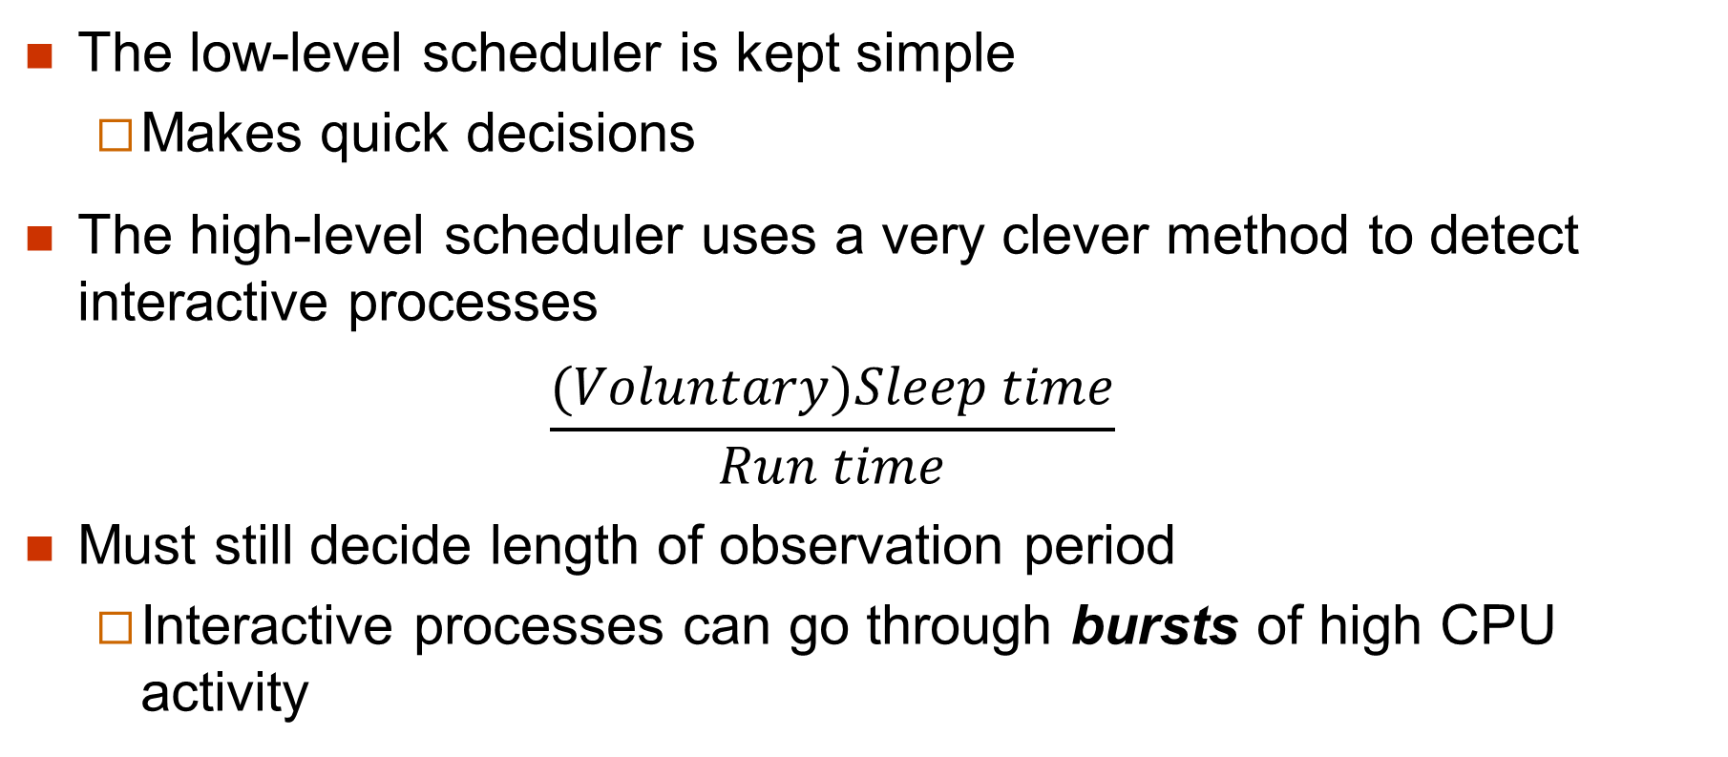
Observations
The low-level scheduler is kept simple
Makes quick decisions
The high-level scheduler uses a very clever method to detect interactive processes
$$\frac{(Voluntary)Sleep time}{Run time}$$
Must still decide length of observation period
Interactive processes can go through bursts of high CPU activity

Slide 116
INTER-PROCESS COMMUNICATION

Slide 117
IPC
Several mechanisms
Pipes
System V shared memory and message queues
BSD sockets

Slide 118
UNIX pipes
Major usage is combining several programs to perform multiple steps of a single task:
a | b | c
Standard output of each process in pipe is forwarded to standard input of next process in pipe:
stdout of a goes to stdin of b
stdout of b goes to stdin of c

Slide 119
Usage
UNIX toolkit includes many “filters” or programs that perform one specific step on their standard input and return the result on their standard output:
pic mypaper | tbl | eqn | troff -ms
Pipes are not a general IPC mechanism: must be inherited from a common parent process

Slide 120
System V IPC
System V offers
Shared memory
Semaphores
Message queues
System V semaphores have a very bad user interface
Prefer POSIX or Pthread semaphores
Message queues require sending and receiving processes to be on the same machine

Slide 121
BSD Sockets (I)
Message passing
Most general IPC mechanism
Basic building block of Internet and WWW
Sockets have addresses either in
the UNIX domain (same machine)
the Internet domain (most interesting)

Slide 122
BSD Sockets (II)
Three important types of sockets
stream sockets: provide reliable delivery of data
No data will be lost, replicated or arrive out of sequence
datagram sockets: make no such warranties
raw sockets: very low level

Slide 123
BSD Sockets (III)
Programming IPC with sockets is a cumbersome task as system calls are quite complex
Use a remote procedure call package or write your own
Applications involving small transfer of data over a LAN usually use datagram sockets
Avoid the overhead of stream sockets
HTTP uses stream sockets

Slide 124
MEMORY MANAGEMENT

Slide 125
Evolution
Somewhat neglected in the earlier versions of Unix
64 KB address space of PDP-11
No memory mapping hardware
Serious work started when UNIX was ported to the VAX
At Bell Labs
At U. C. Berkeley

Slide 126
The VAX
Virtual Address eXtension of PDP family of minicomputers
32 bit addresses
Complicated instruction set (CISC)
Native operating system (VMS) provided virtual memory
No hardware/firmware support for access bit (page-referenced bit)

Slide 127
VMS Virtual Memory (I)
Very small page size: 512 bytes
Minimized internal fragmentation
User could define clusters of contiguous pages that were brought together
Emphasis was on efficient use of main memory
Memory was very expensive
512 KB was a huge investment

Slide 128
VMS Page Replacement Policy
Hybrid local/global page replacement policy
One fixed partition per process
Great for real-time support
Managed by FIFO policy
One global queue containing expelled pages
At page fault time, VMM could retrieve faulting page from global queue
Performance close to that of Global LRU
Key ideas survive in Windows page replacement policy

Slide 129
How policy works
One fixed partition per process
...
FIFO
Reclaim
One global queue
To disk

Slide 130
Policy tradeoffs
Reclaims require kernel intervention
Cost is two context switches
Policy works well when
Fixed partitions are large enough to avoid excessive number of reclaims
Global queue large enough to keep expelled pages long enough to have a chance to be reclaimed

Slide 131
BSD Virtual Memory
Main objective was efficient management of main memory
Wanted to select a page replacement policy that
Kept in memory recently used pages
Could be efficiently implemented on a machine lacking a page-referenced bit

Slide 132
Why not VMS policy?
Requires a good estimate of physical requirements of each new process to allocate a resident set that is
neither too small
nor too big
Such determination is not possible under UNIX

Slide 133
How to simulate access bit?
Access bit
Set to one when page is referenced
Reset to 0 by VMM software
We can simulate it using the valid bit
Reset to 0 by VMM software
First access to page causes an interrupt: VMM software sets the bit to 1
Overhead is two context switches per reset

Slide 134
Multics Clock policy (I)
Organizes page frames in a circular list
When a page fault occurs, policy looks at next frame in list
if access bit = 0, the page is expelled and the page frame receives the incoming page
if access bit = 1, the PR bit is reset and policy looks at next page in list

Slide 135
Multics Clock policy
1
0
1
step 1: clear access bit
1
step 2: clear access bit
1
0
0
step 3: expel this page
1

Slide 136
In reality
1
0
1
step 1: mark page invalid
1
step 2: mark page
invalid
1
0
0
step 3: expel this page
1

Slide 137
Algorithm
Frame *Clock(Frame *Last_Victim) {
Frame *Hand;
int Not_Found = 1; Hand = Last Victim->Next;
do {
if (Hand->Access_Bit == 1) {
Hand->Access_Bit = 0;
Hand = Hand->Next;
} else
Not_Found = 0;
} while Not_Found;
return Hand;
} // Clock

Slide 138
A first problem
When memory is overused, hand of clock moves too fast to find pages to be expelled
Too many resets
Too many context switches
Berkeley UNIX limited CPU overhead of policy to 10% of CPU time
No more than 300 page scans/second

Slide 139
Other modifications
Berkeley UNIX maintained a pool of free pages instead of expelling pages on demand
Page size was increased to 1KB
A pair of 512-byte physical pages

Slide 140
Evolution of the policy (I)
By the late 80’s a two-hand policy was introduced:
First hand resets simulated PR bit
Second hand follows first at constant angle and expels all pages whose PR bit = 0

Slide 141
The two-hand policy
expels
α
resets PR bit

Slide 142
Evolution of the policy (II)
Current x86 and x64 architectures have an access bit
Along with valid bit, dirty bit, copy-on-write bit, …
Hand of the clock can sweep pages as fast as we want!
Remaining problem
Pages that are frequently used should remain longer in memory

Slide 143
New page replacement policy
Each page has a usage count
Initially set at 5, cannot go above 64
When the clock hand scans a page frame,
If access bit is set
Clears access bit
Increments the usage count by the number of references to the page
If its access bit is clear
Decrements the usage count
Expels it if usage count becomes zero

Slide 144
New page replacement policy
Expelled pages are moved to the inactive list
Contains both clean and dirty pages
When more free memory is needed, pageout daemon scans the inactive list
Returns to active list pages that have active bit set
Moves pages with invalid contents to the free list
Moves clean pages to the cached list
Pages out dirty pages as a last resort

Slide 145
Five kinds of pages
Wired pages: cannot be paged out
Active pages: used by one or more processes
Inactive pages: can be dirty
Cached pages: clean pages and dirty pages that were written back to their backing store
Free pages: no useful content

Slide 146
UNIX PROGENY

Slide 147
The XNU kernel
Kernel of MAC OS X and iOS operating systems
Originally developed by NeXT for their NeXTStep OS
Was a hybrid of Mach 2.5 kernel from CMU with components from 4.3BSD kernel
Upgraded to Mach 3 kernel with components from FreeBSD kernel
Now exclusively 64-bit

Slide 148
Android
Uses a modified Linux kernel
Linux shell is easily accessible through Android Terminal Emulator app

Slide 149
Chrome
Modern realization of an old idea:
Thin client
Originally connected to a time-sharing system
Cheaper and easier to maintain than full-fledged workstations
Server is now in the cloud
A web browser on the top of a Linux kernel

Slide 150
Two other traditions
OS/360
From IBM
z/OS is latest realization
VMS
From now defunct DEC
Influenced Window NT and all versions of Windows starting with Windows XP

Slide 151
THE LEGACY OF UNIX

Slide 152
Most lasting contributions
UNIX proved that an OS
Could be written in a high-level language
Did not need to be architecture-specific
Other major contributions include
Hierarchic file system
Device independence
Standardized interfaces

Slide 153
Review questions (I)
How many lines will be printed by the following program
#include <stdio.h> main() { printf("Start\n"); fork(); fork(); printf("Done!\n"); }

Slide 154
Review questions (II)
Where does UNIX store file names?
What are UNIX soft links?
Where does UNIX store its file access control lists?
Why does FFS subdivide each disk partition into cylinder groups?
Why does FFS use blocking writes to implement all metadata updates?

Slide 155
Review questions (III)
Why is the UNIX method of creating a process through a fork()/exec() pair so inefficient?
How does FreeBSD detects interactive threads?
What is the main advantage of the VMS page replacement policy over that of UNIX?
What is the main disadvantage of using the page valid bit to simulate a missing access bit?

Slide 156
Answers (I)
Five lines,
In the directory entry pointing to the file’s inode.
Special entities within the file system that point to other files, much like Windows shortcuts.
In the i-node of each file.
To ensure that most file blocks reside not too far from their file i-node.
To guarantee the consistency of the file system (and the durability of metadata updates).

Slide 157
Answers (II)
Because fork() will create a complete copy of the parent address space that will be destroyed by the following exec().
Interactive threads have higher sleep time to run time ratios.
It allows VMS to support—soft—real-time applications.
Accessing again any page that was marked invalid will require two context switches.

